Slide 1
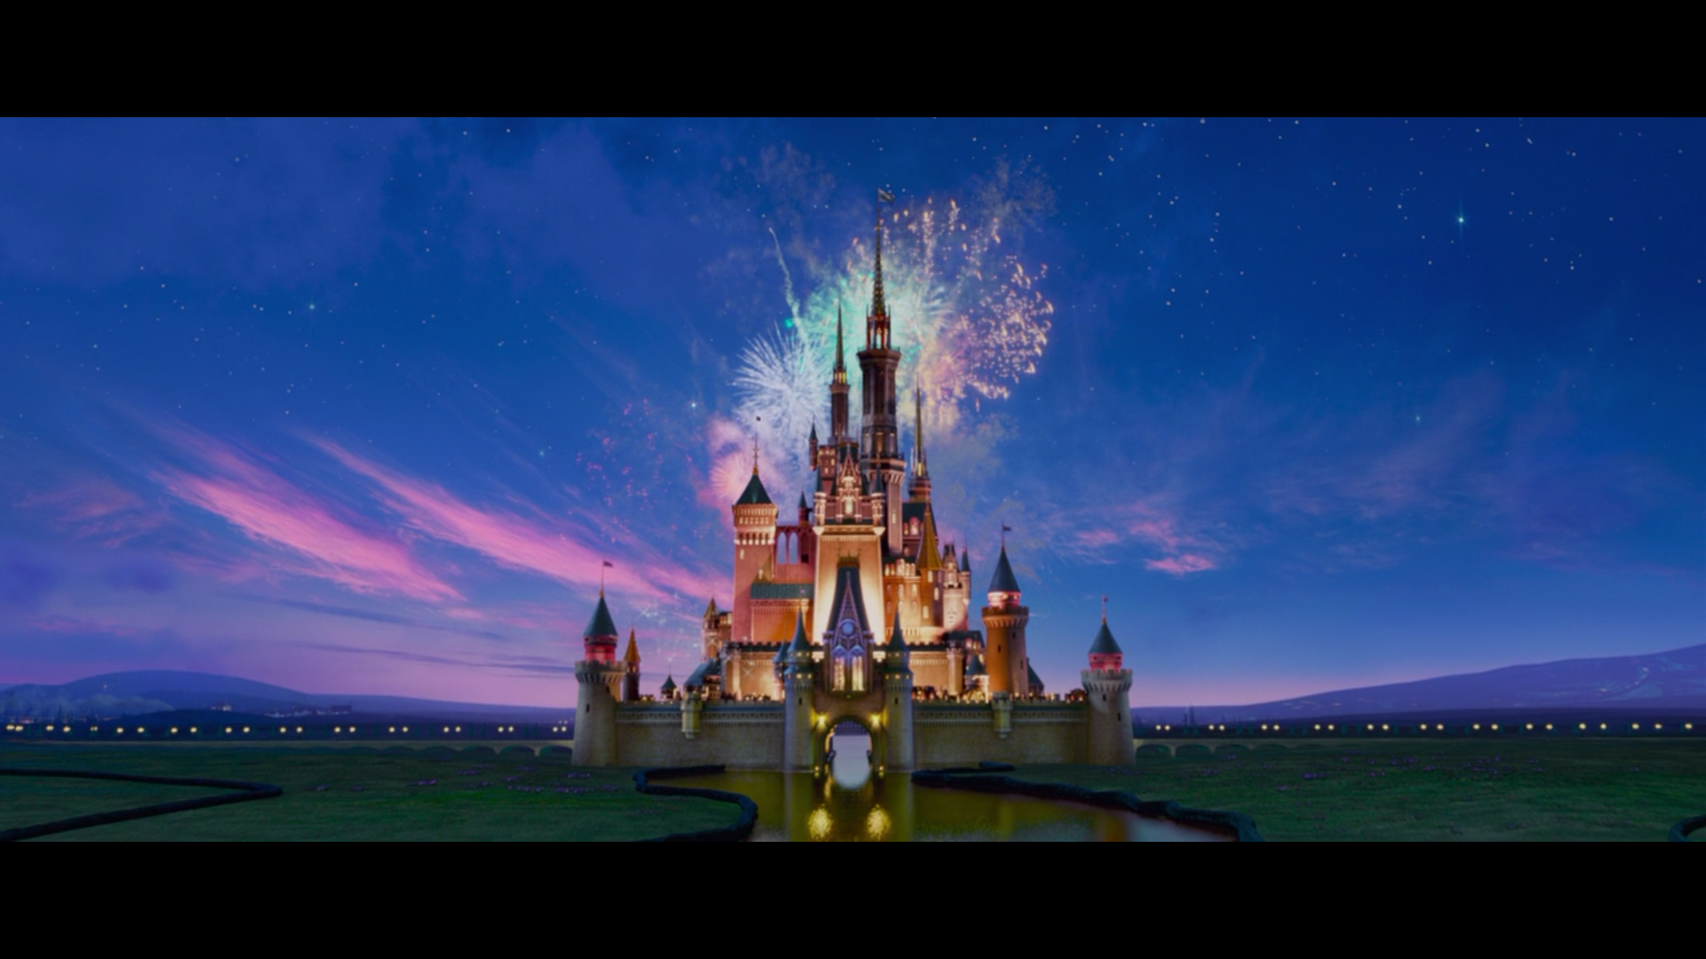


Slide 2
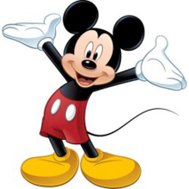
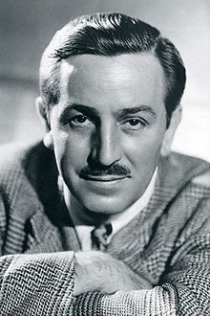
Walter Elias Disney was an American filmmaker and entrepreneur
"Walt Disney Company„
Leads the entertainment industry of the 20th century and the cultural memory of generations

Slide 3
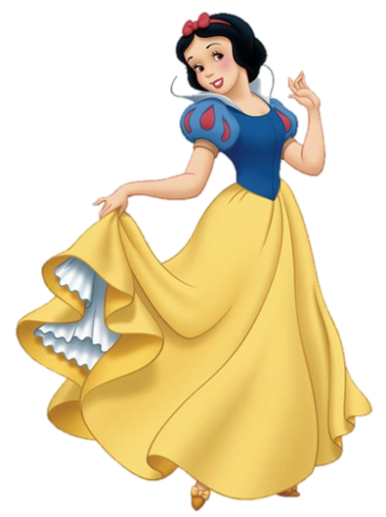
Some Points of Information
Date of birth : December 5, 1901
place of birth : Chicago, United States
date of death : December 15, 1966 († 65, lung cancer)
Place of death : Burbank, Los Angeles, California, USA
Tomb: Forest Lawn Memorial Park, California, United States

Slide 4

Famous quotes
"I prefer to entertain people with fun in the hope that they will learn instead of teaching them something, in the hope that they will enjoy it."
– Walt Disney
“Cinderella believed in dreams, but she also believed in doing something for her. When her dream-prince was waiting, she went over to the palace and took him. "
– Walt Disney (about the difference between Cinderella and Snow White )

Slide 5
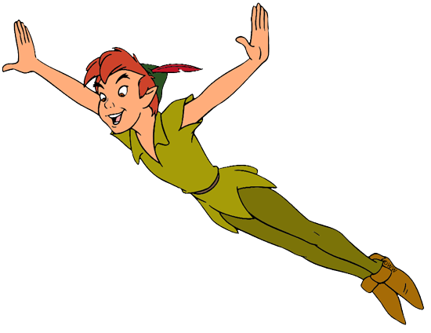
Timeline
Walt Disney's life span was 65 years.
Disney grew up in the 1900s and spent his youth in the 1910s.
He died in 1966 during the Cold War.
Well-known contemporaries of his generation were Ernest Hemingway (1899-1961) and Louis Armstrong (1901-1971).
Oliver Hardy (1892-1957), Katharine Hepburn (1907-2003), and John Wayne (1907-1979) were also active in his life.
His birthday will be the 116th time in 2017.

Slide 6
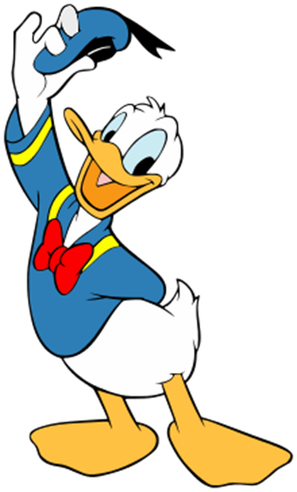
Important Movies
Career starts with Micky Mouse and Donald Duck
Cinderella
Alice in Wonderland
Peter Pan
Sleeping Beauty
Snow White

Slide 7
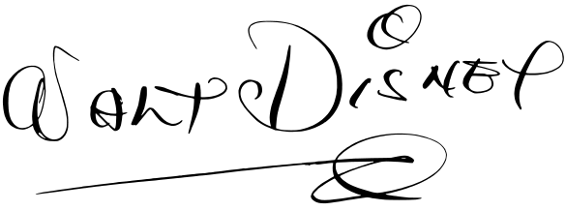
Signature

Slide 8
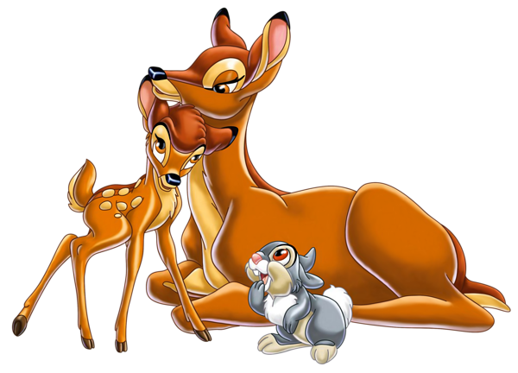
Honors and awards
Disney holds the record for most Academy Awards earned by an individual, having won 22 Oscars from 59 nominations
Golden Globe Awards
-> 1948 - Special price for Bambi (Bambi, 1942)
Walk of Fame
-> Disney has two stars on the famous "Walk of Fame" (Hollywood Boulevard), one for his filming and one for his television work.

Slide 9
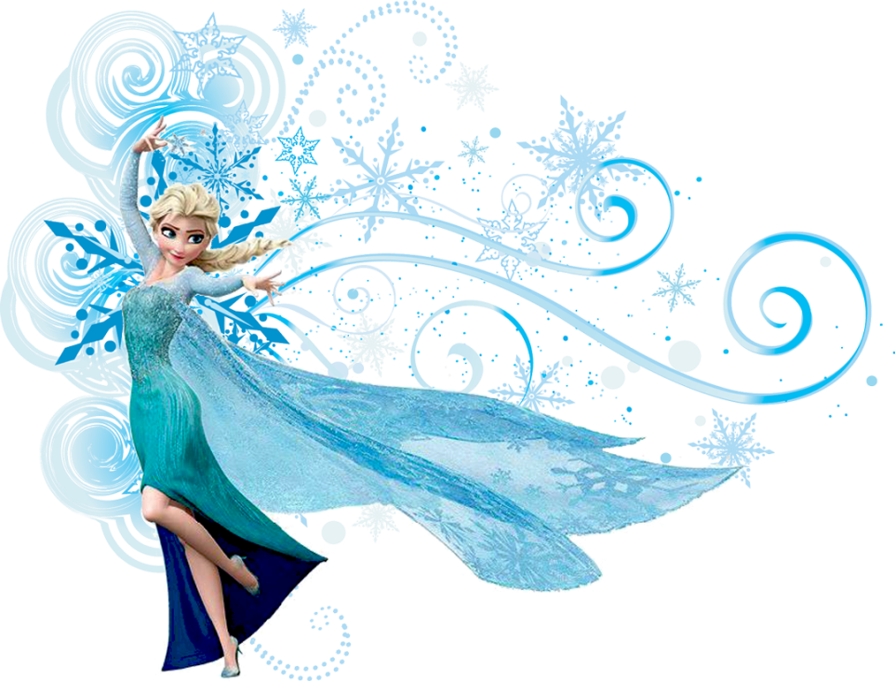

Other honors
  1935 - Medal of the League of Nations for the Micky Mouse
  1935 - Knights of the Legion of Hornor
  1937 - Medal of the US Chamber of Commerce for the election to the "Outstanding Young Man of the Year 1936„
  1938 - Award of the title Master of Fine Arts (Master of Fine Arts) h.c. By the University of Yale as "inventor of a new artistic language“
  1962 - Great honorary sign for services to the Republic of Austria

