Slide 1
MODEL VICTORIA MODESTA
Nikolitsa Valogianni
Giota Xaroni

Slide 2
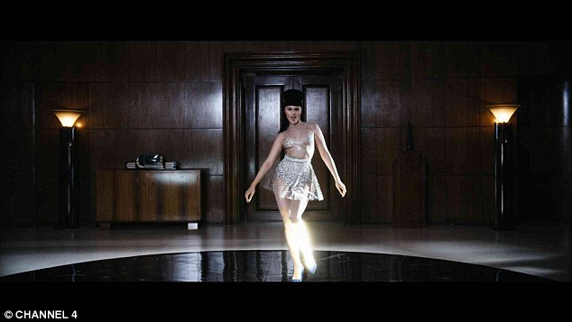
Modesta was born in Daugavpils in 1987 where she learned singing aged six at a local music school. Moskalova moved with her family from Latvia to the United Kingdom when she was 12 years old.

Slide 3
Due to a doctor's negligence at her birth, Moskalova spent most of her childhood in and out of hospitals. This accident led to a lasting problem with her left leg.

Slide 4
In 2007, she had a voluntary below-the-knee leg amputation to improve her mobility and safeguard her future health. Her physicality has become known for challenging the modern perception of altered beauty.

Slide 5
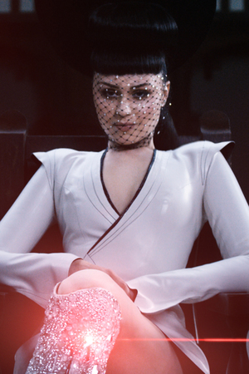
On 12 December 2014 Launched a collaboration with Channel 4 for the campaign Born Risky presenting her as worlds first Bionic Pop Artist supported by a track "Prototype“ released on Spotify for streaming. The video for the campaign video was directed by Saam Farahmand. The video had received global attention with over 6million views on YouTube and over 16 million on Channel 4 Facebook . The story was publicised worldwide throughout news networks publications such as i-D Magazine, Unworthy, Forbes and Elle Magazine USA. Prototype video has received a Silver Lion Award at Cannes Film Festival MIT Media Lab.

Slide 6
Viktoria Modesta | Prototype Dark Dance
https://www.youtube.com/watch?v=UQUmrBnhgF4

Slide 7
Why we chose her.
We chose it because it managed to shine through something that some others see as a disadvantage and also managed to transform it into something modern and admirable.
By destroying the establishment and passing a message of hope to people with special needs.
She brings a new era where disability is not considered a weakness rather a new form of strength.

Slide 8
Thank you!

