Slide 1
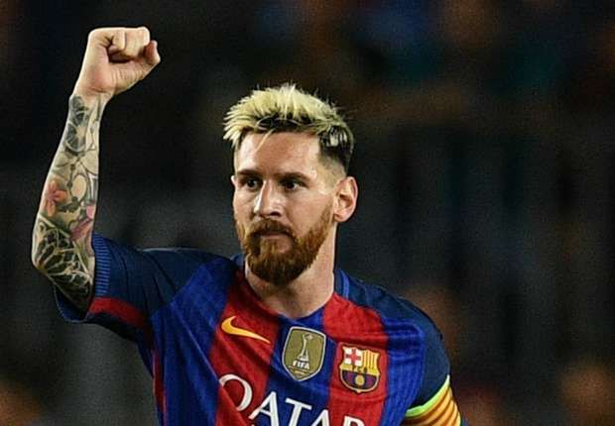
LEO MESSI
ANTONY THEODOROPOULOS
ANSTASIA PANTELIOY
BASO ANASTASINH

Slide 2
resume
Lionel Andres Messi Kucitini, also known as Leo Messi, born June 24, 1987 in Argentina's Argentine, is an Argentine international who strikes for the striker on behalf of Barcelona and Argentina.
Thanks to his performance, Messi has become the world's first best player in the first decade of the 21st century by World Soccer magazine and the first ever player in the history of the Champions League for the past 20 years by UEFA.

Slide 3
EARLY LIFE
Poverty gave him an edge .
He even knew from a very young age that he was injecting himself with his own injections, withstanding the pressure and tempering the difficulties. He improved his football talent not so much by personal ambition but by the need to cope with financial poverty: only if there was a team that would pay him the cost of his treatment he could survive
Poverty also teaches the secrets of leniency and responsibility: unlike the other narcissists of the ball, he knew he was the best to live and not to be promoted. Thanks to his health problem, he turned into a charismatic player and an early professional who managed to turn into a virtue of every kind of difficulty.
He says that he does not do his backs with his teammates and is always generous: why would another big name lose the chance to hat-trick by allowing his teammate to shoot a penalty like he did with Neimar in the match against Cordoba? Six were the words his father had taught him: "Acquaintance, integrity, perseverance, self-discipline and irresistible spirit" - and he still believes in them. "Fyllos," as lonely or arrogant as it may seem, like a boy who has never enjoyed childhood or teenage age, does not play dirty and has a high organizational spirit. It is no coincidence that it rarely can work outside of a team's overall system: apart from authentic googles, it remains a warm organizer and co-driver of the collective effort.

Slide 4
SUCCESS
Having received 5 times the title of the top player of the year in the world by FIFA (consecutive 2009 to 2012 and 2015), another 2 extra for UEFA Europe (2009 and 2015), (Brazil 2014) and Copa America (Chile 2015), Messi is the football player with the most individual distinctions in the history of the sport.

Slide 5
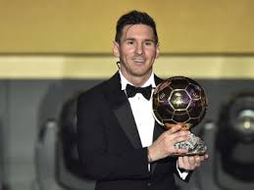
GOLD BALL

