Slide 1
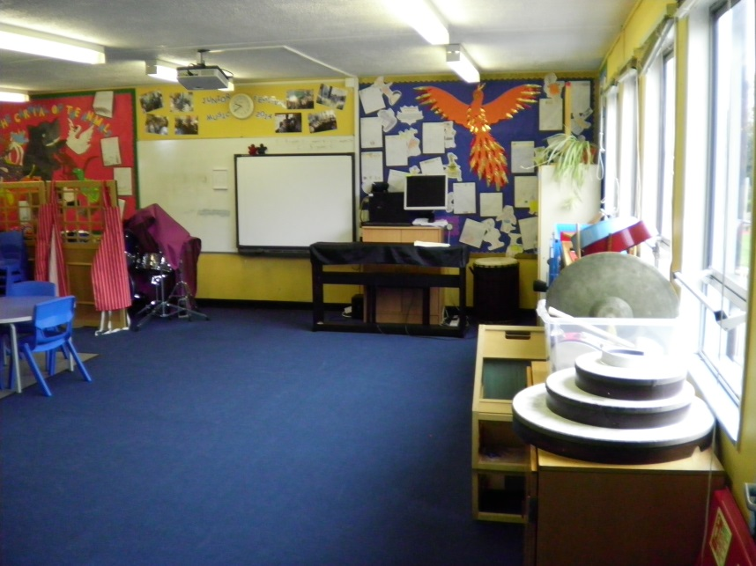
Music at Rayleigh Primary school
By the children of year 3

Slide 2
MUSIC LESSONS
In Music Mr Hack teaches us an hour a week.
The music room is at the bottom of the playground.
We compose, perform and learn about music history.

Slide 3
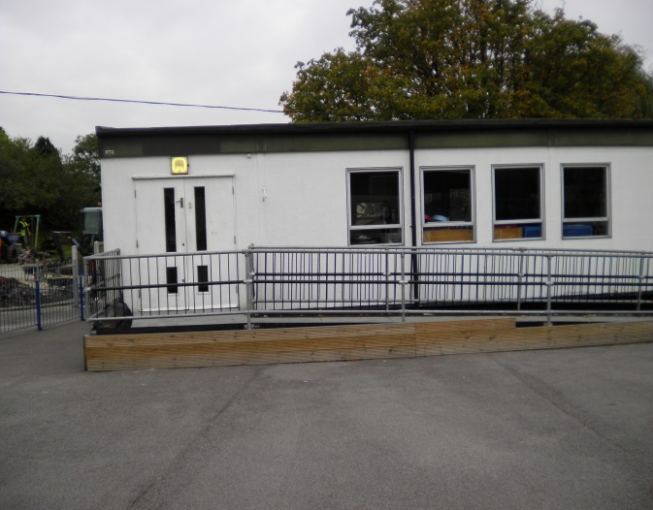
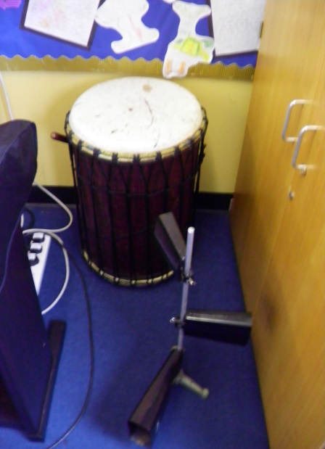
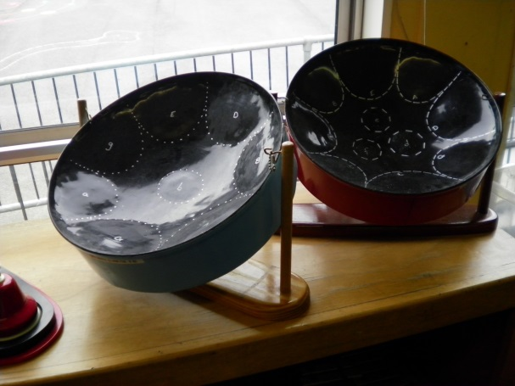
This is our
Music room.
Here are some instruments that we play.

Slide 4
MUSIC CONCERTS
Here are some photos of concerts performed in the school year.

Slide 5
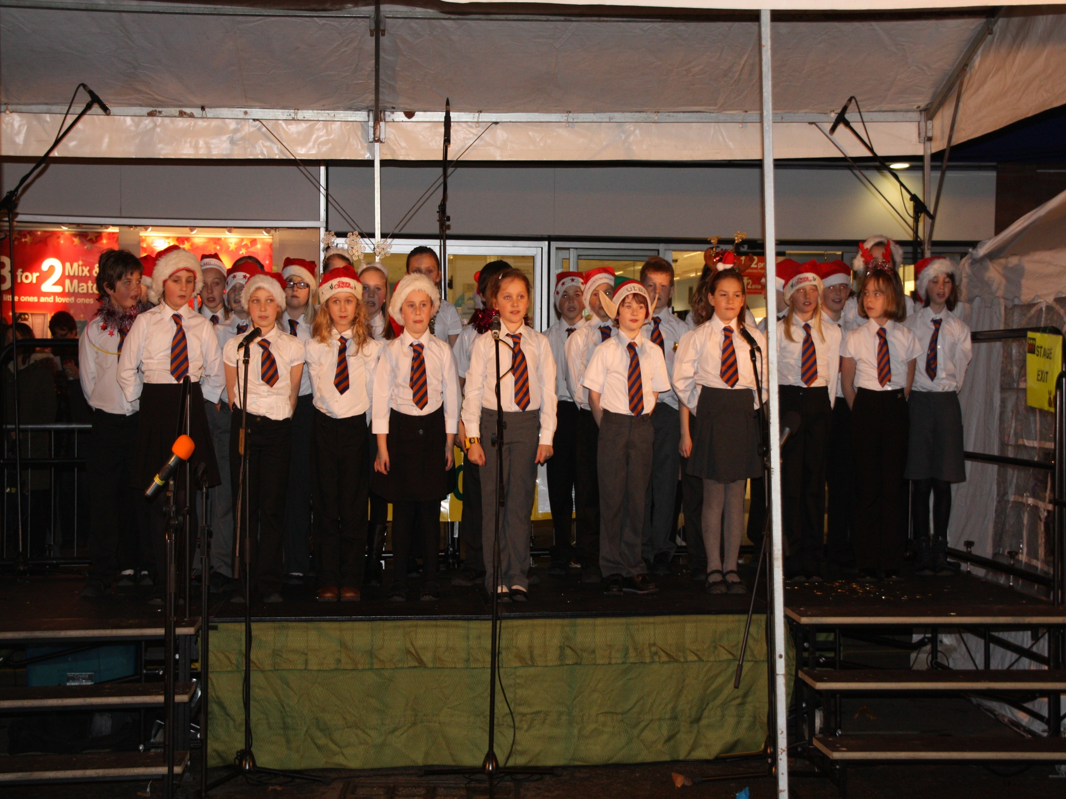

Slide 6
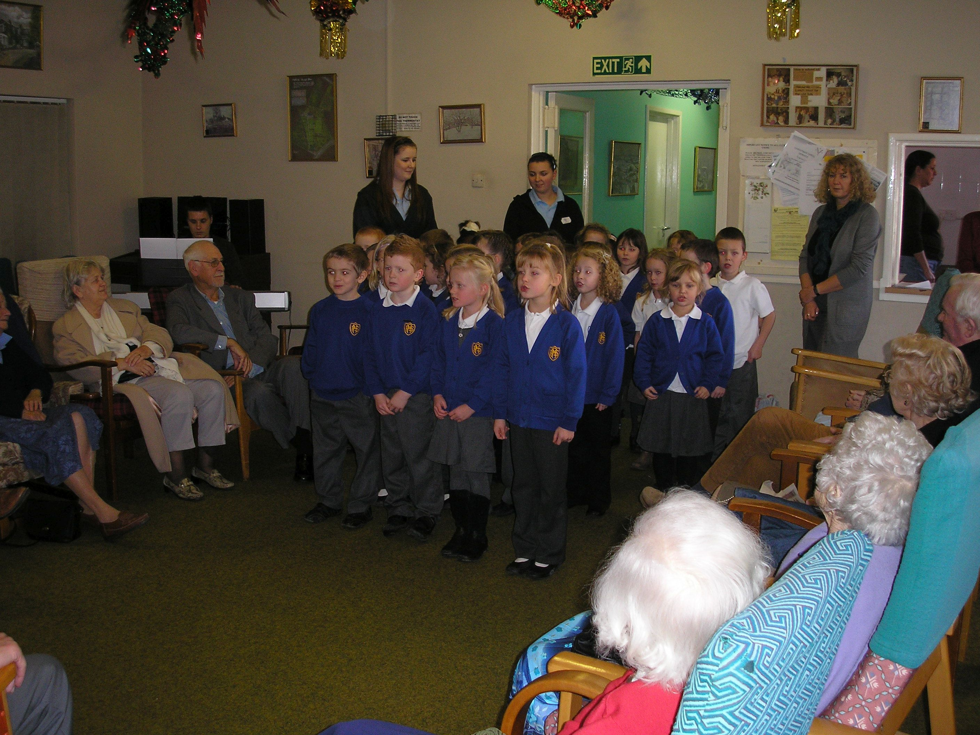

Slide 7
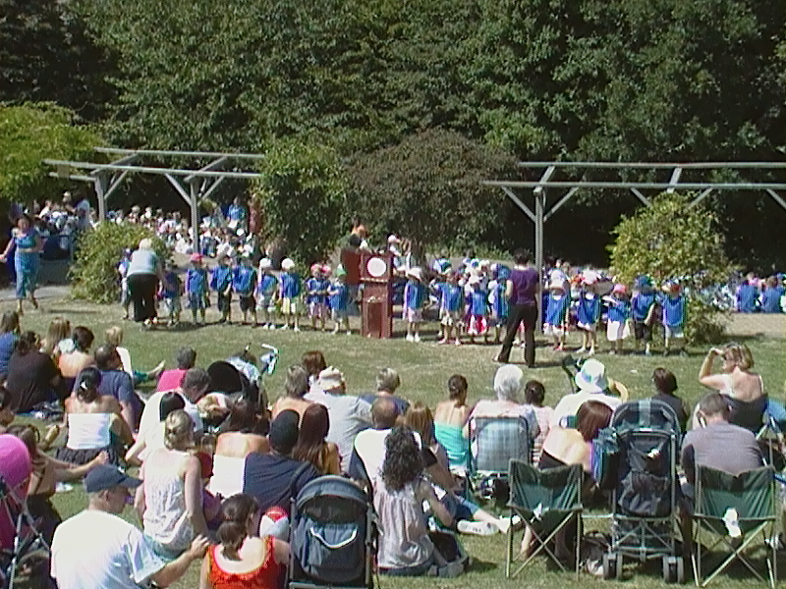

Slide 8
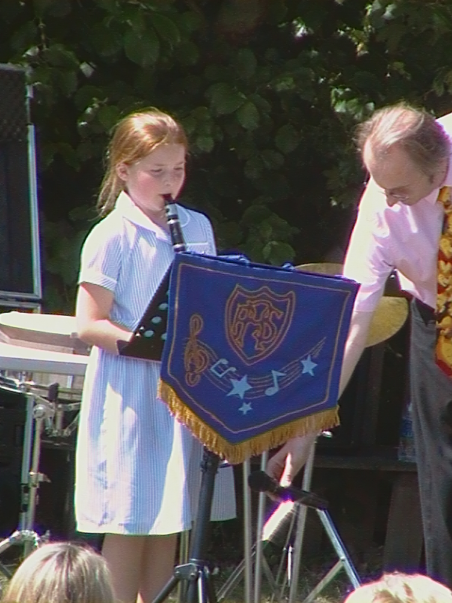

Slide 9
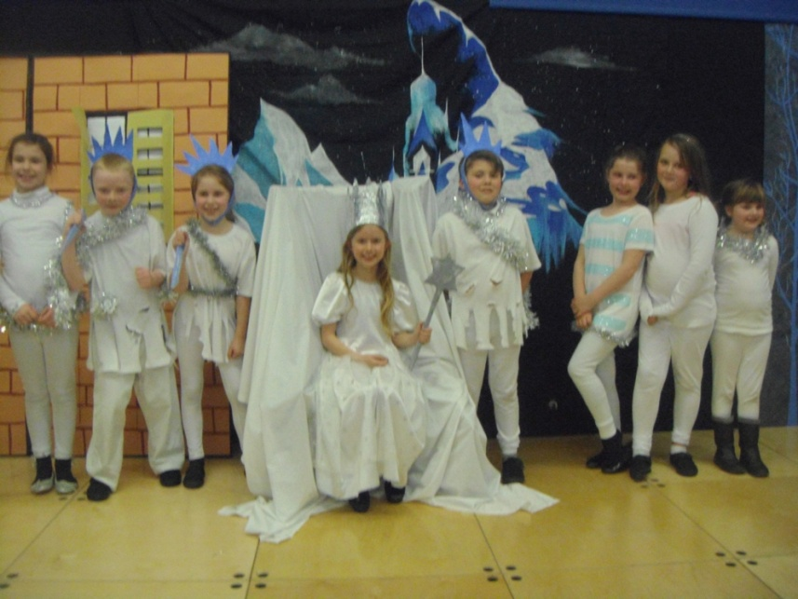
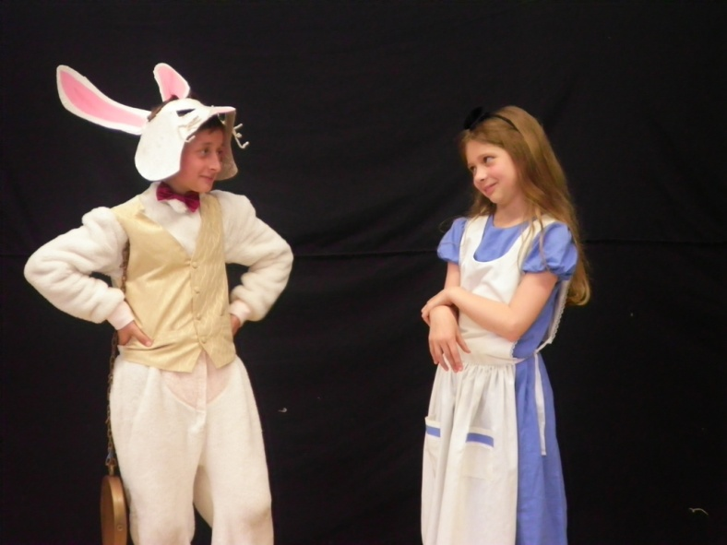
EXAMPLES OF OUR PRODUCTIONS
The Snow Queen
Year 5
Alice In Wonderland
Year 6

Slide 10
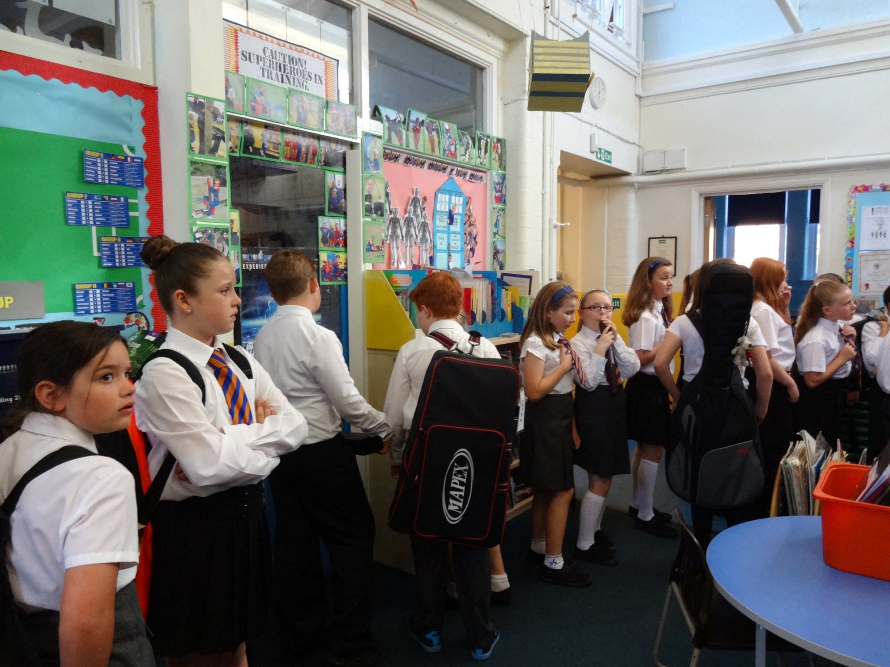
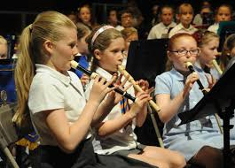
THE ORCHESTRA
Children in
Years 4, 5
and 6 practise
once a week.
We play woodwind,
brass and
percussion
instruments.

Slide 11
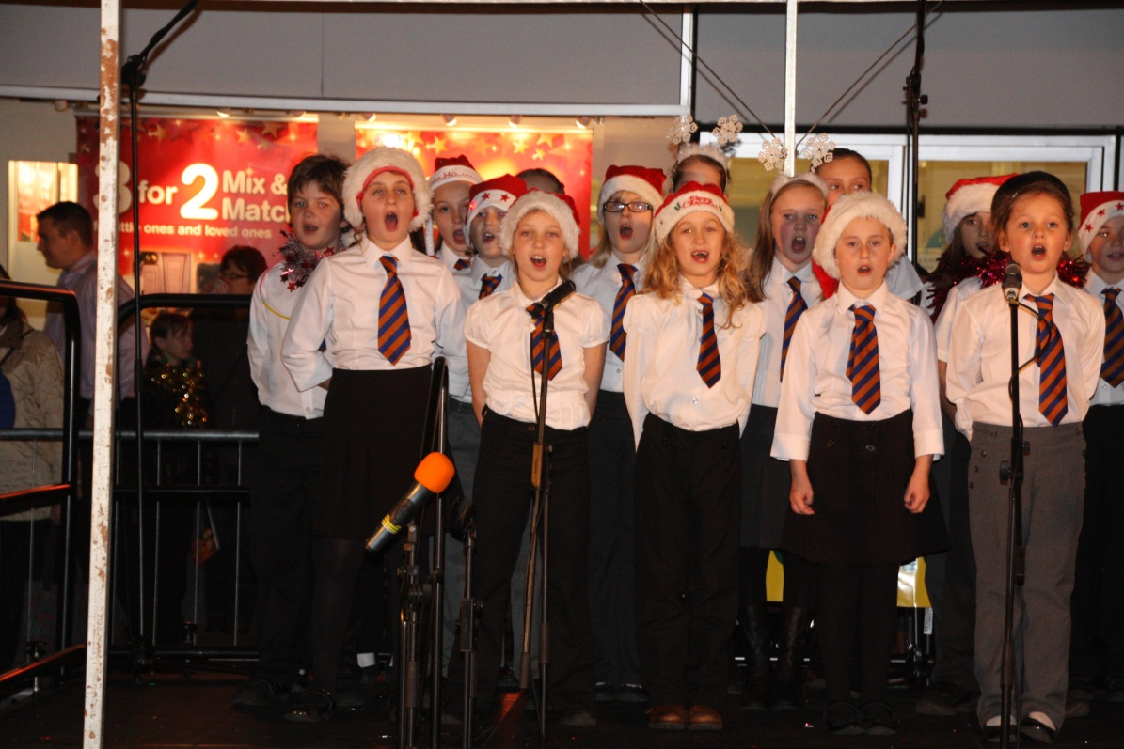
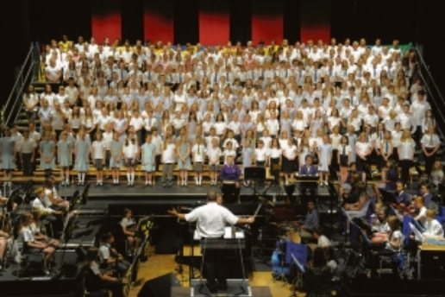
THE CHOIR
Children in
Years 4, 5
and 6 practise
once a week.
We have about 50 members and we make a lot of noise!

Slide 12
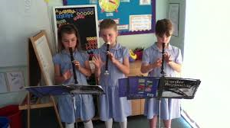
THE RECORDER CLUB
Children in
Years 1, 2
and 3 practise
the recorder
once a week. We have lots of fun!

