Slide 1
Welcome to
http://www.rayleighprimary.org.uk/

Slide 2
Another view

Slide 3
Staff board

Slide 4
School entrance

Slide 5
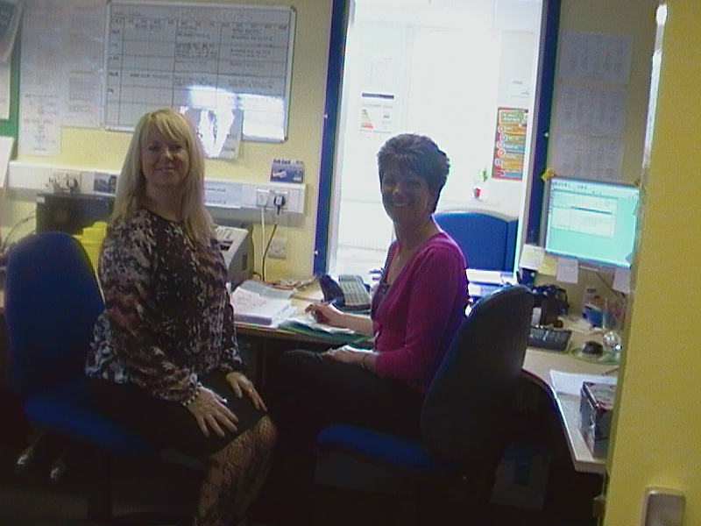
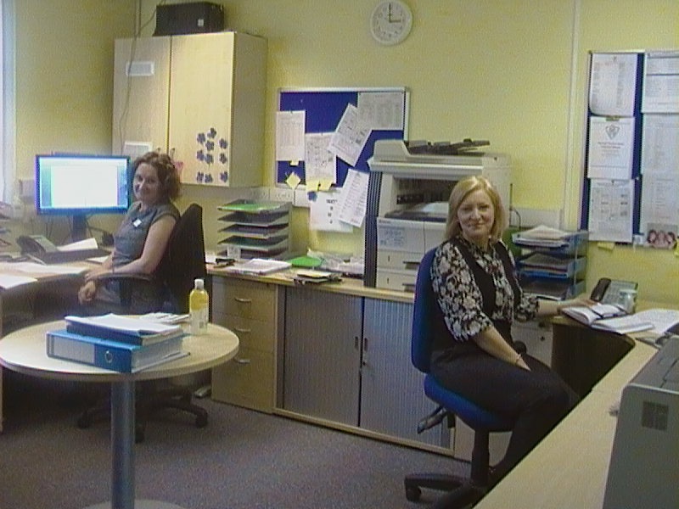
Office

Slide 6
Mr Malcolm, Headteacher

Slide 7
KS1 Corridor

Slide 8
KS1 Library

Slide 9
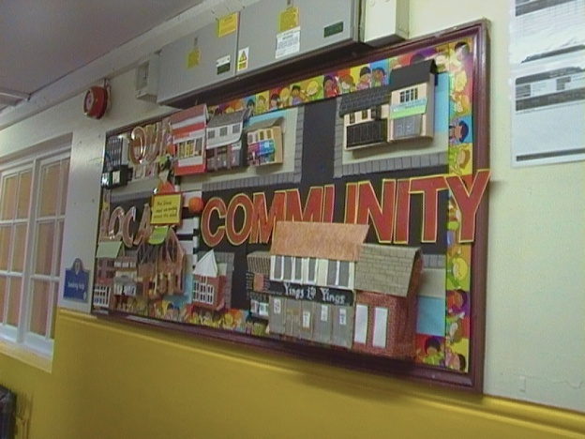
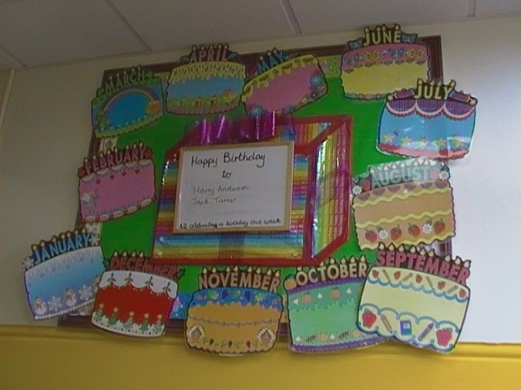
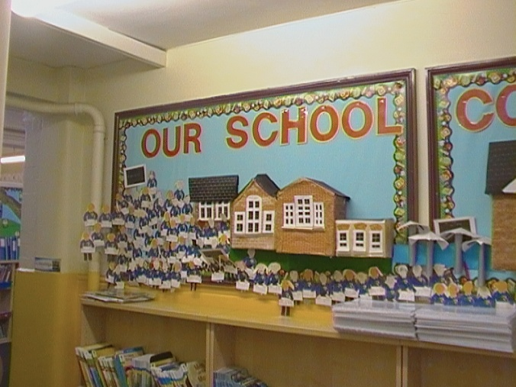
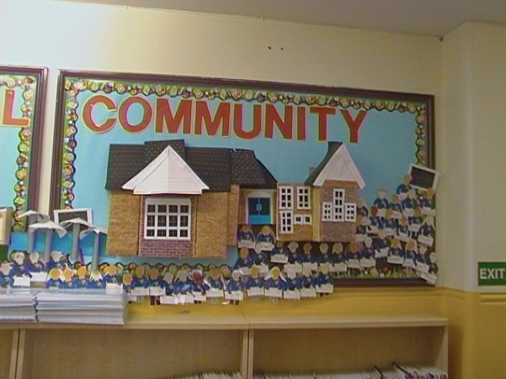
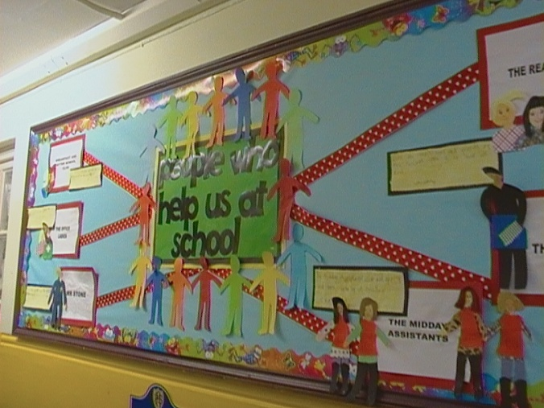
Examples of displays

Slide 10
Nursery Classroom

Slide 11
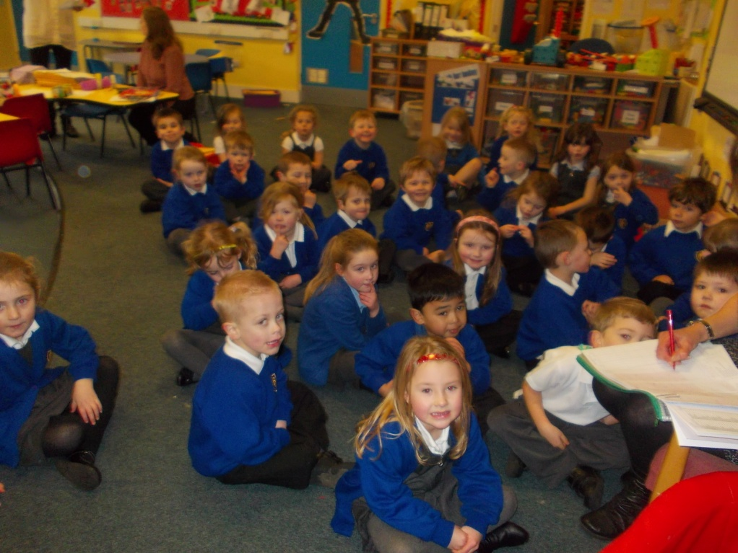
Reception Classroom

Slide 12
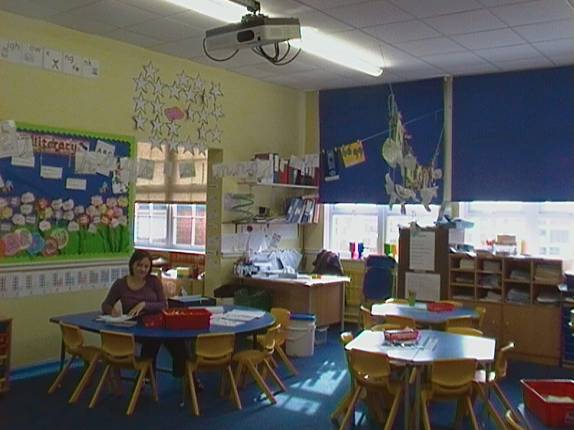
Year 1 Classroom

Slide 13
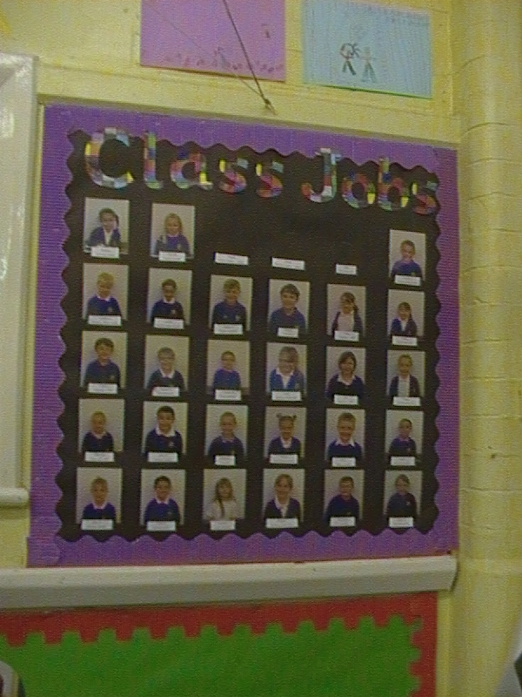
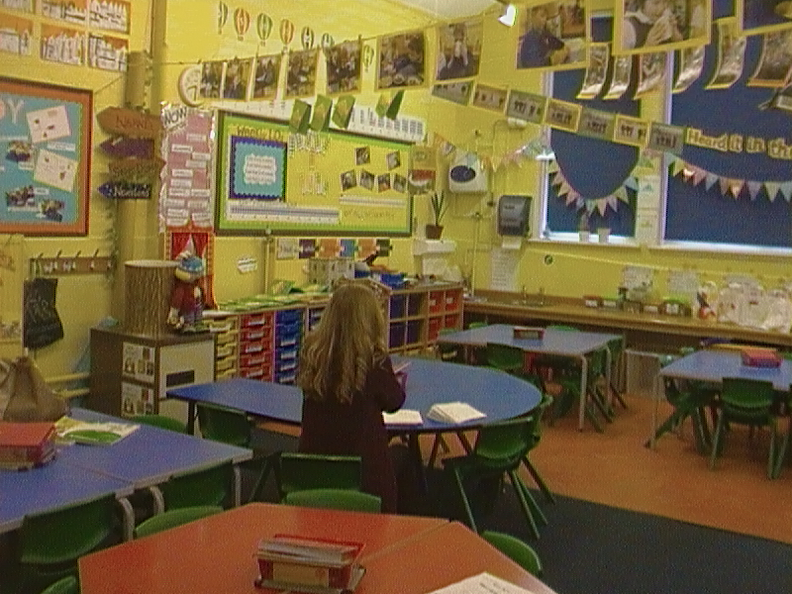
Year 2 Classroom

Slide 14
Year 3 Classroom

Slide 15
Year 4 classroom

Slide 16
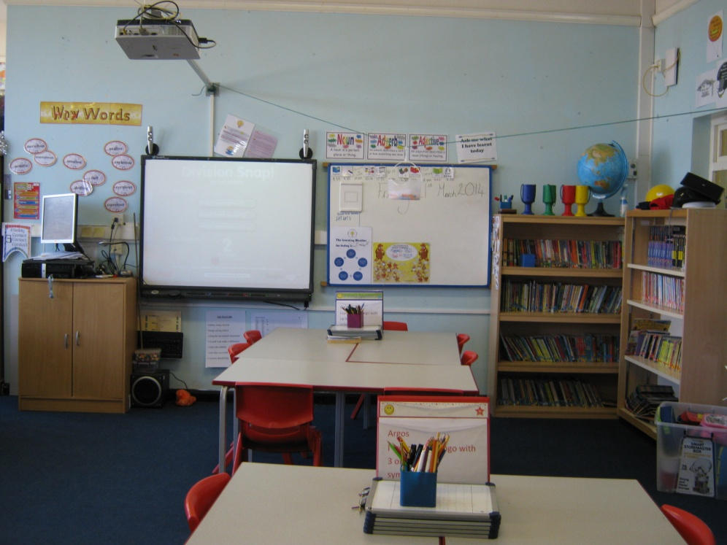
Year 5 classroom

Slide 17
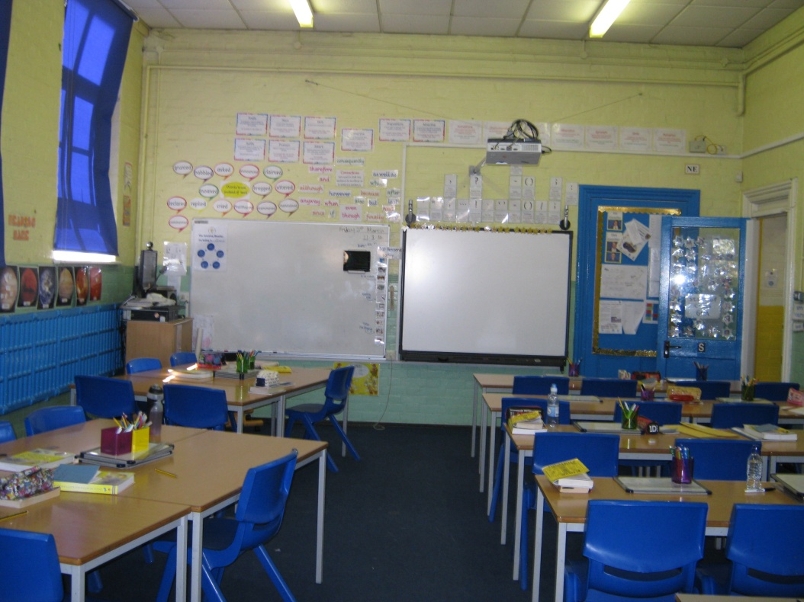
Year 6 classroom

Slide 18
KS2 corridor

Slide 19
KS2 Library

Slide 20
Room for group work

Slide 21
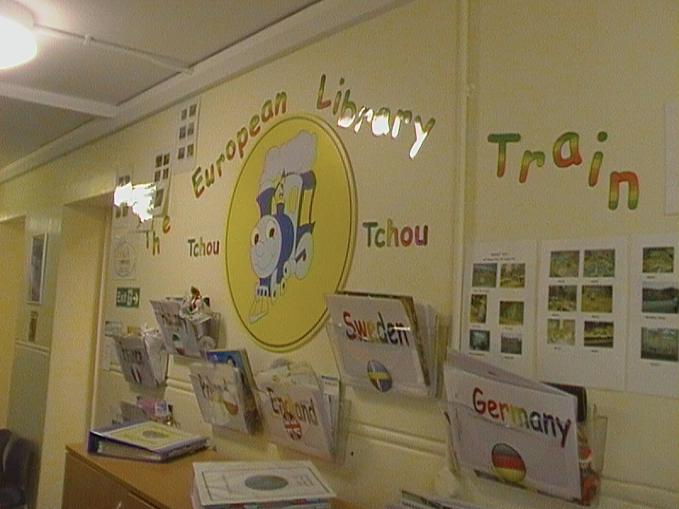
Comenius Project Displays Hand Prints from Year 6

Slide 22
Dance/Drama Studio

Slide 23
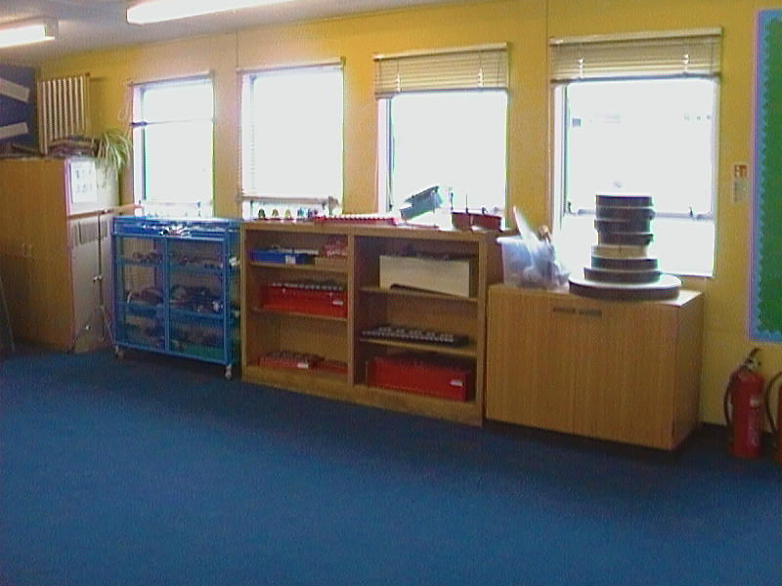
Music Room

Slide 24
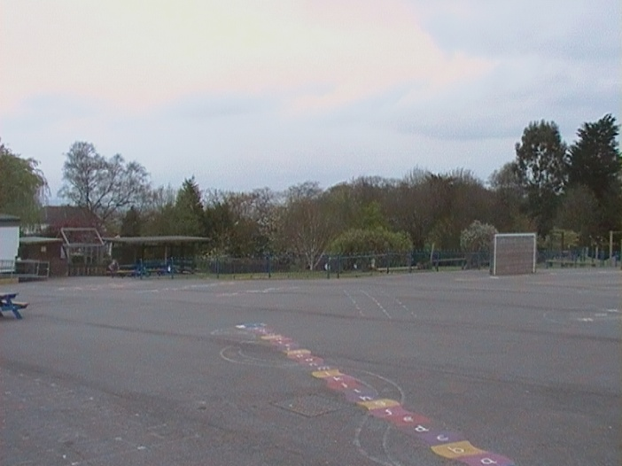
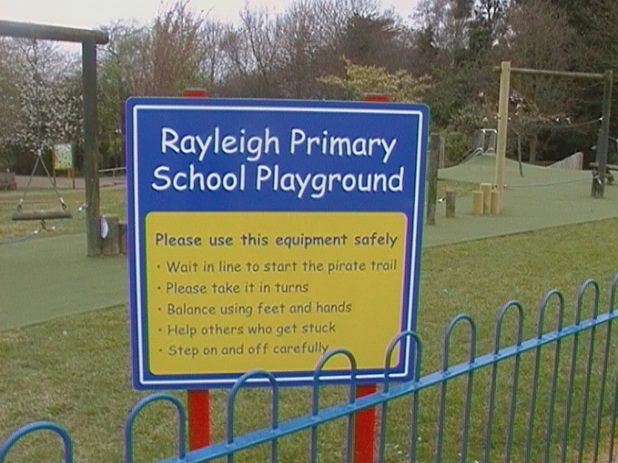
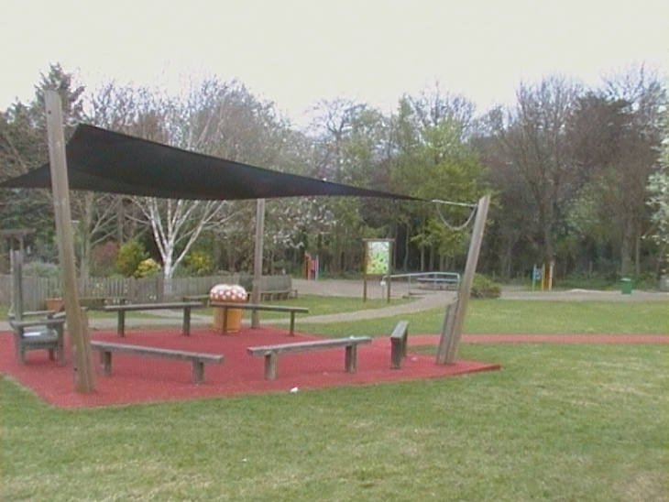
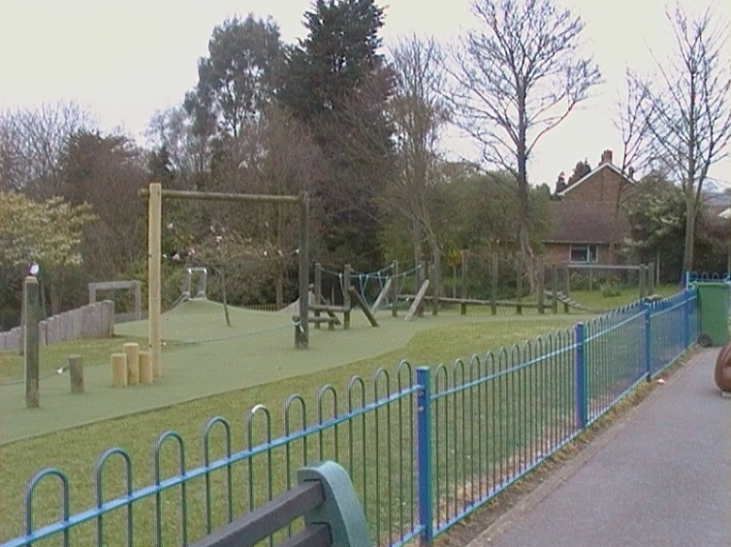
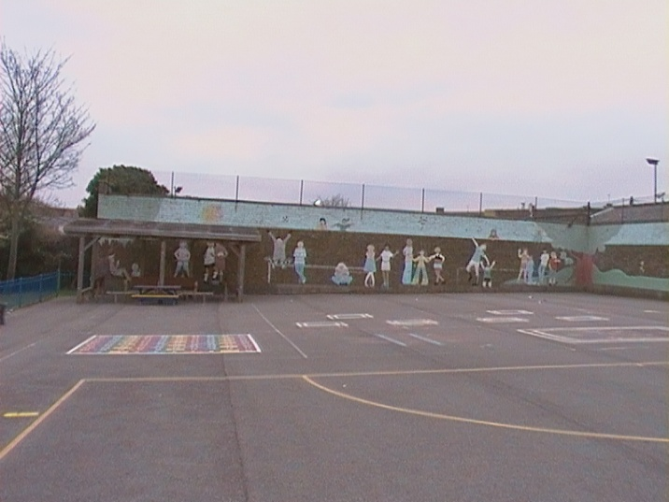
Playground

Slide 25
Medical Area

Slide 26
Toilets

Slide 27
ICT Suite

Slide 28
School Hall

Slide 29
Bye from Rayleigh Primary School

