Slide 1
Eratosthenes Experiment 2018
Taurage ‘Saltinis’ progymnasium
Latitude: 55,2556
Longitude: 22,3
Length of stick: 1m
Length of shadow: 1,41m
Notes:
Latitude: 55,2556
Longitude: 22,3
Length of stick: 1m
Length of shadow: 1,41m
Angle: 55
School partner: 2nd primary school of New Moudania Chalkidiki Greece
Latitude=40,243
Longitude=23,281
Length od stick: 1m
Shadow length: 0,83 m
Angle: 40
Distance between two cities: 1671 km
Circumference: 40104 km
21/03/2018

Slide 2
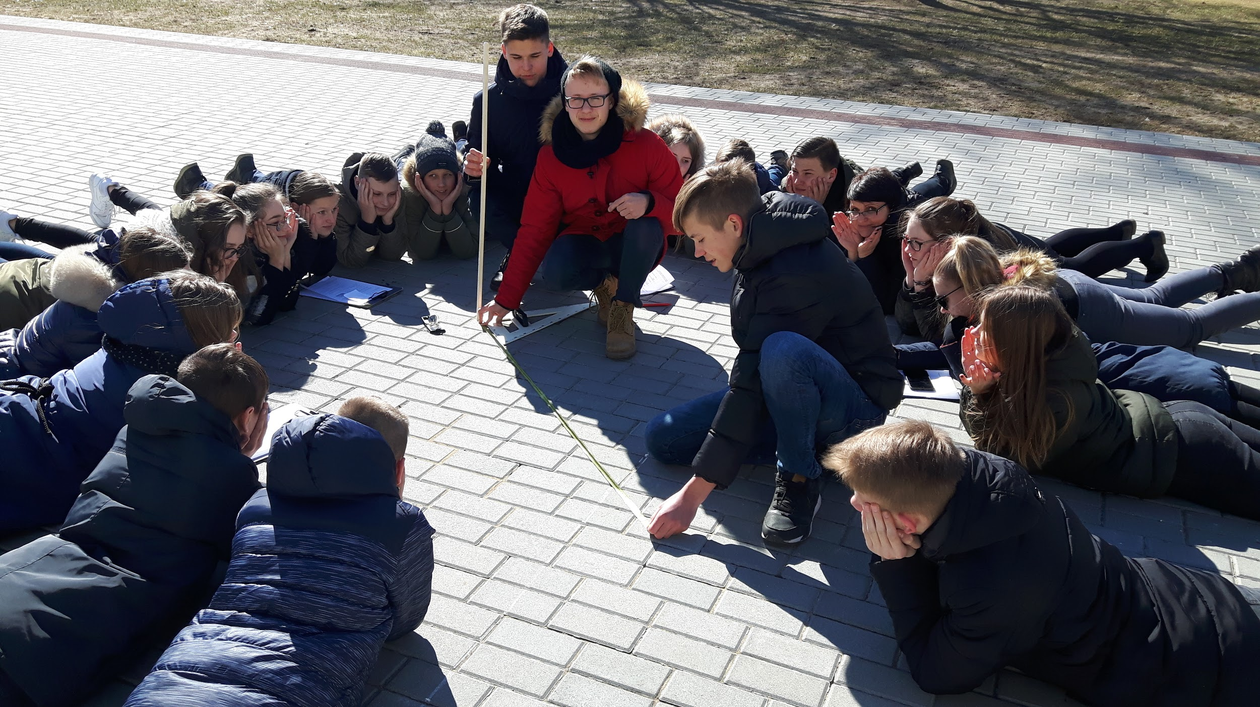
21 March

Slide 3
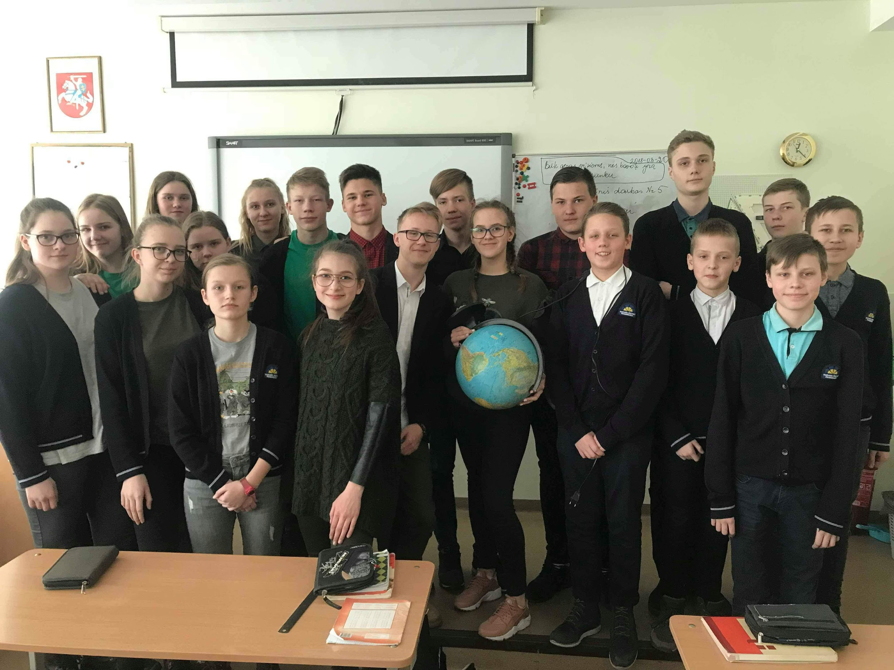

Slide 4
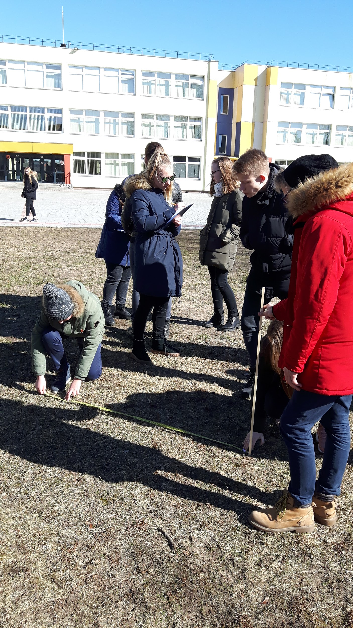
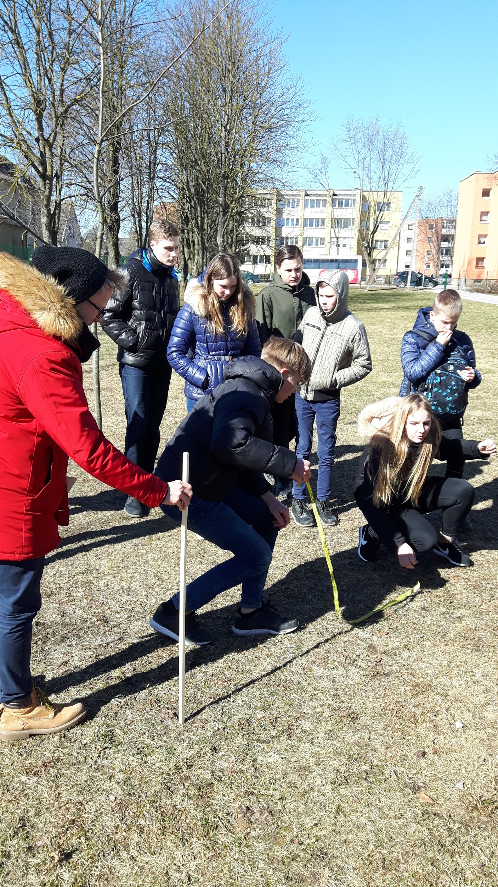
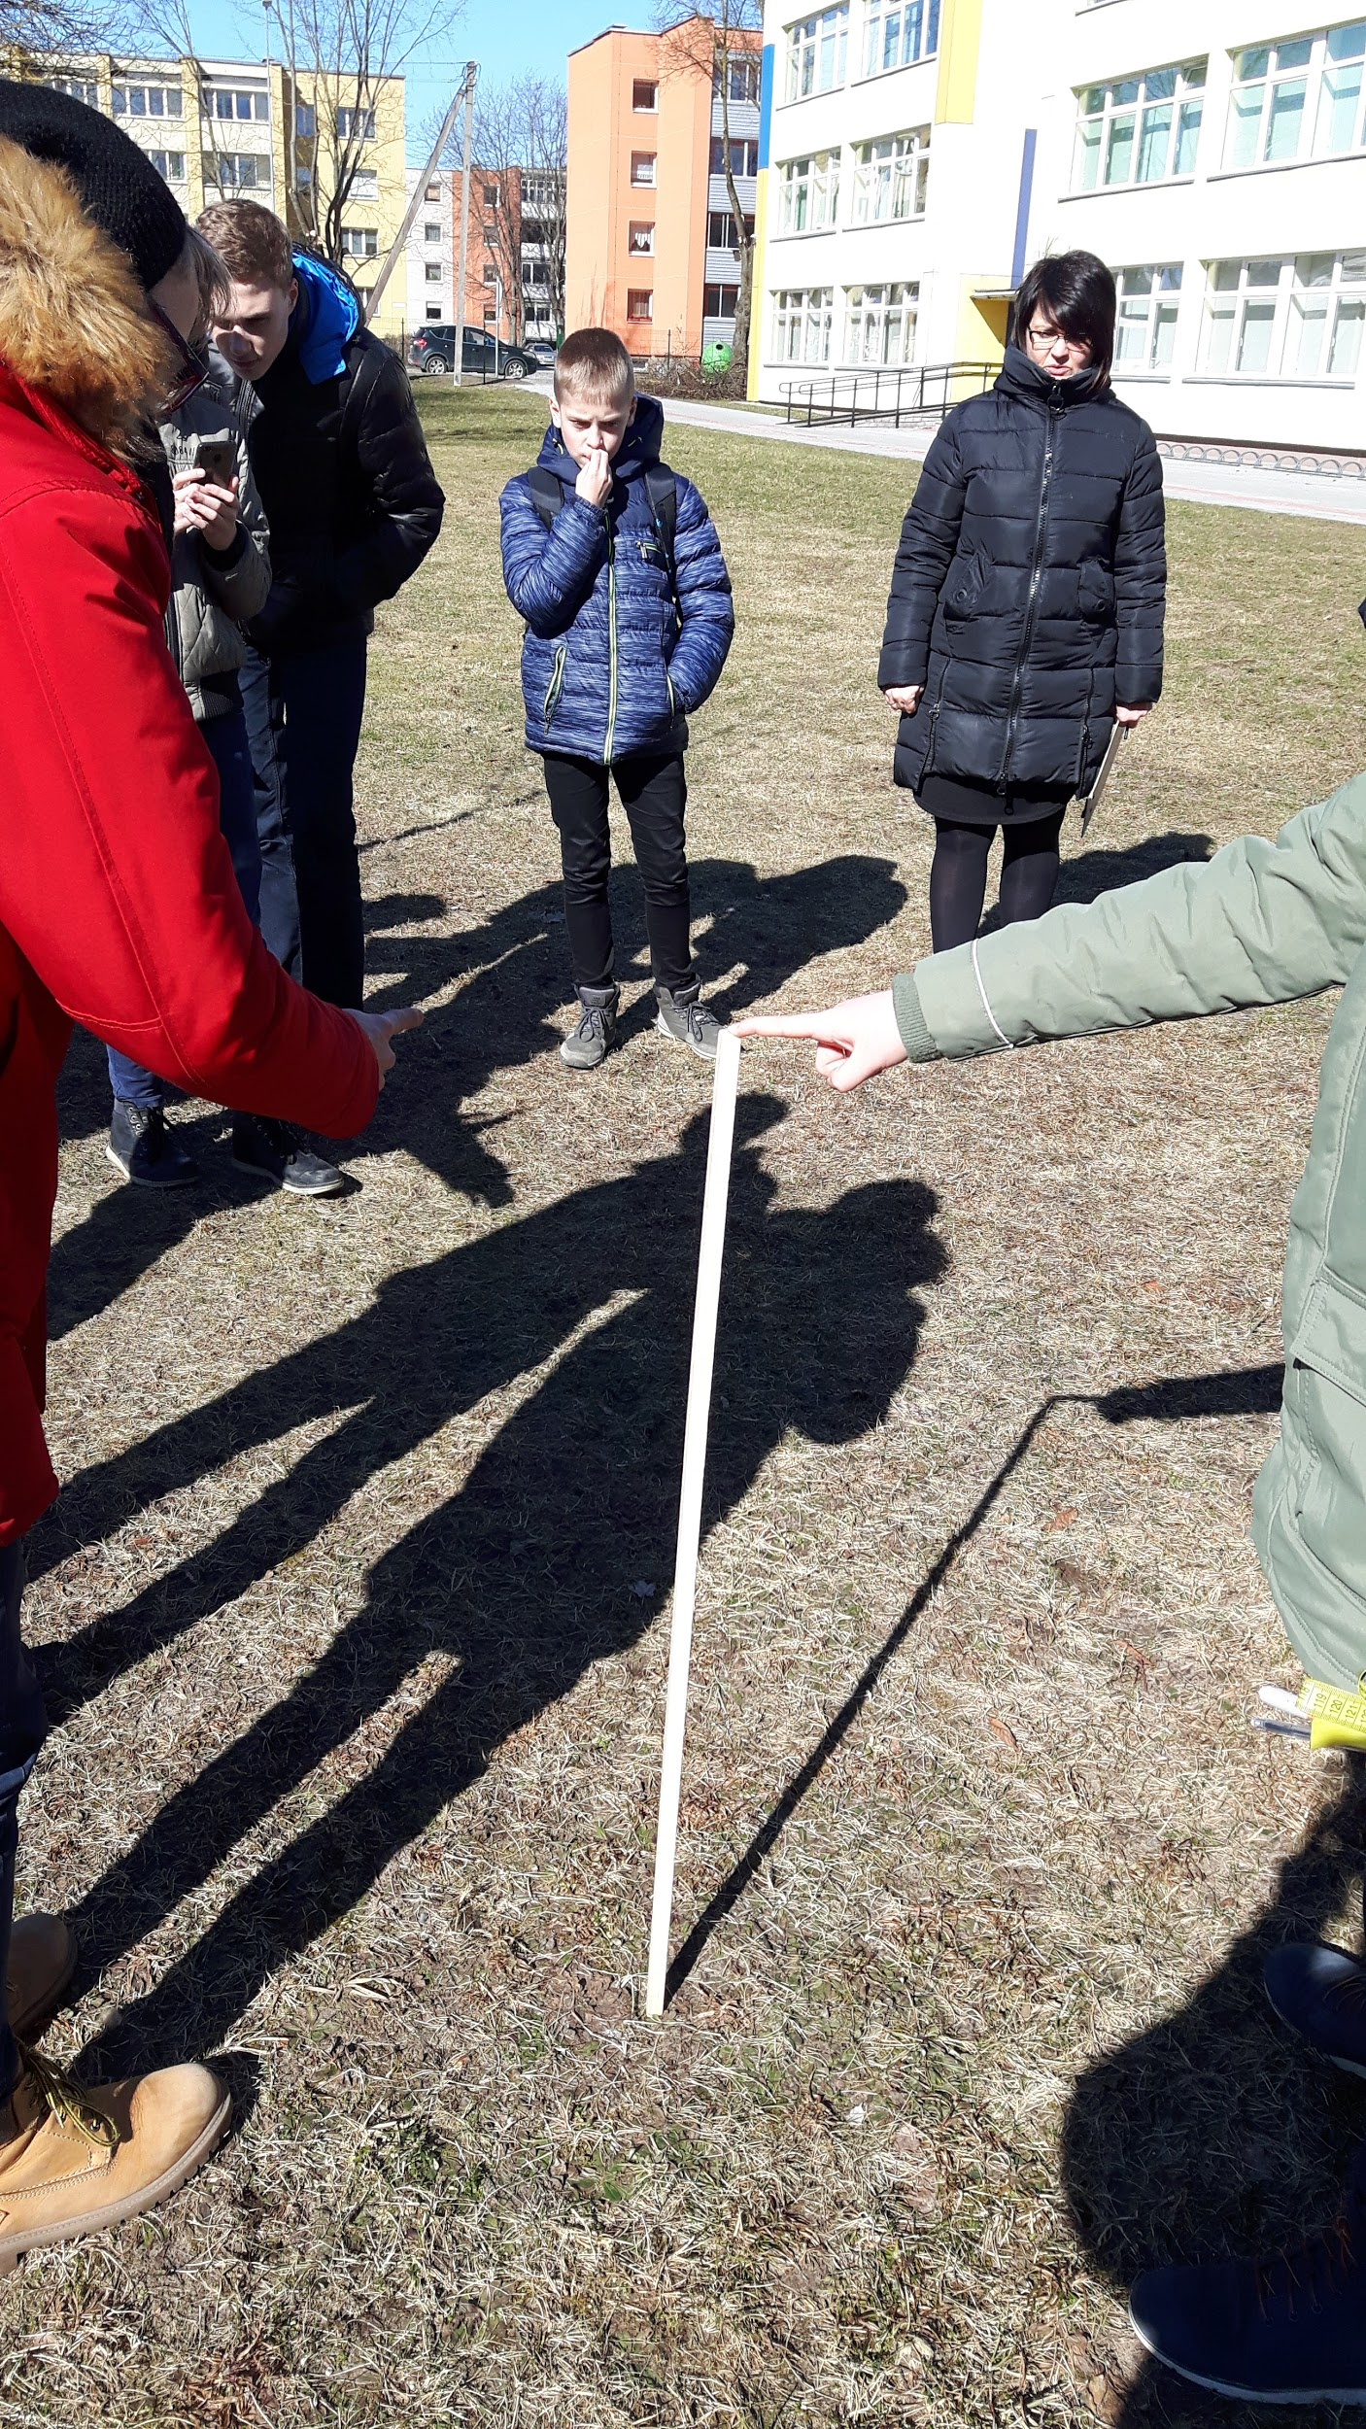

Slide 5
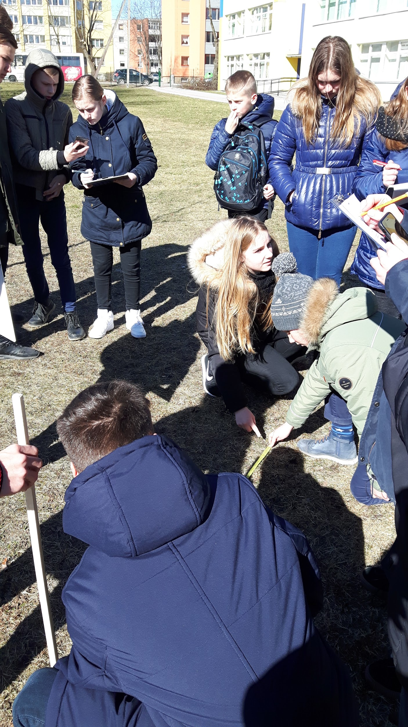
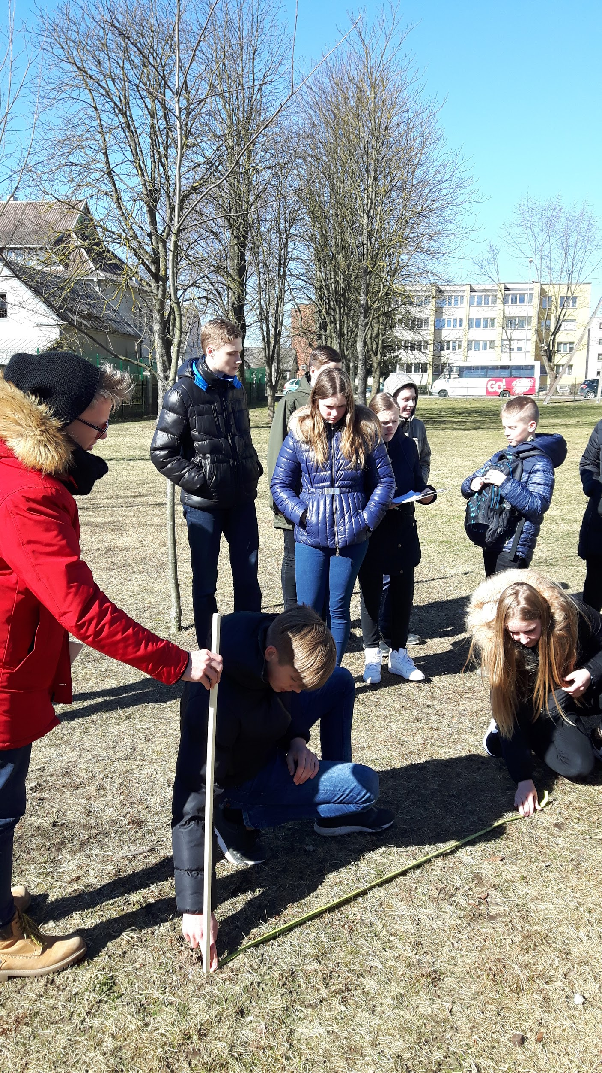
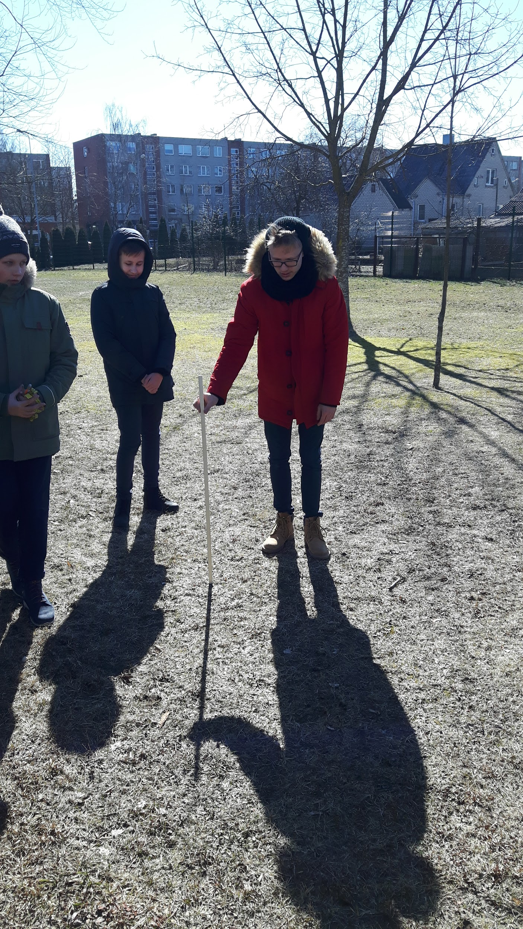

Slide 6
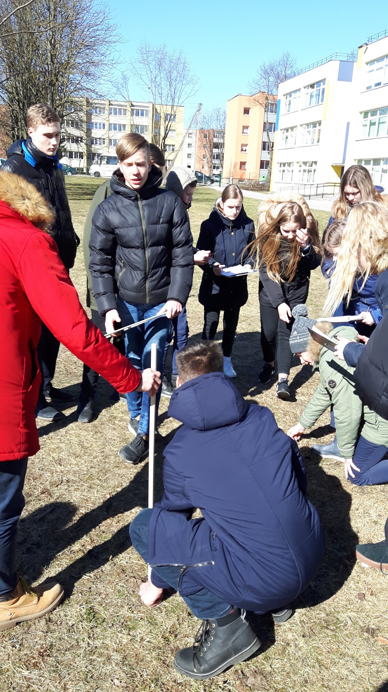
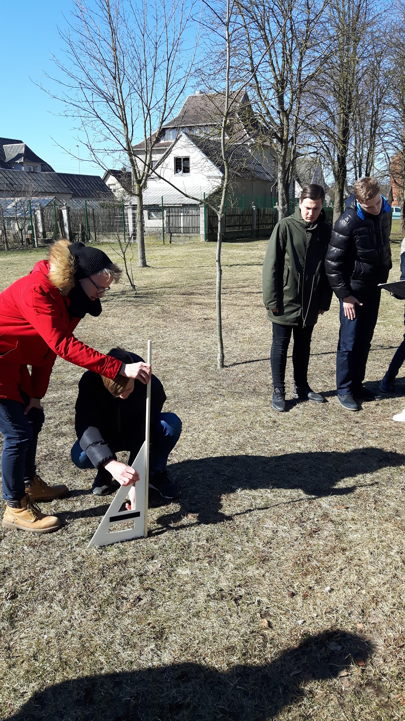

Slide 7
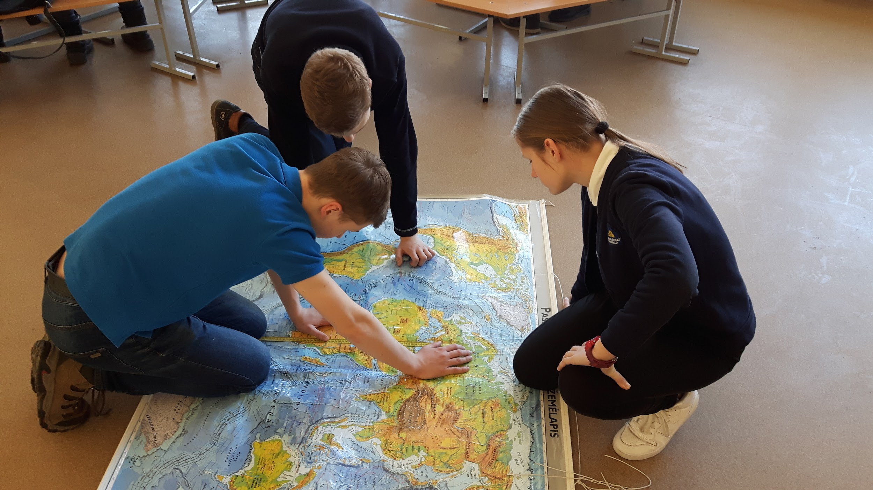

Slide 8
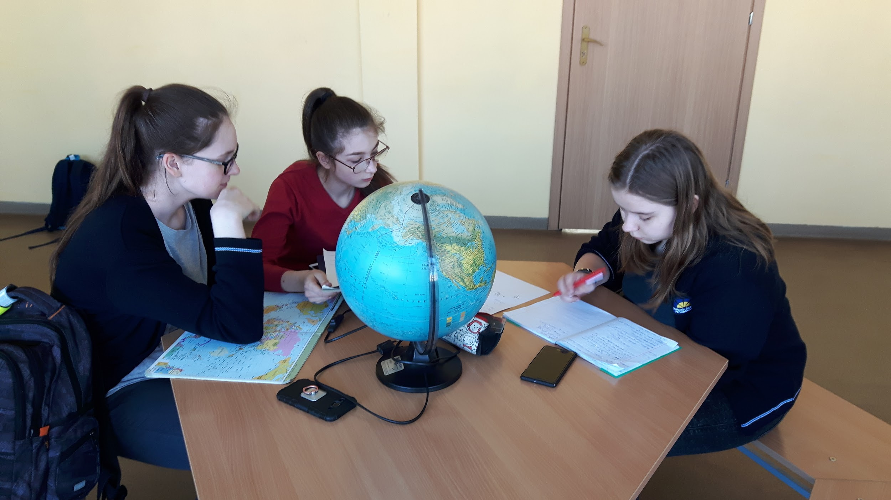

Slide 9
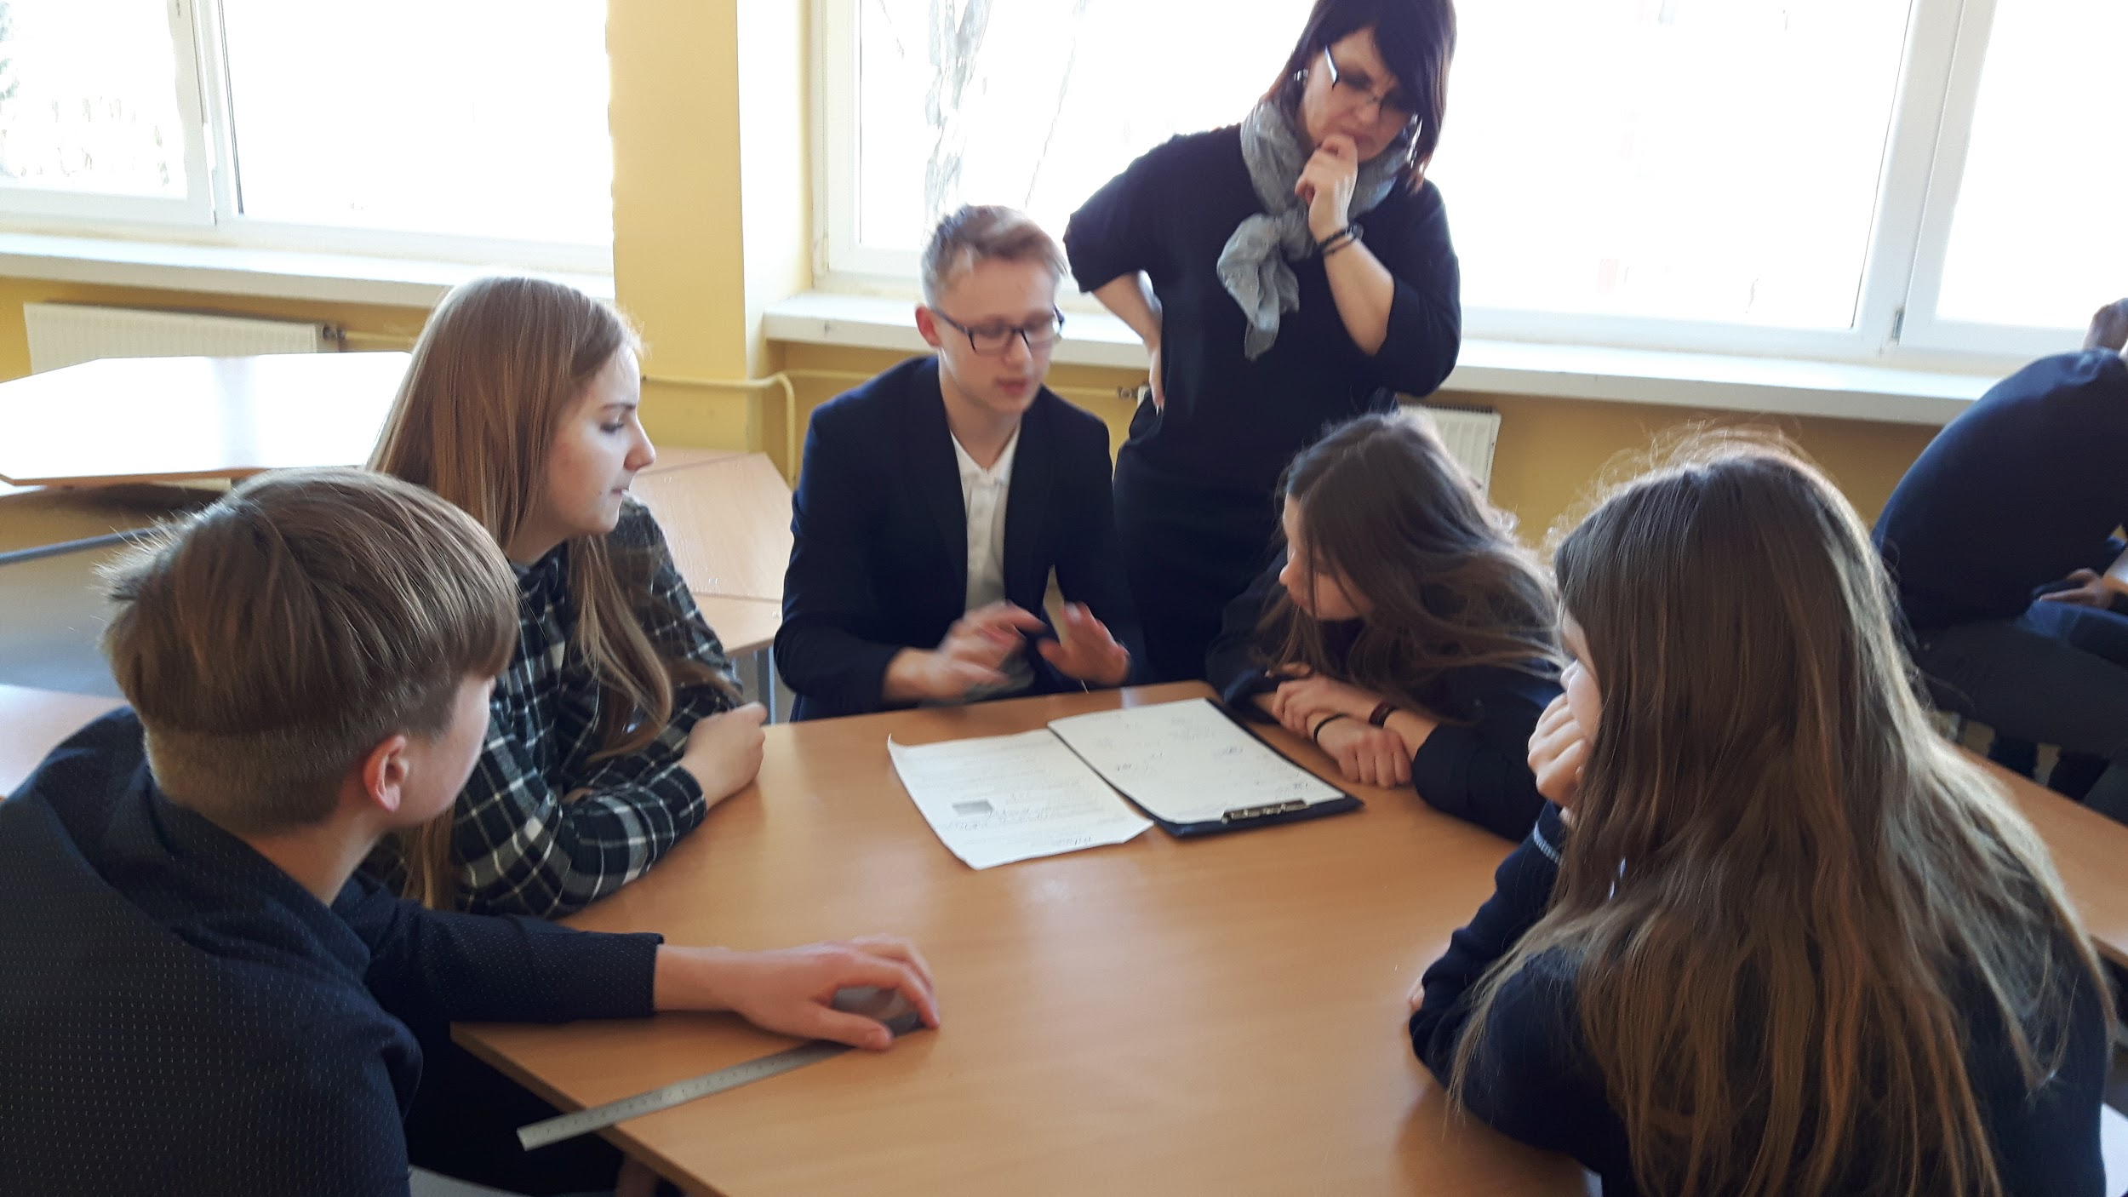

Slide 10
