Slide 1
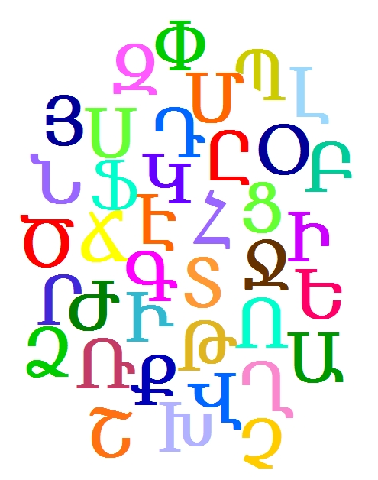
Part of COLORFUL ALPHABET, eTwinning, 2014-2015
Armenian Alphabet Song
Voices : CPD first grader
Musical direction : Mrs Forys
Transcription and text : Mrs Ducamus

Slide 2
Armenian Alphabet Song

Slide 3
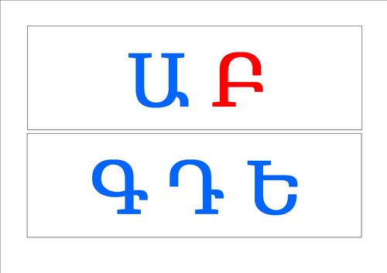
Armenian Alphabet Song

Slide 4
Armenian Alphabet Song

Slide 5
Armenian Alphabet Song

Slide 6
Armenian Alphabet Song

Slide 7
Armenian Alphabet Song

Slide 8
Armenian Alphabet Song

Slide 9
Armenian Alphabet Song

Slide 10
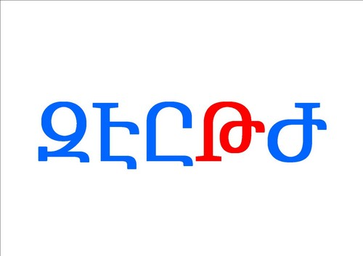
Armenian Alphabet Song

Slide 11
Armenian Alphabet Song

Slide 12
Armenian Alphabet Song

Slide 13
Armenian Alphabet Song

Slide 14
Armenian Alphabet Song

Slide 15
Armenian Alphabet Song

Slide 16
Armenian Alphabet Song

Slide 17
Armenian Alphabet Song

Slide 18
Armenian Alphabet Song

Slide 19
Armenian Alphabet Song

Slide 20
Armenian Alphabet Song

Slide 21
Armenian Alphabet Song

Slide 22
Armenian Alphabet Song

Slide 23
Armenian Alphabet Song

Slide 24
Armenian Alphabet Song

Slide 25
Armenian Alphabet Song

Slide 26
Armenian Alphabet Song

Slide 27
Armenian Alphabet Song

Slide 28
Armenian Alphabet Song

Slide 29
Armenian Alphabet Song

Slide 30
Armenian Alphabet Song

Slide 31
Armenian Alphabet Song

Slide 32
Armenian Alphabet Song

Slide 33
Armenian Alphabet Song

Slide 34
Armenian Alphabet Song

Slide 35
Armenian Alphabet Song

Slide 36
Armenian Alphabet Song

Slide 37
Armenian Alphabet Song

Slide 38
Armenian Alphabet Song

Slide 39
Armenian Alphabet Song

Slide 40
Armenian Alphabet Song

Slide 41
Armenian Alphabet Song
.
Aujourd’hui nous apprenons
Les lettres de l’alphabet,
Ouh là là, y’en a beaucoup
Ca va être difficile.
Today we’re going to learn
How to sing the alphabet,
Dear, there’re too many letters
This is going to be tricky

Slide 42
Armenian Alphabet Song
.
Aujourd’hui nous apprenons
Les lettres de l’alphabet,
Ouh là là, y’en a beaucoup
Ca va être difficile.
Today we’re going to learn
How to sing the alphabet,
Dear, there’re too many letters
This is going to be tricky

Slide 43
Armenian Alphabet Song
.
Aujourd’hui nous apprenons
Les lettres de l’alphabet,
Ouh là là, y’en a beaucoup
Ca va être difficile.
Today we’re going to learn
How to sing the alphabet,
Dear, there’re too many letters
This is going to be tricky

Slide 44
Armenian Alphabet Song
.
Aujourd’hui nous apprenons
Les lettres de l’alphabet,
Ouh là là, y’en a beaucoup
Ca va être difficile.
Today we’re going to learn
How to sing the alphabet,
Dear, there’re too many letters
This is going to be tricky

Slide 45
Armenian Alphabet Song
.
Aujourd’hui nous apprenons
Les lettres de l’alphabet,
Ouh là là, y’en a beaucoup
Ca va être difficile.
Today we’re going to learn
How to sing the alphabet,
Dear, there’re too many letters
This is going to be tricky

Slide 46
Armenian Alphabet Song
.
Aujourd’hui nous apprenons
Les lettres de l’alphabet,
Ouh là là, y’en a beaucoup
Ca va être difficile.
Today we’re going to learn
How to sing the alphabet,
Dear, there’re too many letters
This is going to be tricky

Slide 47
Armenian Alphabet Song
.
Aujourd’hui nous apprenons
Les lettres de l’alphabet,
Ouh là là, y’en a beaucoup
Ca va être difficile.
Today we’re going to learn
How to sing the alphabet,
Dear, there’re too many letters
This is going to be tricky

Slide 48
Armenian Alphabet Song
.
Aujourd’hui nous apprenons
Les lettres de l’alphabet,
Ouh là là, y’en a beaucoup
Ca va être difficile.
Today we’re going to learn
How to sing the alphabet,
Dear, there’re too many letters
This is going to be tricky

Slide 49
Armenian Alphabet Song
.
Aujourd’hui nous apprenons
Les lettres de l’alphabet,
Ouh là là, y’en a beaucoup
Ca va être difficile.
Today we’re going to learn
How to sing the alphabet,
Dear, there’re too many letters
This is going to be tricky

Slide 50
Armenian Alphabet Song
.
Aujourd’hui nous apprenons
Les lettres de l’alphabet,
Ouh là là, y’en a beaucoup
Ca va être difficile.
Today we’re going to learn
How to sing the alphabet,
Dear, there’re too many letters
This is going to be tricky

Slide 51
Armenian Alphabet Song

Slide 52
Armenian Alphabet Song

Slide 53
Armenian Alphabet Song

Slide 54
Armenian Alphabet Song

Slide 55
Armenian Alphabet Song

Slide 56
Armenian Alphabet Song

Slide 57
Armenian Alphabet Song

Slide 58
Armenian Alphabet Song

Slide 59
Armenian Alphabet Song

Slide 60
Armenian Alphabet Song

Slide 61
Armenian Alphabet Song

Slide 62
Armenian Alphabet Song

Slide 63
Armenian Alphabet Song

Slide 64
Armenian Alphabet Song

Slide 65
Armenian Alphabet Song

Slide 66
Armenian Alphabet Song

Slide 67
Armenian Alphabet Song

Slide 68
Armenian Alphabet Song

Slide 69
Armenian Alphabet Song

Slide 70
Armenian Alphabet Song

Slide 71
Armenian Alphabet Song

Slide 72
Armenian Alphabet Song

Slide 73
Armenian Alphabet Song

Slide 74
Armenian Alphabet Song

Slide 75
Armenian Alphabet Song

Slide 76
Armenian Alphabet Song

Slide 77
Armenian Alphabet Song

Slide 78
Armenian Alphabet Song

Slide 79
Armenian Alphabet Song

Slide 80
Armenian Alphabet Song

Slide 81
Armenian Alphabet Song

Slide 82
Armenian Alphabet Song

Slide 83
Armenian Alphabet Song

Slide 84
Armenian Alphabet Song

Slide 85
Armenian Alphabet Song

Slide 86
Armenian Alphabet Song

Slide 87
Armenian Alphabet Song

Slide 88
Armenian Alphabet Song

Slide 89
Armenian Alphabet Song

Slide 90
Armenian Alphabet Song
Maintenant nous connaissons
Tout l’alphabet arménien,
Trente-six lettres que nous chantons
Sans en oublier aucune.
Now we all know very well
The Armenian Alphabet,
We sing all 36 letters
And we don’t forget any.

Slide 91
Armenian Alphabet Song
Maintenant nous connaissons
Tout l’alphabet arménien,
Trente-six lettres que nous chantons
Sans en oublier aucune.
Now we all know very well
The Armenian Alphabet,
We sing all 36 letters
And we don’t forget any.

Slide 92
Armenian Alphabet Song
Maintenant nous connaissons
Tout l’alphabet arménien,
Trente-six lettres que nous chantons
Sans en oublier aucune.
Now we all know very well
The Armenian Alphabet,
We sing all 36 letters
And we don’t forget any.

Slide 93
Armenian Alphabet Song
Maintenant nous connaissons
Tout l’alphabet arménien,
Trente-six lettres que nous chantons
Sans en oublier aucune.
Now we all know very well
The Armenian Alphabet,
We sing all 36 letters
And we don’t forget any.

Slide 94
Armenian Alphabet Song
Maintenant nous connaissons
Tout l’alphabet arménien,
Trente-six lettres que nous chantons
Sans en oublier aucune.
Now we all know very well
The Armenian Alphabet,
We sing all 36 letters
And we don’t forget any.

Slide 95
Armenian Alphabet Song
Maintenant nous connaissons
Tout l’alphabet arménien,
Trente-six lettres que nous chantons
Sans en oublier aucune.
Now we all know very well
The Armenian Alphabet,
We sing all 36 letters
And we don’t forget any.

Slide 96
Armenian Alphabet Song
Maintenant nous connaissons
Tout l’alphabet arménien,
Trente-six lettres que nous chantons
Sans en oublier aucune.
Now we all know very well
The Armenian Alphabet,
We sing all 36 letters
And we don’t forget any.

Slide 97
Armenian Alphabet Song
Maintenant nous connaissons
Tout l’alphabet arménien,
Trente-six lettres que nous chantons
Sans en oublier aucune.
Now we all know very well
The Armenian Alphabet,
We sing all 36 letters
And we don’t forget any.

Slide 98
Armenian Alphabet Song
Maintenant nous connaissons
Tout l’alphabet arménien,
Trente-six lettres que nous chantons
Sans en oublier aucune.
Now we all know very well
The Armenian Alphabet,
We sing all 36 letters
And we don’t forget any.

Slide 99
Armenian Alphabet Song

Slide 100
Armenian Alphabet Song

Slide 101
Armenian Alphabet Song

Slide 102
Armenian Alphabet Song

Slide 103
Armenian Alphabet Song

Slide 104
Armenian Alphabet Song

Slide 105
Armenian Alphabet Song

Slide 106
Armenian Alphabet Song

Slide 107
Armenian Alphabet Song

Slide 108
Armenian Alphabet Song

Slide 109
Armenian Alphabet Song

Slide 110
Armenian Alphabet Song

Slide 111
Armenian Alphabet Song

Slide 112
Armenian Alphabet Song

Slide 113
Armenian Alphabet Song

Slide 114
Armenian Alphabet Song

Slide 115
Armenian Alphabet Song

Slide 116
Armenian Alphabet Song

Slide 117
Armenian Alphabet Song

Slide 118
Armenian Alphabet Song

Slide 119
Armenian Alphabet Song

Slide 120
Armenian Alphabet Song

Slide 121
Armenian Alphabet Song

Slide 122
Armenian Alphabet Song

Slide 123
Armenian Alphabet Song

Slide 124
Armenian Alphabet Song

Slide 125
Armenian Alphabet Song

Slide 126
Armenian Alphabet Song

Slide 127
Armenian Alphabet Song

Slide 128
Armenian Alphabet Song

Slide 129
Armenian Alphabet Song

Slide 130
Armenian Alphabet Song

Slide 131
Armenian Alphabet Song

Slide 132
Armenian Alphabet Song

Slide 133
Armenian Alphabet Song

Slide 134
Armenian Alphabet Song

Slide 135
Armenian Alphabet Song

Slide 136
Armenian Alphabet Song

Slide 137
Armenian Alphabet Song

Slide 138
Armenian Alphabet Song
This song was recorded for the project
COLORFUL ALPHABET, eTwinning, 2014-2015
thanks to Manush Arzumanyan who posted this song for us to learn.
Mrs Forys, our Music teacher, who knows perfectly now the Armenian Alphabet, was our guide.
I changed the songs words (not the Chorus – at least not deliberately), because learning them was a task to difficult for us…
Dominique Ducamus – june 2015

Slide 139
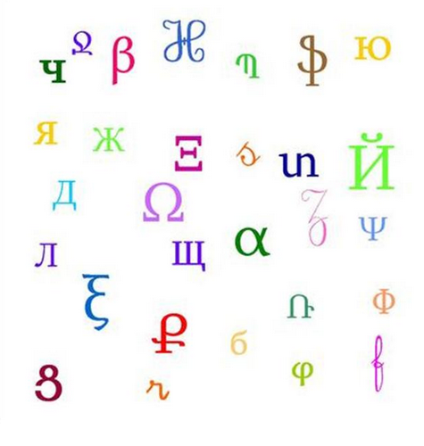
Armenian Alphabet Song

