Slide 1
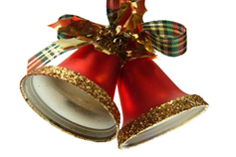
Christmas in Bulgaria

Slide 2
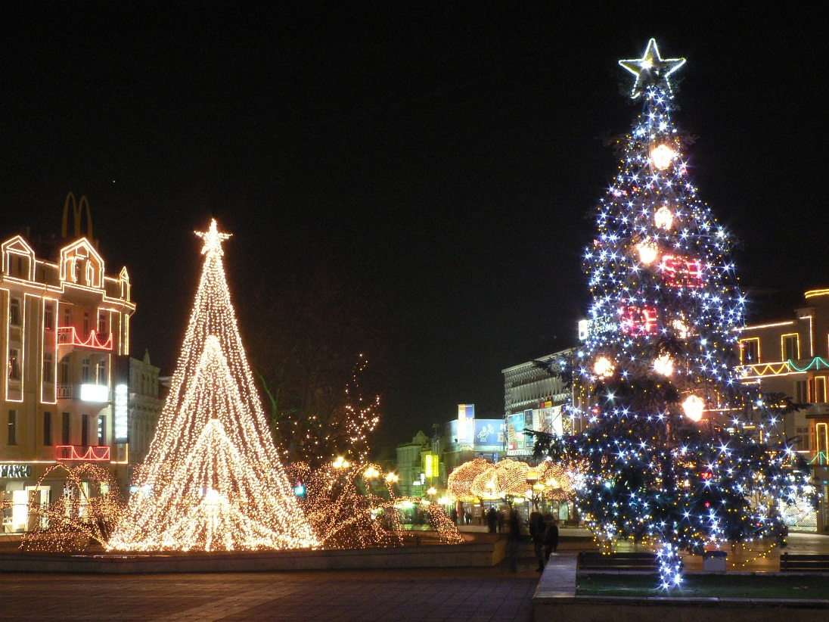
Slide Title
Christmas is a special holiday in Bulgaria.

Slide 3
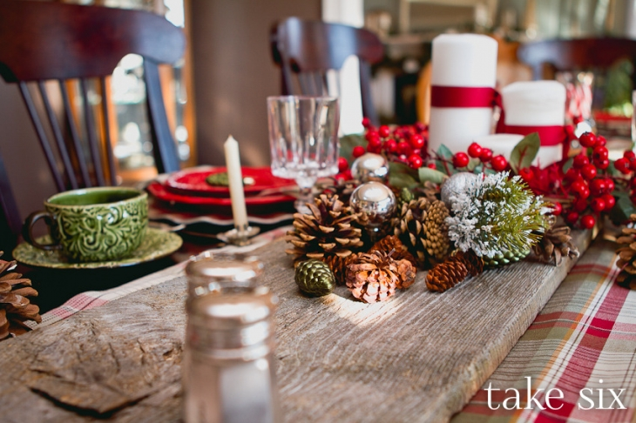
Slide Title
On Christmas Eve all of the family gather around the table.

Slide 4
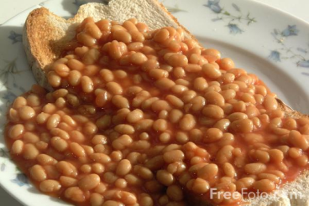
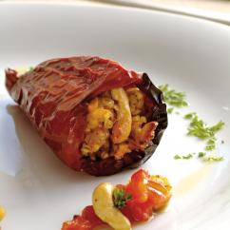
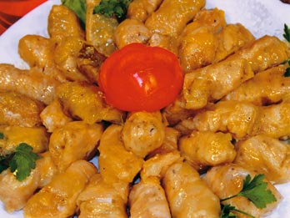
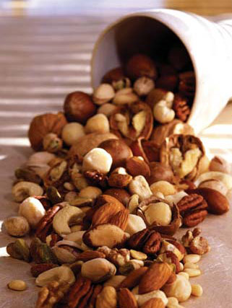
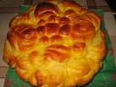
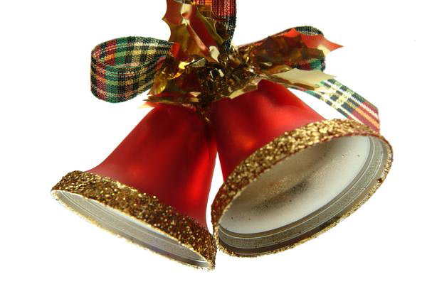
Product B
12 meatless meals like: beans, vain or cabbage sarmi (rice which is in a cabbage or vain leaves), stuffed peppers, pickles, different kinds of nuts, apples, honey and a special kind of bread in which is hidden a coin.

Slide 5
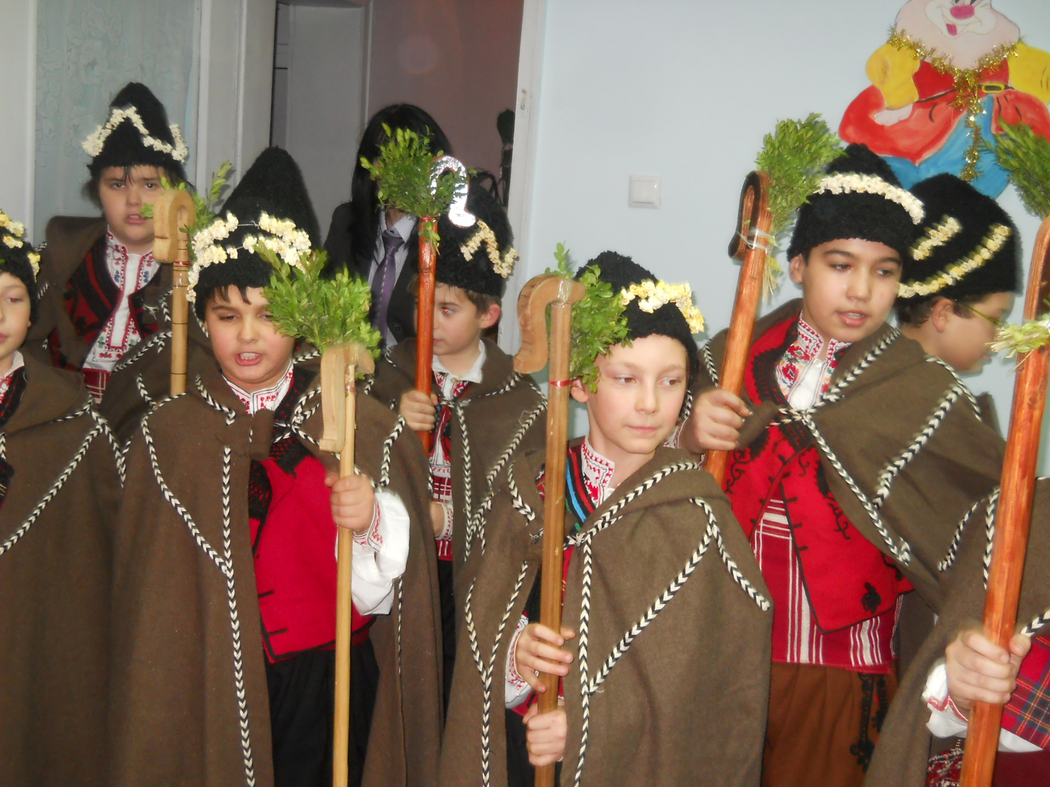
According to the tradition at midnight on Christmas Eve young boys aged 8 to 12 or non-married men form group of about 10-15 boys. The participants are called Koledari.

Slide 6
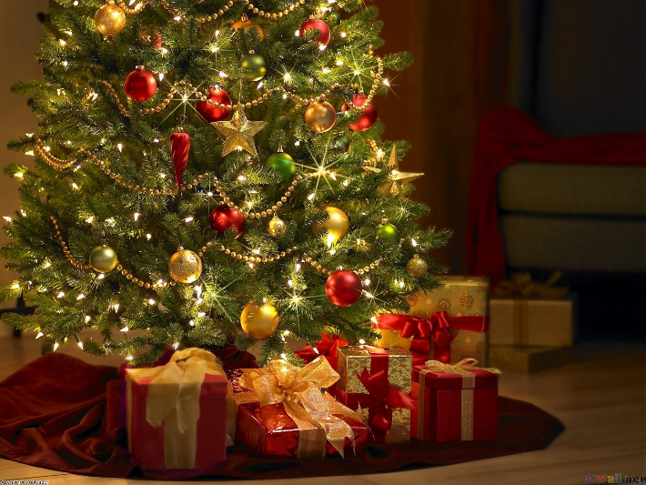
In each home there’s a Christmas tree which is decorated with different balls and colourful lights. Children like this holiday because Santa Clause gives them presents while they are sleeping.

Slide 7
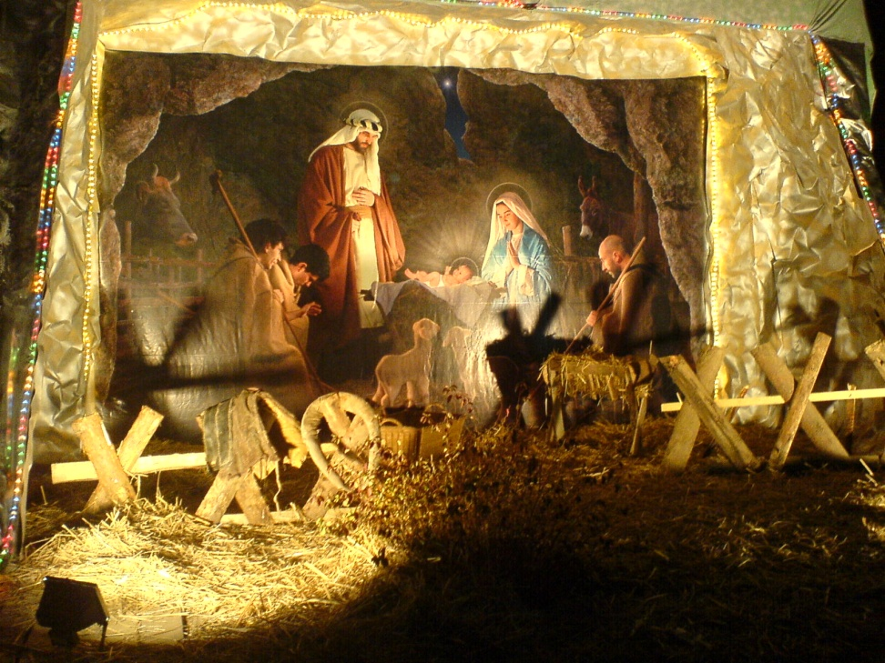
A lot of people go to the church where the liturgy is celebrated. Children recreate the born of Jesus.

