Slide 1
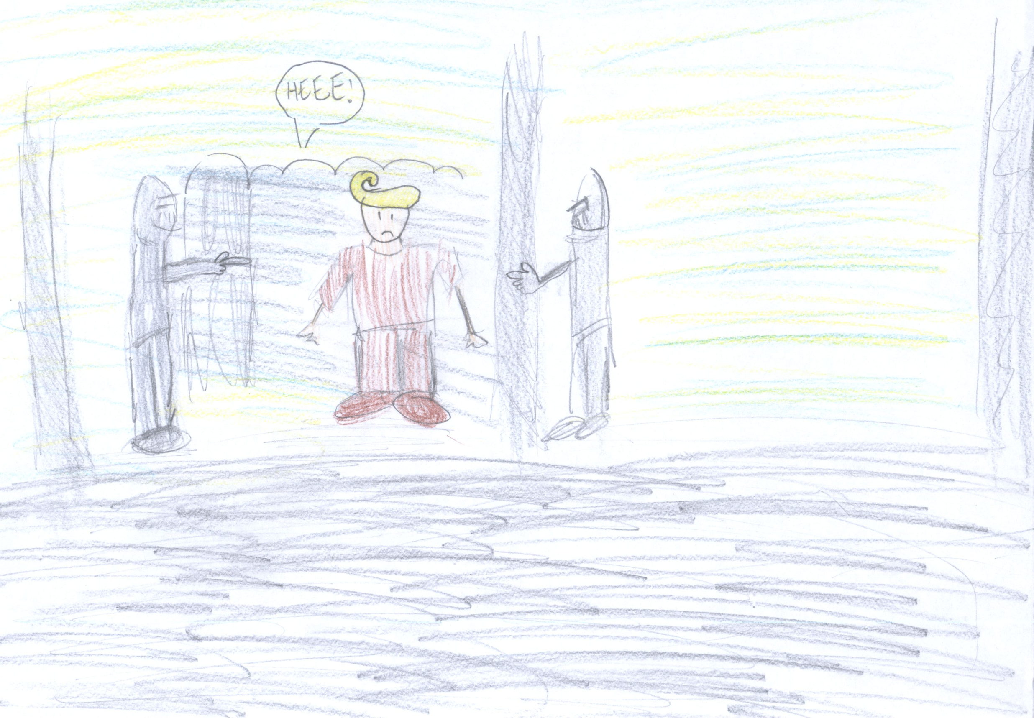
HA HA HA HA! REALLY?

Slide 2
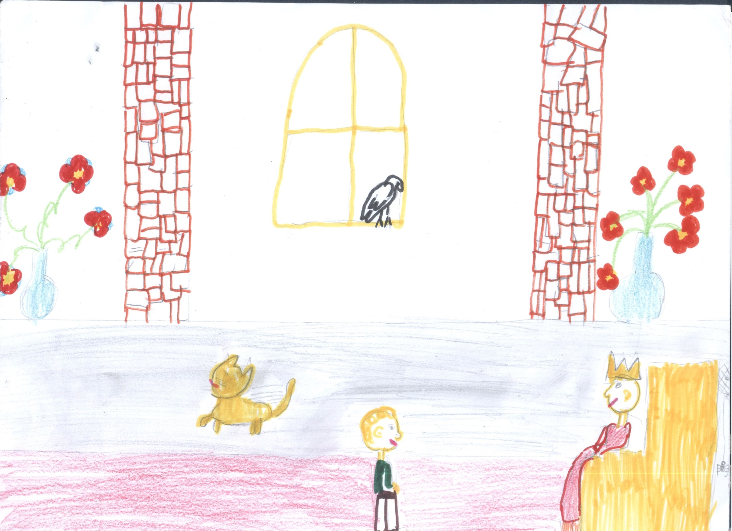
OK.
YOU CAN TRY.
REMEBER THAT MANY KNIGHTS TRIED TO KILL THE DRAGON BUT THE DRAGON KILLED THEM!
I HAVE A PLAN.

Slide 3
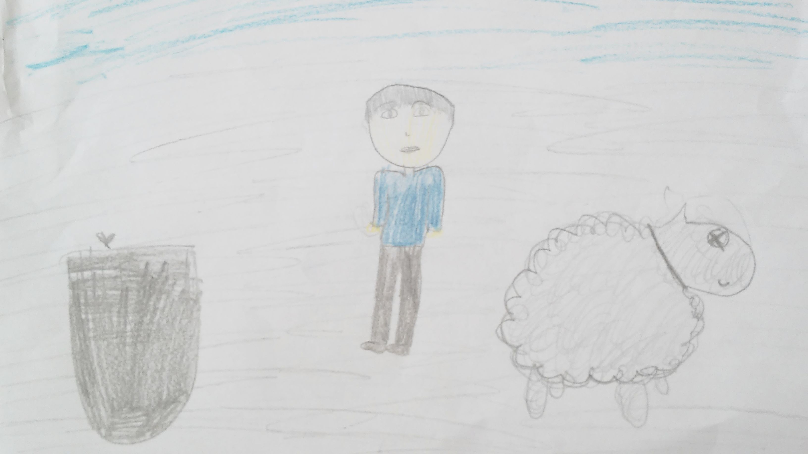
I FILL THE SHEEP WITH SULPHUR.

Slide 4
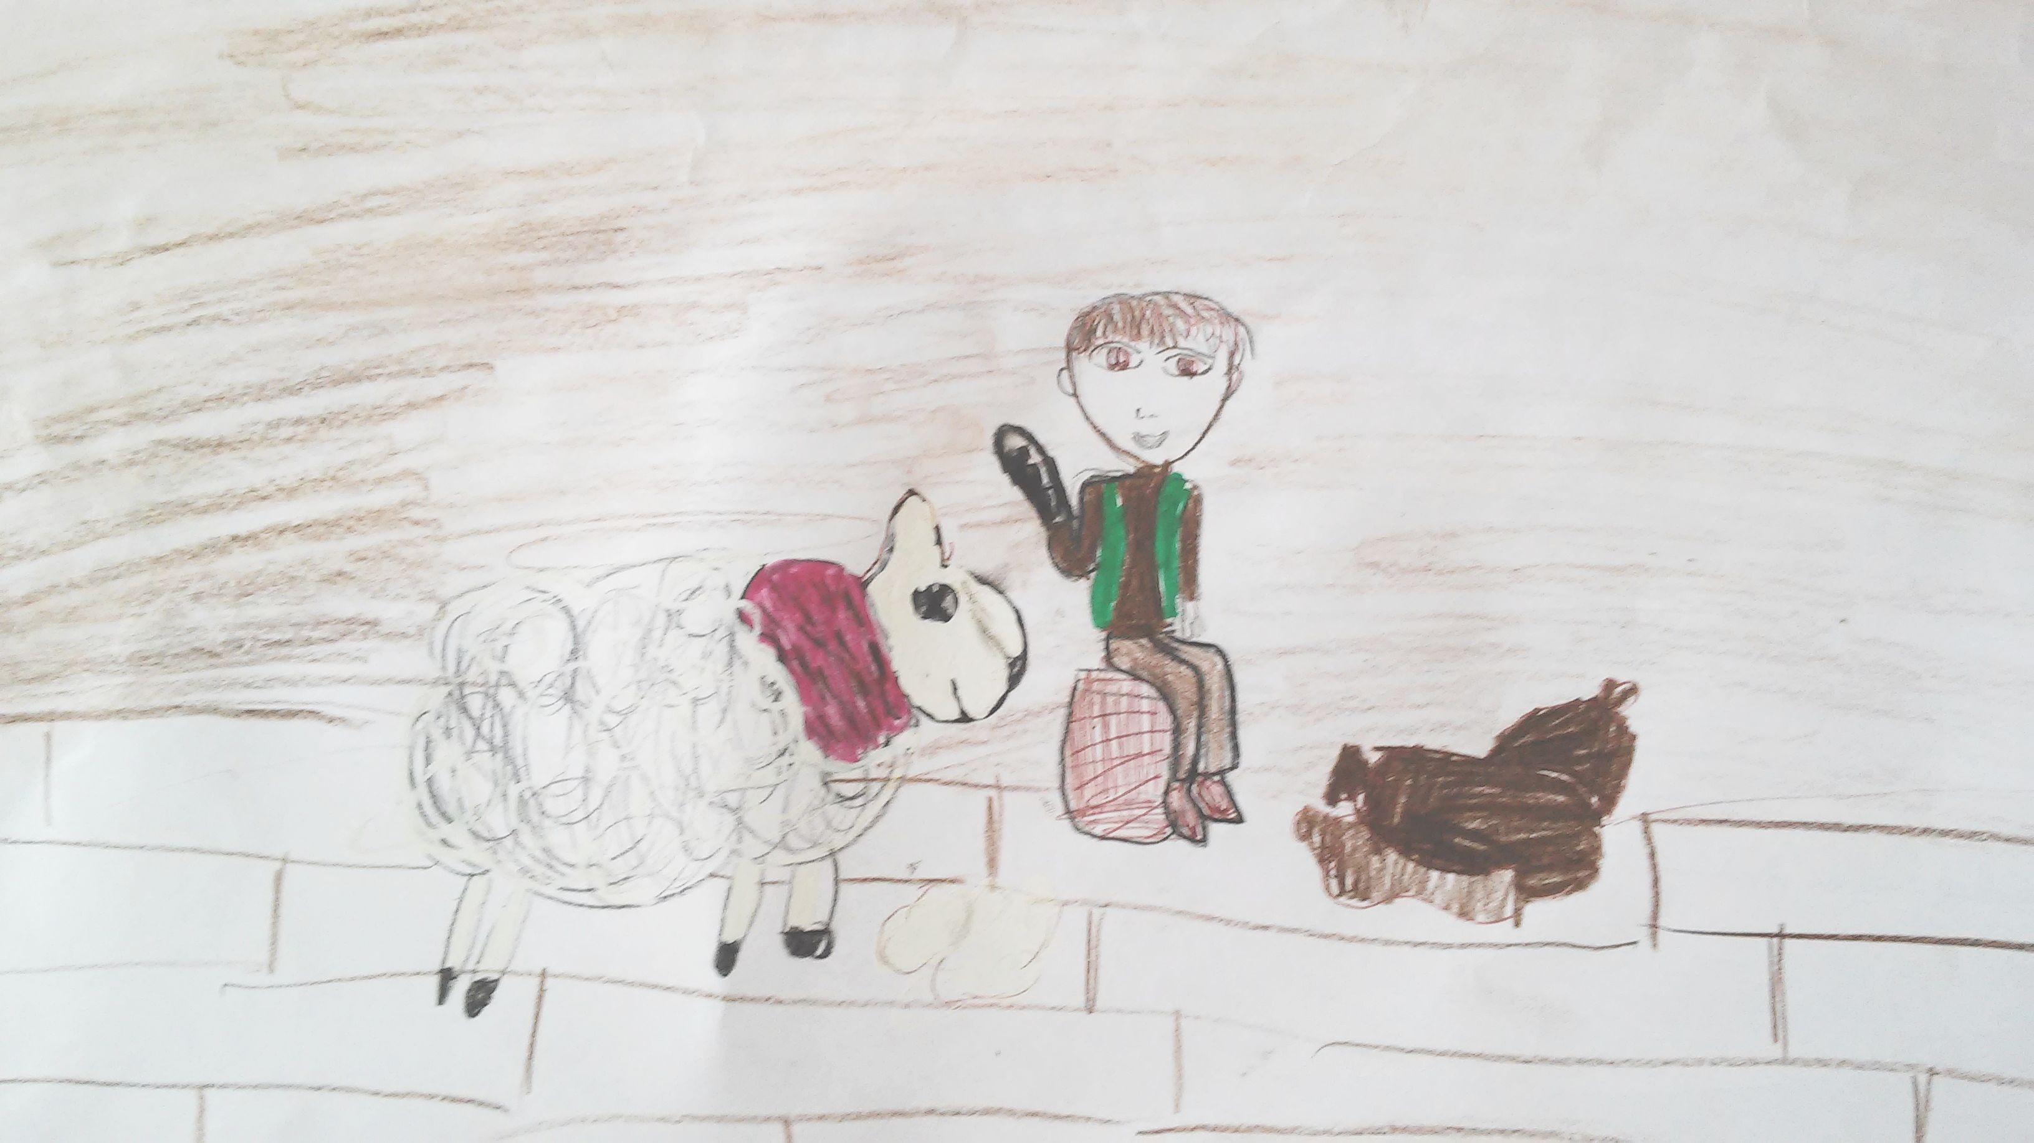

Slide 5
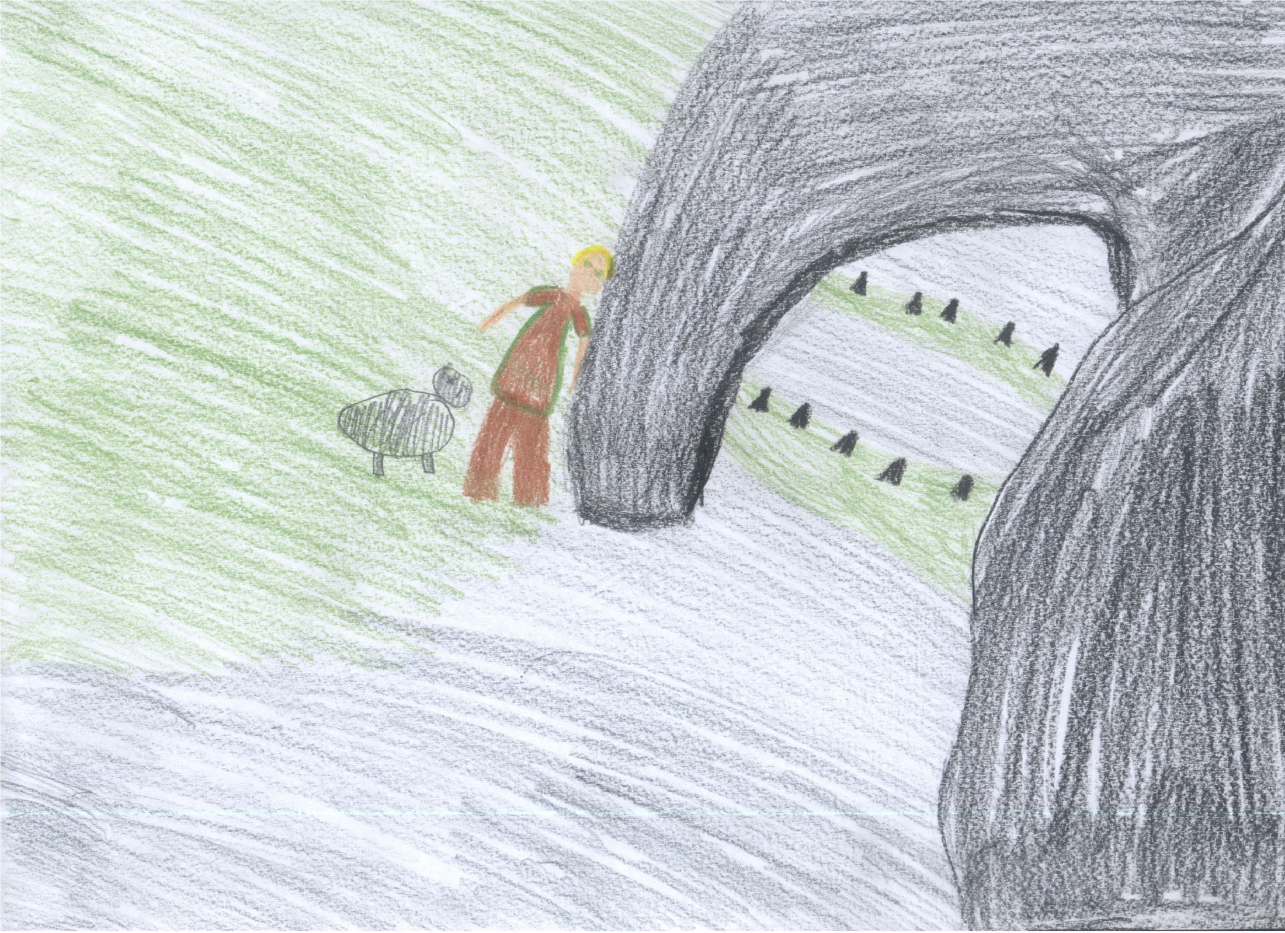
I GIVE THE SHEEP TO THE DRAGON.
HE WILL EAT IT.
The shoemaker sneaks to the Dragon and he gives it the sheep.

Slide 6
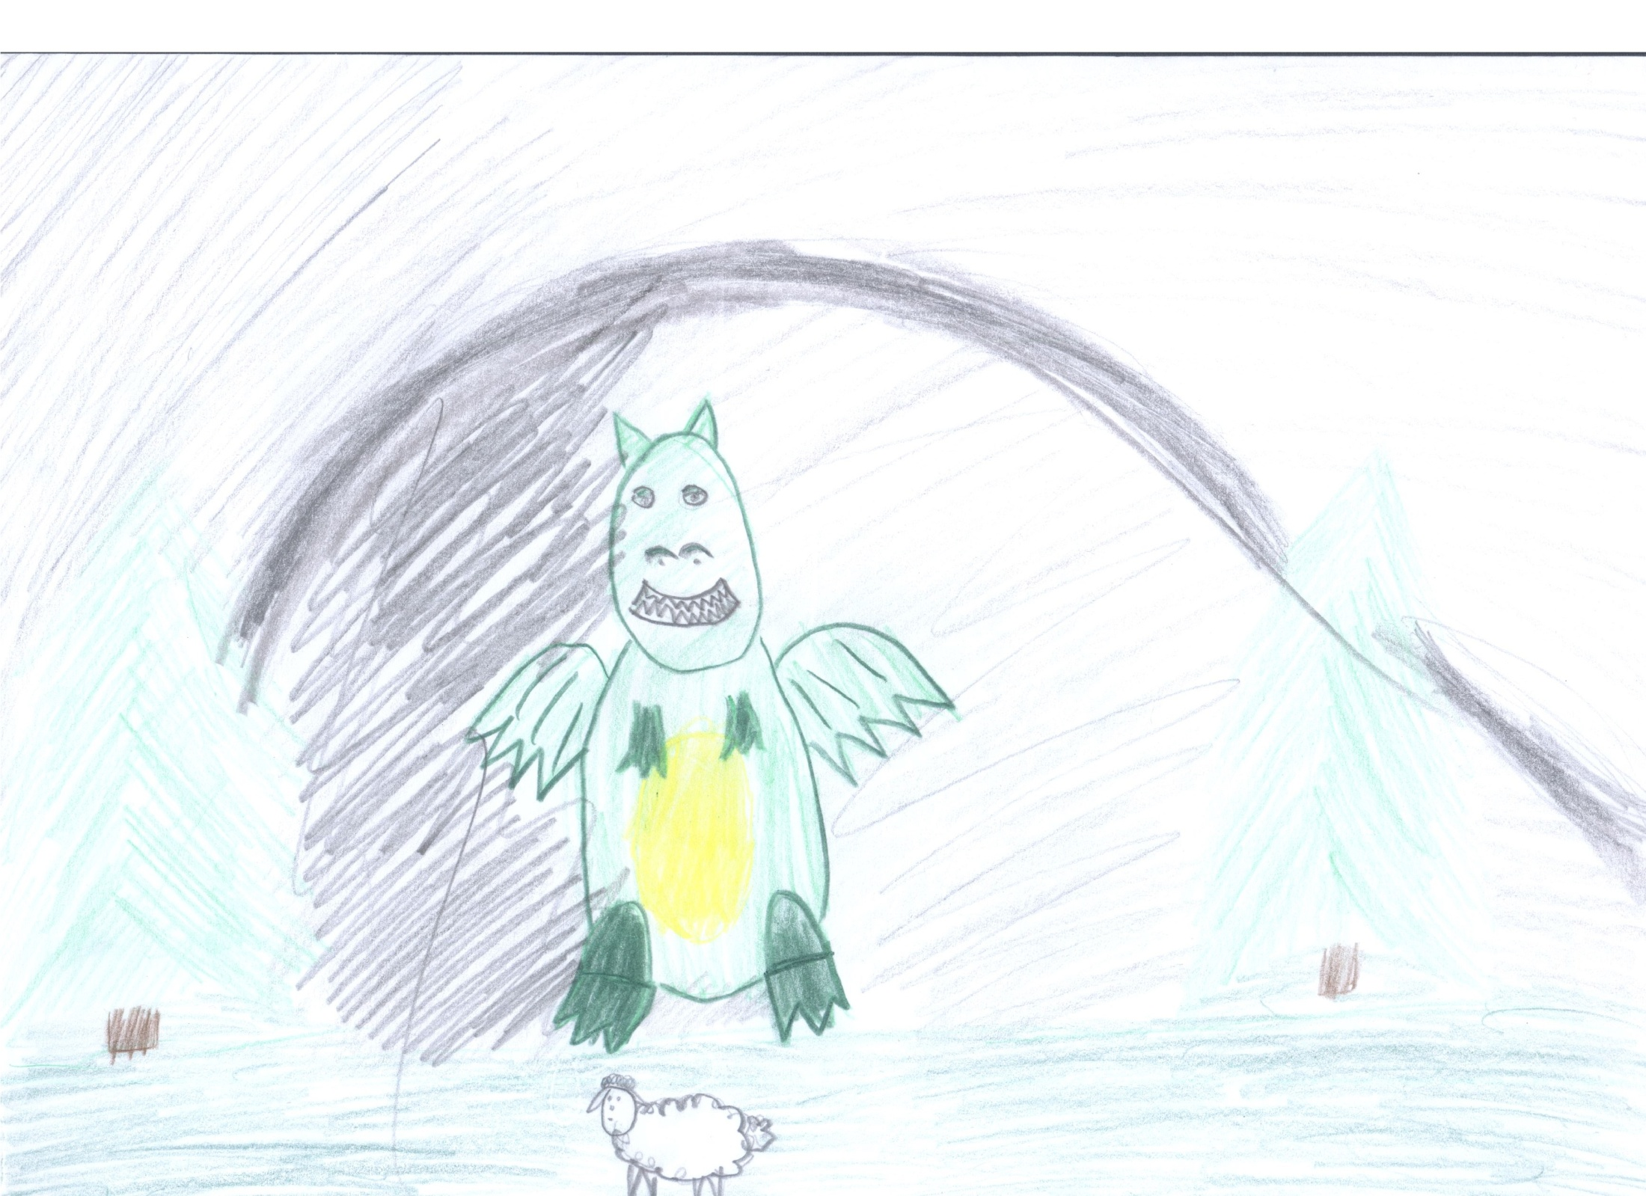
IT’S DELICIOUS...
I LIKE THE SHEEP.

Slide 7
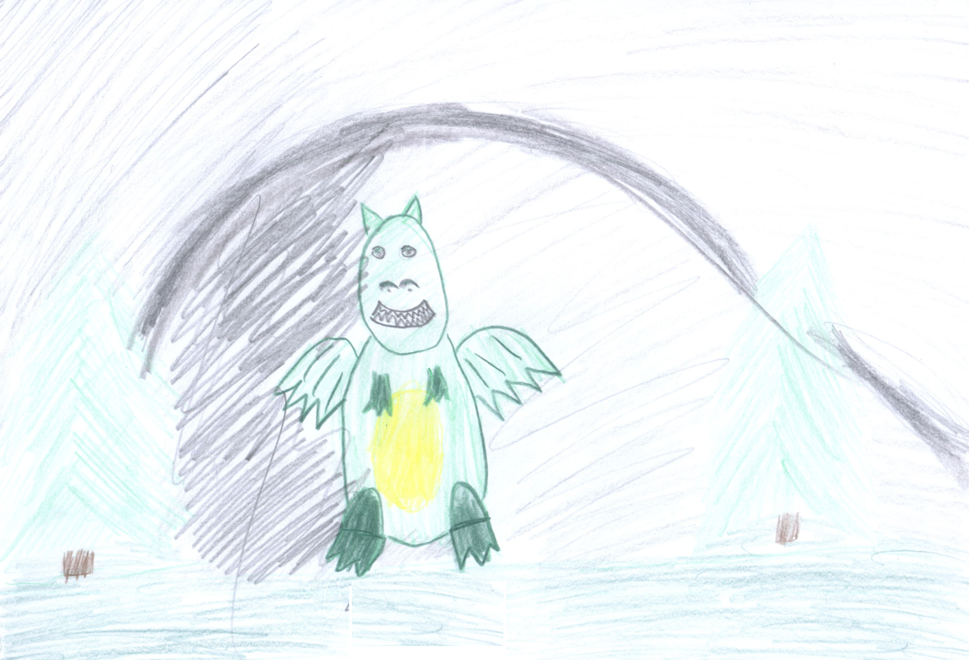
I’M VERY THIRSTY…

Slide 8
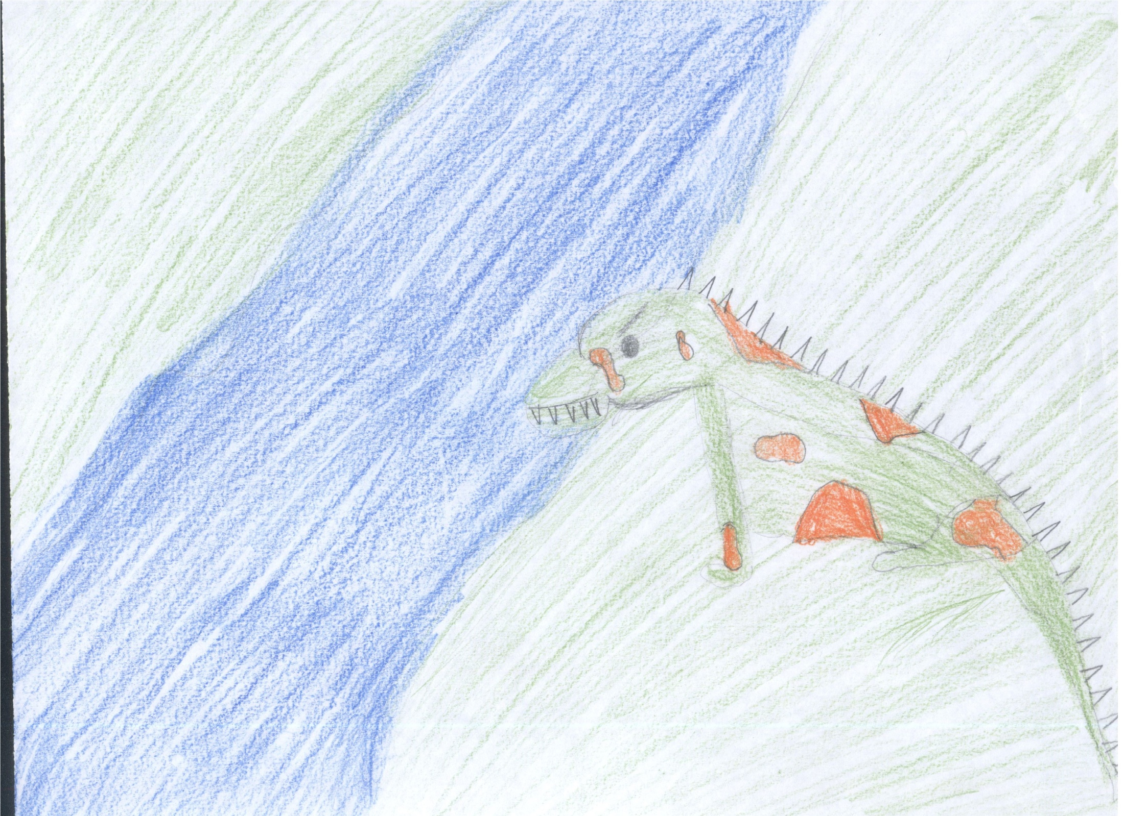
The Dragon drinks water from the Vistula River.
It is very thirsty.

