Slide 1
Ysengrin, the wolf and the fish
This is a medieval story
Renart, the fox, is very smart and likes making jokes…
Ysengrin, the wolf is stupid and believes everything people say.

Slide 2
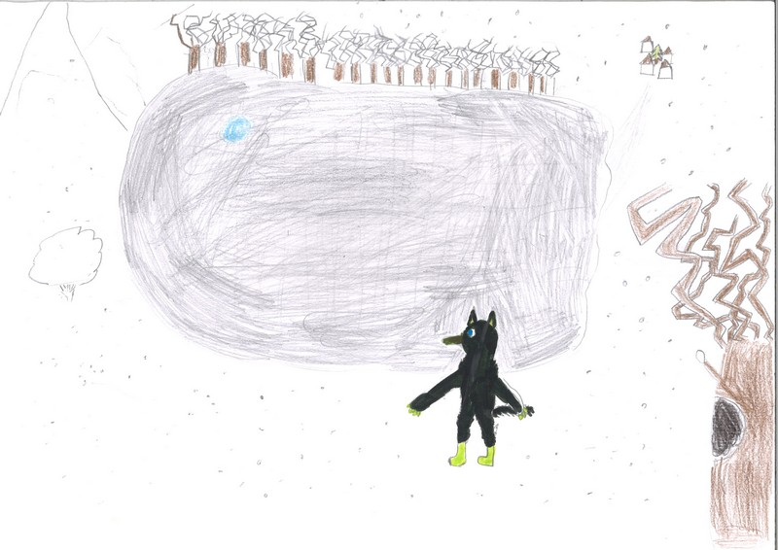
It’s winter .Ysengrin the wolf goes to lake.
It’s cold !

Slide 3
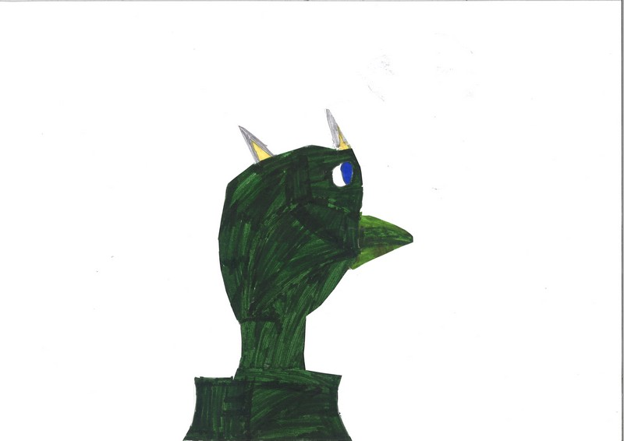
I want to catch fish for the winter…

Slide 4
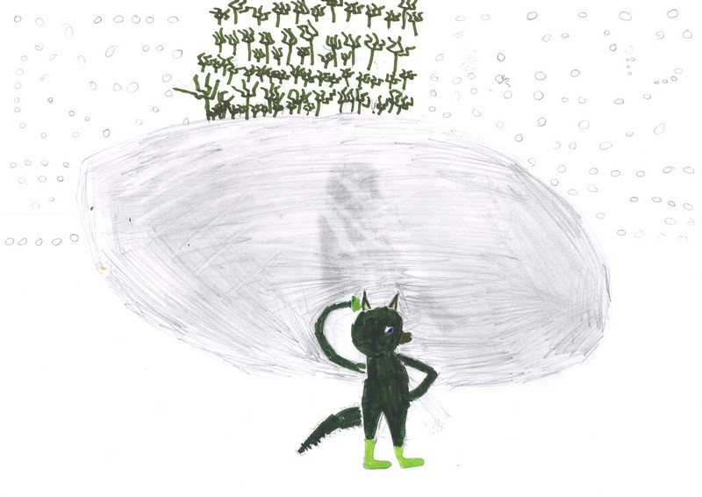
Oh! The lake is frozen!What can I do ?

Slide 5
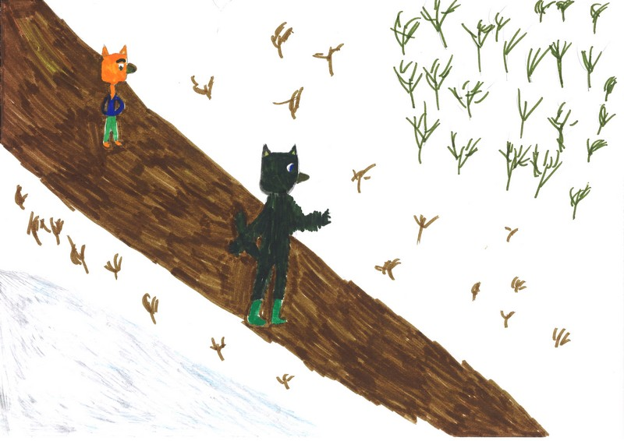
Renart is coming…
hello,Ysengrin.Do you have a problem ?
Yes, Renart ! I want fish for winter but the lake is frozen !!!

Slide 6
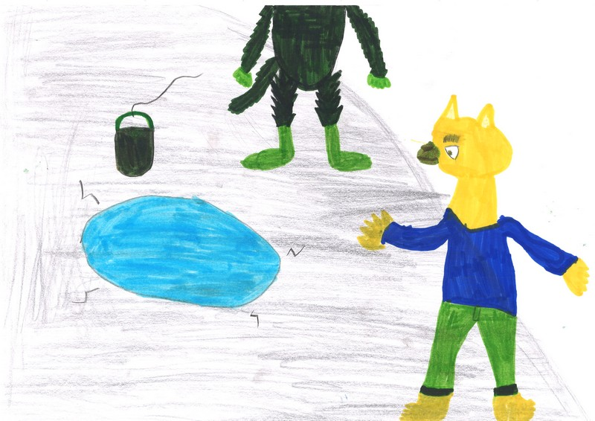
Look ! There is a hole in the ice ! Men made this hole to water their animals

Slide 7
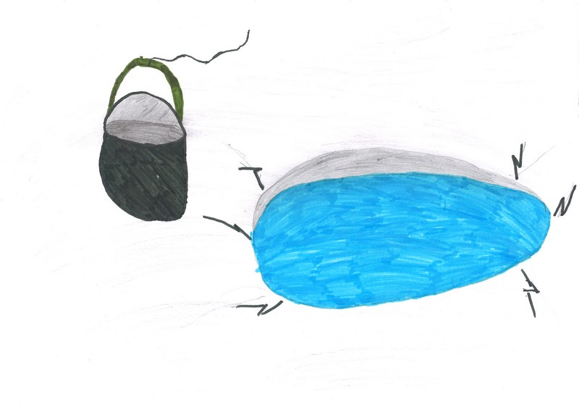
Look ! There is a bucket !!!!!

Slide 8
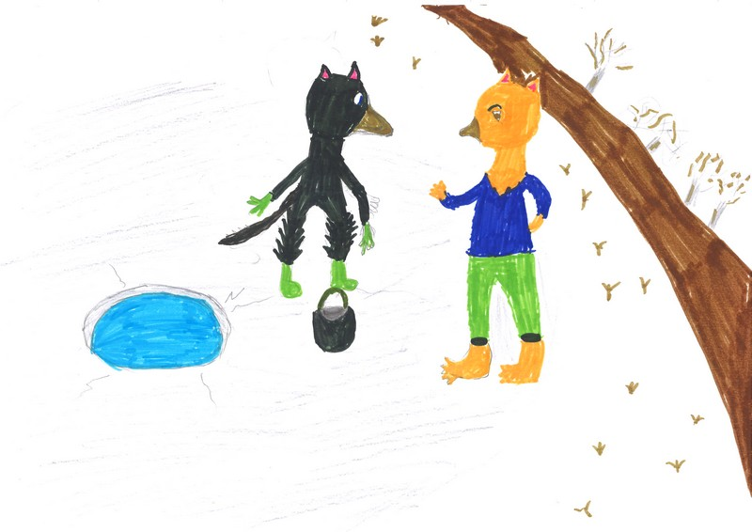
Renart ! Attach the bucket to my tail to catch good fish !

Slide 9
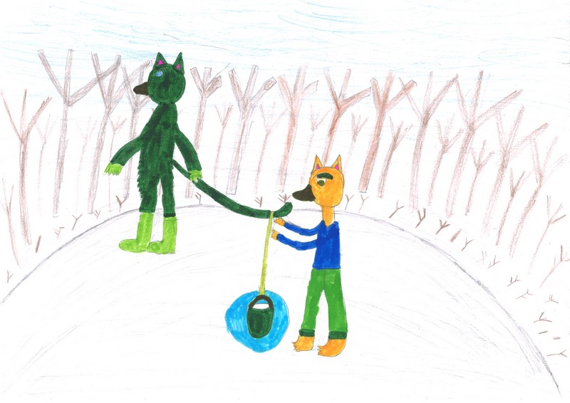
Ok!

Slide 10
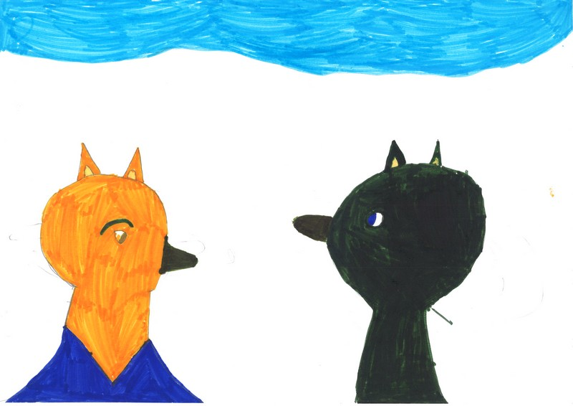
Do not move ! You’ll scare the fish !

Slide 11
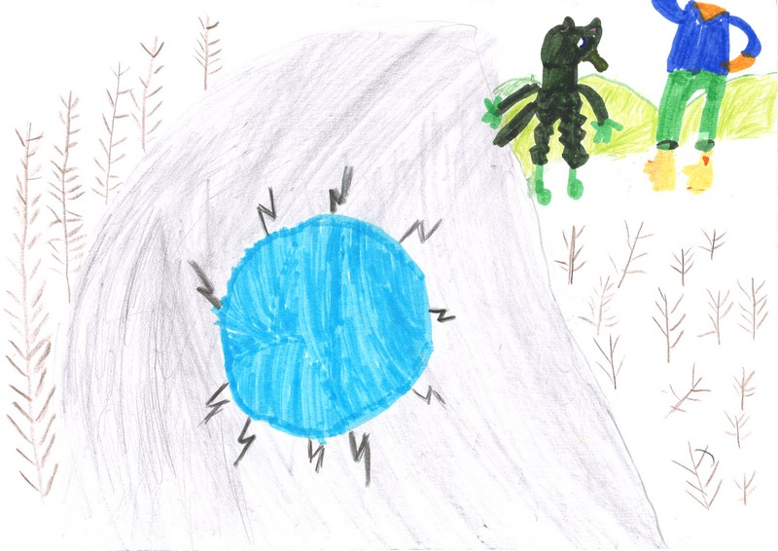
Hehehe !! My joke is very funny !!

Slide 12
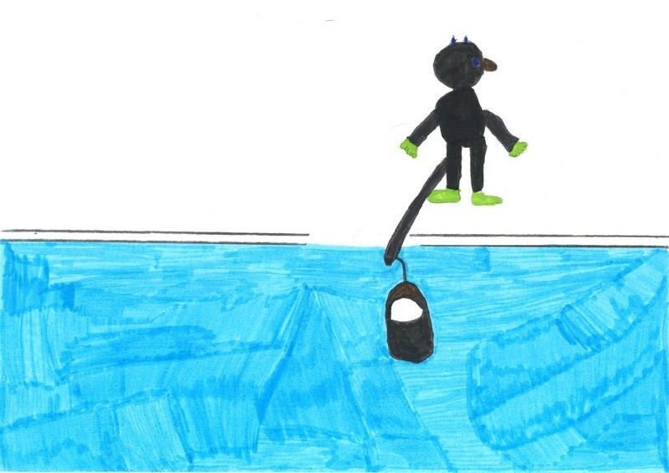
I hope I will have a lot of fish

Slide 13
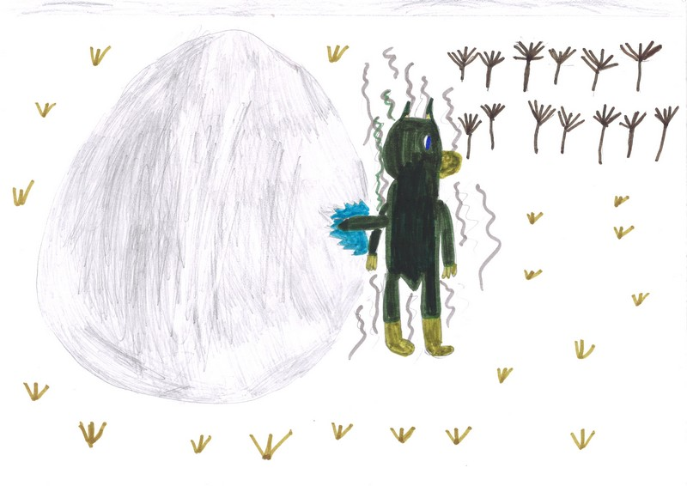
Brrrrr.It’s cold!!!!!!

Slide 14
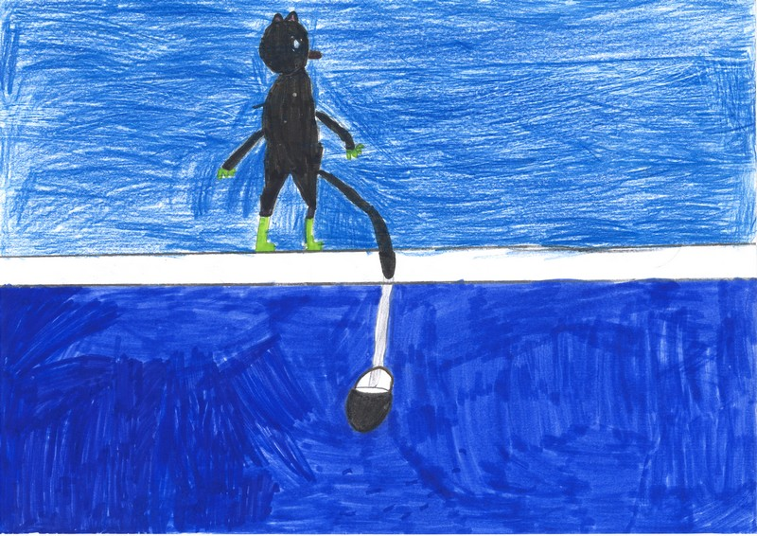
Oh!!!!!!! t’s heavy !!!! There are too many fish !
Help, Renart !!!! My bucket is too heavy

Slide 15
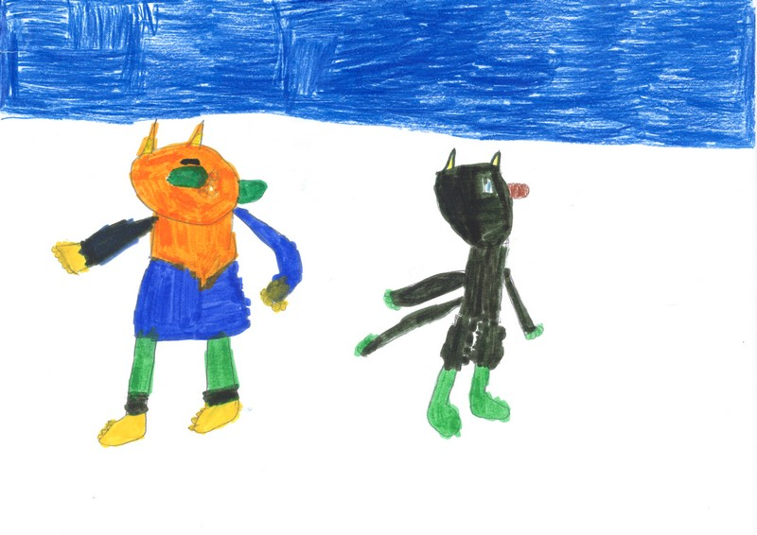
You are stupid, Ysengrin ! When you want too much ,you lose everything

Slide 16
The morning is coming…

Slide 17
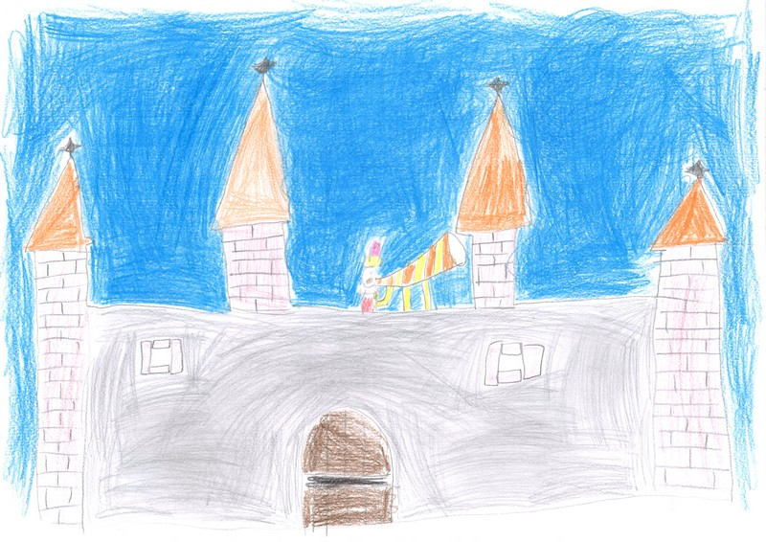
Lord Constant wakes up and prepares for hunting

Slide 18
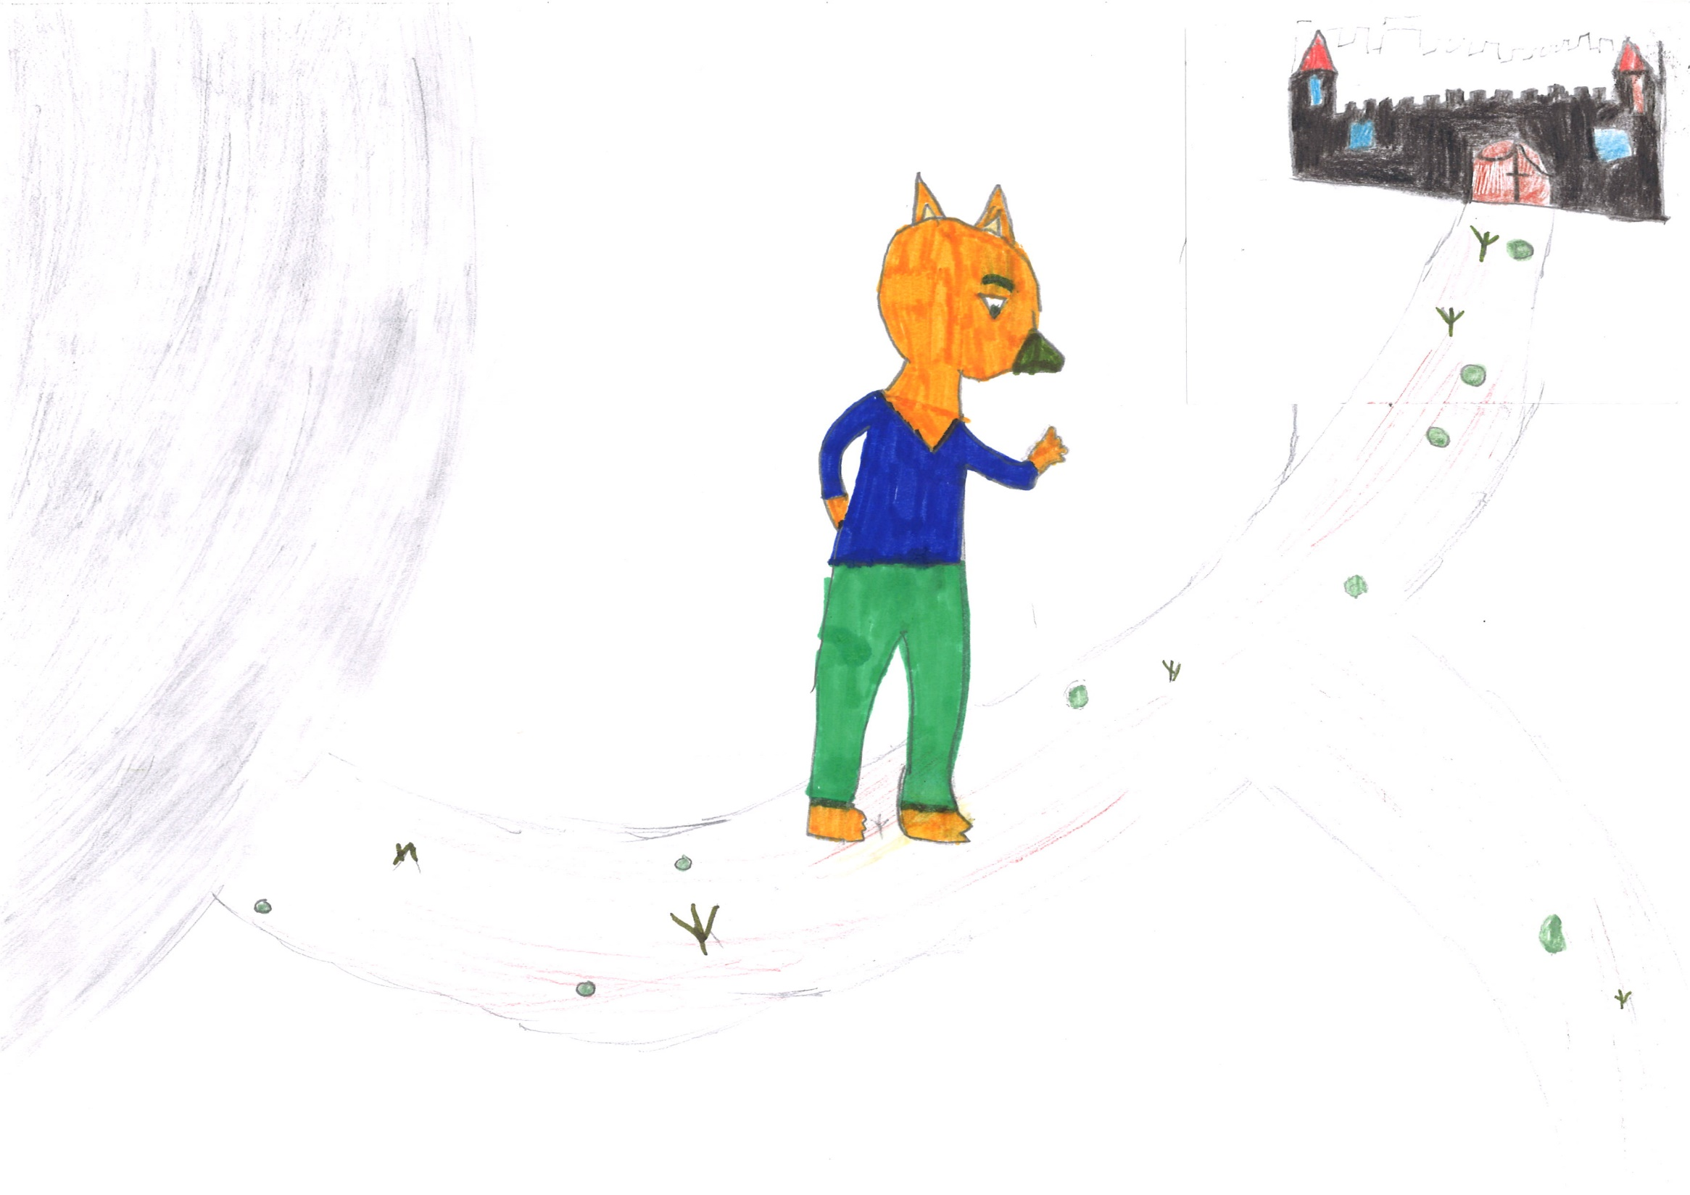
!
I go home, in my castle, because hunters and dogs arrive …

Slide 19
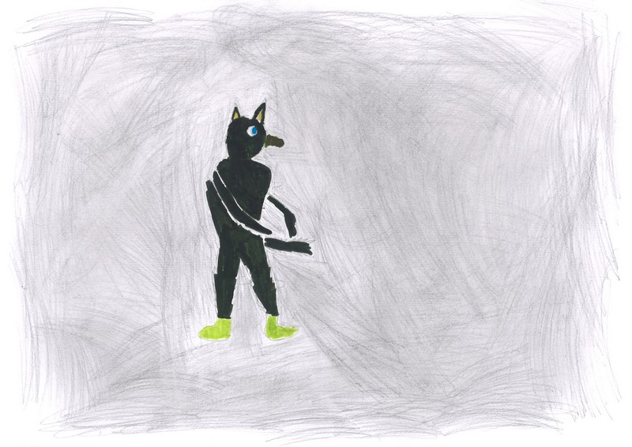
Ysengrin is alone on the ice ,trying to break free.

Slide 20
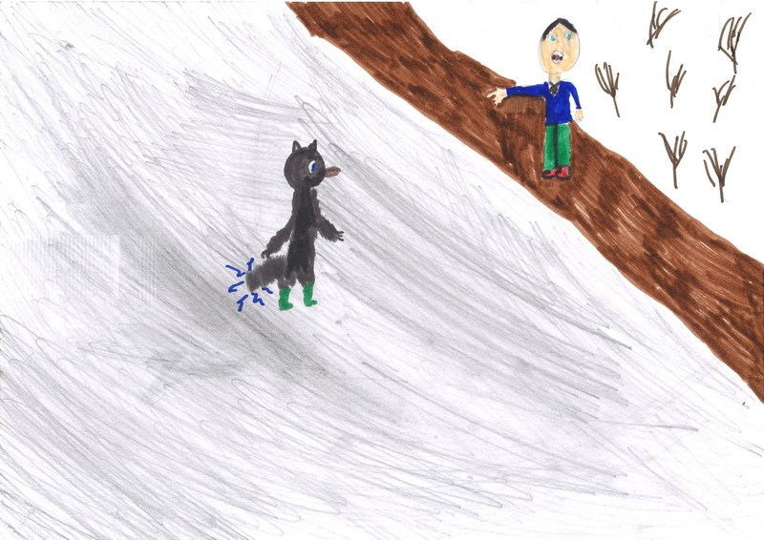
OH MY GOD !!!!!
THERE IS A WOLF ON THE ICE !!!
HELP !!!!
HELP !!!!!

Slide 21
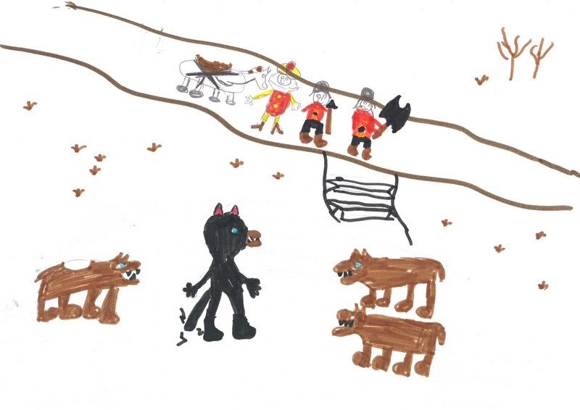
Hunters and Constant arrive with dogs.
Dogs attack Ysengrin

Slide 22
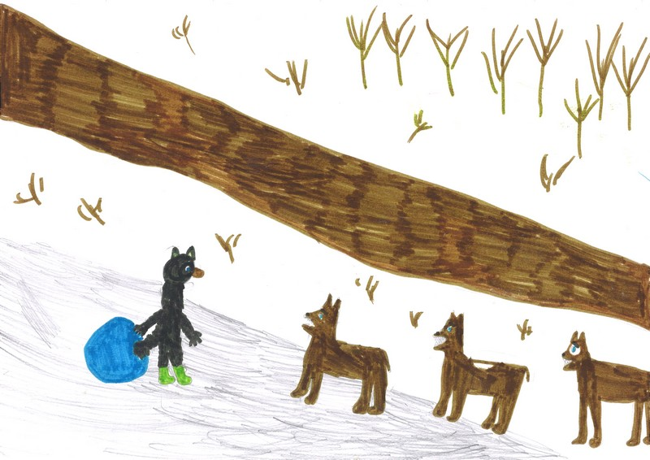
DOGS…..

Slide 23
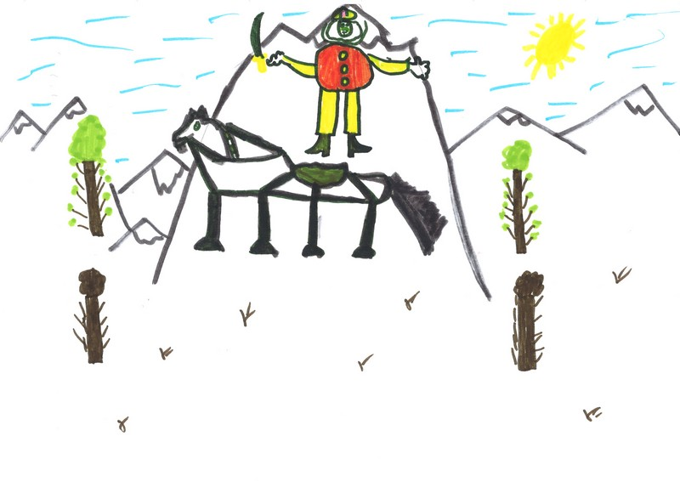
You will die,wolf!

Slide 24
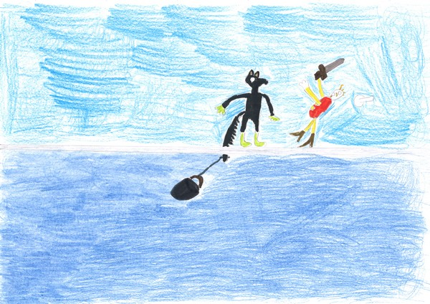
Constant falls on the ice…
It hurts!!!!!

Slide 25
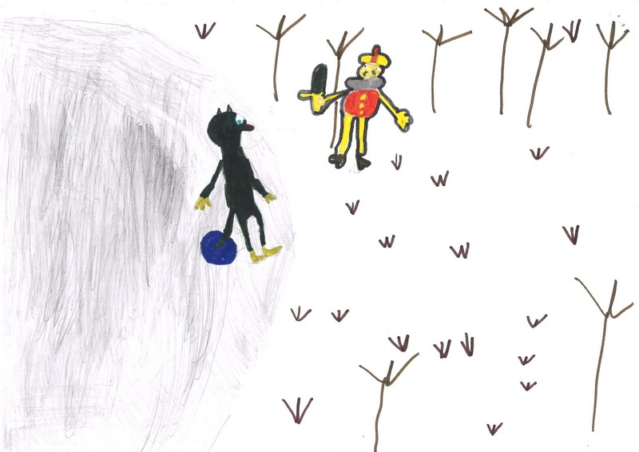
I’ll cut your head !!!

Slide 26
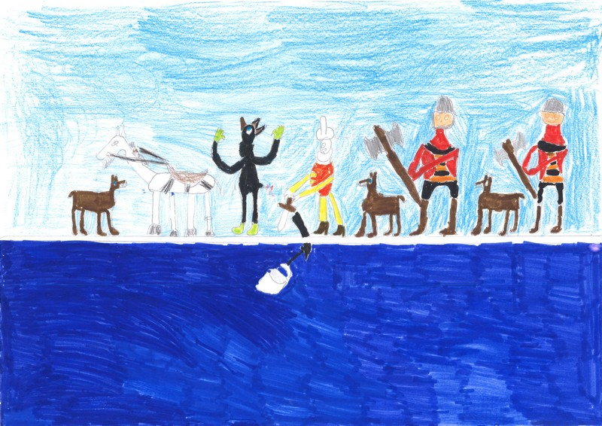
I missed the head ! I’ve cut the tail…

Slide 27
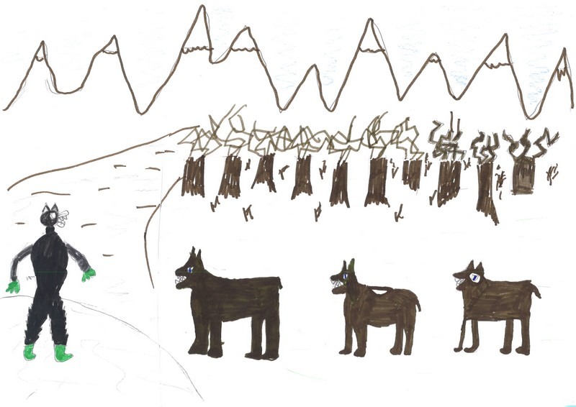
Ysengrin bites the dogs and runs into the forest…

Slide 28
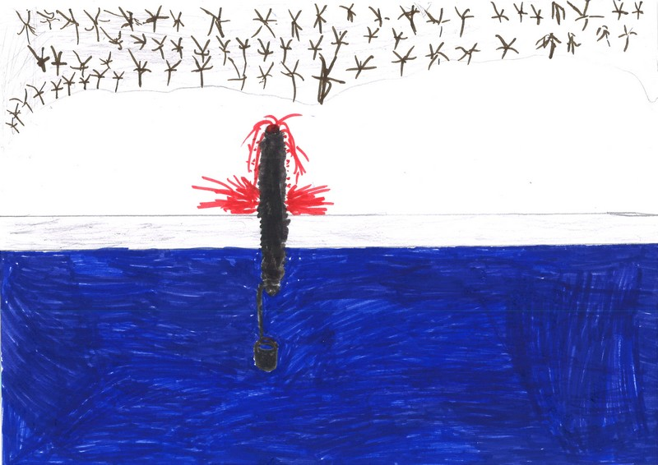
It remains the tail in the ice !!!

Slide 29
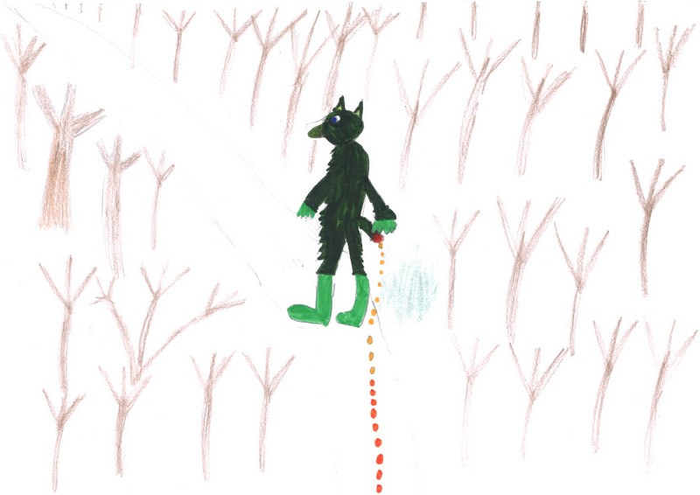
Renart is very naughty!
I will take my revenge!!!!

Slide 30
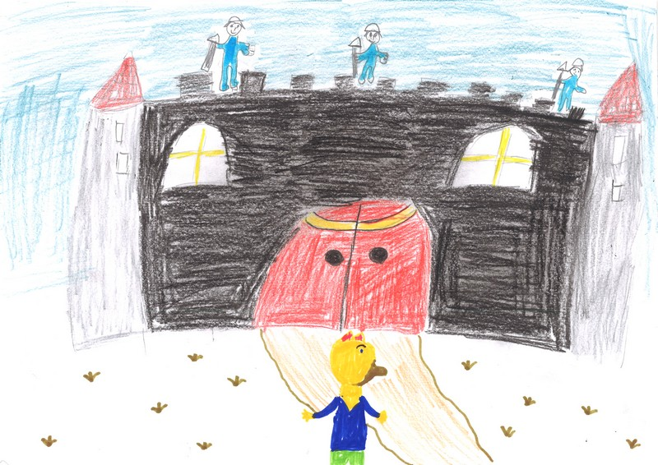
It’s good to be home and to have food…
Ysengrin is really stupid

