Slide 1
THE WAWEL DRAGON

Slide 2
Our legend takes place in Krakow. The main character of our legend is a shoemaker.

Slide 3
Once upon a time…

Slide 4
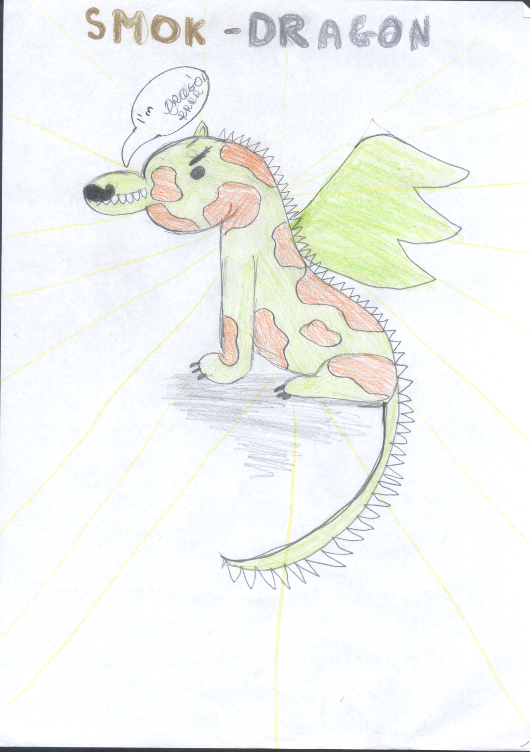
I’M THE BAD DRAGON!
I LIVE NEAR KRAKOW.

Slide 5
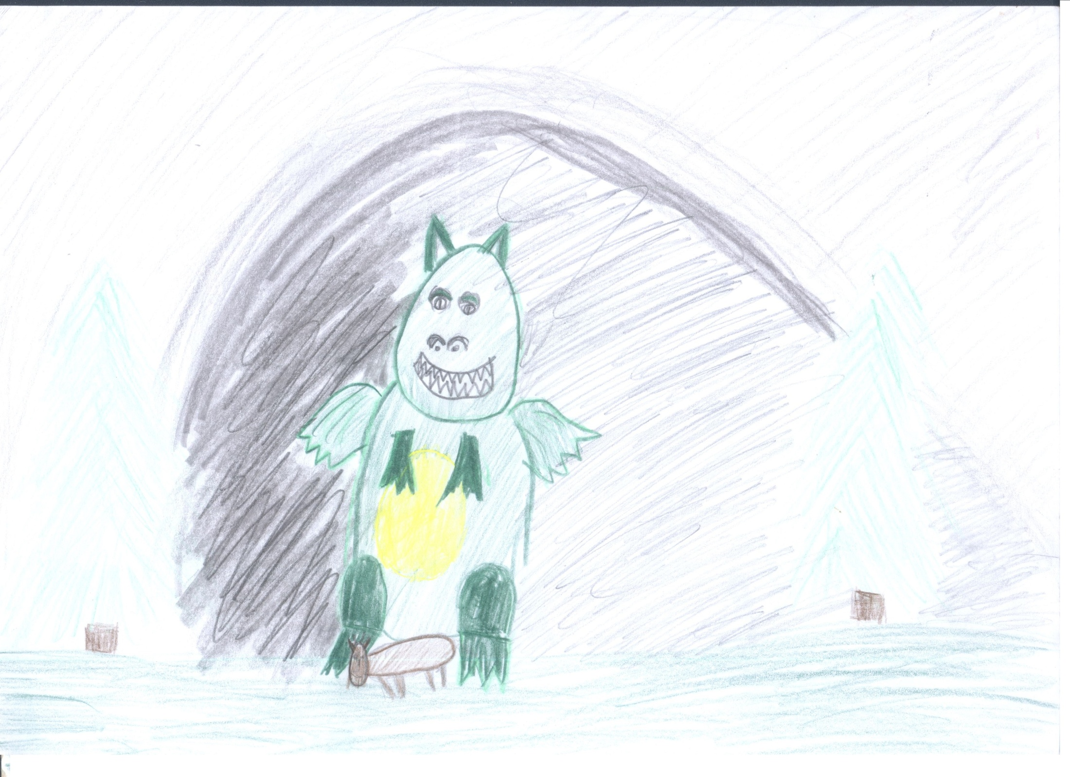
The Dragon eats cows.
I LIKE COWS AND SHEEP!

Slide 6
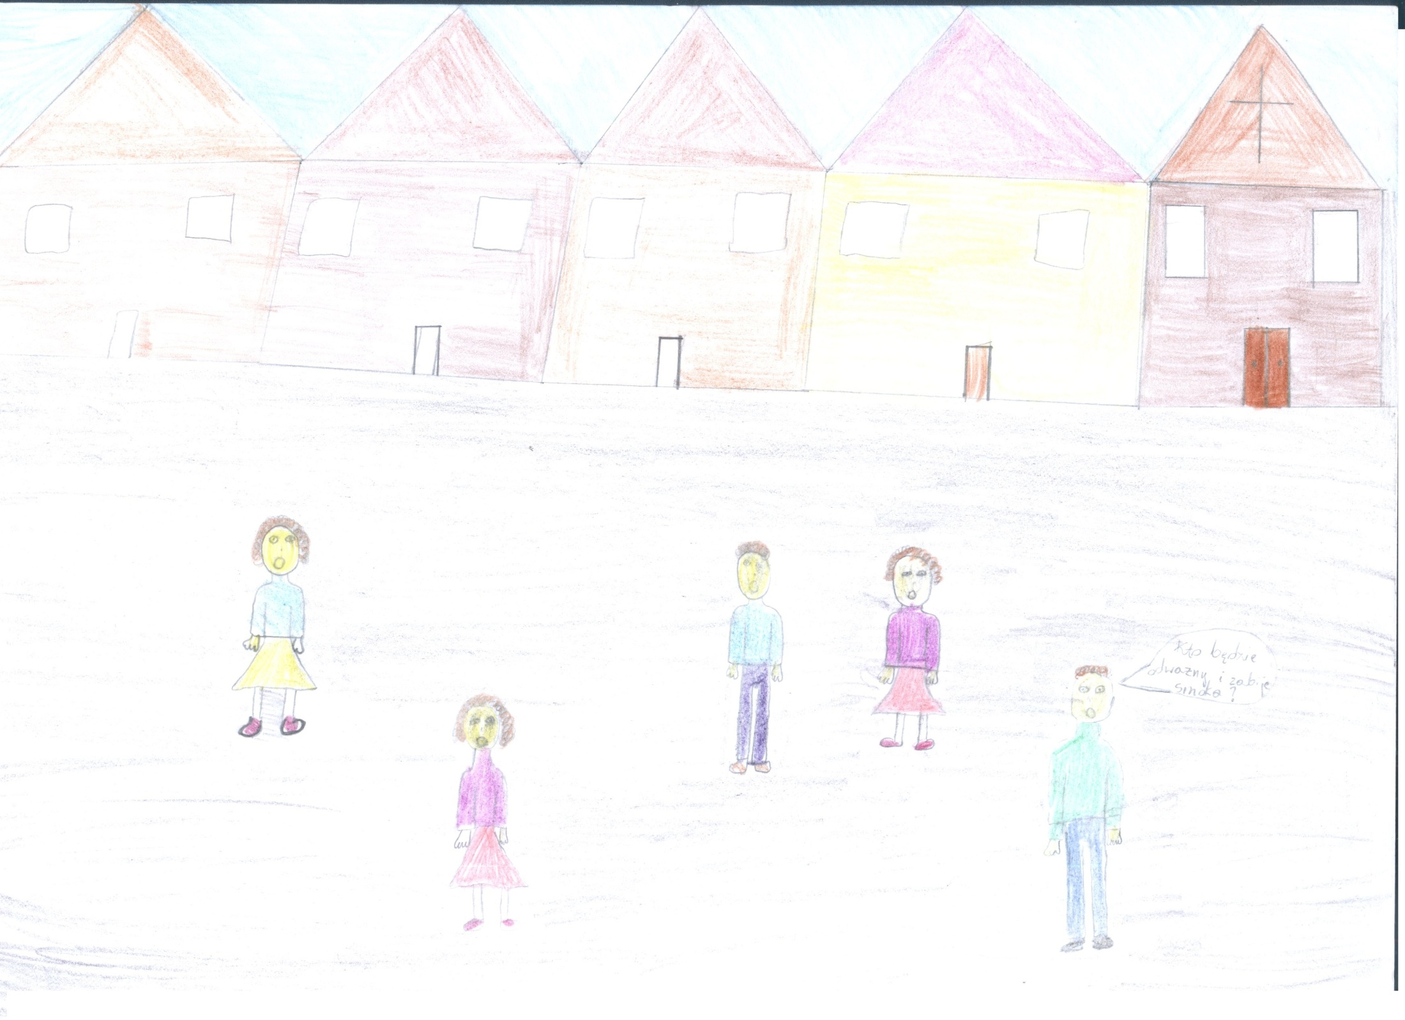
WE LIVE IN CRACOW.
WE ARE AFRAID OF THE DRAGON!
WE NEED SHEEP AND COWS!

Slide 7
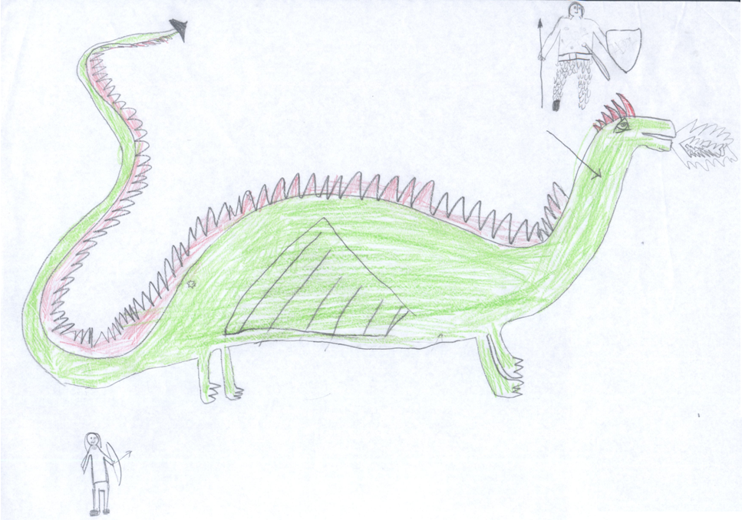
MANY KNIGHTS TRY TO KILL THE DRAGON.
BUT THEY CAN’T KILL IT.

Slide 8
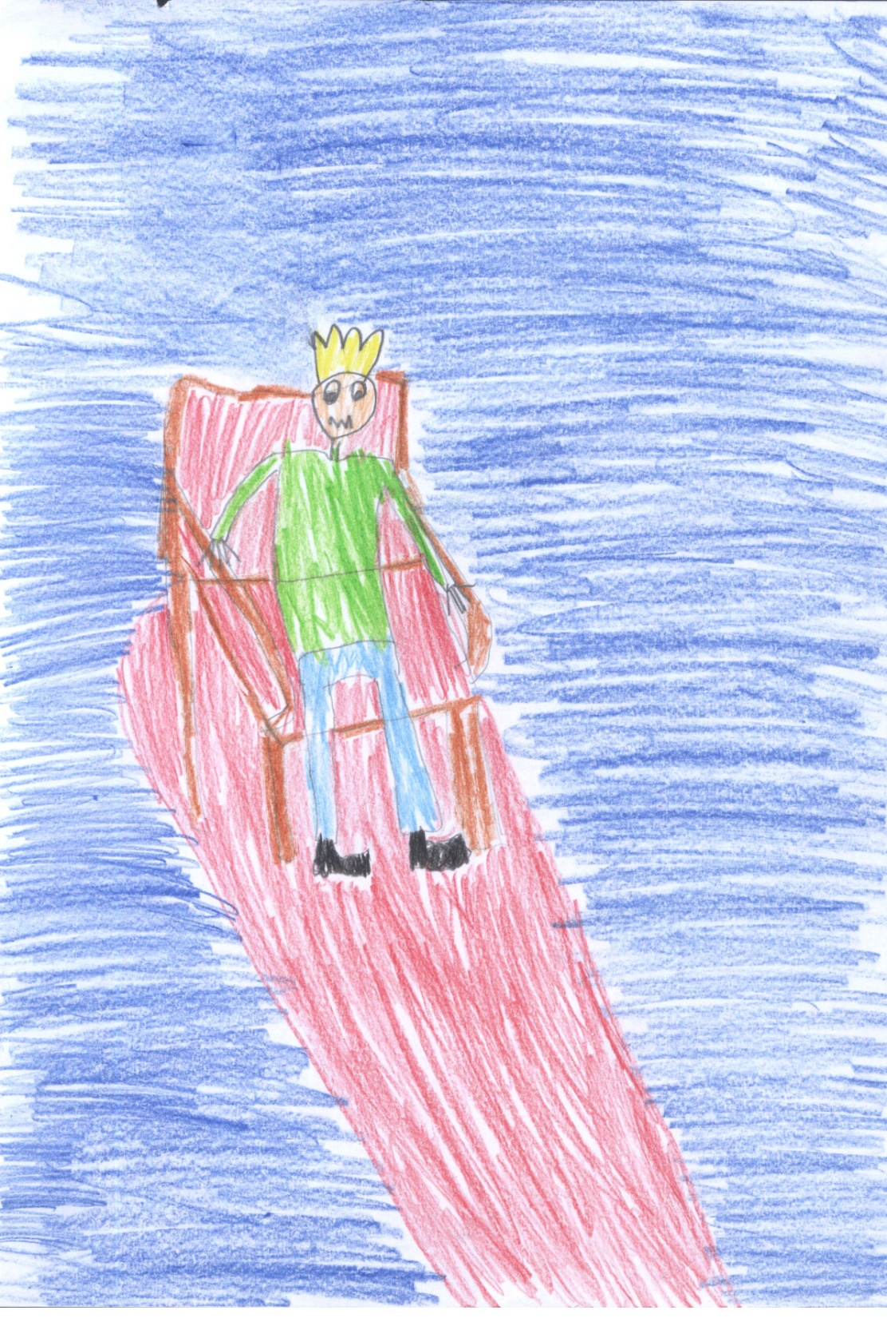
THE KING OF KRAKOW IS VERY SAD.
THE MAN WHO WILL KILL THE DRAGON CAN MARRY MY DAUGHTER.

Slide 9
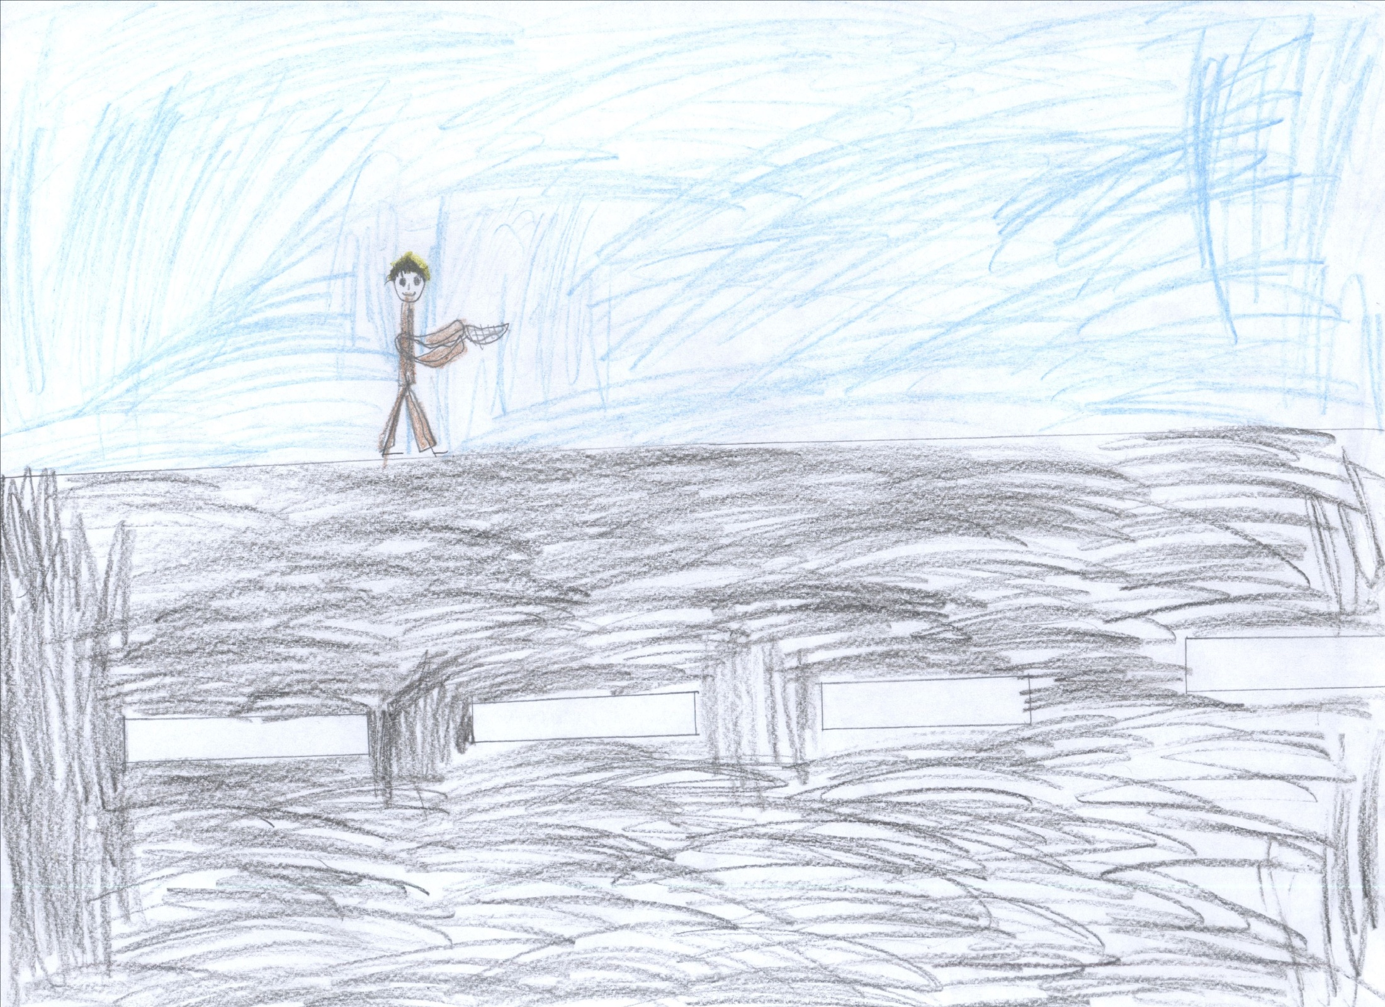
I’M THE SHOEMAKER.
I’M POOR.

Slide 10
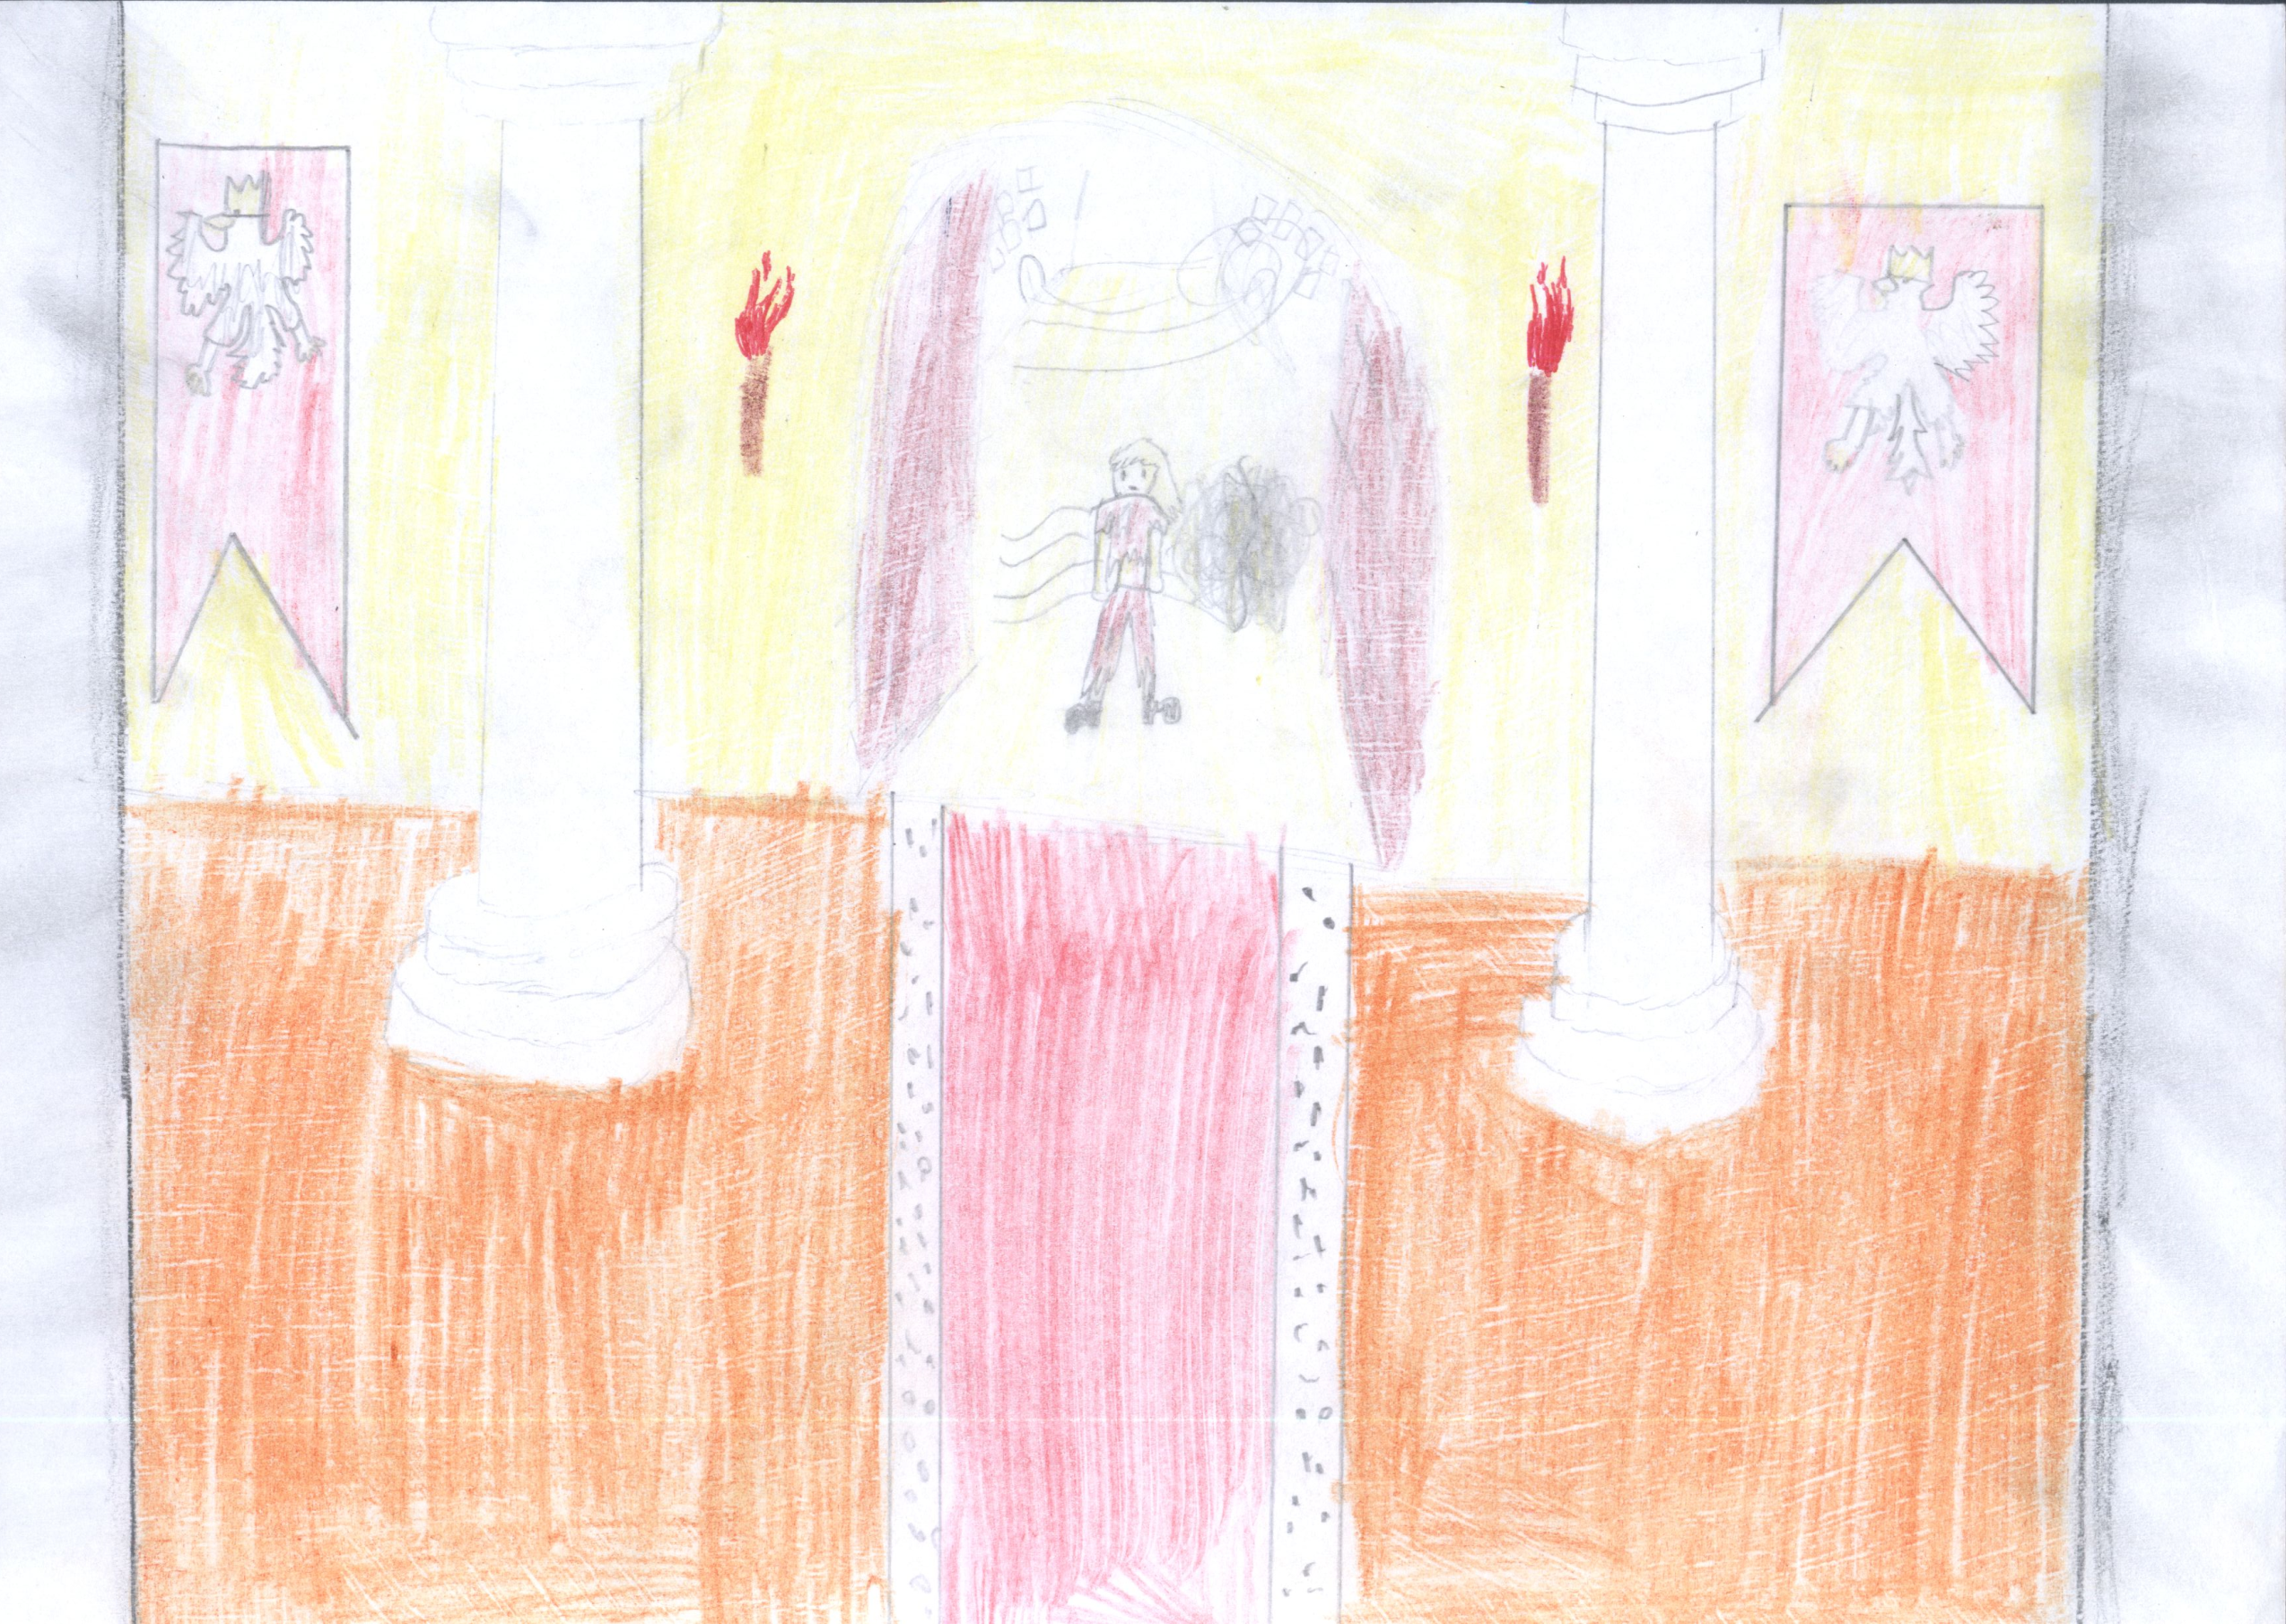
HELLO KING!
I’M THE POOR SHOEMAKER.

Slide 11
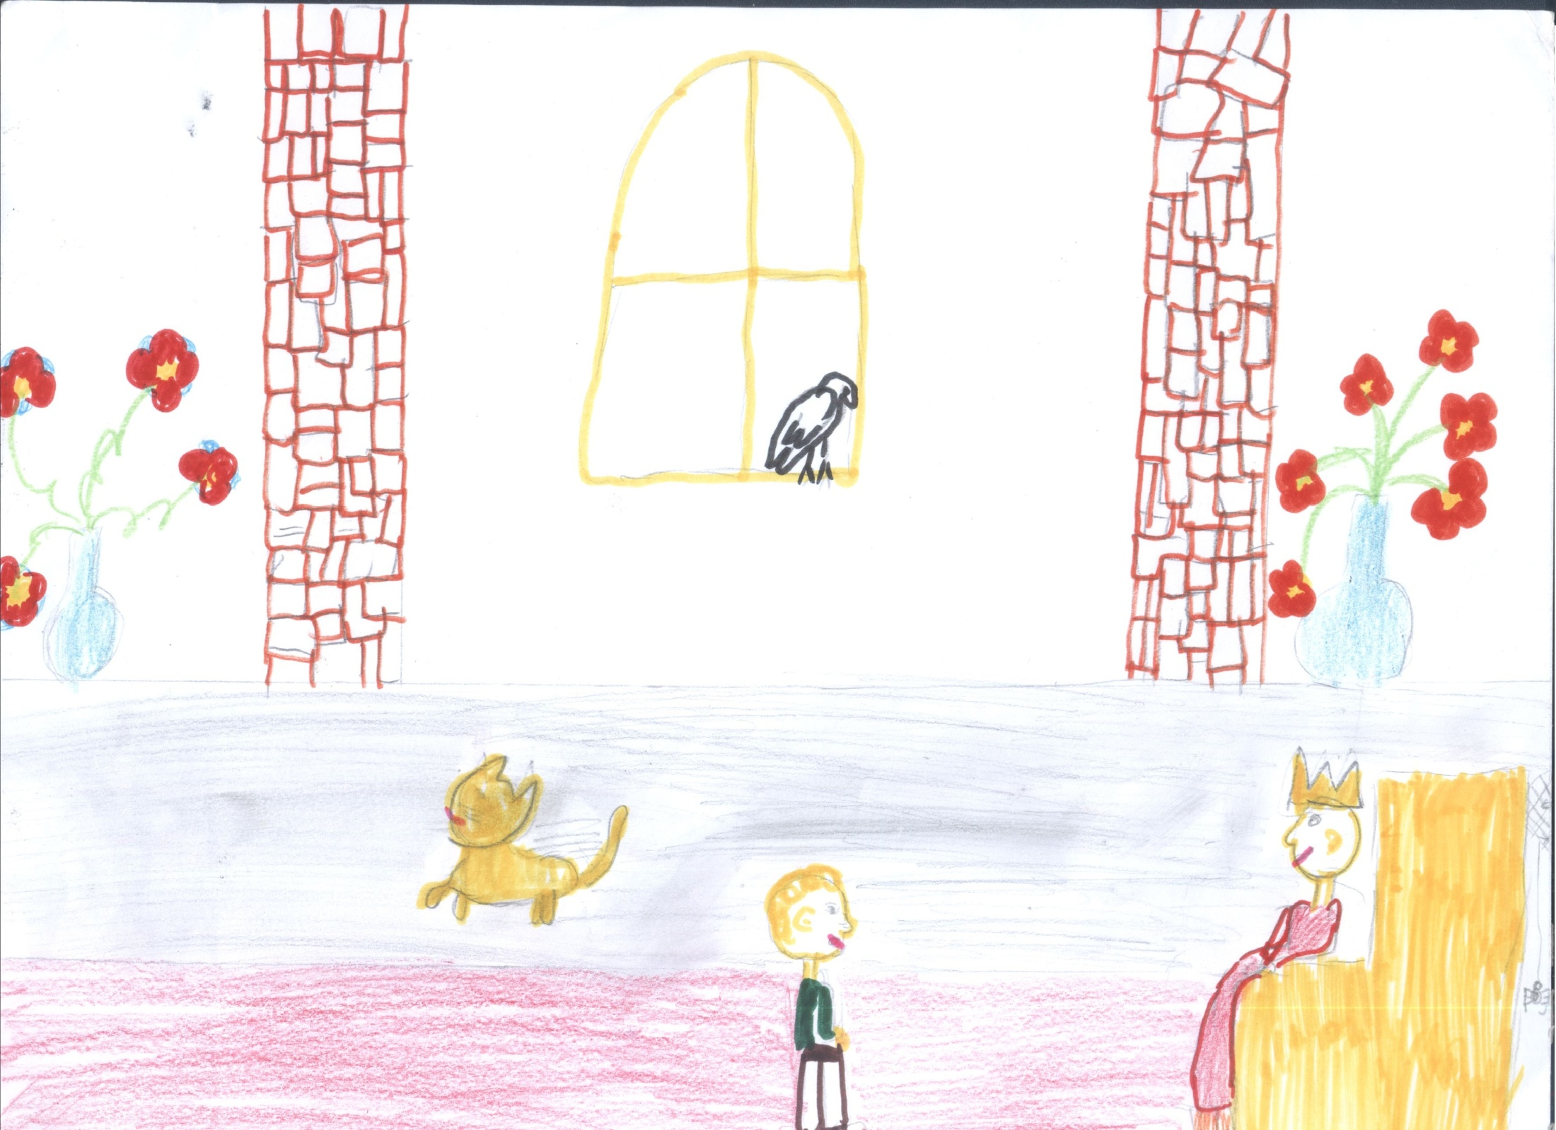
I CAN KILL THE DRAGON!
I WANT TO TRY…

