Slide 1
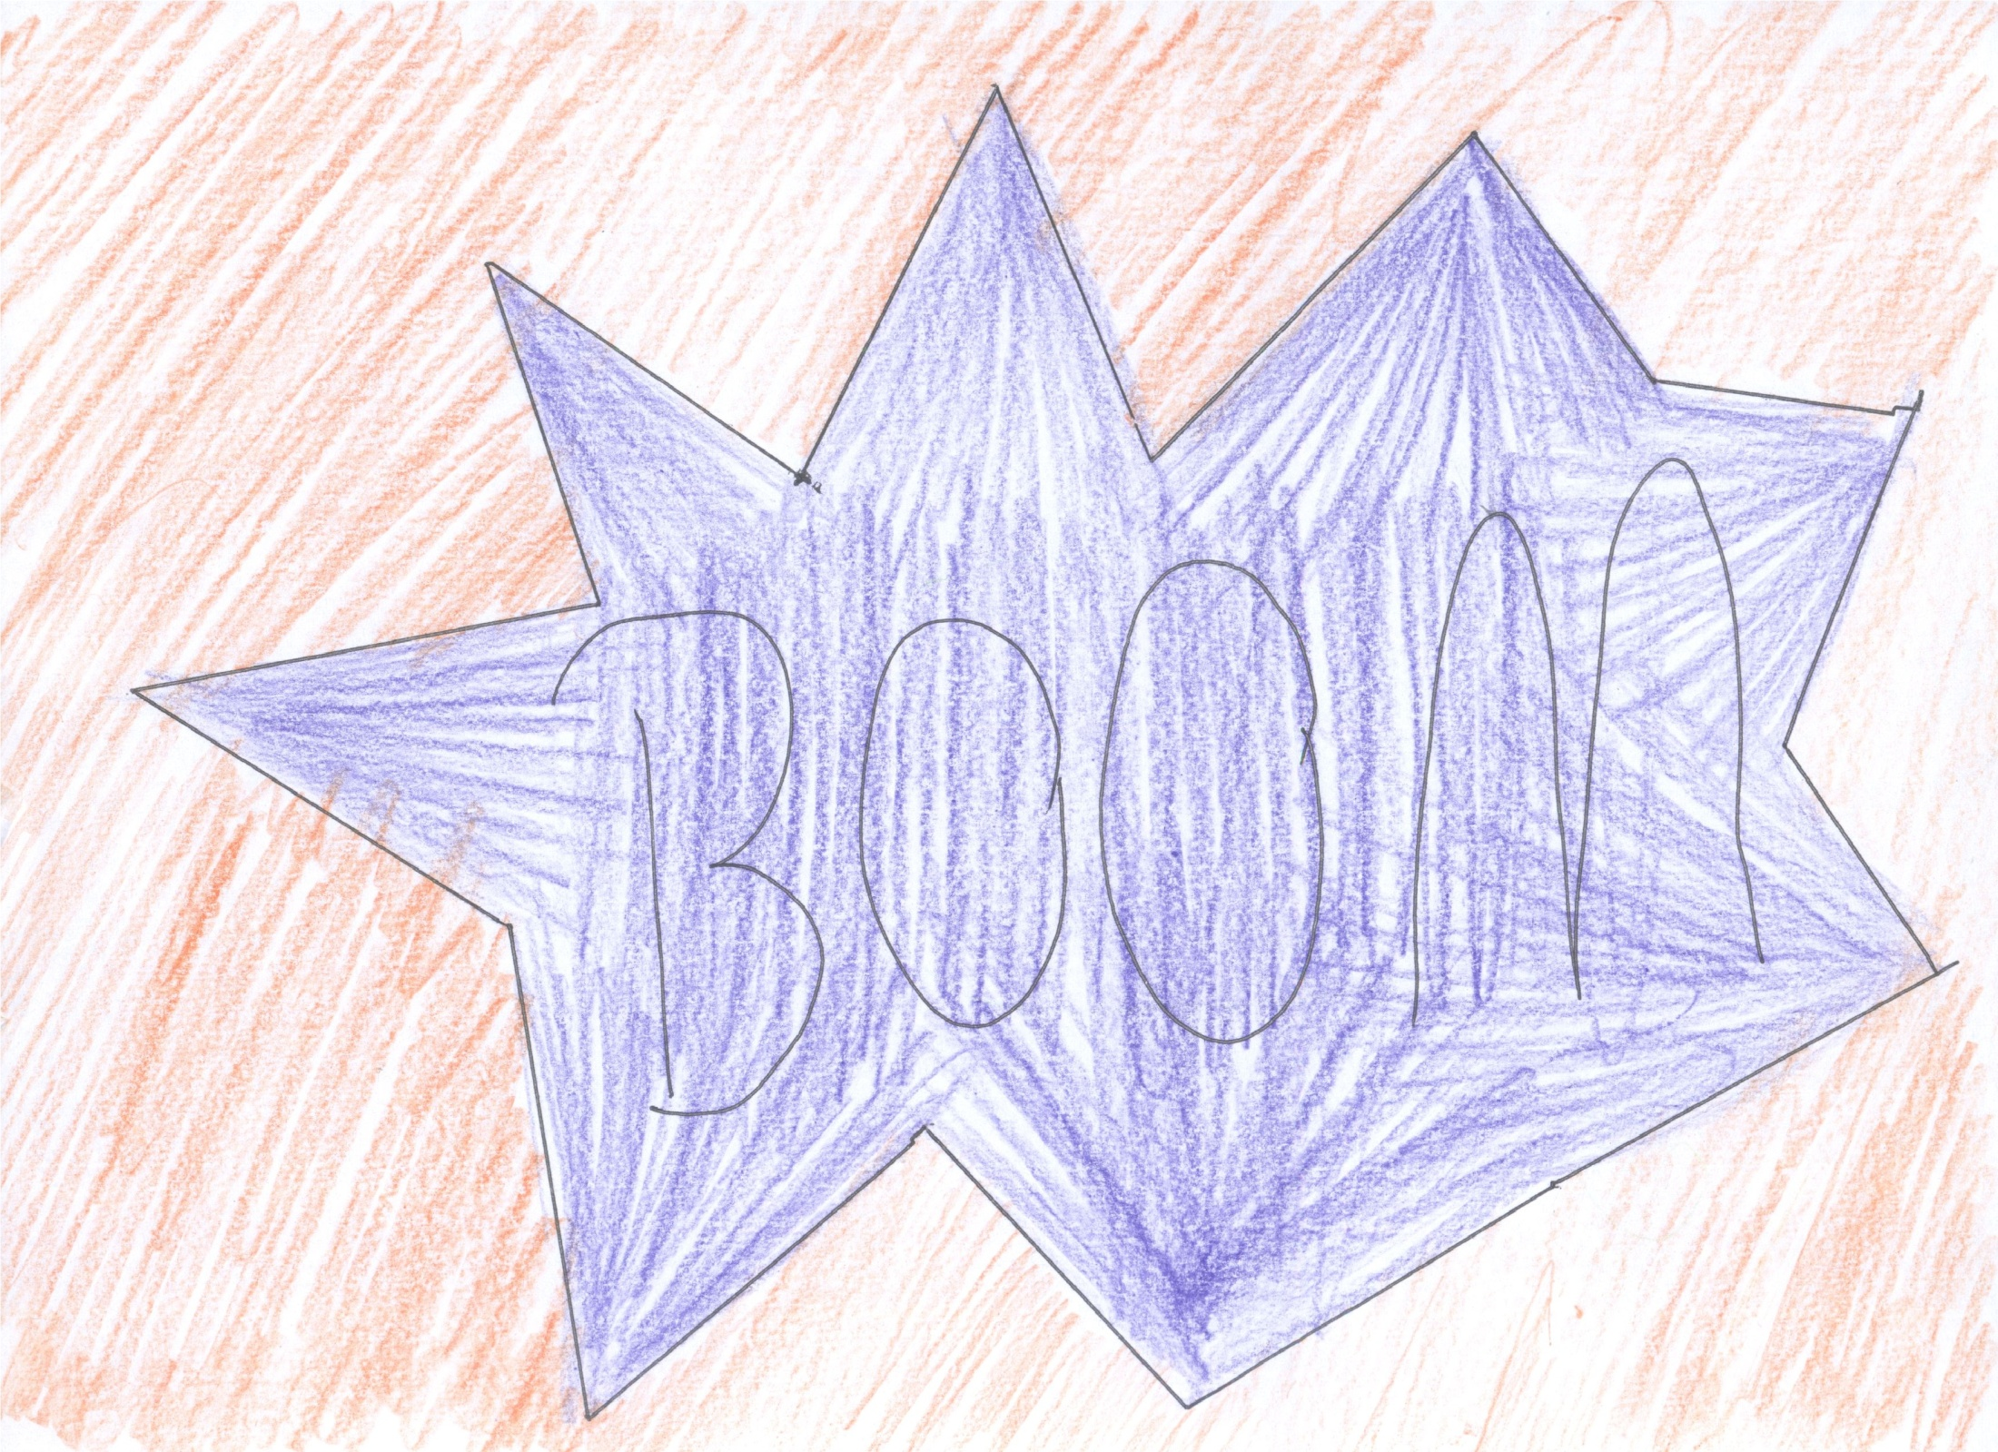

Slide 2
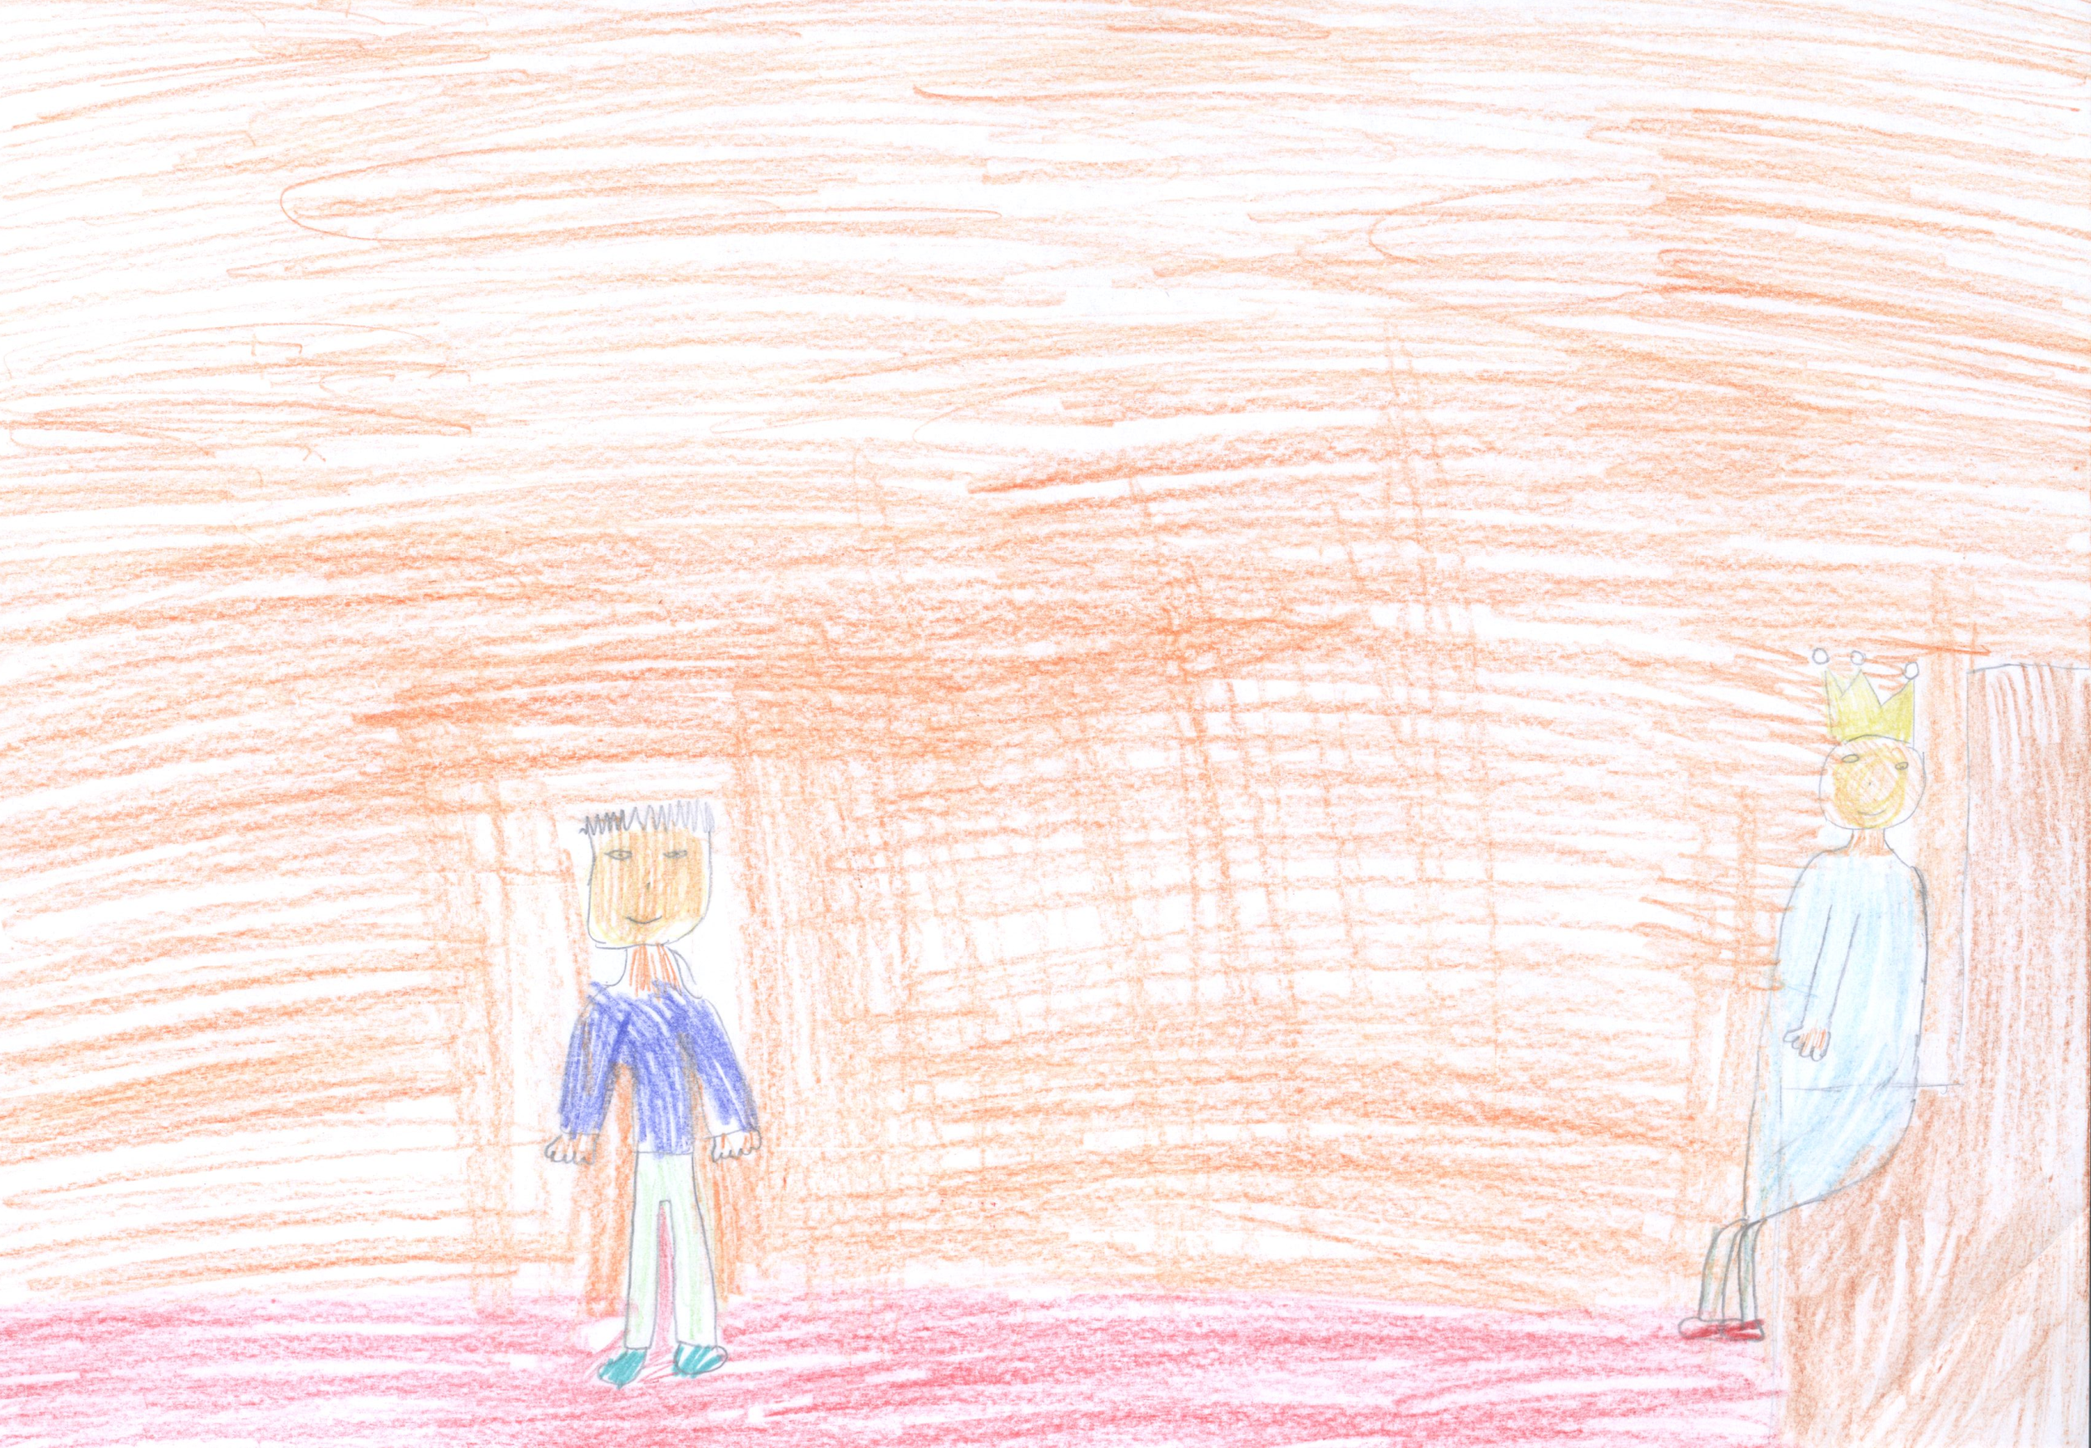
IT’S A HAPPY DAY!
YOU CAN MARRY MY DAUGHTER.
KING! KING!
I KILL THE DRAGON!

Slide 3
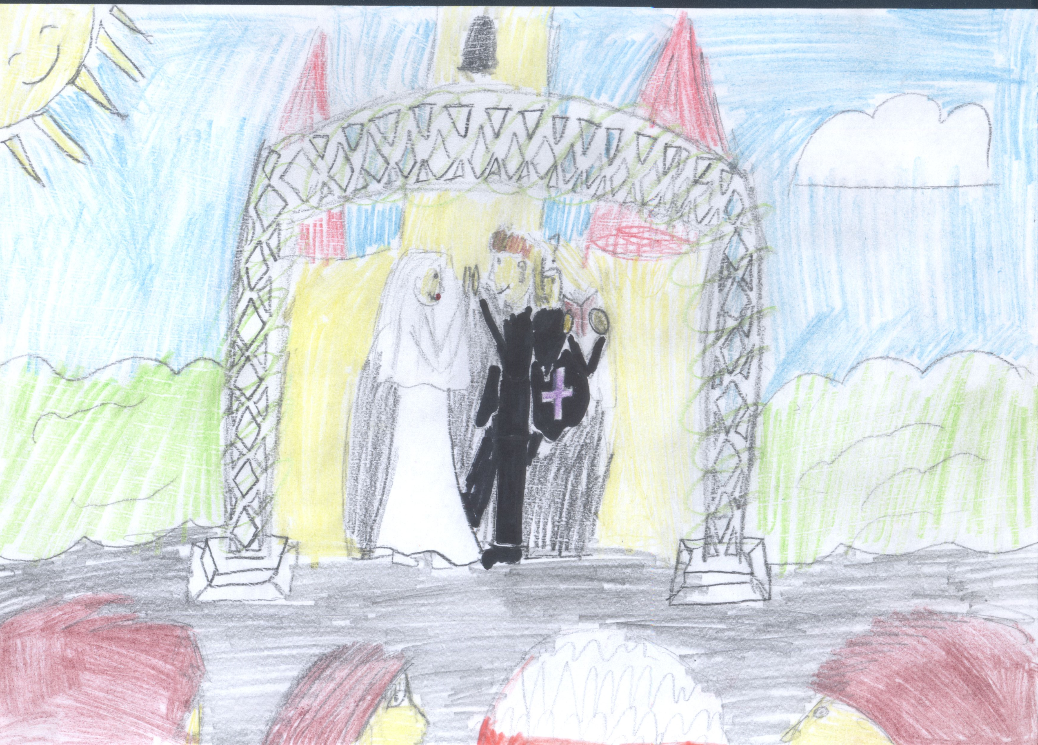
I LOVE YOU!

Slide 4
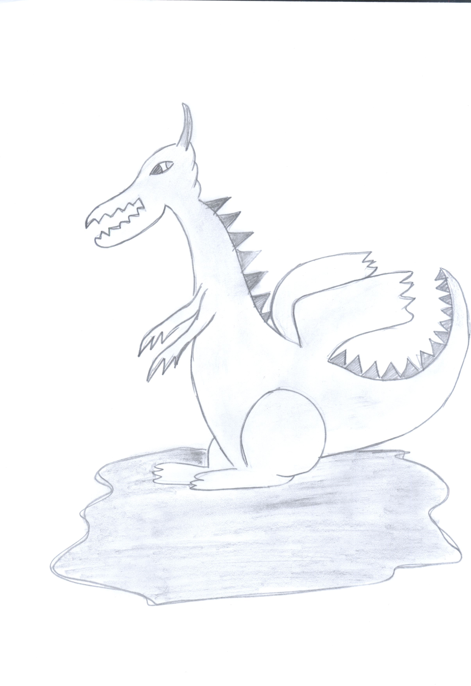
There is a statue of the Dragon in Krakow. It commemorates the story of the Dragon.
THE STATUE OF THE DRAGON IN KRAKOW.

