Slide 1
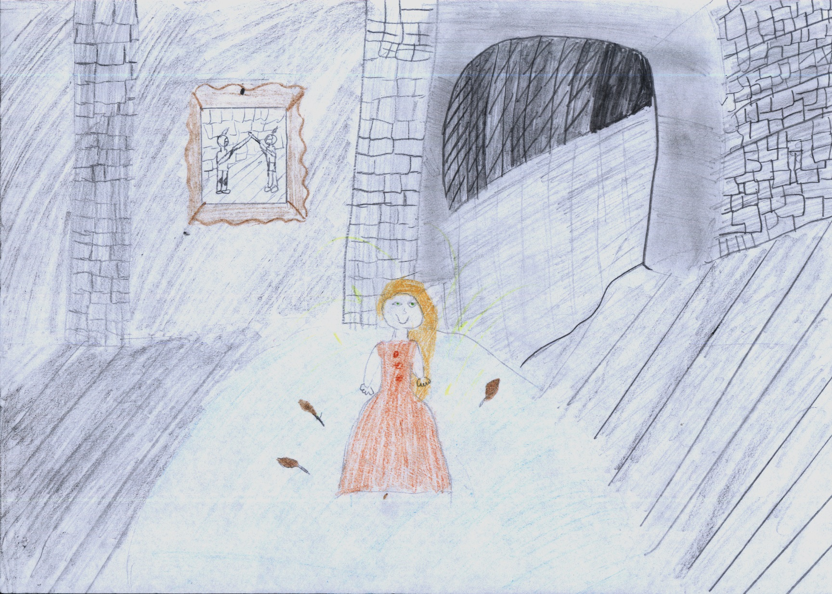
I’m not the golden duck. I’m a princess.
I can give you a lot of money but you have to spend 100 ducats only on you during one day.

Slide 2
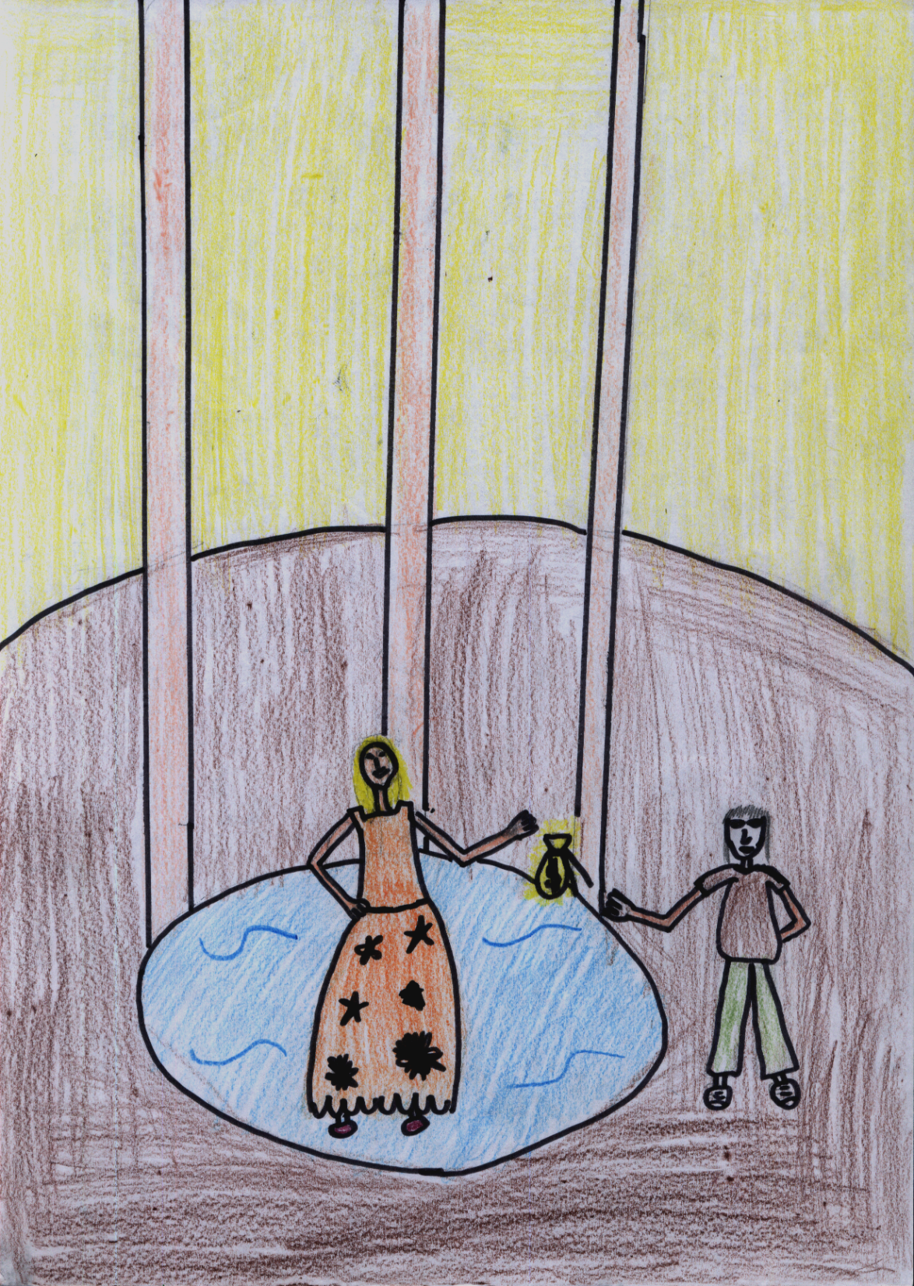
Shoemaker, this is your money.
Thank you very much Princess.

Slide 3
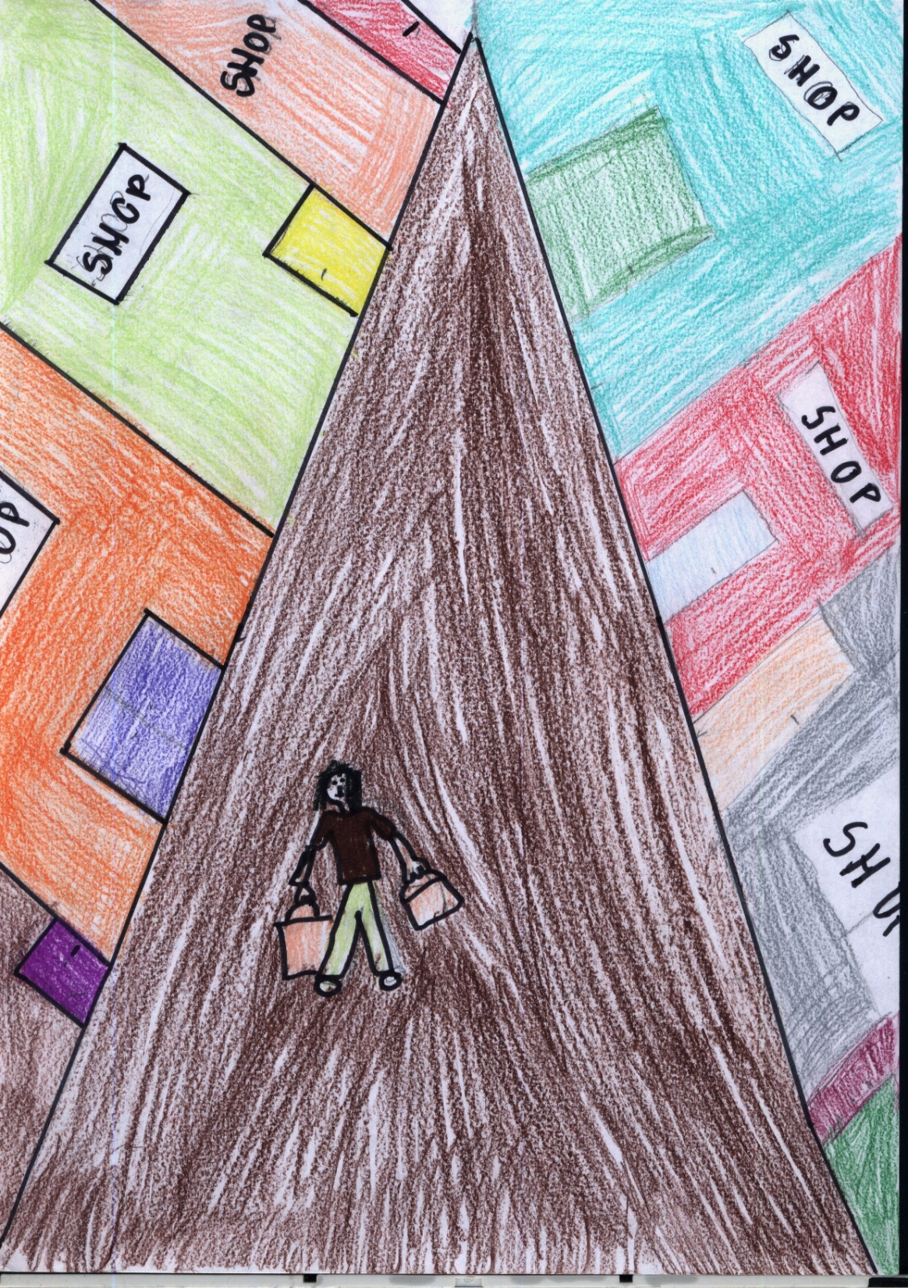
I can buy everything I want!

Slide 4
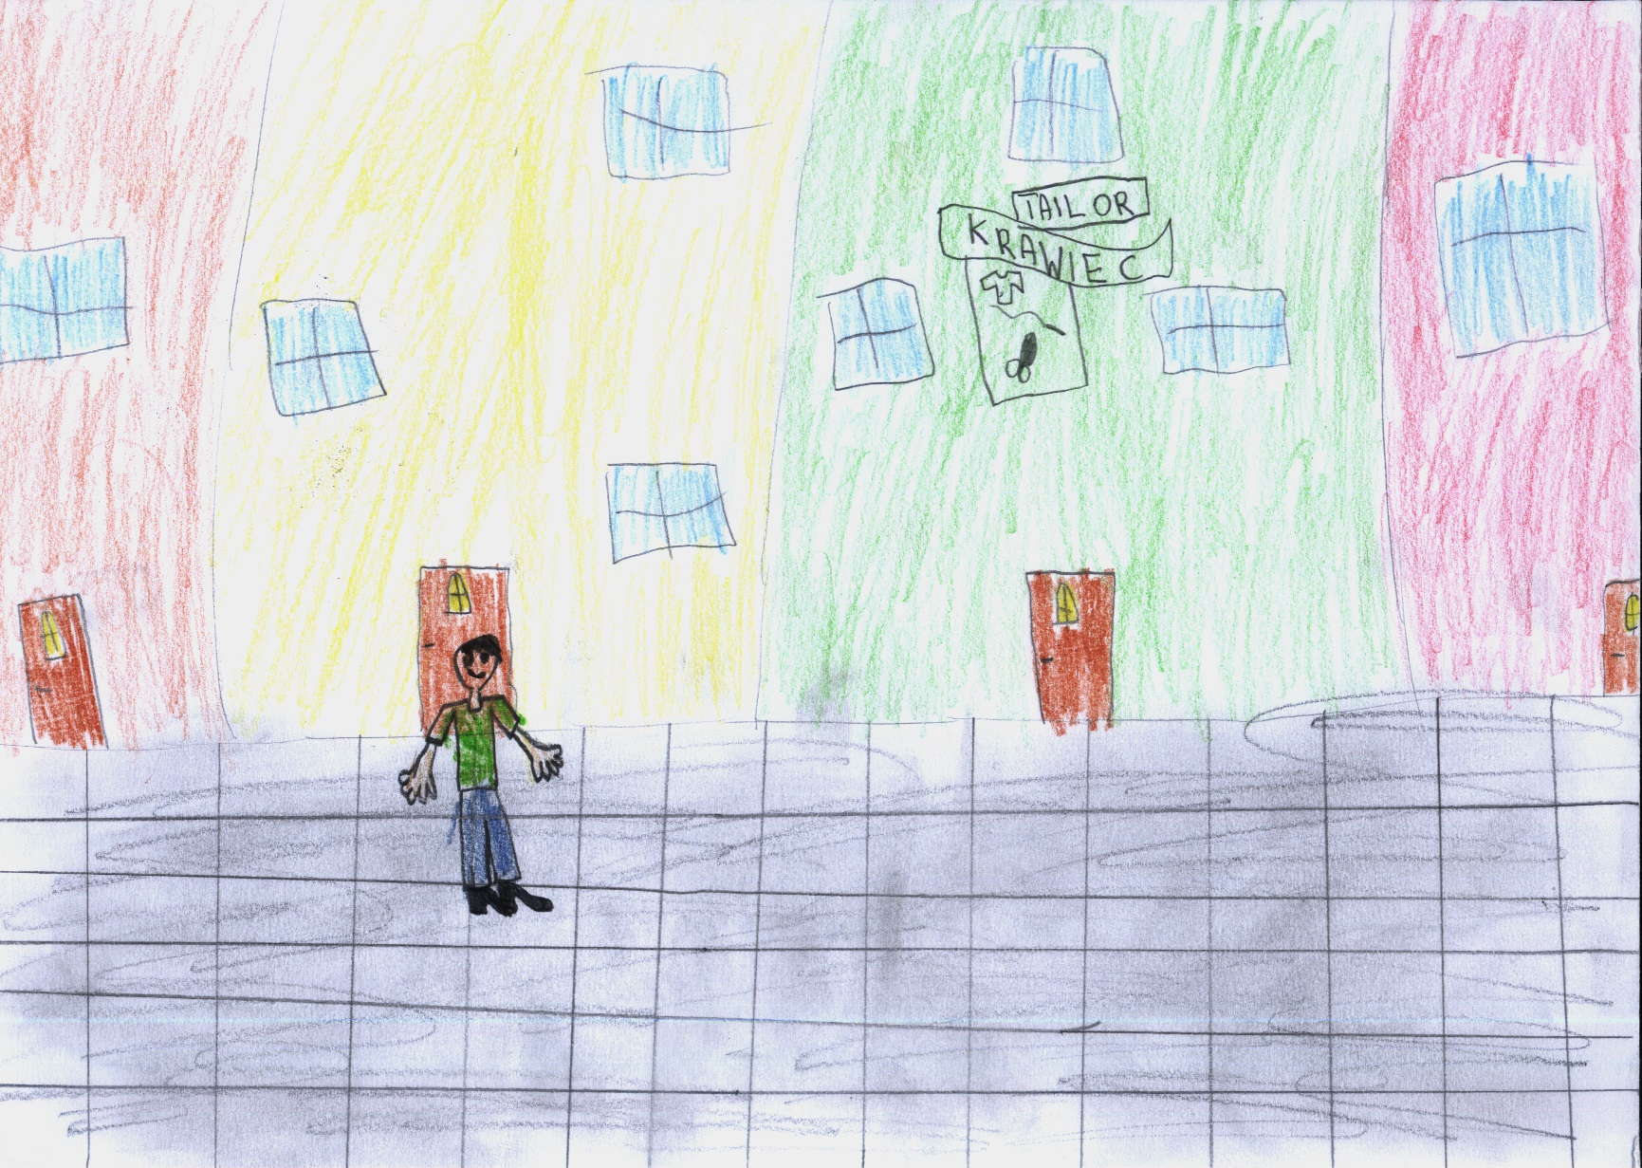
I can buy new clothes.

Slide 5
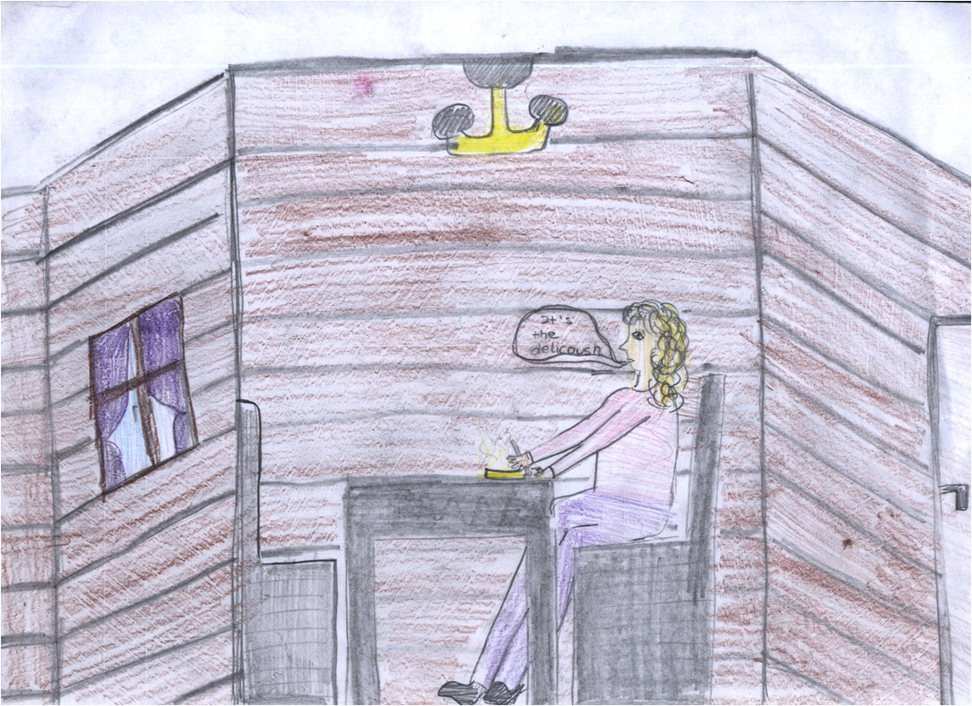
It’s delicious.

Slide 6
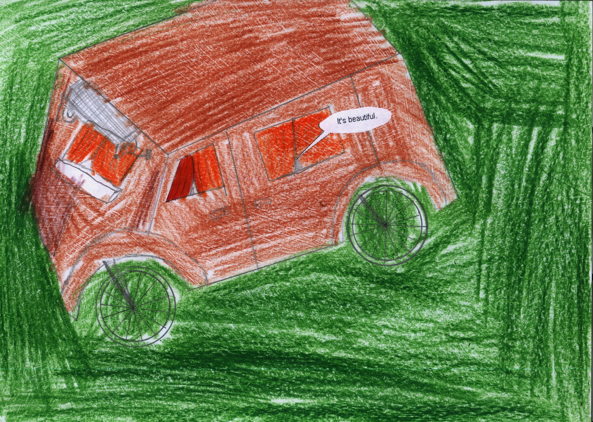

Slide 7
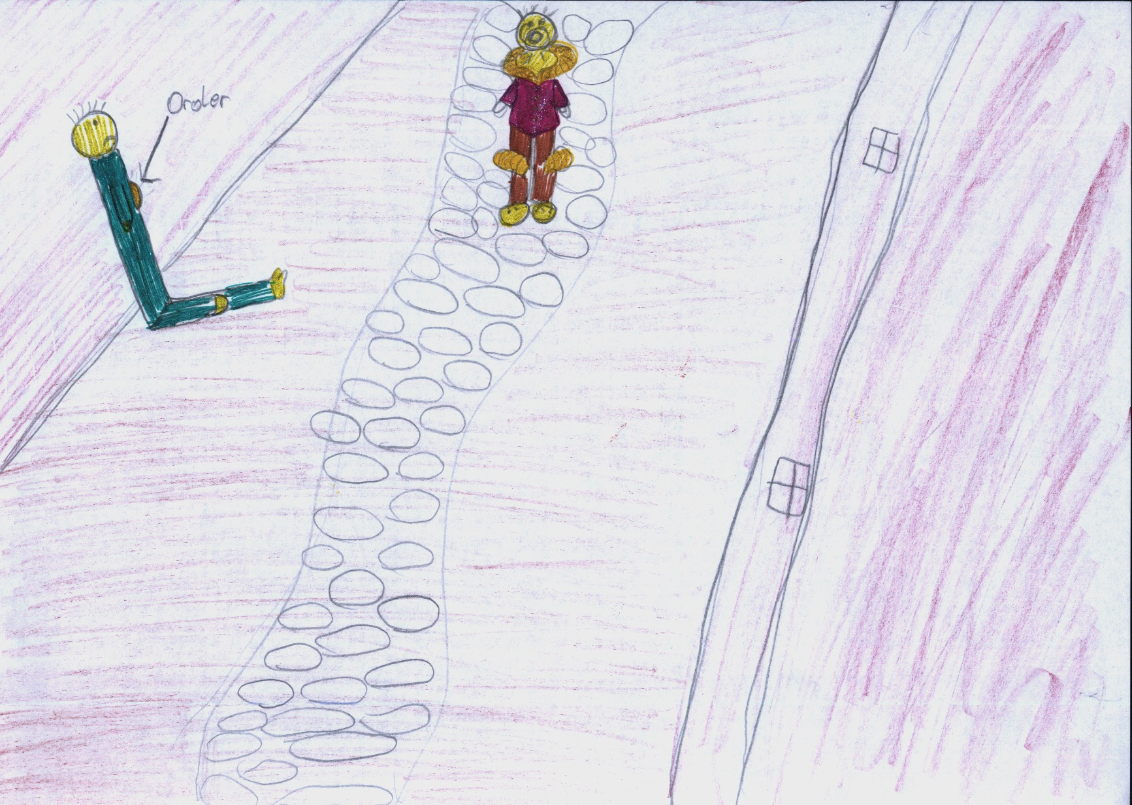
Good man! I’m a soldier. I’m old and poor. I’m hungry. Can you help me?

Slide 8
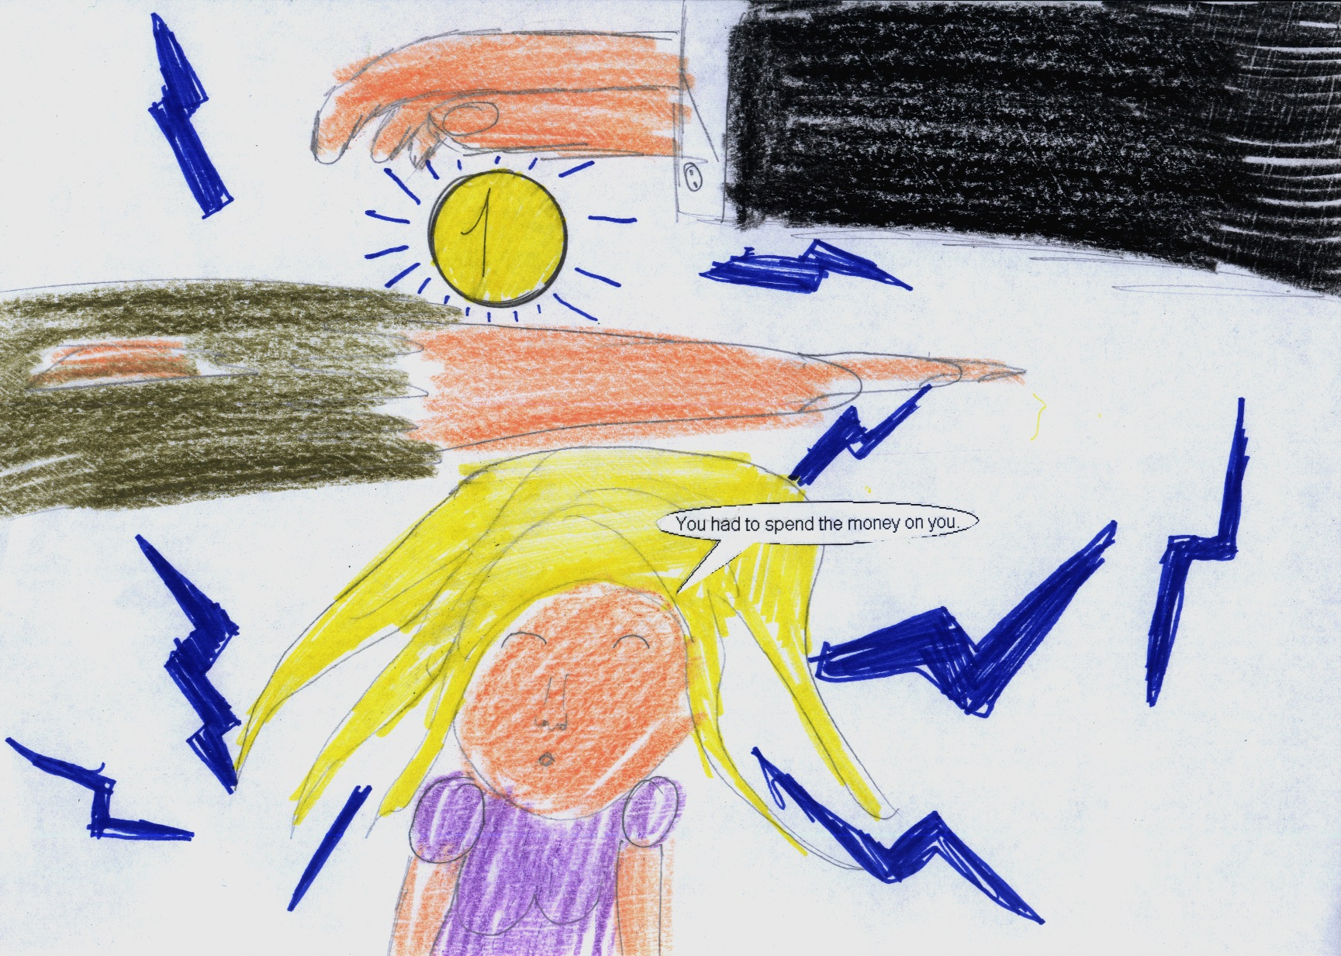

Slide 9
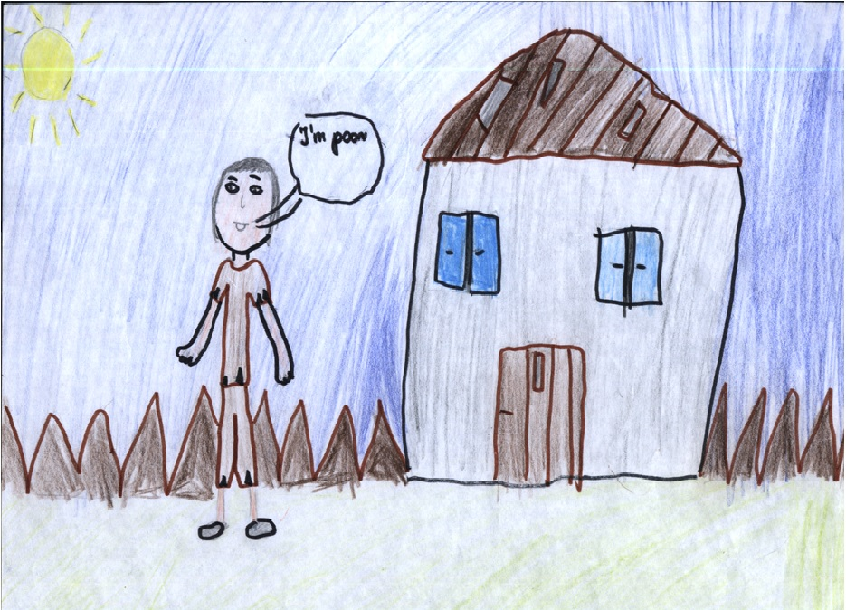

Slide 10
THE END
☺

