Slide 1
THE GOLDEN DUCK

Slide 2
Our legend takes place in Warsaw. The main character of our legend is a shoemaker. His name is Dratewka. Dratewka is very poor.

Slide 3
Once upon a time…

Slide 4
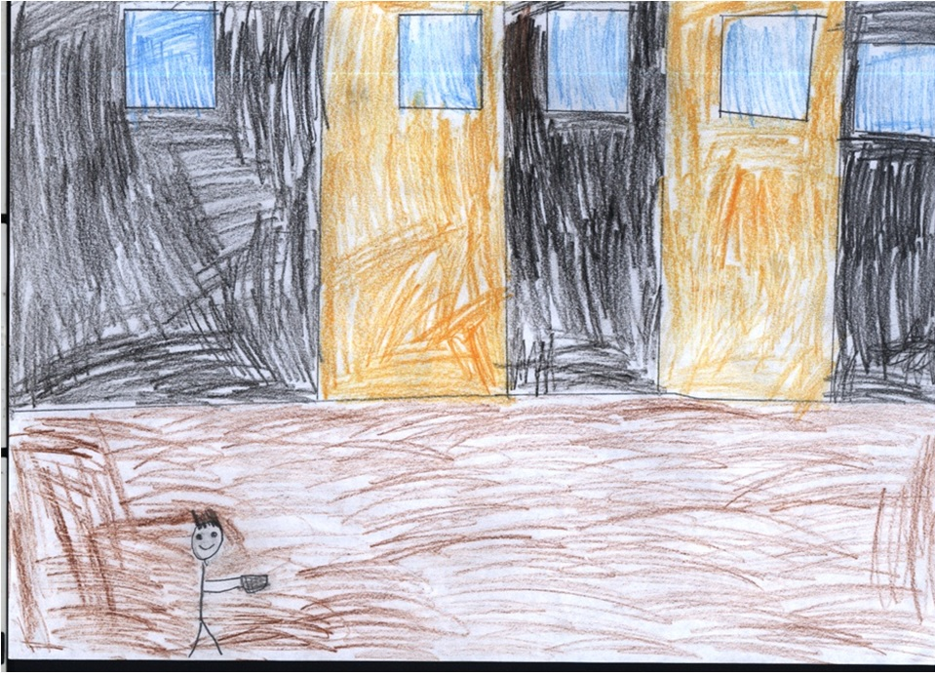
Hello. I’m a shoemaker. My name is Dratewka. I’m poor.

Slide 5
One day, the main character meets a journeyman in the inn.

Slide 6
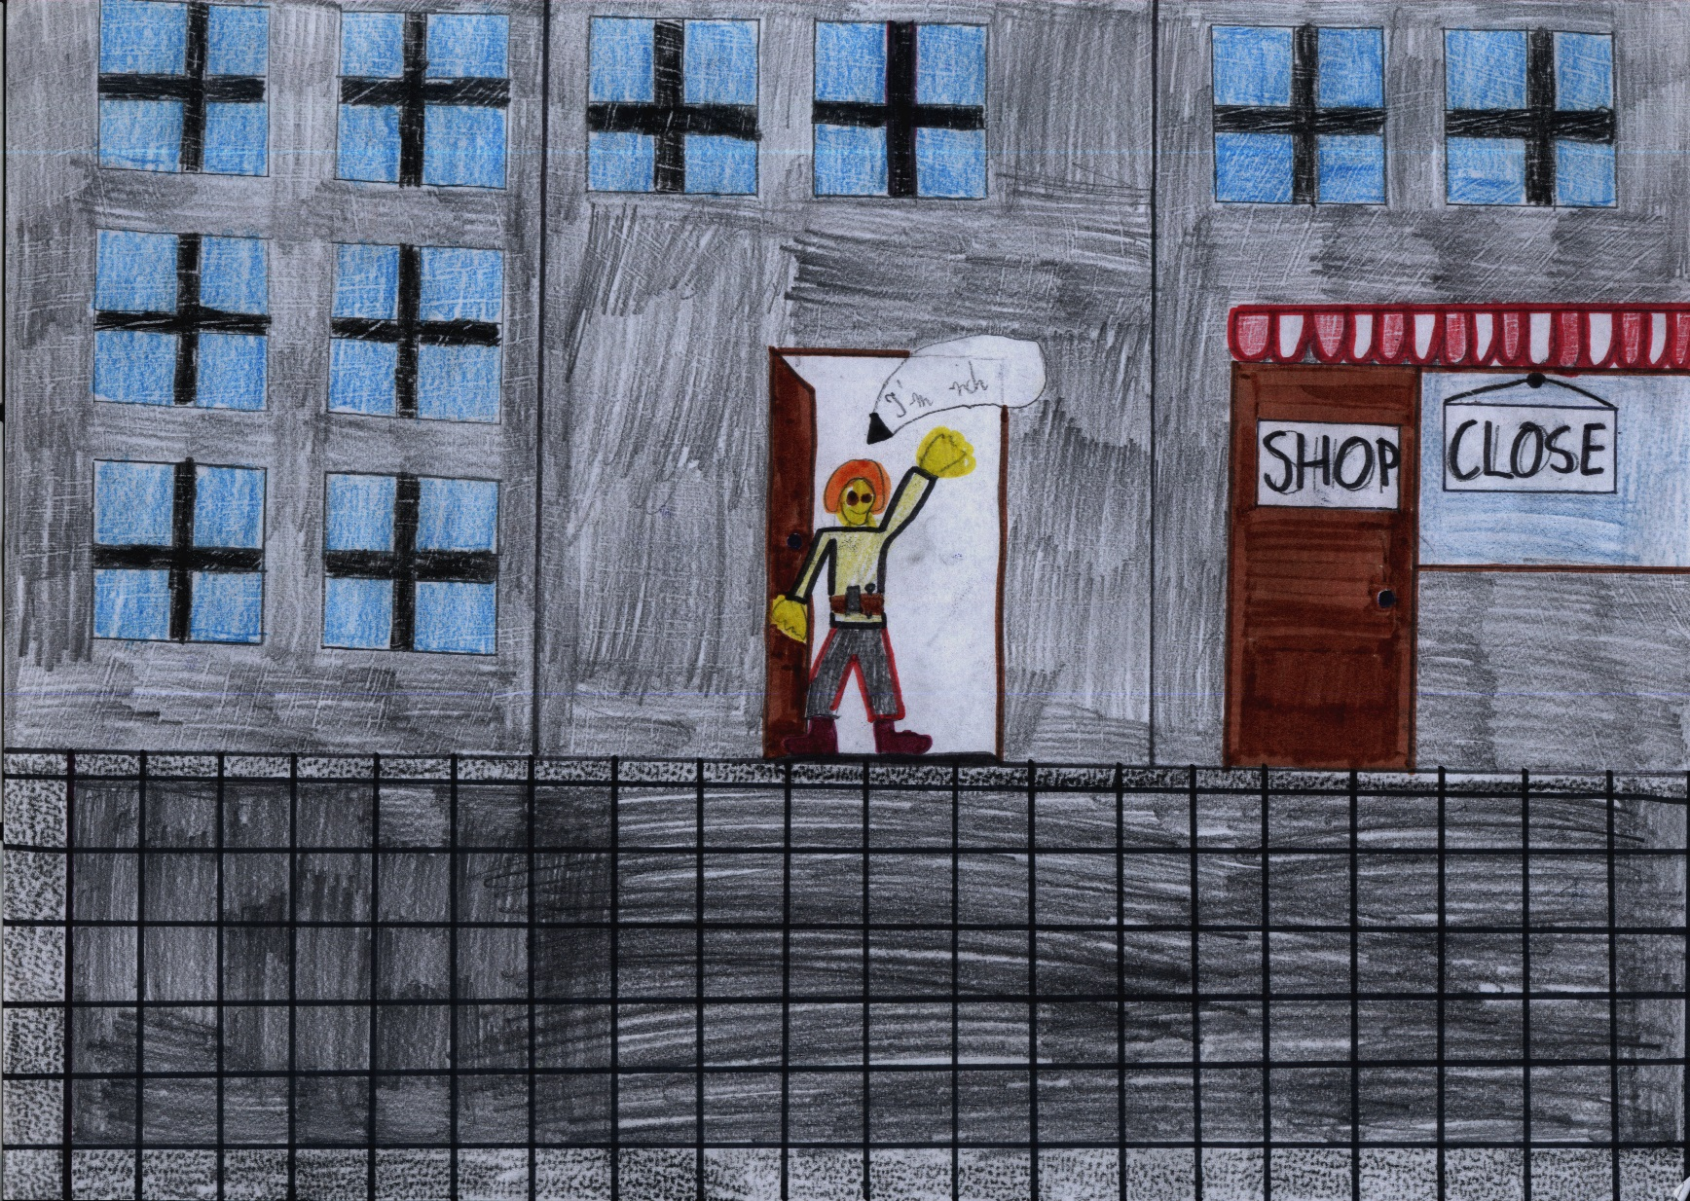
Hello. I’m a journeyman. I’m rich. I have got a shop.

Slide 7
Listen! You know that you can find a golden duck in the castle in Ordynacka street during the Midsummer's Eve. The golden duck can give you a lot of money.

Slide 8
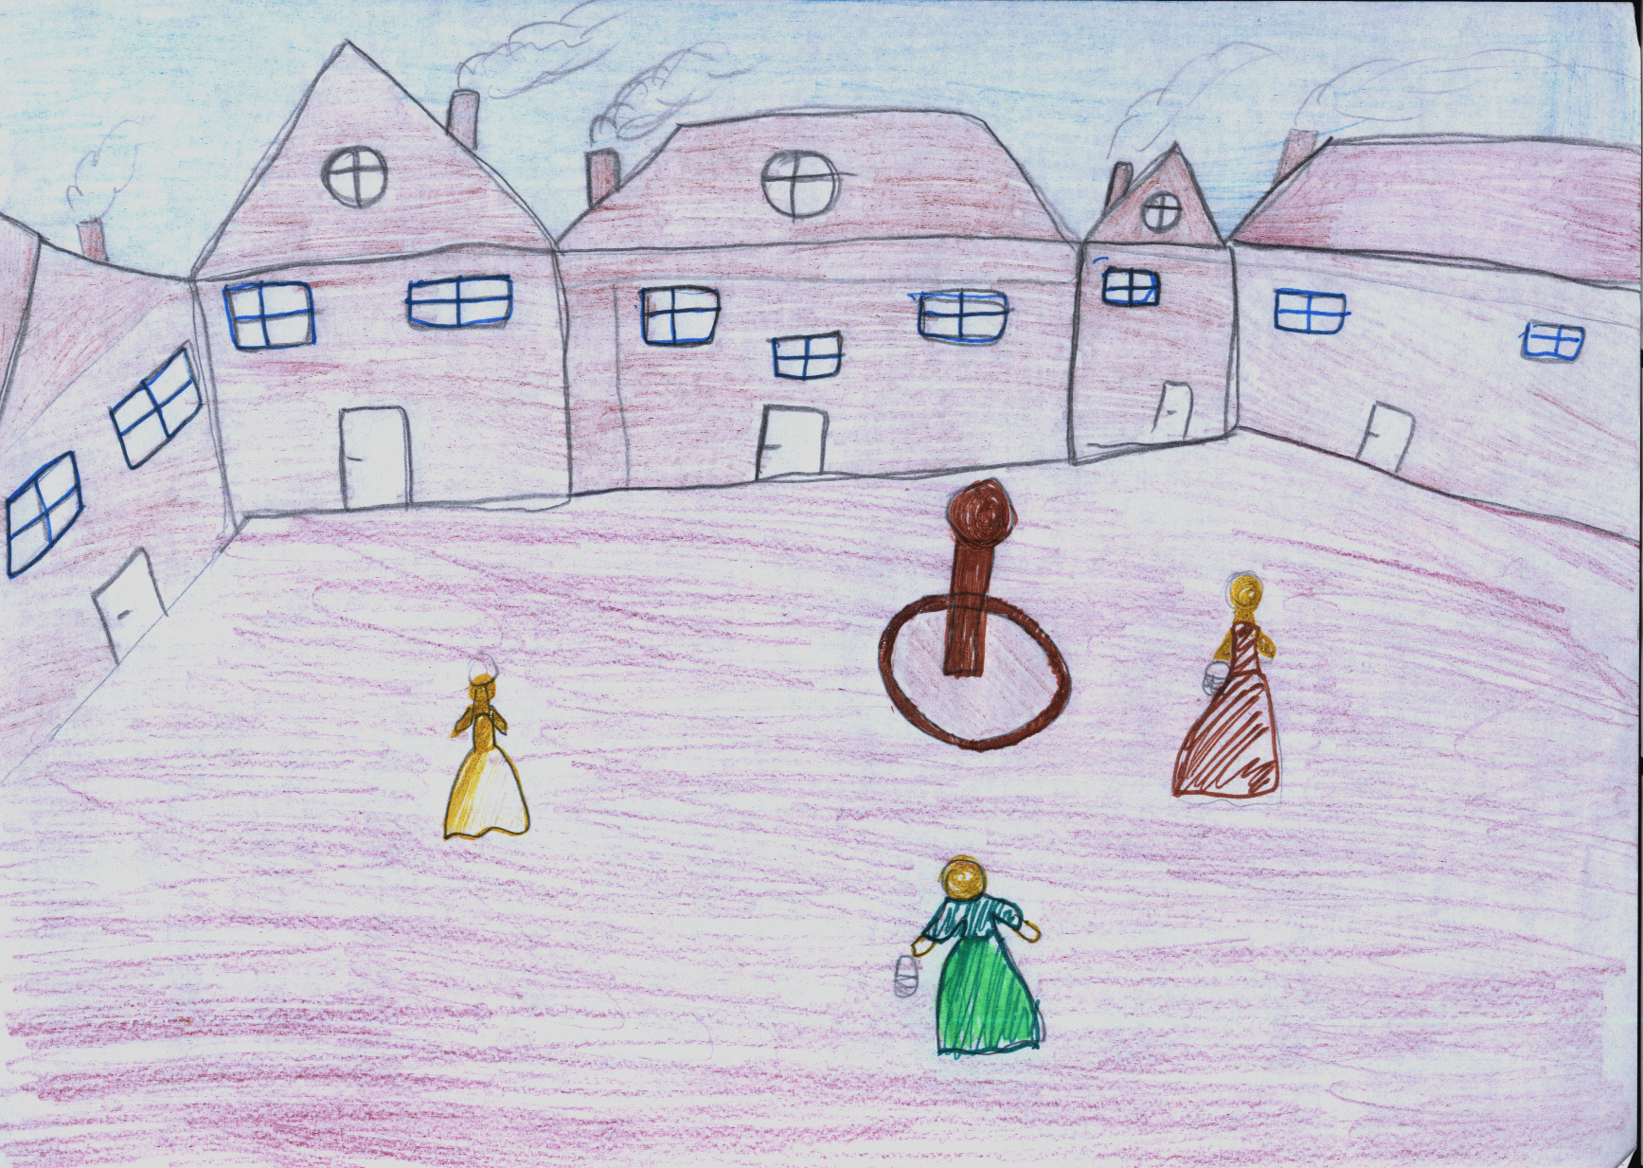
The shoemaker decides to go to the old castle.

Slide 9
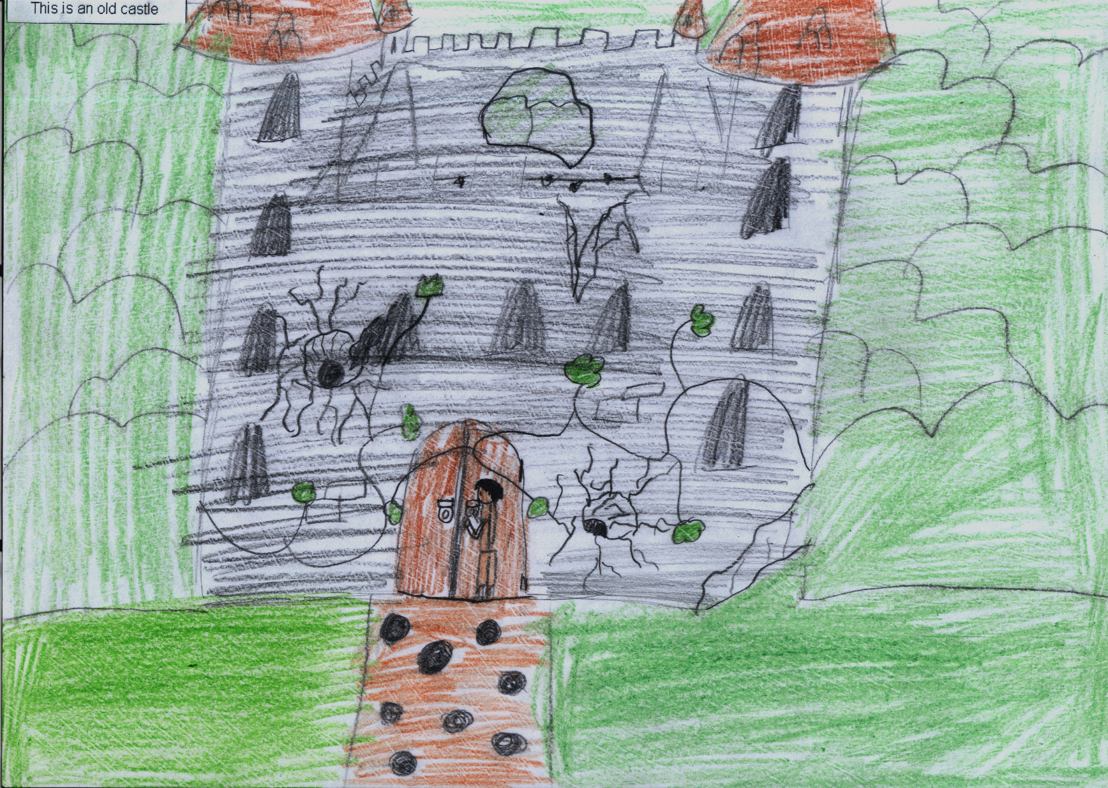

Slide 10
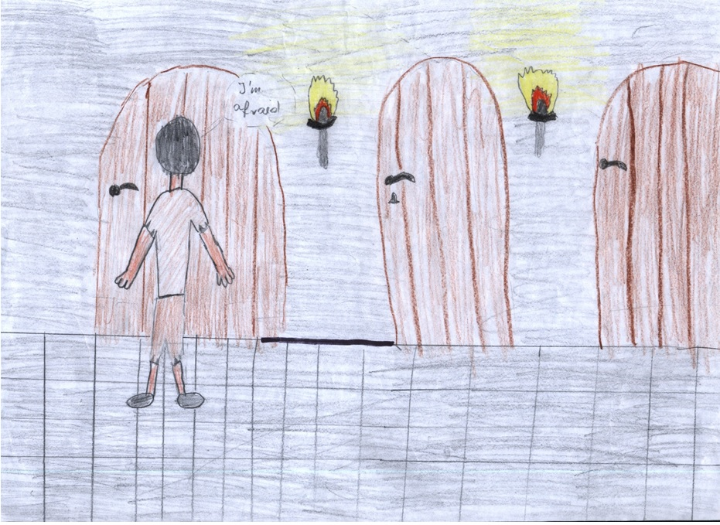
I’m afraid!

Slide 11
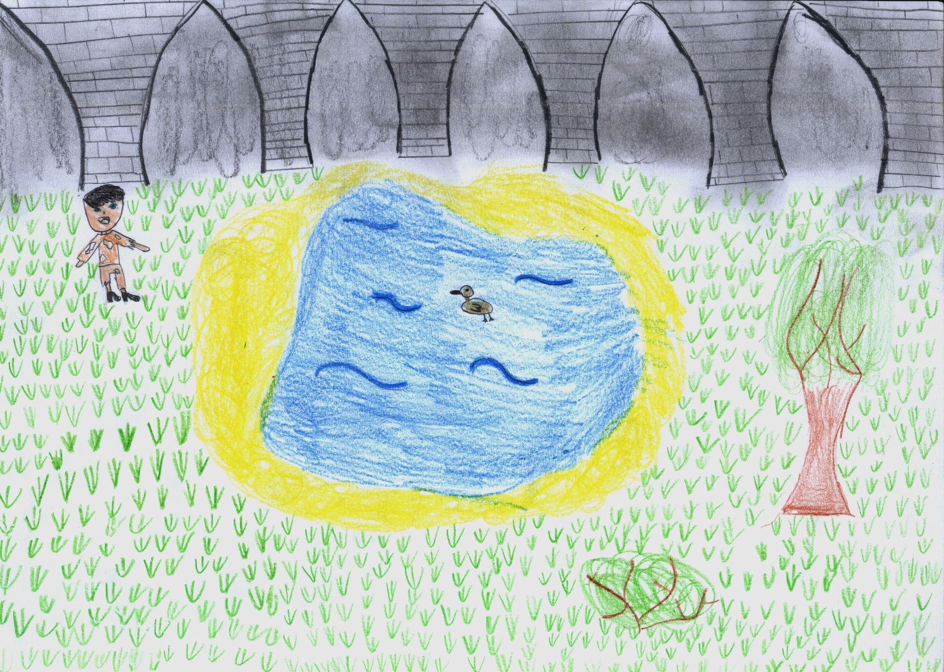
Hello Golden Duck.

