Slide 1
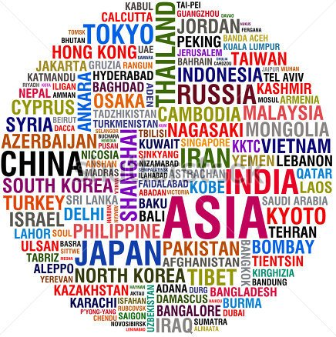
Christmas customs in ASIA

Slide 2
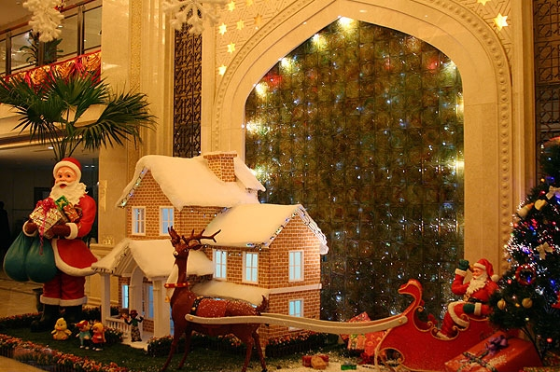
IRAN
Nowruz marks the first day of spring or Equinox and the beginning of the year in the Persian calendar. Typically, on the first day of Nowruz, family members gather around the table and await the exact moment of the arrival of the spring. At that time gifts are exchanged. Later in the day, the first house visits are paid to the most senior family members.

Slide 3
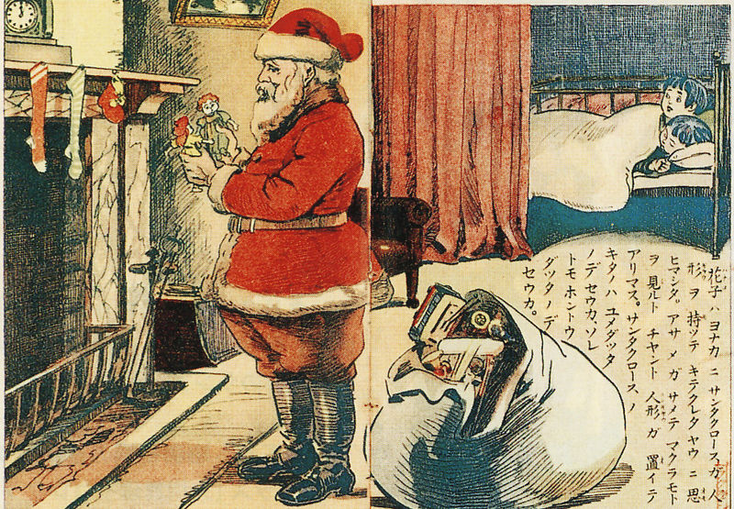
JAPAN
Christmas is not widely celebrated in Japan as not many people there are Christians. It is known as more of a time to spread happiness rather than a religious celebration. Christmas eve is thought of as a romantic day, in which couples spend time together and exchange presents.

Slide 5
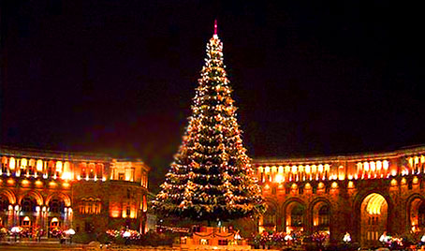
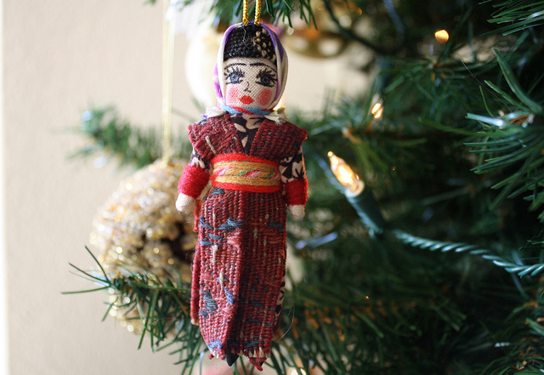
ARMENIA
The Armenian Apostolic Church celebrates Christmas on January 6th. This day it also celebrates the ‘Epiphany’ . Epiphany is now mainly the time Churches remember the Visit of the of Wise Men to Jesus; but some Churches, like the Armenian Apostolic Church, also celebrate the Baptism of Jesus on Epiphany.

Slide 6
VIETNAM
In Ho Chi Minh city people like to go into the city centre, where there is a Catholic Cathedral. The streets are crowded with people on Christmas Eve and in the city centre cars are not allowed for the night.
People celebrate by throwing confetti, taking pictures and enjoying the Christmas decorations and lights of big hotels and department stores. Lots of cafes and restaurants are open for people to enjoy a snack!

Slide 7
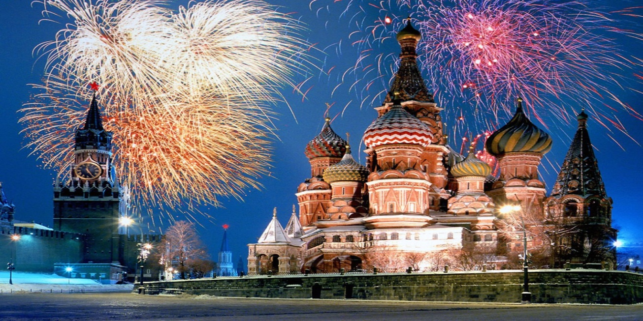
RUSSIA
The official Christmas and New holidays in Russia last from December 31st to January 10th. The Russian Christmas greeting is 'S Rozhdestvom!'.
People then eat 'sochivo' or 'kutia' a porridge made from wheat or rice served with honey, poppy seeds, fruit chopped walnuts or sometimes even fruit jellies!

Slide 8
LINKS
http://www.whychristmas.com/cultures/japan.shtml
http://www.whychristmas.com/cultures/china.shtml
http://www.whychristmas.com/cultures/armenia.shtml
http://www.whychristmas.com/cultures/vietnam.shtml
http://www.whychristmas.com/cultures/russia.shtml

Slide 9
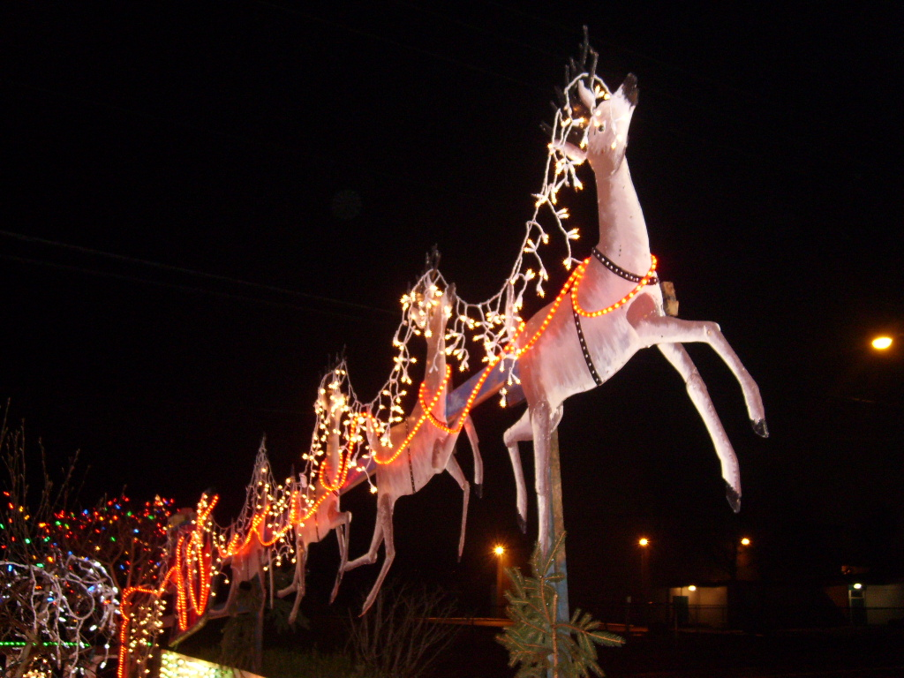
THANK YOU FOR YOUR ATTENTION!
DEMIR EZGI
TSAOUS EDA
KAMBA ALEINA

