Slide 1
The Christmas in Africa

Slide 2
Christmas is celebrated throughout the African continent by Christian communities large and small. There are approximately 350 million Christians in Africa. On Christmas day carols are sung from
Ghana on down to South Africa . Meats are roasted, gifts are exchanged and family visits made. The Coptic Christians in Ethiopia and Egypt celebrate Christmas on the 25th of December in their calendar, which is the 7th of January for most of the rest of us. Kwanzaa is not celebrated in Africa, as it's an African-American holiday. And unless you're in the Atlas Mountains in Morocco , there's little chance of anyone enjoying a white Christmas in Africa .
Even in some of Africa's predominantly Muslim countries, Christmas is still marked for celebration. In Dakar, Senegal's capital, hawkers are happy to sell plastic trees and inflatable santas. "While secularism may mean elsewhere that each person is free to celebrate his or her own holidays, many in Senegal have interpreted it to mean they should celebrate all holidays." (Mail & Guardian).

Slide 3
Gift Giving
Those who can afford it will generally give gifts at Christmas but the holiday is not nearly as commercial as it is in Europe or the Americas. The emphasis is more on the religious aspect of celebrating the birth of Jesus and singing in church, than it is on gift giving. The most common thing bought at Christmas is a new set of clothes to be worn to the church service. Many Africans are too poor to be able to afford presents for their kids and there aren't too many toy stores in rural Africa to shop at anyway. If gifts are exchanged in poorer communities they usually come in the form of school books, soap, cloth, candles and other practical goods

Slide 4
Christmas Dinner
As in most Christian cultures, celebrating Christmas dinner with friends and family tops the list after attending church. In most countries Christmas is a public holiday and people take the opportunity to visit friends and family. In East Africa goats are quickly snapped up at the local markets and roasted on Christmas day. In South Africa the sun is hot and the beaches are full of families enjoying braais (bbq's) or traditional Christmas dinners with paper hats, mince pies, turkey and plum pudding (a vestige of the British colonial legacy.) In Ghana Christmas dinner is not complete without fufu and okra soup and in Liberia rice, beef and biscuits are the order of the day. Zimbabweans make sure there's plenty of bread, jam and tea to eat along with their goat meat.

Slide 5
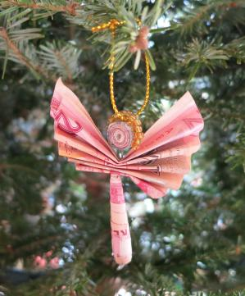
Christmas Decorations
Decorating shop fronts, mango trees, churches and homes is common throughout African Christian communities. You may see fake snow decorating store fronts in Nairobi , palm trees laden with candles in Ghana, or oil palms loaded with bells in Liberia.
Christmas Angel, Zimbabwe (made from million dollar notes).

Slide 6
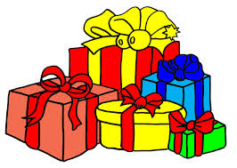
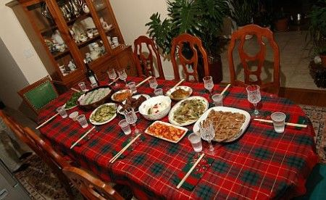
SEYCHELLES’ CHRISTMAS
Christmas in Seychelles is the time for sumptuous feasts and family gatherings. On this festive occasion, every family member usually hosts a lavish dinner which is then followed by gift-giving and evening parties. With delicious food, games, and fun-filled activities, the celebrations in Seychelles are no less exciting than that in any other part of the world during this festival.

Slide 7
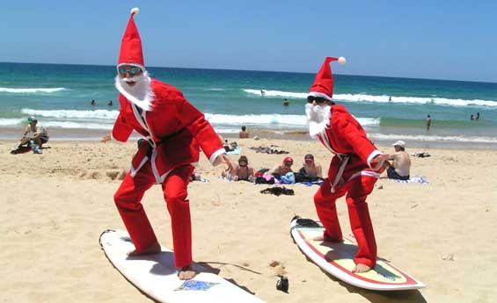
CHRISTMAS CELEBRATIOS
IN SEYCHELLES
Beach parties: Seychelles is known for its wonderful beach parties which are just ideal for adventure lovers. Whether it is sailing, diving, or fly fishing, you can actually indulge in a lot of activities while celebrating Christmas in this island country.

Slide 8
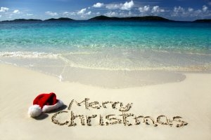
Colorful decorations: The festive celebrations in Seychelles include decorating the interiors and exteriors of the malls, stores, homes, and commercial buildings with colorful lights. Even the pubs and restaurants are adorned with such lights. Homemade crafts and decorative items are widely used during Christmas celebrations in Seychelles.
Sight seeing: On this festive occasion, people in Seychelles go sightseeing to catch a glimpse of the popular tourist locations in this island nation. Some of the places worth visiting here are AnseLazio, Valle de Aldabra, and Valle de Mai. AnseLazio is a crystal water lake
with white sandy beaches and
quiet waves. Aldabra is considered
to be one of the largest coral
reefs in the world, and it extends
for 22 Km. Visiting these tourist
attractions, especially during
Christmas, will let you experience
the joys and wonders of this
festive season.

Slide 9
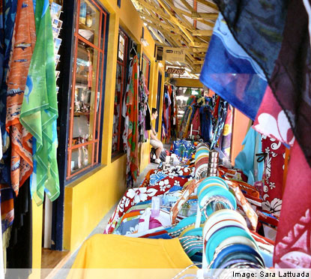
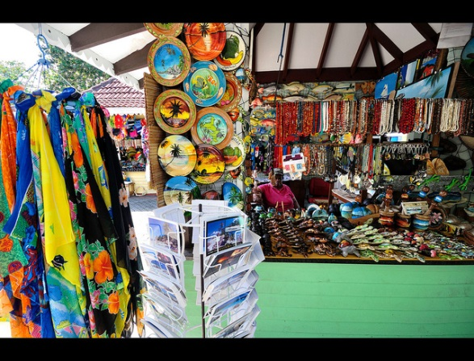
Shopping during Christmas: If you shop around, you will find unbelievable discounts and deals. Such deals will help you save more while you go shopping to celebrate Christmas in a very special way.
This is how people celebrate Christmas in Seychelles.

Slide 10
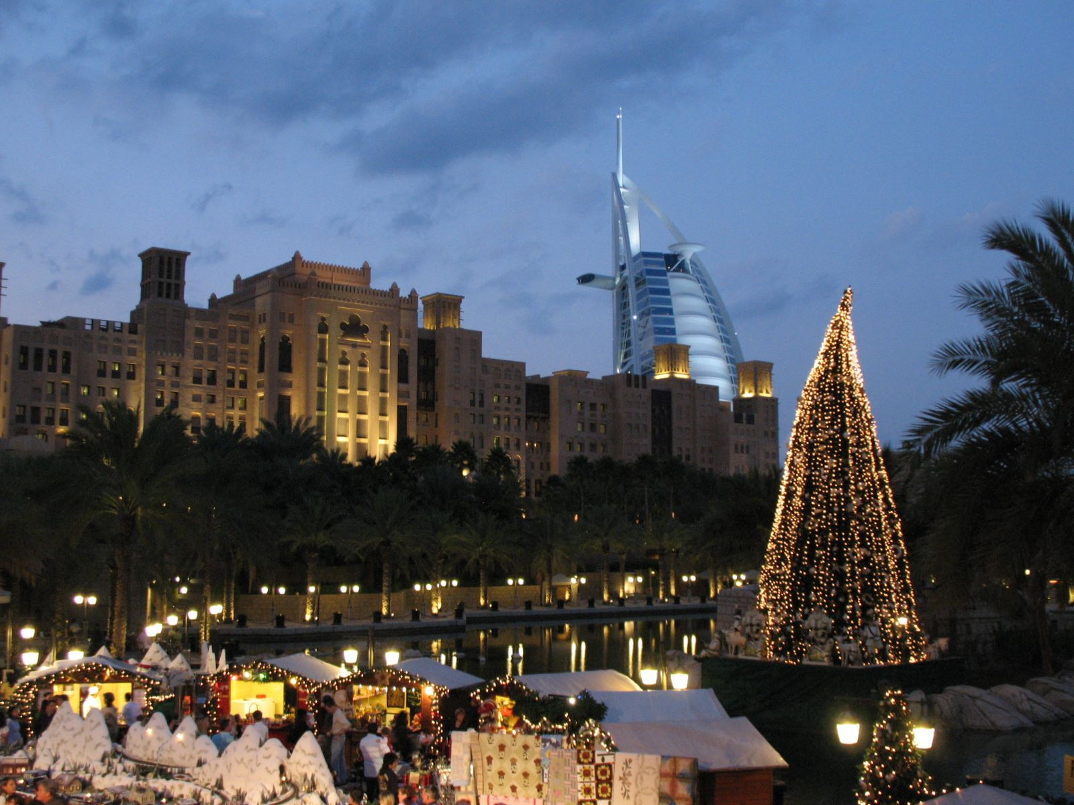
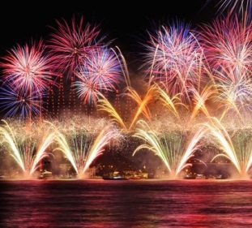
This is very much a family day in the Seychelles. Feasts are eaten at night and people normally indulge in a family get-together with music and dancing.
NEW YEAR DAY

Slide 11
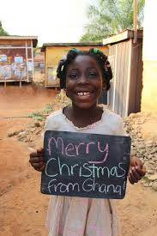
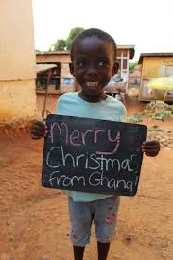
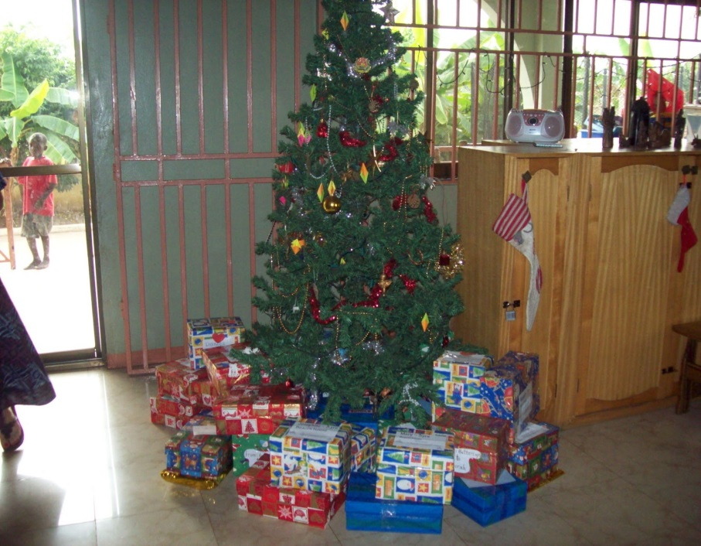
CHRISTMAS IN GHANA
Christmas is celebrated in Ghana as with us in Europe. Even in Ghana are preparing cribs with figurines of dark wood and gets the Christmas tree with a local species of spruce that grows here, similar to ours but a little 'different. There are also performances of living nativity scene.
Do not use colored balls or electric lights because they cost a lot and there is not always electricity, but they hang fruits, such as bananas, mangoes, papayas and nuts and glossy paper and colored in the end the effect is very nice.

Slide 12
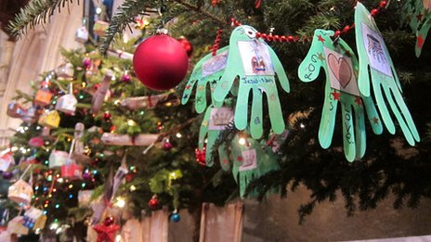
In the houses they hang greeting cards with drawings and written type Merry Christmas or AFE Shiya PA '!!, which means Merry Christmas in Twi language, which is spoken by Ashanti.
The weather is very hot, as with us in the spring, and then they party in the streets and squares and after the religious celebration, which lasts almost all night on Christmas Eve, you come out to the street and sing in groups, hymns Religious and Christmas songs (in English mostly).

Slide 13
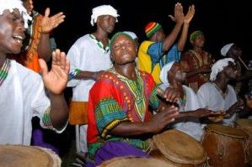
On the night of Christmas Eve is the time when the festivities begin with dances and dances that last all night but there is always those who prefer to celebrate Eve with fireworks.

Slide 14
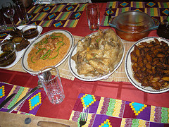
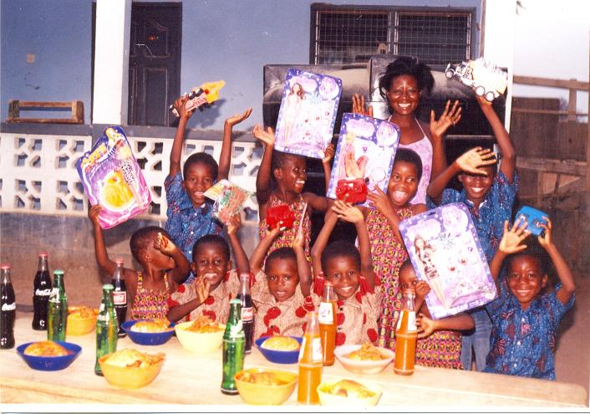
Ghana does not Eve dinner, but on Christmas Day gets a special lunch with chicken and who is richer, beef; fish, food that is very common, is for normal days.
You do not make a lot of gifts, there are many toys as here. There are no cars or trains wood and cloth dolls for children. They are usually built in the family. For larger stack radios or cassette tape and the like.

Slide 15
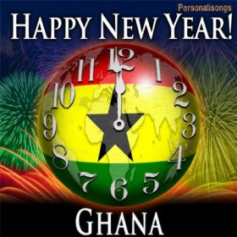
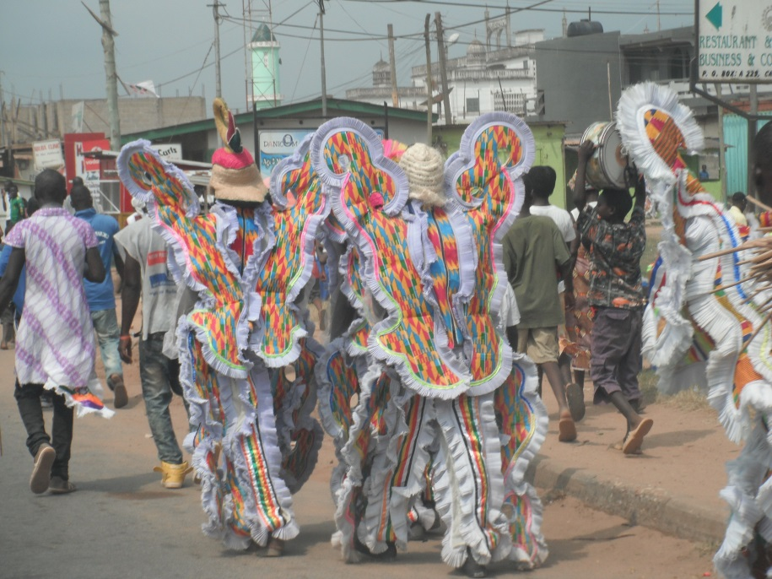
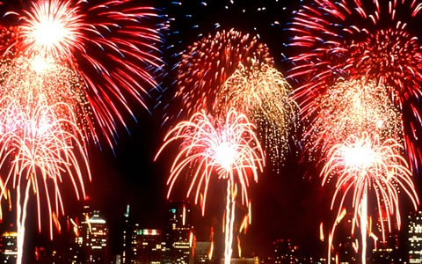
NEW YEARS DAY
People in Ghana celebrate Christmas from 20 December to the first week of January, with a lot of different activities. Many people travel to visit their relatives and friends in other parts of the country .Here are more than 66 languages spoken, and all of these language groups have different traditions and customs.

Slide 16
Christmas in Egypt
Because of the time the Holy Family spent in Egypt with the infant Jesus, Christmas is a very special celebration in Egypt. In Egypt, Copts, who are Egypt's traditional Christians, have their own Pope who is the head of the Coptic churches of Egypt and the Sudan. Copts consider St. Mark to be their first Pope. He introduced Christianity to Egypt, and for hundreds of years, Alexandria was the home of the Pope.
Egyptian Orthodox Christians (or Coptic Christians) celebrate the birth of Jesus Christ on January 7th, a date equivalent to the 29th day of the Coptic month of "kiohk, or Khiahk", though this date in relation to the western calendar advances over long periods of time. Of course, in many other countries Christmas is celebrated on December 25th, though celebrating Christmas on this date is not unique to the Copts. The difference in the dates comes from the difference between the Coptic and Gregorian calendars.
All Coptic feasts come after a period of fasting. A Coptic fast does not means going completely without food for a part of the day. They may eat normally, but the type of food that is consumed is limited to non-animal products. Therefore, meat, fish, eggs and milk are forbidden The fast leading up to Christmas is called "lent fasting", and traditionally lasts for 43 days, celebrating the forty days of fast Moses endured while receiving the Ten Commandments and the three days of fast associated with the miracle of moving the mountain of El Mokattam, a purely Egyptian event.
Much of the Christmas celebration actually begins in the last week leading up to Christmas. This is when much of the cooking takes place, and like in the west, homes are decorated with lights and Christmas trees.
Some Christmas trees are real, but many are artificial. One will even find Christmas trees in Coptic operated businesses. Christmas cards are also sent out.
Nowadays, the Coptic Nativity is celebrated by a special midnight service in the church, followed by the ringing of the church's bells.
After the service, families go home to break their fast and children receive new clothes and gifts. The meal is called fatta, and usually consists of meat and rice.On Christmas morning people visit friends and neighbors. Children are given El 'aidia, a feast gift consisting of a small sum of money to buy sweets, toys and ice cream.

Slide 17
The Nativity Christmas in Past
Nothing has changed since Islam came to Egypt in 642. Coptics had, and continue to have, the freedom to practice their religion, including feasts. Even the Fatimid caliphs (who had several Coptic & Jewish palace officials) often encouraged non-Muslim festivals. In fact, the Nativity became one of the main festivals celebrated by both Christians and Muslims. The caliph once distributed special trays of food to princes and officials, especially including dishes of "bouri" (mullet fish) and "Zalabya" (doughnuts). During the Nativity, churches have always been decorated with special candles and lamps. Copts also gave candles and lamps as gifts to their families, neighbors and friends, as well as to the poor. It is believed that the candles are in memory of Joseph the Carpenter, who lit lamps to protect Mary (The Virgin) from the cold on the night of the Nativity. For many centuries the Nativity was celebrated by performances in the streets and by fire-shows. In the Mamluk times, lamps decorated the streets and candles were everywhere.

Slide 18
Trivia
The birthplace of the Christmas Tree is Egypt, and its origin dates from a period long antecedent to the Christian era. The palm-tree is known to put forth a shoot every month and a spray of this tree with twelve shoots on it was used in Egypt at the time of the winter solstice as a symbol of the year completed.
The palm-tree spray of Egypt, on reaching Italy, became a branch of any other tree (the tip of the fir was found most suitable from its pyramidal or conical shape) and was decorated with burning tapers lit in honor of Saturn, whose saturnalia were celebrated from the 17th to the 21st of December, the period of the winter solstice. Later, this tradition was carried forward for the Christmas season.

