Slide 1
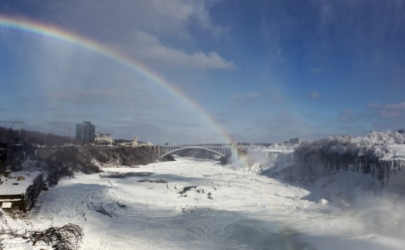
North America- Canada
Canada, like the USA, is a multinational country with a lot of traditions and many different cultures. This has a big influence on the way people celebrate Christmas. The country is divided into English-speaking Canada and French–speaking Canada. The people celebrate Christmas differently there.

Slide 2
English-speaking Canada
The people in that part of Canada start celebrating Christmas on 26th December. Everybody is happy in the morning – it’s present time. People exchange gifts. The family go to church and than eat dinner. The main dishes are turkey or beef and pudding. It is an old custom to hang mistletoe decorated with bells in the house . Mistletoe brings good lucky and happiness especially to those who kiss underneath it .

Slide 3
French-speaking Canada
The most important day of Christmas is 26th December. Before going to church, the family put a crib under the Christmas tree - it shows that baby Jesus was born. When they come back home they eat a nice dinner. The main dish is Tourtiere - a meat pie. They eat Yule Log for dessert – it is a chocolate cake in a shape a wooden log. The French people used to burn the birch logs in fireplaces before they moved to Canada. The children unpack presents that were hidden in big socks by Santa Claus. However, the biggest ones will be opened no sooner than on the New Year’s Eve.

Slide 4
Boston Christmas tree
One of the most interesting Christmas traditions in Canda is Boston Christmas tree. On 6th December 1917 in Halifax there was a big accident in the bay - two ships collided and an explosion occurred. As a result 1,900 people were killed, 9000 injured and 325 acres of city were destroyed. The city of Boston sent nurses, food and special equipment to help the residents of Halifax. To show their gratitude the Canadians send a special Christmas tree to Boston every day.

Slide 5
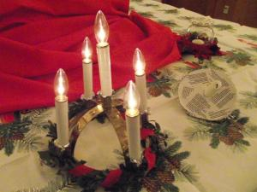
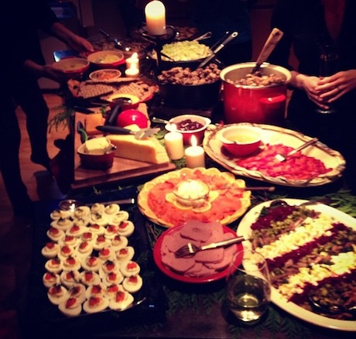
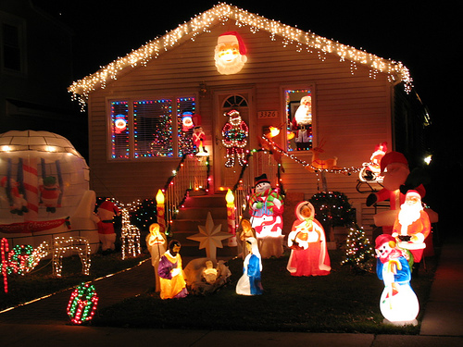
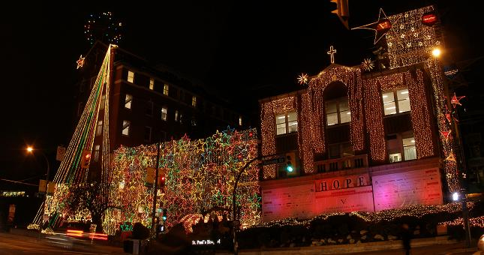
The end !
Ania Budzyńska
Laura Światek
Kinga Lament

