Slide 1
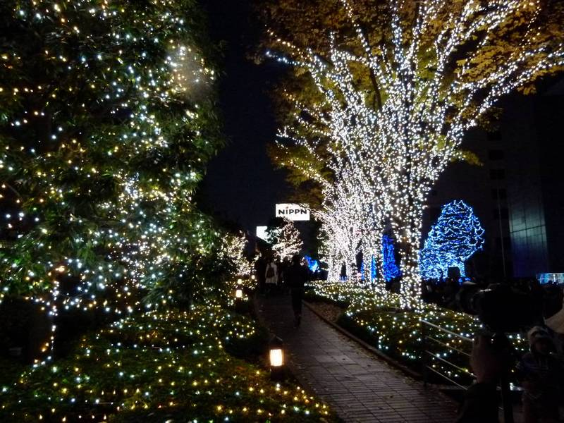
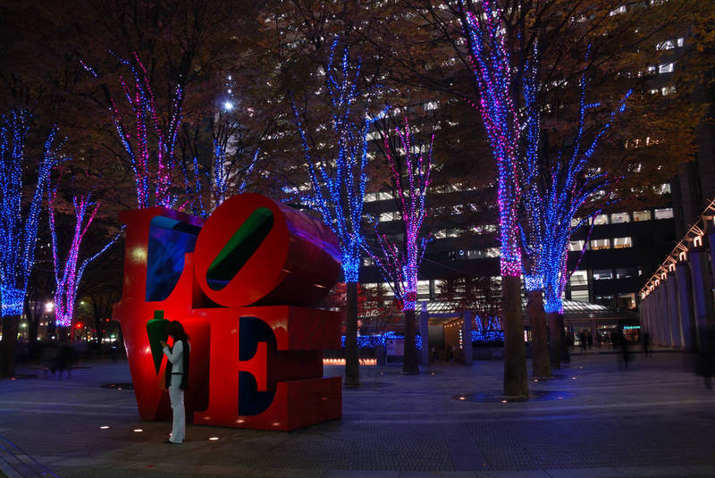
Christmas in Japan
Although virtually it is a Christian holiday, and Christians in Japan are a minority (there are no accurate statistics, however, they should be around 3.5-4% of the population), Christmas is very popular in Japan, but it has some different facets compared to the Western Christmas. However, it is not an official national holiday, in fact, schools and offices are all open on December 25. December 23 is instead a national holiday, because it is the birthday of the current emperor Akihito. In the month of December, and sometimes also in November, the cities are filled with lights and fantastic illuminations, Christmas trees and various Christmas decorations that are removed, however, just after the 25th. In fact, Japan doesn't celebrate and doesn't know Epiphany, at least until some shopping center won't get the idea of ​​launching this new holiday to try to make more money. Even in Japan, there is the custom of giving gifts to friends and family, and especially to their boyfriends. Christmas in Japan is in fact a time to spend mainly with their partner rather than with the family, perhaps with a romantic dinner and night. I remember, for example, when a Japanese friend of mine wrote me, a few days before Christmas, to be sad because she was single and had no one with whom to spend the night of December 24.

Slide 2
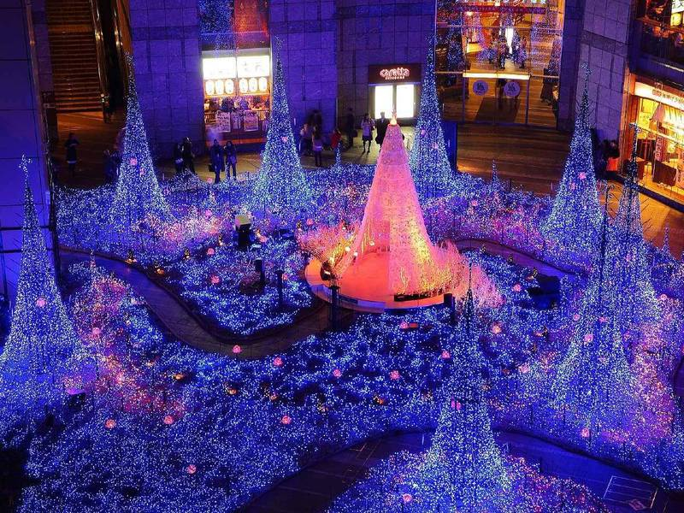
Food traditions at Christmas in Japan
Christmas at KFC
KFC (Kentuchy Fried Chicken) is an American fast food chain specializing in chicken, which can be found almost everywhere in the world. What has to do Christmas with KFC? In 1974, when Christmas in Japan was already known but still a recent holiday, since they began to celebrate it as a commercial holiday only after the war, this company launched an incredible campaign across the country, which, incredible but true, gave life to a tradition. On Christmas Day eating chicken is a tradition in Japan, even better if it is from KFC. Don't be surprised, therefore, if on December 25 you will find long queues to eat in this fast food chain.

Slide 3
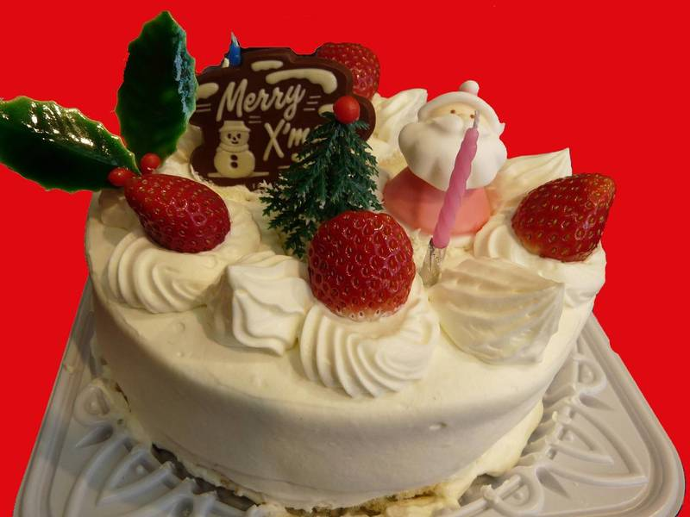
Christmas Cake
Another Japanese Christmas tradition is that of eating, especially in the evening of 24 December, a cake. This is usually a simple sponge cake with cream and strawberries, decorated with Christmas theme, as you can see in the picture below. The term "Christmas Cake" is also sometimes used in a derogatory sense referring to the girls with more than 25 years, with the meaning that, after the 25th birthday, males no longer have interest in them, just like Christmas cakes after December 25th.
a typical Japanese Christmas cake
Christmas Greetings in Japanese
Obviously there isn't a Japanese word that means "Christmas", nor a kanji to write it, and the most widely used greeting is the english "Merry Christmas", with a typical japanized pronunciation, so "Merii Kurisumasu", written in katakana or very often right in the Latin alphabet.

Slide 4
Japanese New Year
The Japanese New Year is an annual festival with its own customs. Since 1873, the Japanese New Year has been celebrated according to the Gregorian calendar, on January 1 of each year, New Years Day . However, the original celebration of the Japanese New Year is still marked on the same day as the contemporary Chinese,Korean, and Vietnamese New Year.

Slide 5
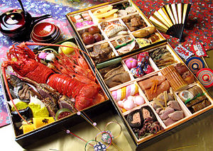
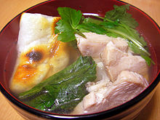
Traditional food
Osechi-ryōri, typical new year's dishes
Typical ozoni, a soup with mochi
Japanese people eat a special selection of dishes during the New Year celebration called osechi-ryōri , typically shortened to osechi. This consists of boiled seaweed konbu?), fish cakes ), mashed sweet potato with chestnut ), simmered burdock root kinpira gobō?), and sweetened black soybeans .Many of these dishes are sweet, sour, or dried, so they can keep without refrigeration—the culinary traditions date to a time before households had refrigerators, when most stores closed for the holidays. There are many variations of osechi, and some foods eaten in one region are not eaten in other places (or are considered unfortunate or even banned) on New Year's Day. Another popular dish is ozōni ,a soup with mochi rice cake and other ingredients that differ based on various regions of Japan. Today, sashimi and sushi are often eaten, as well as non-Japanese foods. To let the overworked stomach rest, seven-herb rice soup is prepared on the seventh day of January, a day known as jinjitsu .

Slide 6
CHRISTMAS IN SOUTH KOREA

Slide 8
25 and 26 Dicember
There are more Christians in South Korea than in other asian countries such as China and Japan, so Christmas is celebrated more widely. (Christians make up about 25-30%of the population.) However, the other 70% of people in South Korea are Buddhist(about 25%) or don't have a religion. Unlike Japan, in the Republic of Korea Christmas is an official public holiday. So some people have the day of work and school. But they go back on the 26th (Boxing Day). There's a longer official winter break in the New Year. Churches are decorated with lights. Most churches have a service on Christmas day. Going to Church for Christmas is becoming more popular.

Slide 9
Some people (especially Christians and westerns who live in South Korea) have decorations at home including a Christmas tree. Presents are exchanged and a popular present is money! Giving actually gifts has become more popular, but giving money is still very common.
Santa Claus can also be seen around Korea but he might be wearing red or blue! He's known as 산타 클로스.A popular Christmas food is a Christmas Cake, but it's often a sponge cake covered in cream brought from a local bakery. Or you might even have an ice cream cake.Merry Christmas in Korean is 'Meri krismas' ( 메리 크리스마르). Christians can say 'Sungtan chukhahaeyo' ( 성탄 축하해요) to celebrate the birth of Jesus.
If you live in North Korea Christmas will be very different. Being a Christian is 'officially‘ allowed but you can go to prison, or even be killed for being a Christian or even having a Bible. Christians in North Korea have to meet in secret and any celebrations of Christmas will also be held in secret.

Slide 11
NEW YEAR
Koreans celebrate New Year's Day at the start of the year on the lunar calendar and
have done so for thousands of years. However, many Koreans now also celebrate the
New Year at the start of the solar calendar (January 1). So these days, many people in
Korea and abroad celebrate New Year's Day twice. But it is the lunar New Year that is
one of the most important Korean holidays on the calendar.
New Year's Day is a family holiday, and the lunar New Year is a three-day event in
Korea. Most people try to return to their family homes to spend time with relatives and
honor ancestors. The solar New Year is also a family day for Koreans, even for those
that live in the West of the word where it is usually more traditionally celebrated with
friends.

Slide 13
BY ALBERTO SIMIONATO
AND MATTEO LONGO

