Slide 1
OCEANIA
NEW ZEALAND AND AUSTRALIA

Slide 2
Australia

Slide 3
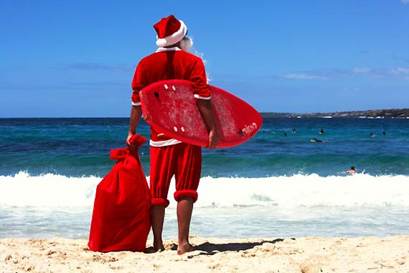
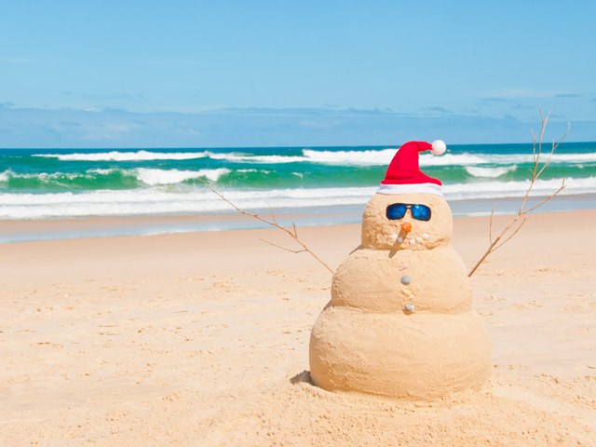
Christmas in Australia
Australian Christmas traditions reflect faithfully the Saxon tradition
The particularity of Australian Christmas however is that, being this continent in the southern hemisphere of the globe, here it falls in summer, though they should be adopted in all respects (snow and reindeer sleigh included) European winter traditions.

Slide 4
Christmas traditions
Using hanging flower wreaths on the doors and decorate the houses and gardens with Christmas trees and Christmas lights. For the decorations you use bunches of Christmas Bush, an Australian Christmas tree with small green leaves and red flowers. When Santa Claus arrives in Australia his reindeers rest and he uses the kangaroos.

Slide 5
Christmas Cracker
The Christmas cracker is a cardboard tube wrapped in wrapping paper and packaged as a great candy. Inside the Christmas Cracker there is usually a "banger" (a bang) that breaks out when the cracker is pulled at the ends. There is also a Crown of paper on which is written a joke or Riddle and small gifts.

Slide 6
Pudding and another dessert
Christmas dessert par excellence is the Pudding, prepared according to tradition by mixing the dough and in turn entrusted him to round a special wish. Often there is hiding inside a silver faith, as a guarantee of marital happiness, and a playing card or a dime, as a symbol of good fortune and wealth. Another typical Australian dessert for Christmas is the Paylova, cooked with strawberries, passion fruit and whipped cream

Slide 7
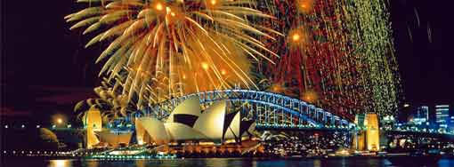
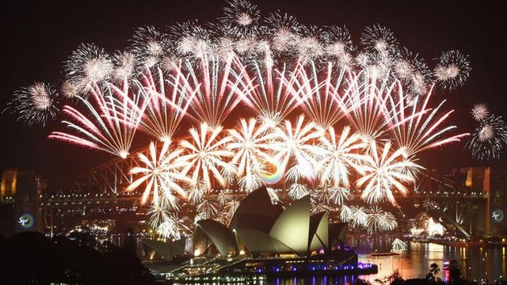
New year in Sydney
The capital of the Australian new year is undoubtedly Sydney. The capital of New South Wales is famous worldwide for the beautiful Fireworks over the Bay, from seeking privileged vantage points of the city, on all Harbour Bridge. Exclusive magic and the many events planned on the small islands of the Bay, even more evocative the Opera House with beautiful festive lights. Bondi Beach, one of the most exclusive beach resorts, is the scene of unbridled celebrations and turns into a huge outdoor nightclub, with the contribution of the best international dj

Slide 8
New Zealand

Slide 9
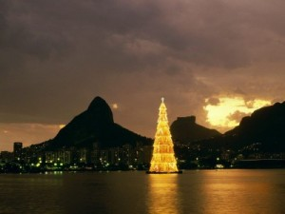
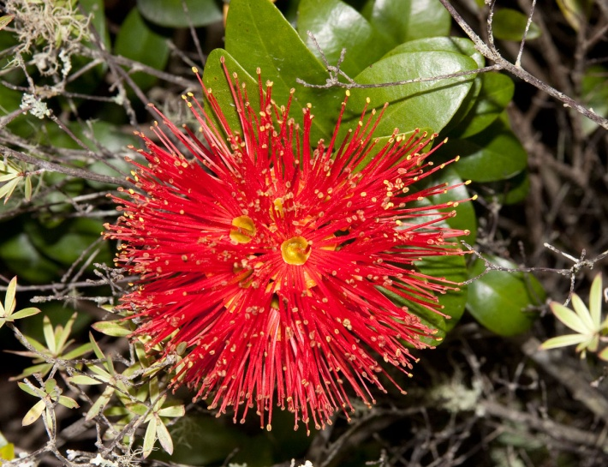
Christmas in New Zealand
Purple flowers and an almost unpronounceable name (Pohutokawa) for the Christmas tree New Zealander.
For some years now is spreading the habit to celebrate with all good faith a second Christmas on July 25, when the southern hemisphere is in winter. Christian Christmas is celebrated in the same period in which the maori tradition celebrating the arrival of the month of Hakihea, an overlay. He has also created a unique cultural mix: on the one hand the "Europeans"They comunciato to use the hangi, a stone with a holein which you can cook meat, vegetables and fruits. The maori have enriched its cosmogony with a new task for Papatuanuku, the earth mother: the distribution of gifts to the children.

Slide 10
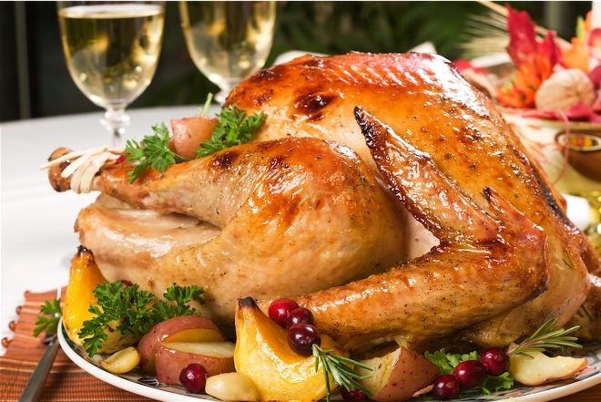
Pavlova
The British customs
are popular, proof of this is the lunch on December 25, when on the table dominates the Turkey with plum pudding, which appears next to some typically New Zealand dishes. One of these is the Pavlova, a kind of meringue with strawberries and kiwi.

Slide 11
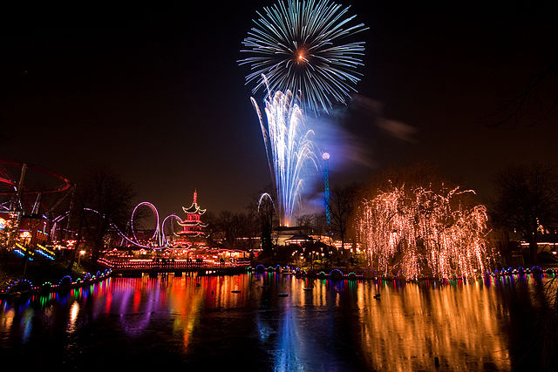
New year in New Zealand
The New Zealand is a land of festivals, and there is no best time of Year to celebrate outdoors. It is not a coincidence that thousands of people decide to celebrate the beginning of the new year gathering under the Sun during some of the most popular events of the year. Which is the best is difficult to establish, the festivals that are organized by this date change by gender, location, and target, and although some manage to gather thousands of people shouldn't be fooled by the numbers, each festival is unique in its style.

Slide 12
Prana Blue Moon Festival
On the beaches of Opoutere, for five consecutive days, is held this retreat that brings together thousands of people every year, where drinking alcohol and smoking are prohibited, and from early morning, handicraft courses are carried out, body care, tribal dances, and a long series of tasks for hippies. An artisans ' market exists for all five days and three stages with over fifty bands play throughout the event. This festival is aimed at families and those who prefer a more sedate event than the other great electronic concerts around the country. Prices vary greatly depending on the number of participants, age, number of days, and the space in which you choose to camp.

Slide 13
Rhythm ‘N’ Vines
On the coast of Gisborne, in the northern part of Hawke's Bay, there is Rhythm 'n' Vines, a festival that in nine years has managed to grow to collect more than 30,000 people, and host names like N.E.R.D., Franz Ferdinand, Shihad, and the Naked and Famous. The festival lasts three days, from December 29 to 31, and several venues offer music for every genre, there is something for every taste. Also here it is possible to camp on site, but tickets are quite expensive, starting at $ 369 for the CampeggioFestival combo. This year's line-up is composed of dozens of the most famous names Kimbra, Home Brew, Six60, The Black Seeds.

Slide 14
Work done by:
Laura Beriozza
Aurora Citriolo
Nicola De Mori
Denys Stocco

