Slide 1
Christmas traditions in Europe

Slide 2
SPAIN

Slide 3
8th December begins Christmas atmosphere. This day the Spanish celebrate the Feast of the Immaculate Conception of the Blessed Virgin Bride. This holiday have important significance in Sevilla, when the ceremony of dancing „Baile de los Seises” takes place.

Slide 5
Christmas in Spain is similar to Christmas in Poland. People sing Christmas carols, prepare Christmas Eve dinner, but there are also traditions, which we do not follow in Poland.

Slide 7
December 22nd - Christmas Loterry
This lottery is the oldest and also the largest lottery in Spain. It is a tradition in which almost every Spaniard participates, because it gives the illusion of winning a million in euro. The draw lasts five hours and is broadcast on radio and television. Bars, factories and offices work very slowly that day , because millions of people want to listen to the children from Colegio San Ildefonso in Madrid sing winning numbers.

Slide 8
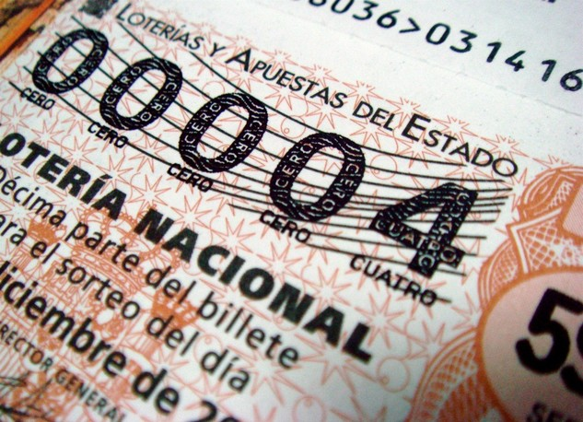
The first prize is known as "El Gordo" and amounts to 2,000,000 euros, which could change the lives of many Spaniards.

Slide 9
December 28 „El Día de los Santos Inocentes” (Day of the Holy Innocents)
This holiday has its roots in a very bloody event. In fact, this day celebrates the slaughter of children, which King Herod of Judea ordered. But now the custom of the day is to make jokes with friends or family to laugh and have fun. This day newspapers publish absurd or unreliable information, and sometimes you can also find the city fountain filled with foam soap. All, however, accept these jokes, because it is a day of jokes.

Slide 10
germany

Slide 11
Christmas in Germany
Christmas in Germany is the most important holiday in the whole year. Christmas starts on 25th December . The arrangements start four weeks earlier , on the first Sunday of Advent . In most houses there are Advent wreaths made of twigs of fir. Germany is the first country when people started the custom of decorating a Christmas tree .

Slide 12
Germans like cooking cakes in a form of small houses or people ( Plätzchen ) .

Slide 13
The most famous cake on Christmas is Weihnachtsstollen

Slide 14
In many cities of Germany Christmas fair takes place (Weihnachtsmärkte ). At this fair you can buy all Christmas items.

Slide 15
The most popular food on Christmas is :
- potato salad
- various types of sausages
- dishes made from sauerkraut
They don't have shepherds' mess at midnight. The main mass is in the afternoon .
Presents are stacked on the table .

Slide 16
Aleksandra Marchańska – Spain
Kamil Bednarczyk – Germany

