Slide 1
Christmas and New Year΄s customs of Oceania

Slide 2
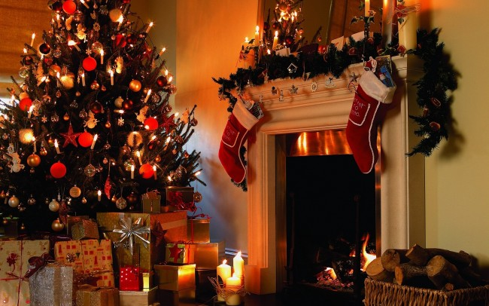
Santa Nicholas and Christmas decoration
The houses are decorated with flowers and with socks hanging on every chimney hoping that Santa Nicholas (and not Santa Claus) will pass from there during Christmas and not during New Year to fill the socks with gifts.

Slide 3
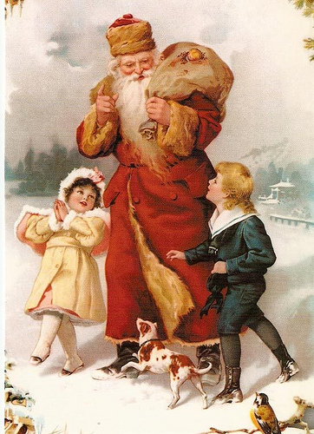
The history of Santa Nicholas
According to tradition, there was a man, whose wife had died and had three daughters to grow.
After losing all his money, his family had to move.
When his daughters had to marry, their father fell into greater depression, since the daughters could not marry without dowry. One night after the daughters had spread their clothes and their stockings by the fireplace to dry, fell asleep.

Slide 4
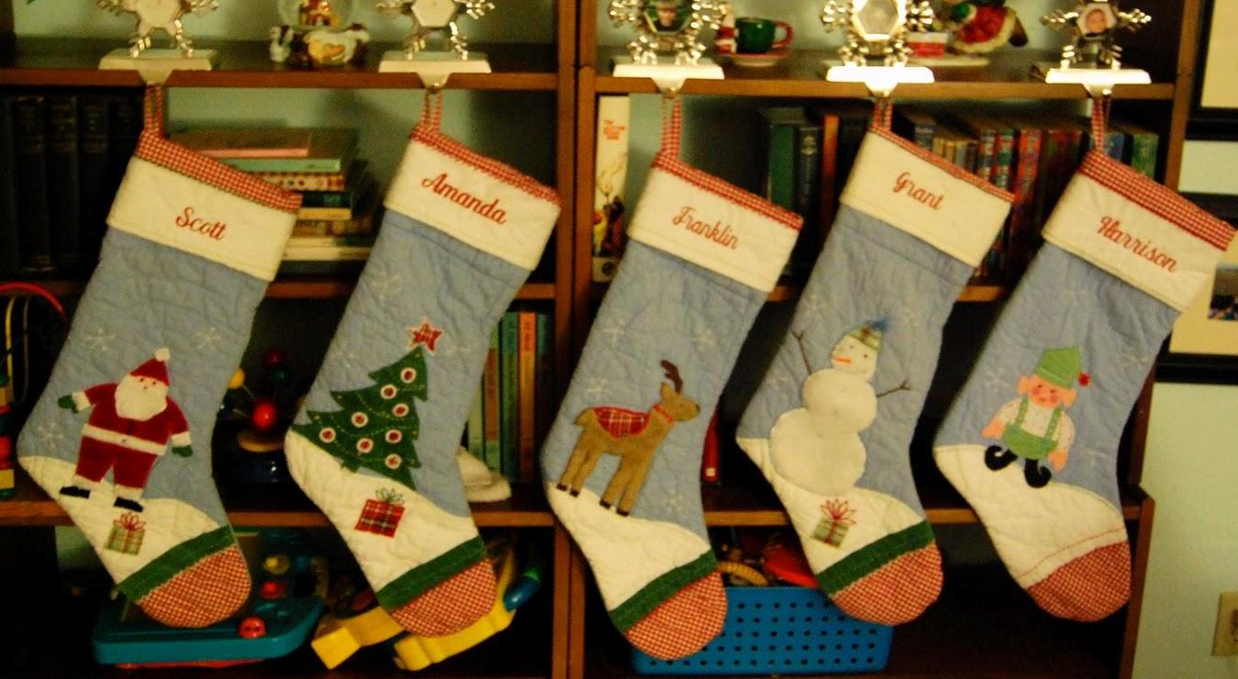
Santa Nicholas knew the despair and the misfortune of his father. He stopped at the house and saw that the family had gone to bed and noticed the socks were hanging in the fireplace. Then he got a small pouch of gold and went to threw it down the chimney so that it will fall into the socks.
The next morning the daughters found their socks contain gold. Thus, their father will see them live happily with this gold, and all lived many happy years.

Slide 5
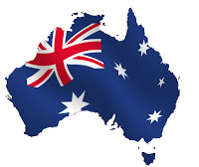
Customs of AUSTRALIA
Christmas is in summer.
On Christmas Eve, the Christian inhabitants go to churches, while we go from dawn.
After churchgoing they rush for a festive picnic and surfing on the beach.
In Australia, (after the Christmas meal) they go either for a walk on the beach or for a cricket game.
The funny thing is that the sleigh of Santa Claus is not pulled by reindeer but by eight kangaroos.

Slide 6
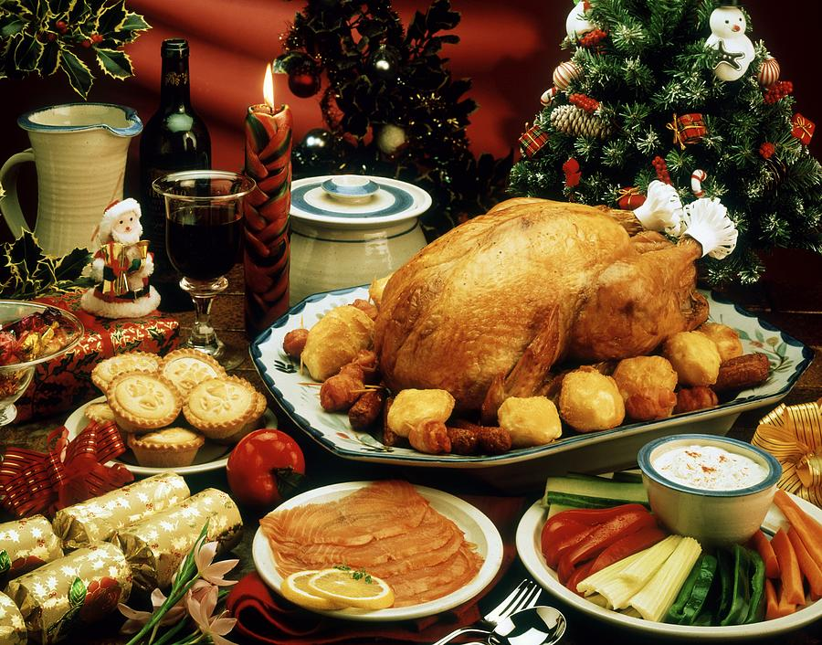
Christmas meals of AUSTRALIA
The festive breakfast includes ham and fried eggs.
The dinner includes stuffed turkey.
The dessert includes pudding flambé, within which there is a coin for good luck.

Slide 7
Christmas in New Zealand
In New Zealand, Christmas comes in the middle of summer as in Australia.
Traditionally, families celebrate Christmas on the beach

Slide 8
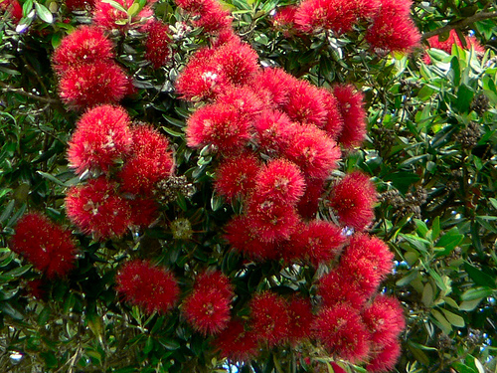
The Christmas tree
In New Zealand their traditional Christmas tree is called Pohutukawa.
It is a beautiful endemic evergreen tree that blooms just at Christmas time on the beaches
The deep red flowers, that adorned the trees, attracted the attention of New Zealand's first settlers and they established it as their official Christmas tree.

Slide 9
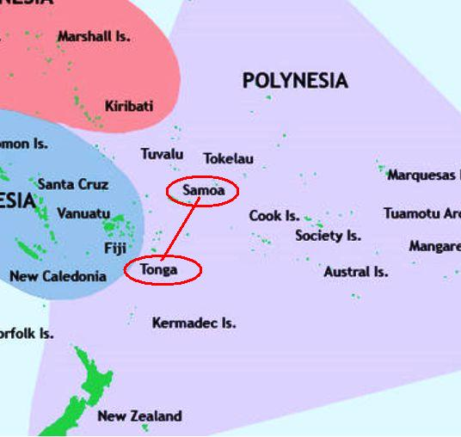
Christmas in Samoa and Tonga
The Kingdom of Tonga and Western Samoa are in the center of the South Pacific.
Due to their geographical location, their inhabitants are the first people on Earth who celebrate the New Year!
In Tonga the new year starts with the Eve dinner. Regional specialties, plenty of wine and tropical fruits begin to be served as midnight comes. And when the time passes, those who want can fly to Western Samoa, where they land a year earlier to celebrate the coming of the New Year again !

Slide 10
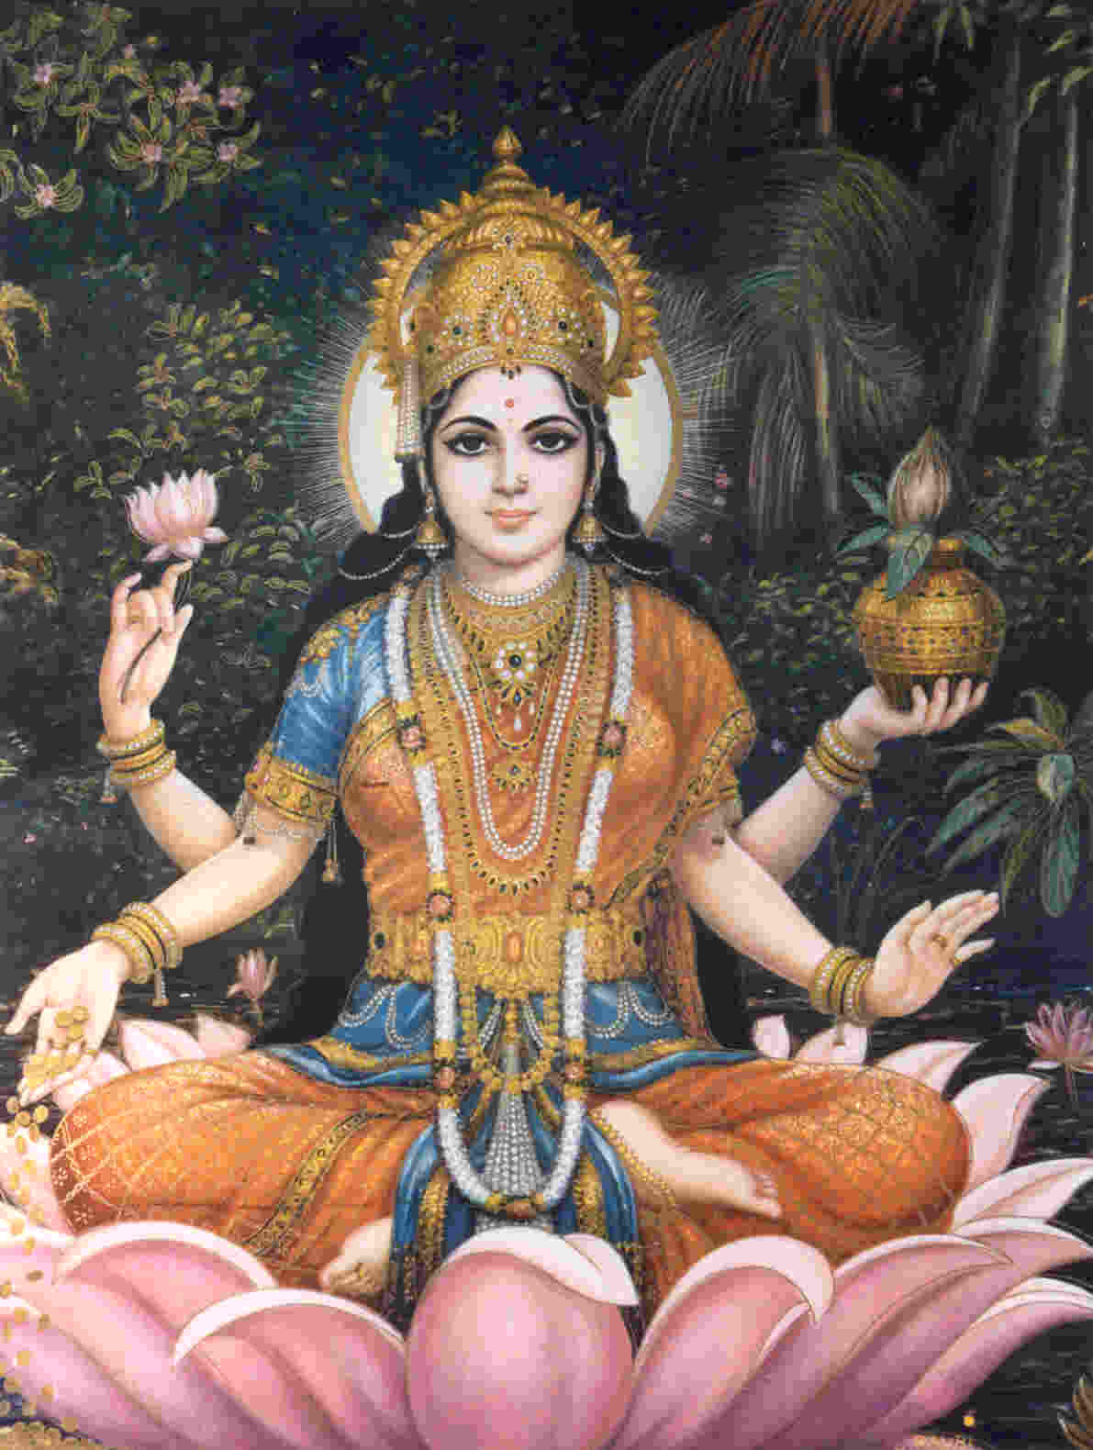
CHRISTMAS IN FIJI
October / November: Is the day of lights in honor of Lakshmi the goddess of wealth and prosperity. On that day the Hindus open their homes to other families and share sweets and dishes.
On December 25 they celebrate Christmas and on 26, they celebrate the day after Christmas.

Slide 11
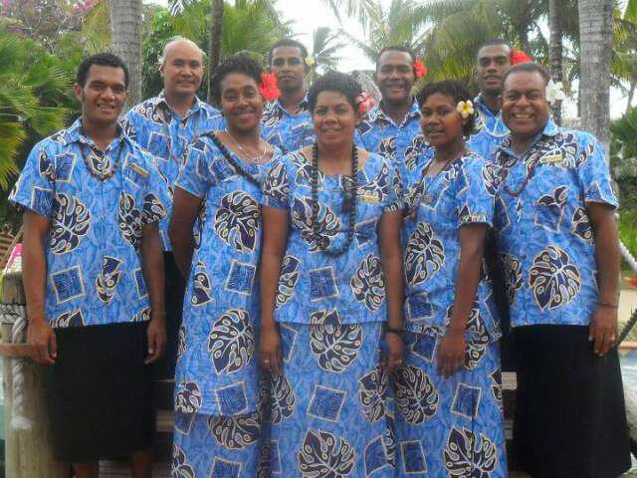
January 1st: They celebrate New Year for a week or even a month in some areas. They beat drums, they splash each other with water, they throw fireworks and organize a street party for the reception of the new year.
They dance traditional dances (meke) with traditional Sulu clothing.
Table: it includes wine and a blend of food with foods of India.

Slide 12
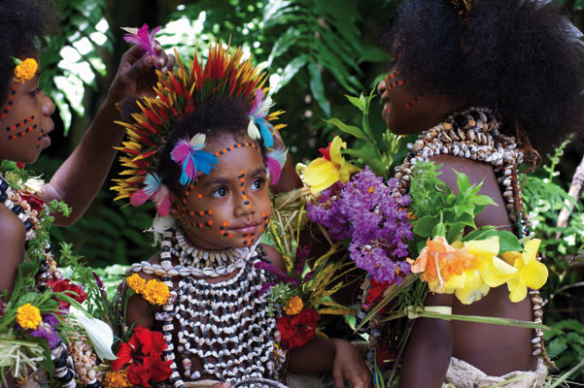
CHRISTMAS IN NEW GUINEA
The leader of all the tribes chooses and calls an infant as a Child of Peace to stop the conflicts between the tribes.
If the baby dies the time of peace ends and a struggle between the tribes breaks out again.

Slide 13
Links:
http://neoskosmos.com/news/el/ Χριστουγεννιάτικα-έθιμα-της-Αυστραλίας
http://panhellenicpost.com/archives/78293
http://www.babybaby.gr/showarticle.jsp?CMRCode=17CF5A4OI&CMCCode=01010116&extLang
http://www.sheblogs.eu/2009/12/03/pohutukawa-christmas-tree/
http://www.tovima.gr/culture/article/?aid=84723
http://en.wikipedia.org/wiki/List_of_festivals_in_Fiji
http://journals.worldnomads.com/gaganbatra87/story/80282/Australia/New-Years-Eve-at-Fiji
http://www.everyculture.com/No-Sa/Papua-New-Guinea.html
http://www.sheblogs.eu/wp-content/uploads/2009/12/Pohutukawa.jpg
http://www.nationalgeographic.biz/wp-content/uploads/Tonga-Map-4.jpg

Slide 14
The end!!
Tsoulfa Eugenia
Tzatzana Ioanna
Tsakalou Konstantina

