Slide 1
Christmas Customs in Europe

Slide 2
Christmas Customs in Greece
Some of the Christmas Festival in Greece are "Ρουγκατσάρια" Rugatsariα, where all the residents of the city of Kastoria are delivered in a separate Dionysian revelry, with the accompaniment of folk melodies bodies all traditional musical sounds of the area. This ancient habits, whose origin is lost in time. In Mani there are beliefs about demonic and other supernatural beings, who come from the Twelve Days of Christ as the Epiphany. These are the goblins and say that they are the descendants God Pan or Satyrs, who jumped from the mythology in the Christian life.

Slide 3
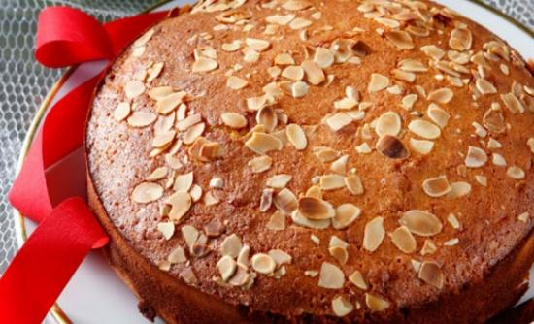
Christmas Customs in Greece

Slide 4
Christmas Customs in Greece
The festive period lasts from 30 November to 6 January (Epiphany) on the Greek calendar. 25 and 26 December is a public holiday in Greece. In Greek, Christmas is known as Christougena (Χριστούγεννα) and people wish Merry Christmas to each other saying Kala Christougenna Καλά Χριστούγεννα). Most families set up Christmas trees and shops have decorations and lights. Presents are placed under the Christmas tree and are opened on the 1st of January, St Basil's Day. In Greek tradition, Basil’s (of Caesarea) name was given to Father Christmas and is supposed to visit children and give presents on the 1st of January (when Basil's memory is celebrated), unlike other European traditions, where this person is Saint Nicholas and comes every Christmas. Carol singing is another tradition on Christmas and New Year’s Eve. The Christmas meal usually includes lamb or pork and desserts such as kourabies (κουραμπιές) and melomakarona (μελομακάρονα). Other Christmas and new year foods include 'Baklava' (sweet pastry), Kataifi (pastry), Theeples (a kind of fried pastry).

Slide 5
Christmas Customs in Greece
Christmas Eve on December 24 and 23 housewives make the Christmas cake with a cross in the middle and avgokouloures which subsequently offered to the elderly and children. Children singing carols from house to house either before or on Christmas Day. People go to church at early the morning of Christmas of 25 December. Christmas morning after the church there is the practice to become the "pork batches", served with wine to open the appetite, and "thick" which is done by Eve, which is boiled pork with plenty of lemon, which leave to clot overnight. The pork-food is in the hallmark of Greek Christmas. In many Greek cities and ports like Thessaloniki, Volos, Patra, the Greek Islands etc., it is decorated the traditional Christmas boat. And in many central squares of the country a big Christmas tree, where take place many of the Christmas festivals.

Slide 6
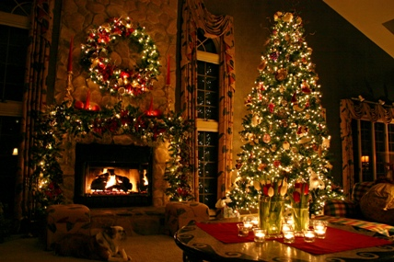
Christmas Customs in Greece

Slide 7
Christmas Customs in Germany
In some German-speaking communities, particularly in Catholic regions of western and southern Germany, Switzerland, Austria, South Tyrol and Liechtenstein, as well as in other Catholic regions of Central Europe, the Christkind (literally "Christ child") brings the presents on the evening of December 24 (Holy Evening or Heiliger Abend).The Christkind is invisible; thus he is never seen by anyone. However, he rings a bell just before he leaves in order to let children know that the Christmas tree and the presents are ready.
It is a tradition to lavishly decorate a Christmas tree in the days directly before Christmas or on the morning of Christmas Eve. On late Christmas Eve, after the bell rings, the tree is shown to the children and presents are exchanged.

Slide 8
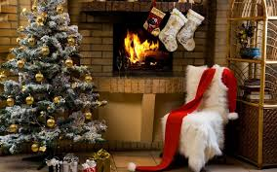
Christmas Customs in Germany

Slide 9
Christmas Customs in Germany
n Protestant churches, there is a service in the late afternoon intended to immediately precede the Christmas Eve meal and the exchanging of gifts. This service, called Christvesper, consists most often of scriptural readings, the Christmas Gospel from Luke 2, a Krippenspiel (nativity play), favorite Christmas carols and festive music for organ and choirs. In some regions the tradition of Quempas singing is still popular. Some Lutheran churches also celebrate a candlelight service at midnight besides the Christmas Vespers in the afternoon or early evening.
Many Catholic churches also have a first Mass of Christmas, called Christmette, on "Heiliger Abend" about 4 p.m. for the children and parents to attend before the families return home for their meal. The crib is a very important part of the celebrations in Catholic areas especially Bavaria.

Slide 10
Christmas Customs in Italy
The Feast of the Immaculate Conception (Italian Festa dell'Immacolata Concezione) on December 8 is a national holiday in Italy. Christmas decorations, including the presepe (nativity scene), as well as the Christmas tree, are put up on this day. Some modern takes on this holiday involve them hanging vultures to symbolize the cleaning of their spirits.
Saint Lucy's Day (Italian: Giorno di Santa Lucia) is celebrated as a Catholic holiday in Sicily and Northern regions of Italy on the supposed Shortest day of the year which is December 13. Saint Lucy is the patron saint of the city of Syracuse better known as Santa Lucia as she is called in the traditional Neapolitan song. Evening candlelight processions called the parade of light are conducted and are followed by the Feast of St. Lucy. Sicilians pay tribute to a miracle performed by St Lucy during a famine in 1582. At that time, she brought a flotilla of grain-bearing ships to starving Sicily, whose citizens cooked and ate the wheat without taking time to grind it into flour. Thus, on St. Lucy's Day, Sicilians do not eat anything made with wheat flour. Instead they eat cooked wheat called cuccia.

Slide 11
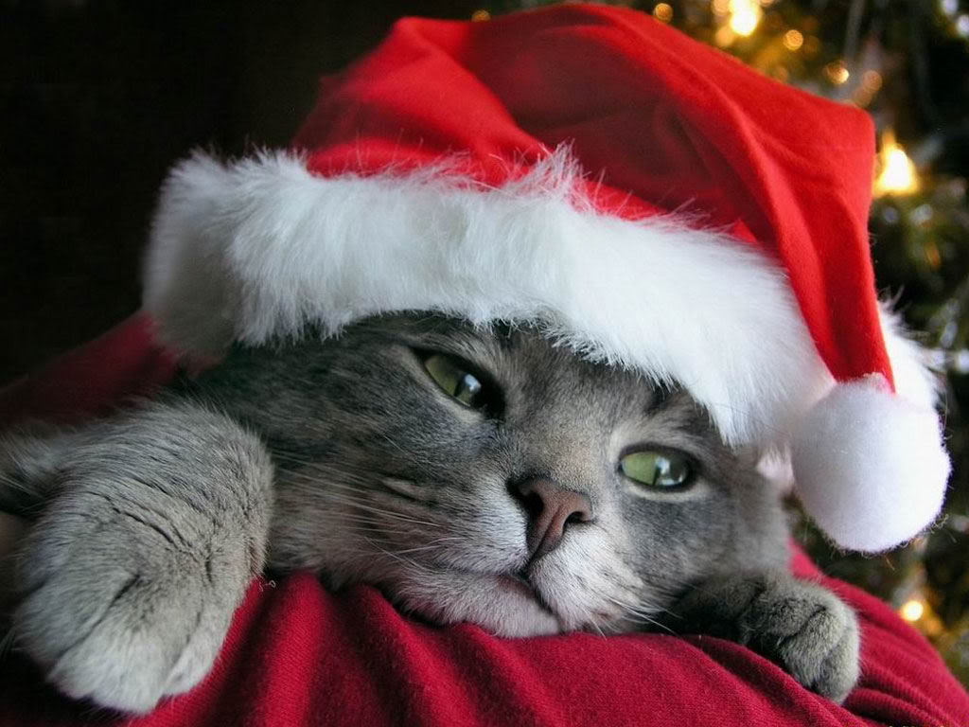
Christmas Customs in Italy

Slide 12
Christmas Customs in Italy
Christmas is celebrated in Italy in a similar fashion to other Western European countries, with a strong emphasis given to the Christian meaning of the holiday and its celebration by the Catholic Church, also reinforced by the still widespread tradition of setting up the presepe, a tradition initiated by Saint Francis of Assisi. It is quite common to attend midnight mass on Christmas Eve and practice the custom not to eat any meat. The dinner traditionally consists of seafood, with the Feast of the Seven Fishes, followed by typical Italian Christmas sweets, such as pandoro, panettone, torrone, panforte, struffoli, caggionetti, Monte Bianco or others, depending on the regional cuisine. Christmas on the 25th is celebrated with a family lunch, consisting of different types of meat dishes, cheese and local sweets.

Slide 13
Christmas Customs in Poland
In the largely Roman Catholic Poland, Christmas Eve begins with a day of fasting and then a night of feasting. The traditional Christmas meal is known as Wigilia ("Vigil"), and being invited to attend a Wigilia dinner with a family is considered a high honor. On the night of Christmas Eve, the appearance of the first star in in the sky is watched for, in remembrance of the Star of Bethlehem, that it has been given an affectionate name of "the little star" or Gwiazdka (the female counterpart of St. Nicholas). On that evening, children watch the sky anxiously hoping to be the first to cry out, "The star has come!" Only after it appears, the family members sit down to a dinner table.
According to tradition, bits of hay are spread beneath the tablecloth as a reminder that Christ was born in a manger. Others partake in the practice of placing money under the table cloth for each guest, in order to wish for prosperity in the coming year. The dinner contains of twelve dishes, one for each Apostle. In many homes place one extra seat in case and an empty setting is symbolically left at the table for a lonely wanderer who may be in need of food, an angel, the Baby Jesus or the Holy Spirit should appear to share the feast.

Slide 14
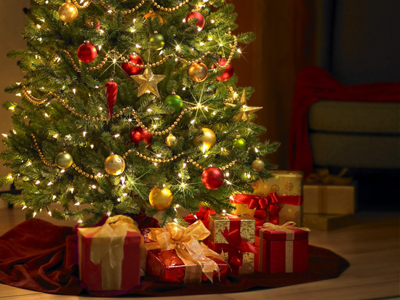
Christmas Customs in Poland

Slide 15
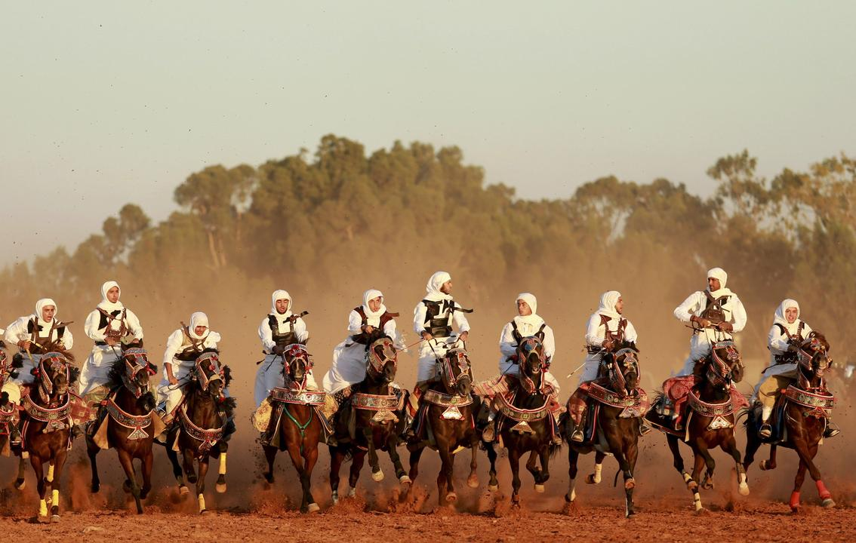
Christmas Customs in Europe
Group name: Cavalierly Berke,Ozat,Sergen,Mete ☺

