Slide 1
Christmast Day in Africa

Slide 2
Congo
Preparations for Christmas in Congo begins with choosing groups for the preparation of the annual Christmas show. When Christmas day begins, a group of carolers wander around the city and along the roads and visit the houses of missionaries singing world famous Christmas carols. Often people are woken up early in the morning when a group of carolers gather in front of their houses on their way to church.

Slide 3
Congo
Christmas Eve dinner of Congolese is not as rich in food, as in case of European countries. It is hard to talk about twelve Polish Christmas Eve dishes, because of the effort with which residents acquire daily food. So they eat the same things as every other day. On the christmas they gives small gifs of rice, paste and fish in tin.

Slide 4
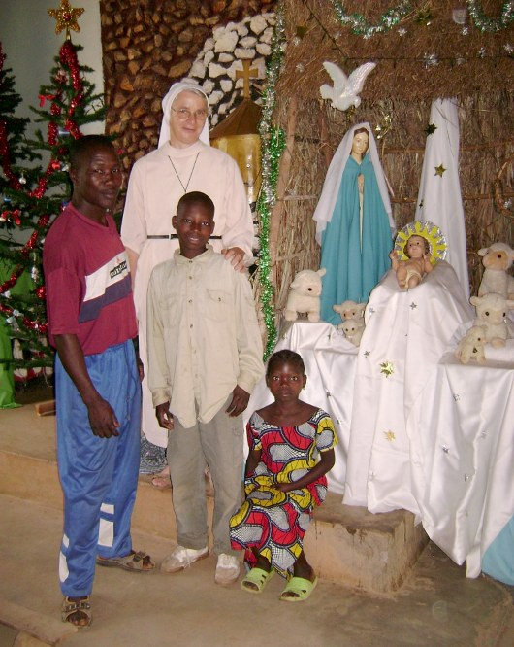

Slide 5
South Africa
Christmas time in South Africa is the period of summer holidays. In December the summer brings beautiful sunny days.
In cities and towns on Christmas Eve you can hear loud voice of carolers. Carol concerts take place beside a variety of entertainment.
Homes are decorated with pine branches and nearly everyone puts a Christmas tree in the corner of the living room. On Christmas Eve, at bedtime, children can also hang stockings for gifts of St. Nicholas.

Slide 6
South Africa
Many people organize Christmas dinner in the open air. Among the traditional dishes there are: turkey, roast beef, mince pie cupcakes, yellow rice with raisins, vegetables and crackers.

Slide 7
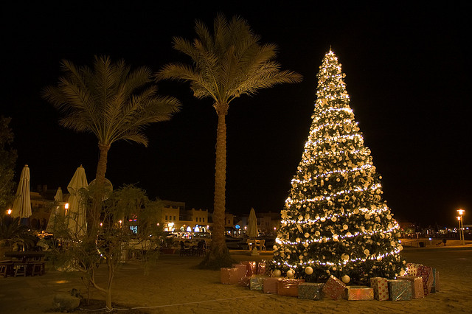

Slide 8
Ghana
In Ghana, on the west coast of Africa, to announce the arrival of Christmas people decorate churches and houses in the first week of Advent ie. four weeks before Christmas. That period coincides with the harvesting of cocoa, so it is a time of double joy and wealth.
On Christmas Eve children march through the streets singing carols and shouting "Christ is coming, it is already close!" In the evening, people gather in churches, which are decorated with palm trees and the enormity of lighted candles.

Slide 9
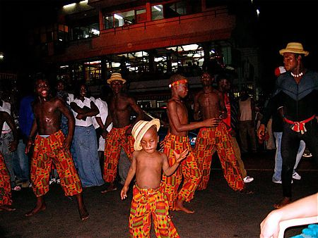

Slide 10
Ghana
Also the food is exceptional. At Christmas the locals prepare fufu – kind of dough eaten with fingers, served with soup or sauce. Other kinds of traditional dishes are rice with chicken, different types of soup and stewed goats meat.

Slide 11
By Tomek Królik & Tomek Króliczak

