Slide 1
Christmas Traditions

Slide 2
CHRISTMAS IN ROMANIA
How would winter look without Christmas and how would Christmas be without all its charming traditions? It’s hard to imagine, especially in a country like Romania where Christmas traditions were kept alive and passed from generation to generation, finding their place and relevance even today when more commercial habits are occupying the Christmas holiday.

Slide 3
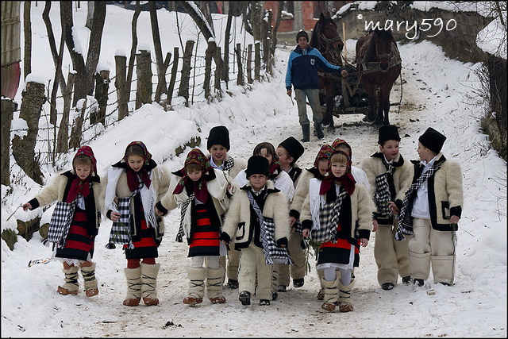

Slide 4
Varying from one region to the other, the Romanian Christmas traditions are authentic and valuable pieces of cultural heritage, closely linked to the agrarian life of the countryside, going back in time to pre-Christian beliefs when gods were celebrated on winter solstice to bring nature back to life. The pagan elements are still visible in the rituals performed in this time of the year like the dance with masks or the pig’s sacrifice before Christmas.
We would add that there’s no better place like the traditional village to experience these celebrations and each region of Romania will enchant you with very specific customs. Next, we’re going to present two of these traditions, still widely spread today.

Slide 5
cAROLS
Caroling is one the most popular Christmas traditions in Romania and although it’s usually related to the Christian celebration, carols go way back in time. In fact, carols were first sung in Europe thousands of years ago as part of the rituals of winter solstice celebration. On the territory of today’s Romania, they were performed according to the agrarian calendar to bring good crops or to protect people from evil spirits. This dynamic changed once the Orthodox Church became strong enough to impose its own view on carols, their content becoming mostly religious.
In Romania, the children are those who begin caroling, usually in the first part of the Christmas’ eve day and in many villages from traditional regions like Bucovina or Maramures, they wear specific traditional clothes for this occasion. On the evening of the same day, older carolers often accompanied by instrumentalists take their place. If in the past, only young unmarried men could be part of these groups, today both women and men carol on the Christmas eve day and even in the next days in some of the regions.
Although many of the features of traditional caroling have adapted to more modern realities, this is still a major part of Christmas celebration in Romania and there’s no better place to experience it than in a traditional village.

Slide 6
THE PIG’S SACRIFICE
Well, it’s pretty tricky to present the pig’s sacrifice tradition without raising some questions regarding animal rights or EU norms that pretty much oppose this practice. Nevertheless, this is a tradition that exists from pre-Christian times when the sacrifice of animals on the winter solstice holidays was part of a more complex ritual of asking the gods to bring back the light and sun.
Many superstitions still exist regarding this custom, usually performed before Christmas, the tradition having it done on the 20th of December, on the day of Ignat. Although it lost its ritual purposes, the pig’s sacrifice is a still a powerful tradition in rural Romania, having very precise social and utilitarian implications for families in the countryside. It’s also becoming a tourist attraction and one of the highlights of many winter holiday offers. It’s up to you to like it or not.

Slide 7
INDIA
Being a British colony until 1947, many British traditions stayed on in India. Christmas is a state holiday in India, although Christianity in India is a minority with only 2.3% (of 1.237 Billion) of the population. Most of the Christians in India attend the church. Many Christian houses in India decorate Christmas cribs and distribute sweets and cakes to their neighbors. In many of the schools that are run by the Christian missionaries, the children actively participate in Christmas programs. Also in many non-religious schools, there is tradition of Christmas celebration. Christmas is also increasingly celebrated by other religions in India. Christmas is known as "Badaa Din" (Big Day) in North and North-West India.

Slide 8
JAPAN
Encouraged by commerce, the secular celebration of Christmas is popular in Japan, though Christmas is not a national holiday. Gifts are sometimes exchanged. Christmas parties are held around Christmas Day; Japanese ChristmaS cake, a white sponge cake covered with cream and decorated with strawberries, is often consumed and Stollen cake, either imported or made locally, is widely available. Christmas lights decorate cities, and Christmas trees adorn living areas and malls. Christmas Eve has become a holiday for couples to spend time together and exchange gifts. A successful advertising campaign in the 1970s made eating at KFC around Christmas a national custom. Its chicken meals are so popular during the season that stores take reservations months in advance.

Slide 9
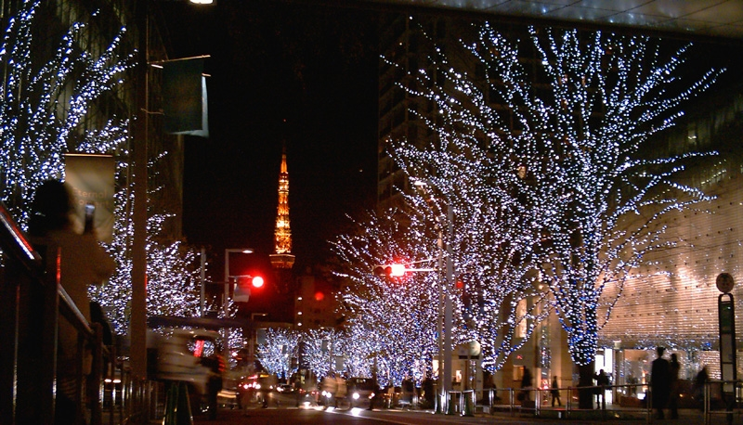
CHRISTMAS LIGHTS IN TOKYO

Slide 10
MALAYSIA
Although Christmas is a public holiday in Malaysia, much of the public celebration is commercial in nature and has no overt religious overtones. Occasionally, Christian activist groups do buy newspaper advertorials on Christmas or Easter but this is largely only allowed in English newspapers and permission is not given every year. The advertorials themselves are usually indirect statements. There has been controversy over whether or not the national government has exerted pressure on Malaysian Christians not to use Christian religious symbols and hymns that specifically mention Jesus Christ.

Slide 11
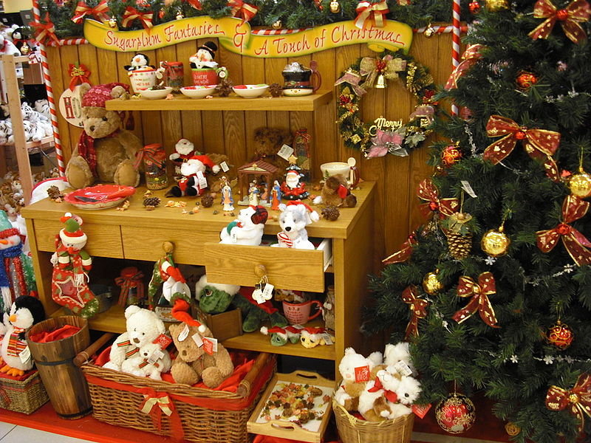

Slide 12
SINGAPORE
Christmas is a public holiday in Singapore that is widely celebrated. The Christmas season is also a popular period for shopping centres and business to conduct year-end sales, and will offer discounts and promotions that tie in with the festivities. The famous Singaporean shopping belt Orchard Road, as well as the Marina Bay area will feature lights and other decorations from early November till early January (the 2014 part is 14 November 2014 all the way until 5 January 2015). The Christmas light-up and decorated shopping malls along Orchard Road often attract numerous visitors, locals and tourists alike. Other than the light-up, other activities such as caroling, concerts and parades can also be experienced in Orchard Road. In addition, companies in Singapore usually arrange gift exchange programs on the last working day before Christmas.

Slide 13
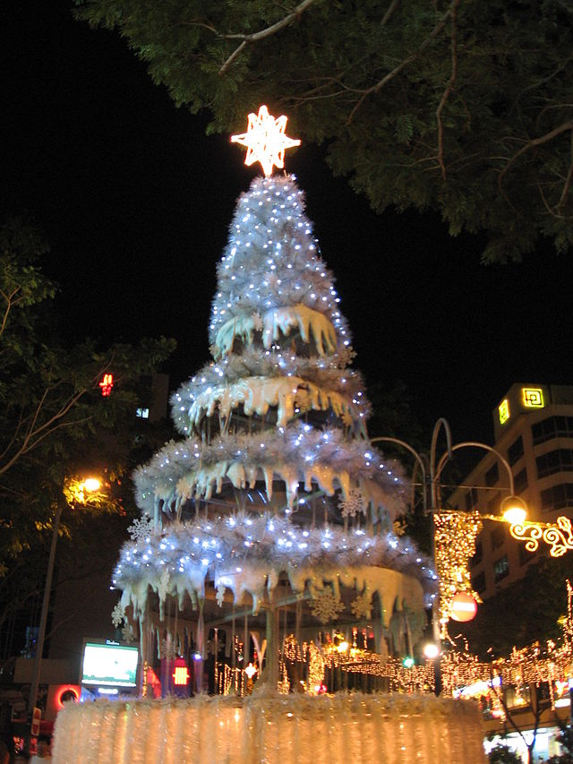

Slide 14
Iran, Iraq, Syria, and Turkey
The Assyrians, the indigenous people of northwestern Iran, northern Iraq, northeastern Syria, and southeastern Turkey that belong to theAssyrian Church of the East, Ancient Church of the East, Syriac Orthodox Church, and Chaldean Catholic Church today celebrate Christmas on December 25. Assyrians call Christmas Eeda Zura, meaning "little feast." Traditionally, Assyrians fast (sohma) from December 1 until Christmas Day. In Iraq, for instance, on Christmas Eve, Assyrian families congregate outside of their house and hold lighted candles while a child reads aloud the nativity story. Then they all sing psalms over a bonfire made of thorn bushes. Folklore says that if the thorns burn to ashes, the family will have good luck. After the fire has been reduced to ashes, the family members will jump three times over the ashes and make a wish.

Slide 15
The next day, on Christmas, "as another bonfire burns in the churchyard, the bishops lead the service while carrying a figure of the baby Jesus. He blesses one person with a touch. That person touches the next person and the touch passes around until all have felt the touch of peace."[Many Assyrians will attend the Shaharta, or midnight vigil before Christmas. On Christmas Day, when families gather together after the Shaharta or morning mass, raza d'mowlada d'maran, the fast is broken by eating traditional Assyrian foods such as pacha/reesh-aqle (meaning "from the head to the tail"), which is a boiled soup made of sheep or cow intestines, tongue, stomach, legs, and spices or harissa, a porridge made of ground wheat and chicken (both dishes are prepared usually overnight). These two dishes are only made twice a year: on Christmas and Easter. Traditional desserts eaten after the main course include Killeche, a date and walnut-stuffed cookie, and Kadeh, another stuffed pastry. After the feast is finished, Assyrians will visit the houses of family and friends to exchange Christmas greetings, saying, "Eedokhon breekha," meaning "May your feast be blessed." There, the host will serve tea, Turkish coffee, and Killeche and Kadeh to guests. Although Christmas is celebrated in a much more religious fashion, in recent years, families put up a small Christmas tree in the house.

Slide 16
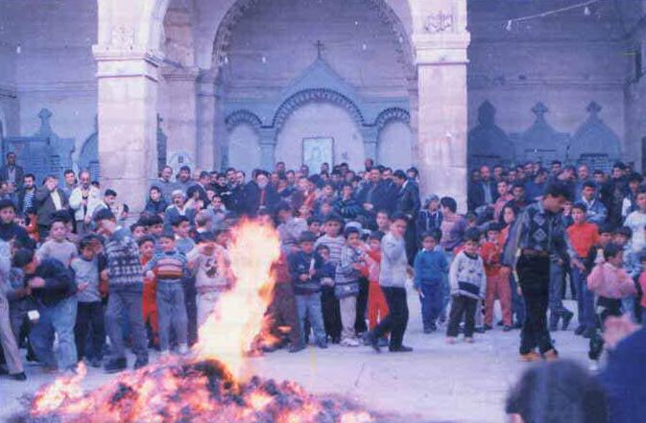
Traditional Ceremony

Slide 17
CANADA
In the Canadian provinces where English is the predominant language, Christmas traditions are largely similar to those of the United States, with some lingering influences from the United Kingdom and newer traditions brought by immigrants from other European countries. Mince pies, plum pudding and Christmas cake are traditionally served in English Canada as Christmas dinner desserts, following the traditional meal of roast turkey, stuffing, potatoes and winter vegetables. Christmas table crackers are not uncommon in English-speaking Canada. In some parts of Newfoundland and Nova Scotia Christmas traditions include mummers.
North American influences on Christmas are evident in the hanging of stockings on Christmas Eve, to be filled by Santa Claus. However, Canadian children believe that the home of Santa Claus is located at the North Pole, in Canada, and through Canada Post address thousands of letters to Santa Claus each year, using the postal code designation "HOH OHO", a play on Canada's six digit postal code that includes letters and numbers. Decorated Christmas trees, either fresh cut or artificial, were introduced to Canada in 1781 originally by German soldiers stationed in Quebec during the American Revolution, are now common in private homes and commercial spaces throughout most of Canada.

Slide 18
As Canada is a cold, dark country in winter, lights are often put up in public places, and on commercial and residential buildings in November and December. Many communities have celebrations that include light events, such as the Cavalcade of Lights Festival in Toronto, the Montreal Christmas Fireworks or the Bright Nights in Stanley Park,Vancouver. A national program, Christmas Lights Across Canada, illuminates Ottawa, the national capital, and the 13 provincial and territorial capitals.
In the east-central Canadian province of Quebec and other French-speaking areas of North America, Christmas traditions include réveillon, Père Noël ("Father Christmas") and the bûche de Noël (Yule log), among many others. A traditional dish for the réveillon is tourtière, a savoury meat pie, and gifts are opened during réveillon, often following Midnight Mass.

Slide 19
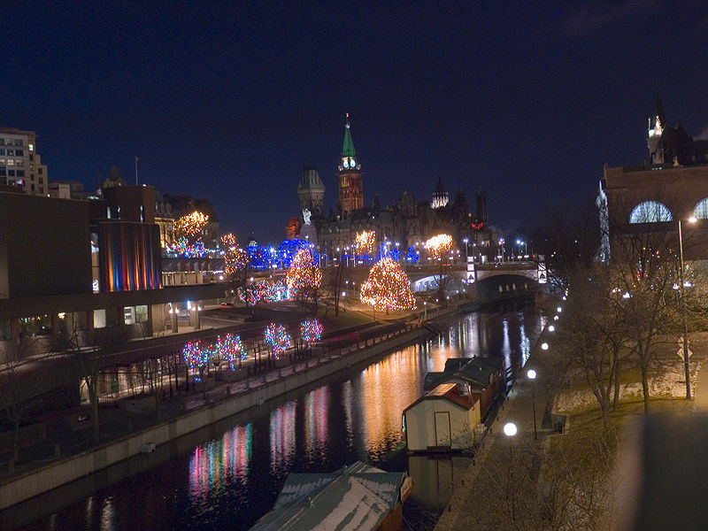

Slide 20
BRAZIL
Christmas Day on December 25 is a national holiday in Brazil. In the small cities in the entire country, as well as in the largest cities, like São Paulo, Rio de Janeiro, Recife, Salvador, Fortaleza, Curitiba, Porto Alegre, Brasília, Manaus, Belém, Natal and Belo Horizonte, the celebrations resemble in many ways the traditions in Europe and North America, with the Christmas tree, the exchanging of gifts and Christmas cards, the decoration of houses and buildings with electric lights and the nativity scene. Despite the warm tropical summer weather, some incongruences such as decorations with themes of winter and snow are not uncommon. In some cities like Curitiba, there are decoration contests, when judges go to houses to look at the decorations, inside or outside of the house, and decide the most beautiful house. Christmas Eve is the most important day. Unlike in the North American and Anglo-Saxon tradition, Christmas takes action mainly near midnight, usually with big family dinners, opening of gifts and the celebration of the "Missa do Galo" (the rooster's mass) in churches throughout the nation.

Slide 21
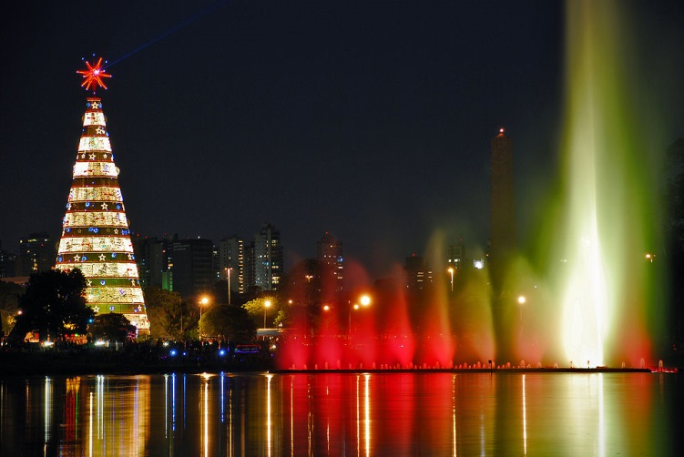

Slide 22
Greece and Cyprus
The festive period lasts from 30 November to 6 January (Epiphany) on the Greek calendar. 25 and 26 December is a public holiday in Greece. In Greek, Christmas is known as Christougena (Χριστούγεννα) and people wish Merry Christmas to each other saying Kala Christougenna Καλά Χριστούγεννα). Most families set up Christmas trees and shops have decorations and lights. Presents are placed under the Christmas tree and are opened on 1 January, St Basil's Day. In Greek tradition, Basil’s (of Caesarea) name was given to Father Christmas and is supposed to visit children and give presents on 1 January (when Basil's memory is celebrated), unlike other European traditions, where this person is Saint Nicholas and comes every Christmas. Carol singing is another tradition on Christmas and New Year’s Eve. The Christmas meal usually includes lamb or pork and desserts such as kourabies (κουραμπιές) and melomakarona (μελομακάρονα). Other Christmas and new year foods include 'Baklava' (sweet pastry), Kataifi (pastry), Theeples (a kind of fried pastry).

Slide 23
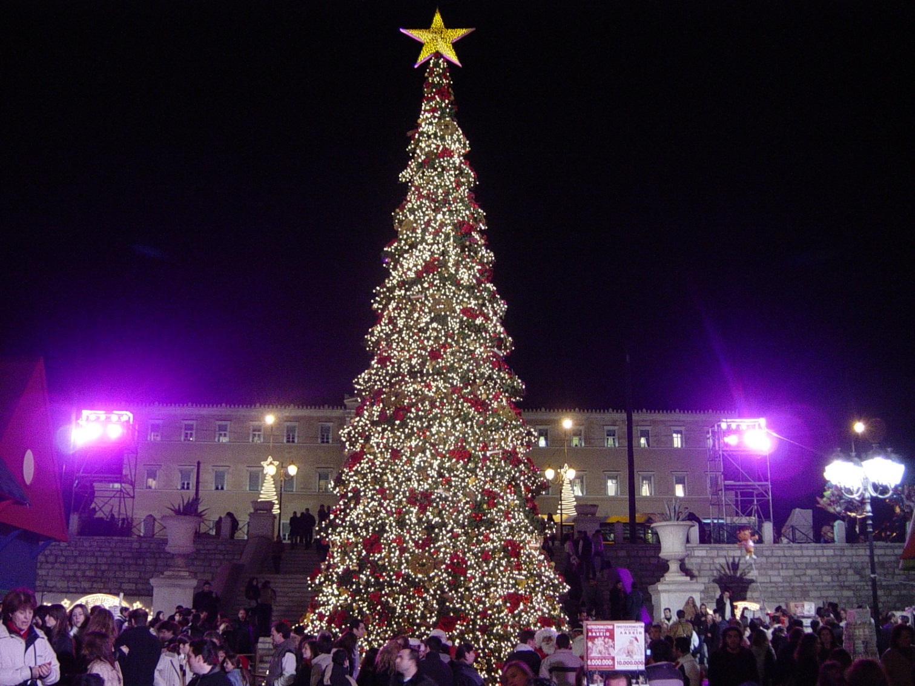

Slide 24
France
Christmas in France (Noël on the French calendar) is celebrated mainly in a religious manner, though secular ways of celebrating the occasion also exist, such as Christmas decorations and carols. Children do not hang Christmas stockings but put their shoes by the fireplace or under the Christmas tree so Père Noël (Father Christmas or Santa Claus) can give them gifts (a practice also among French-speaking Switzerland). Some families also attend midnight mass and decorate their homes with Nativity Scenes depicting the birth of Jesus. Additional Santons (little saints) may be added in the nativity scenes.
In France and in other French-speaking areas (see French Canada), a long family dinner, called a réveillon, is held on Christmas Eve.The name of this dinner is based on the word réveil (meaning "waking"), because participation involves staying awake until midnight and beyond. Réveillon is generally of an exceptional or luxurious nature. Appetizers may include lobster, oysters, escargots or foie gras, etc. One traditional dish is turkey with chestnuts. Réveillons in Quebec will often include some variety of tourtière. Dessert may consist of abûche de Noël. In Provence, the tradition of the 13 desserts is followed, almost invariably including: pompe à l'huile (a flavoured bread),dates, etc. Quality wine is usually consumed at such dinners, often with champagne or similar sparkling wines as a conclusion. Christmas carols may also be sung.

Slide 25
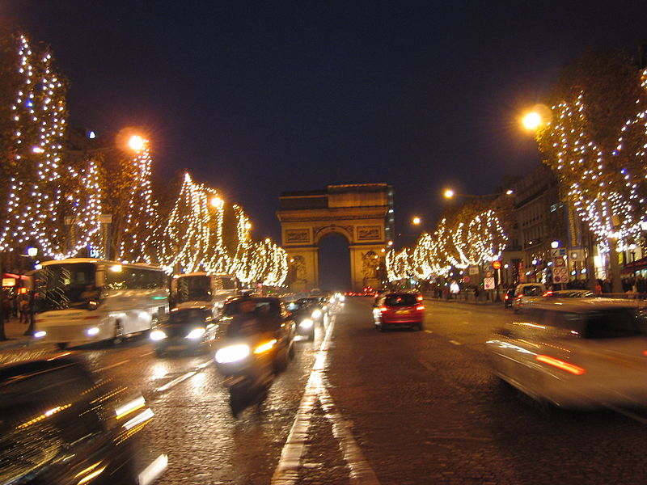
Christmas decorations along the Champs-Élysées

Slide 26
United Kingdom
In the United Kingdom Christmas decorations are put up in shops and town centres from early November. Many towns and cities have a public event to mark the switching on of Christmas lights. Decorations in people's homes are commonly put up from early December, traditionally including a Christmas tree, cards and lights both inside and outside the home. Every year, Norway donates a giant Christmas tree for the British to be raised in Trafalgar Square as a thank you in return for help during the Second World War. Christmas carolers at Trafalgar Square in London are singing around the tree on various evenings up until Christmas Eve in Christmas decorations are traditionally left up until the evening of 5 January (the night before Epiphany) and it is considered bad luck to have Christmas decorations up after this date. In practice, many Christmas traditions such as the playing of Christmas music largely stop after Christmas Day.

Slide 27
Mince pies are traditionally sold during the festive season, and are a popular food for Christmas. It is common in many UK households for children to put up advent calendars in their homes, which may either contain chocolates or Christmas scenes behind their doors. A common feature of the Christmas season is the Nativity play which is practiced in most primary and some secondary schools across the UK, this practice is becoming less common, and Christmas pantomimes may be performed instead. Midnight Mass is also celebrated by Anglicans, Catholics and other denominations and services take place in nearly all Church of England parishes on Christmas Eve.
On Christmas Eve, presents are supposedly delivered in stockings and under the Christmas tree by Father Christmas, who previously had been something like The Ghost of Christmas Present in Charles Dickens' A Christmas Carol, but has now become mainly conflated with Santa Claus. The two names are now used interchangeably and equally known to British people and some distinctive features still remain. Many families tell their children stories about Father Christmas and his reindeer. One tradition is to put out a plate of carrots for the reindeer and mince pies and sherry for Father Christmas to help him on his way.

Slide 28
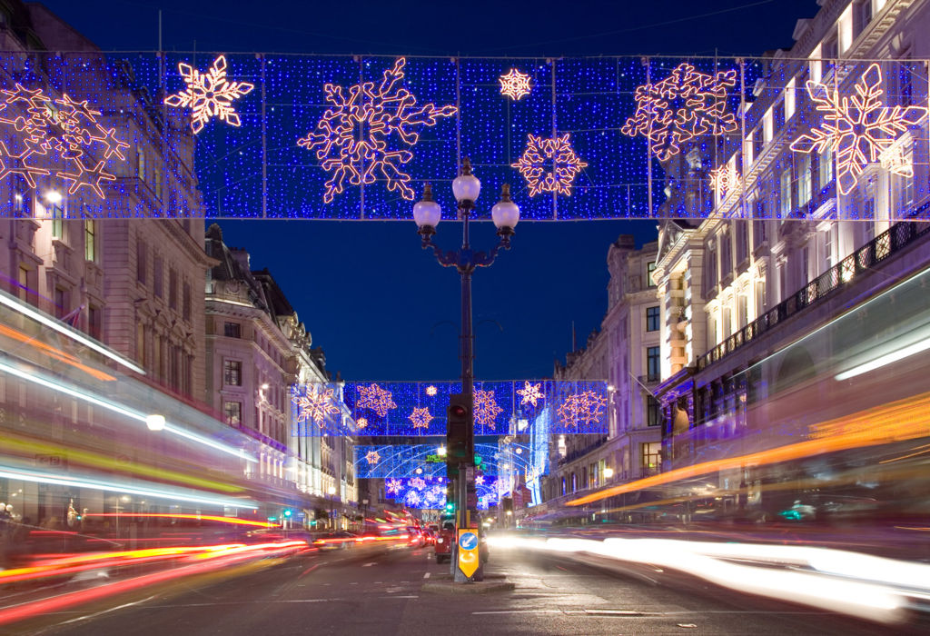
Regent Street, London

Slide 29
Austria
In the largely Catholic Austria, Christmas markets are a long-standing tradition. In Vienna, for instance, the market is held in the large square in front of City Hall. Innsbruck opens its romantic Christmas market in the narrow medieval square at the foot of the Golden Roof. In Salzburg, the Christmas market takes over the square in front of the Cathedral with its picturesque stalls, while the tree vendors occupy Residenzplatz on the side of the huge Cathedral. However almost every small town has its own Christmas market.

Slide 30
In Austria, Christmas tree plays a very important part of Christmas celebrations. Every town sets up its own huge tree on the main square all decorated with candles, ornaments and candies and frequently there will be an extra one, adorned with bread crumbs, for the birds. In families the tree is decorated with gold and silver ornaments or stars made our of straw, sweets and candy wrapped in tinfoil, gilded nuts, etc.
The feast of St Nicholas marks the beginning of Christmas in Austria. On Christmas Eve (December 24) the tree is lit for the first time and the whole family gathers to sing Christmas carols like “Silent Night, Holy Night”. Gifts that are placed under the tree are opened after dinner on Christmas Eve. Austrian Christmas tradition has it that it is the Christ Child himself who decorates the Christmas tree on Christmas Eve and brings the children their Christmas presents, and it is to him that their letters and wish lists are addressed in the weeks before Christmas. The Christmas Eve dinner is the main event of the night often served with fried carp. The famous sachertorte and different kinds of chocolates are served as dessert. The Austrians also have special crescent shaped cookies served during Christmas time.

Slide 31
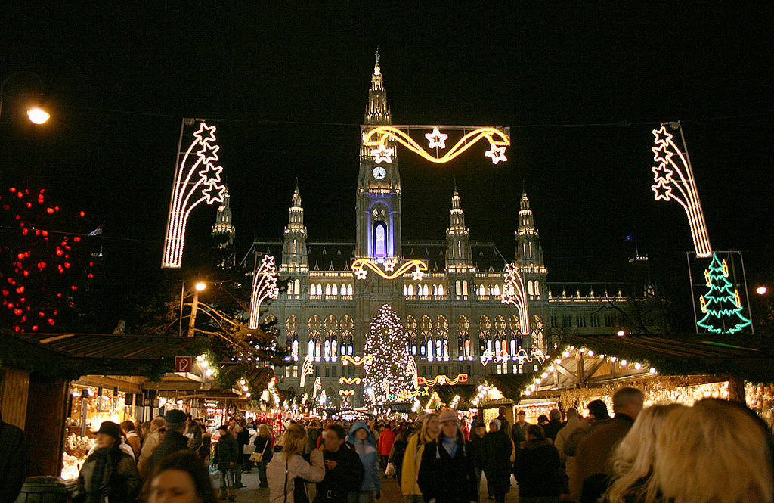
Vienna

Slide 32
Sports programme highschool, Suceava
Romania
Florea Cristina
Student at 10th F
English teacher: Muresan Loredana

