Slide 1
Wedding and birthday traditions in America

Slide 2
United States - handling wedding
Planning a wedding can be labor-intensive and time consuming. Many brides in the United States look for professional help in the form of a wedding consultant who will take care of every detail of this important day.
Traditional weddings in the USA are quite large and lavish. Especially when it is the first wedding for the bride. On the wedding day she is dressed in a wedding dress and a long veil. If the wedding takes place in a church, the one who presides over the wedding is a priest or another clergyman. At the time of the ceremony newlyweds say to each other marriage vows, which is very often written by themselves. They speak of love, the desire to make partner's life safe and happy and swear mutual faithfulness.
One of the most important thing of traditional ceremony in the United States is the question addressed to all the audience if any of them is aware of any reason why the relationship can’t be entered into a marriage. If no one raises objections, the bride and groom put rings on each other fingers and are announced a husband and wife

Slide 3
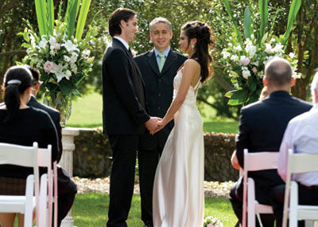

Slide 4
Mexico- Wedding traditions
At the time of speaking, the necks of newlyweds are symbolically wrapped in a white ribbon or Rosary, called a "lasso". It is a symbolic gesture of the connection between the young couple.
These are blessed by the priest during the marriage ceremony. That gesture means putting out the groom to his new wife.
When the newlyweds leave the Church they are thrown by red beads. It should bring them good luck and prosperity.
During the first dance at the wedding a young couple is surrounded by guest . They are holding hands in a heart shape.

Slide 5
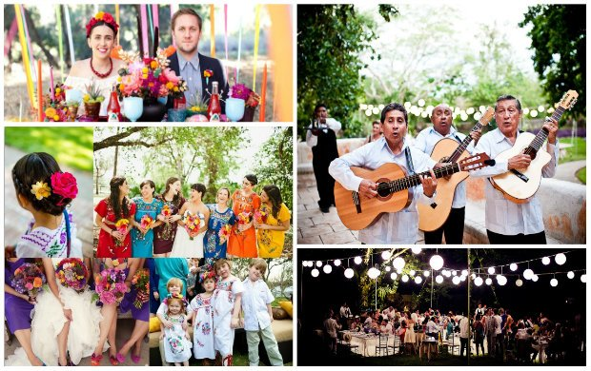

Slide 6
Brazil -wedding traditions
The weeding ring is worn on the left hand.
After leaving the Church, a young couple is thrown over with rice for good luck. The newlyweds get gifs according to the list of goods available in the selected store. There is no custom of giving money.
Weddings are organised at home, in the restaurant or in the lounge money
In Brazil there is one established and traditional wedding menu or buffet.
During weddings the groom dress up in a costume. During the wedding the newlyweds change their official clothes and wear something more comfortable .
They also are the first to leave the reception; you solemnly say good-bye to Newlyweds , and they continue to play.
The Brazilian weddings usually have very lively atmosphere, there's a lot of dancing and talking –although there is not practiced live music

Slide 7
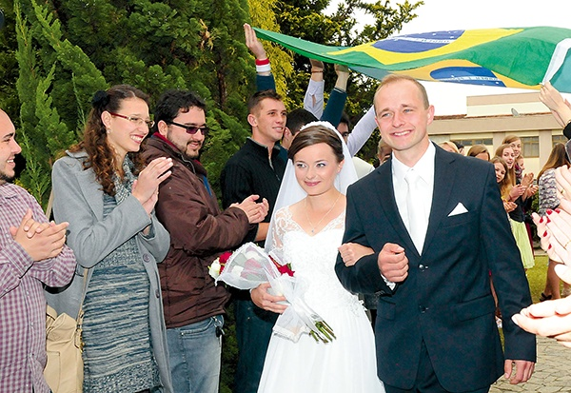

Slide 8
Argentina - birthday traditions
Birthdays are full of gift-giving and cake-eating. A funny tradition for children’s birthdays is that friends and family members pull the child’s earlobes for each year they are old.
Girls wait for her 15 , because they can dance their first waltz with her father or another man.
At this birthday girls celebrate their entrance into adulthood. A huge party is normally thrown and birthday gifts are more lavish than for other birthdays.

Slide 9
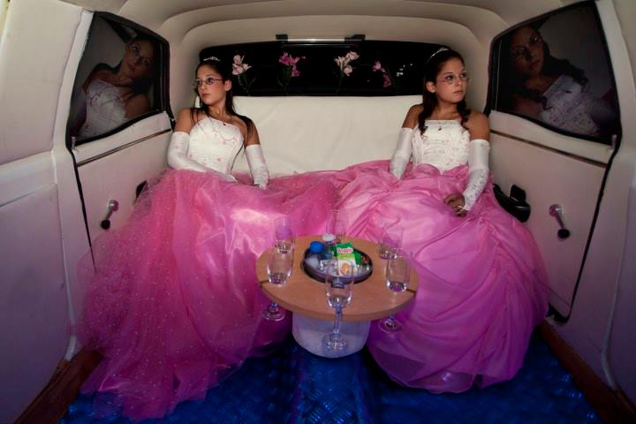

Slide 10
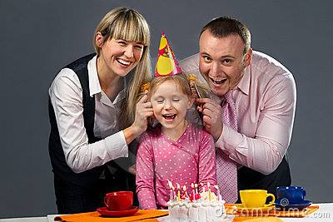

Slide 11
Canada -birthday traditions
When a Canadian person has birthday, the guest usually cover his or her nose with butter to make it slippery and unreachable for the bad luck.
Into multi-layered birthday cakes coins are inserted.

Slide 13
Mexico- birthday traditions
Pinata is a Mexican birthday custom, taken from the Italian culture. It is a figure of plaster, ceramics or paper -mache showing a favourite character or animal, filled with sweets and suspended over the floor. A blindfolded birthday person should break it up with a bat to rain themselves and the guests with sweets.

Slide 14
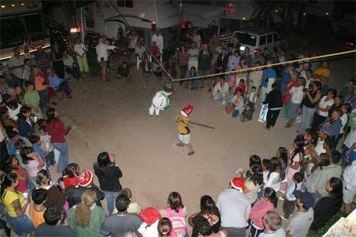

Slide 15
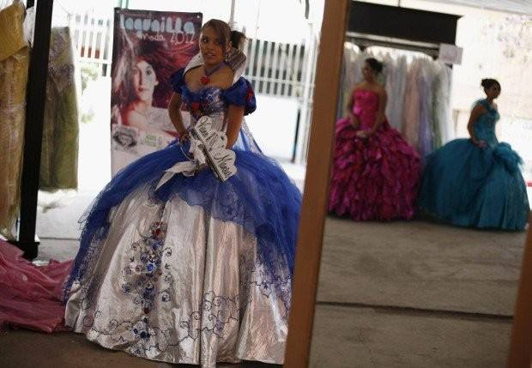

Slide 16
The End
Ania Budzyńska
Laura Świątek
Kinga Lament
Weronika Sulek

