Slide 1
CHRISTHMAS IN ASIA

Slide 2
INDIE

Slide 3
Christians in India
Christmas
Christians in India come together for Christmas dinner. They also decorate mango or banana trees, or just buy the equivalent of green artificial Christmas tree. Christmas is also popular among the followers of other religions who are very eager to visit their Christian friends (perhaps it is related to the fact that during the holidays everyone is free from work, regardless of religion). There is a tradition of singing carols and going to church at midnight, where you can see a typical crib. On the streets you can meet Santa Claus in a red costume. Preparations for Christmas begin long before the deadline. Shopping, cooking dishes - regional fish dishes, cheese, vegetables and rice. Tuning houses, buying Christmas baubles on street stalls and it all in the heat of Indian winter.

Slide 4
HAPPY DIWALI !!!
Diwali or Dipawali - festival praising the victory of Good over Evil. This is the most important festival for all Indians, traditionally starts on the darkest, new moon night of the Hindu Lunisolar month Kartika (between mid-October and mid-November) and lasts for five days. The second and third day of this period are regarded as the most important. It is an opportunity to meet with family and friends giving them the sweets. Lamps symbolize the victory of light over darkness. Diwali festival is accompanied by fireworks and flower decorations. Diwali is celebrated on a grand scale, accompanied by numerous cultural events.

Slide 5
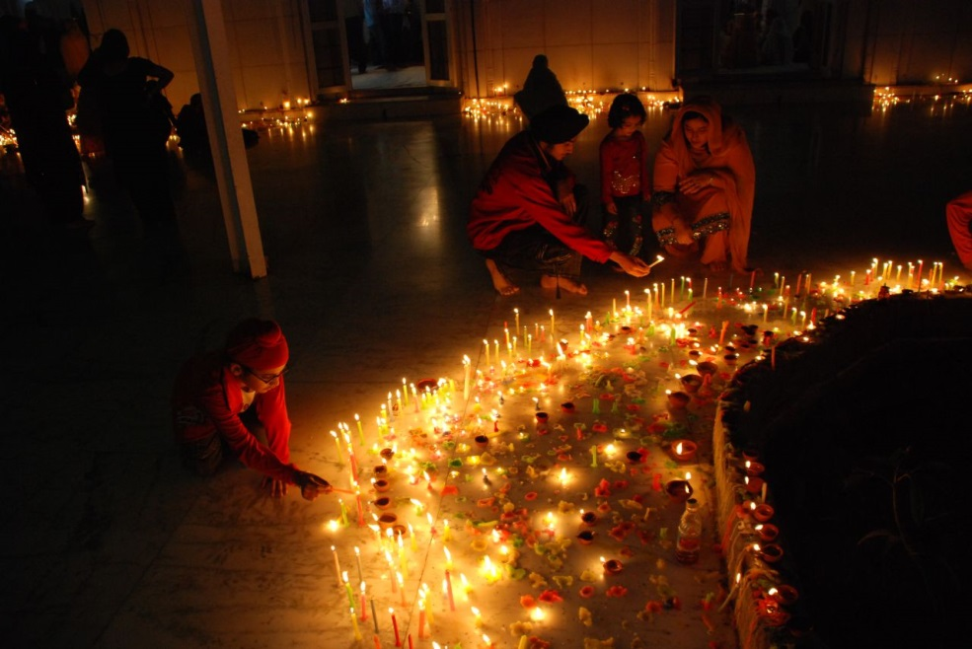

Slide 6
New Year’s Eve in India
In India, the custom of saying goodbye to the Old and welcome to the New Year at the end of December and January is rooted in the local tradition. In the tradition of the Indians New Year starts during Diwali. But in many regions of India it is also celebrated in March or April. Its advent is associated with the coming of spring and the beginning of spring agricultural work.

Slide 7
Theyyam
Theyyam (a dance in masks) is one of former Indian traditions. This tradition is connected with religious observance of heroes and goddesses. Often the ceremony is called „kaliyattam” which means „the dance of the goddess Kali". Theyyam is one of more interesting religious ceremonies which is possible to see in India. The elements of Theyyam are: mantra recitatives, hypnotic dances, blood.

Slide 8
JAPAN

Slide 9
New Year’s Eve
New Year is the most important holiday in Japan. Most businesses will be closed from 1 to January 3, so people have time to spend with their families. All the matters should be closed before the end of the year, when the parties "Bōnenkai" are organized in order to leave the worries and sorrows behind. Houses and entrance gates are decorated with reeds made out of pine, bamboo, and plum branches. It is best to start the new year by looking at the sunrise (Hatsu-Hinode), which according to the belief shows us what the next year will be like. That day should be full of joy, without anger and sorrow, and any works shouldn't be performed. The tradition also includes visiting the chapel or temple during these three days. During this time, the more popular temples are visited by several million people. It is also very popular to visit them at midnight when their bells herald the New Year.

Slide 11
SEVEN, FIVE, THREE (SHICHIGOSAN)
It is celebrated on 15th November. On that day people pray for boys at the age of three and five years and girls at the age of three and seven so that they were healthy and they had a long life. That day or the nearest weekend children are dressed in kimonos and taken to Shinto chapels. They also get sweets in bags embellished with turtles and cranes. All these three things symbolize the longevity.

Slide 12
Christmas
Celebrated on December 25th, is growing in popularity among Japanese. On this day people decorate trees, give presents and make a cake made from sponge cake with whipped cream and strawberries. Shop decorations are the most amazing element of this holiday in Japan. A few weeks before Christmas, you can see Christmas trees and other decorations in stores.

Slide 13
Prezentacje wykonały : Gabriela Baran Joanna Cupryan

