Slide 1
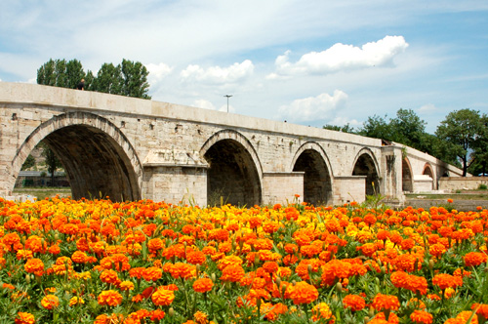
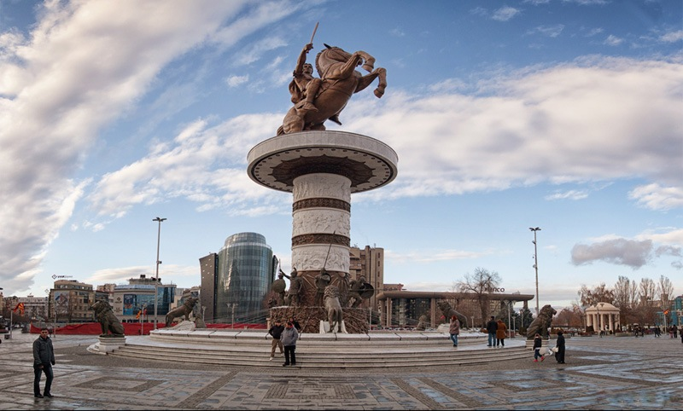
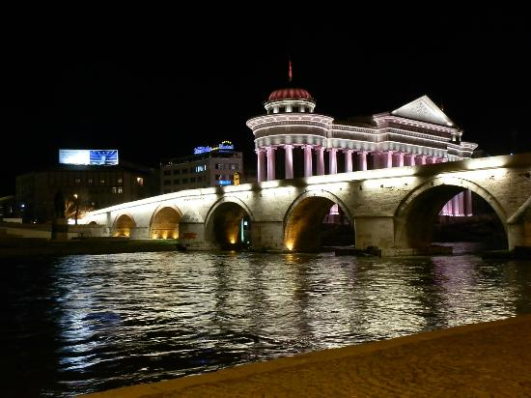
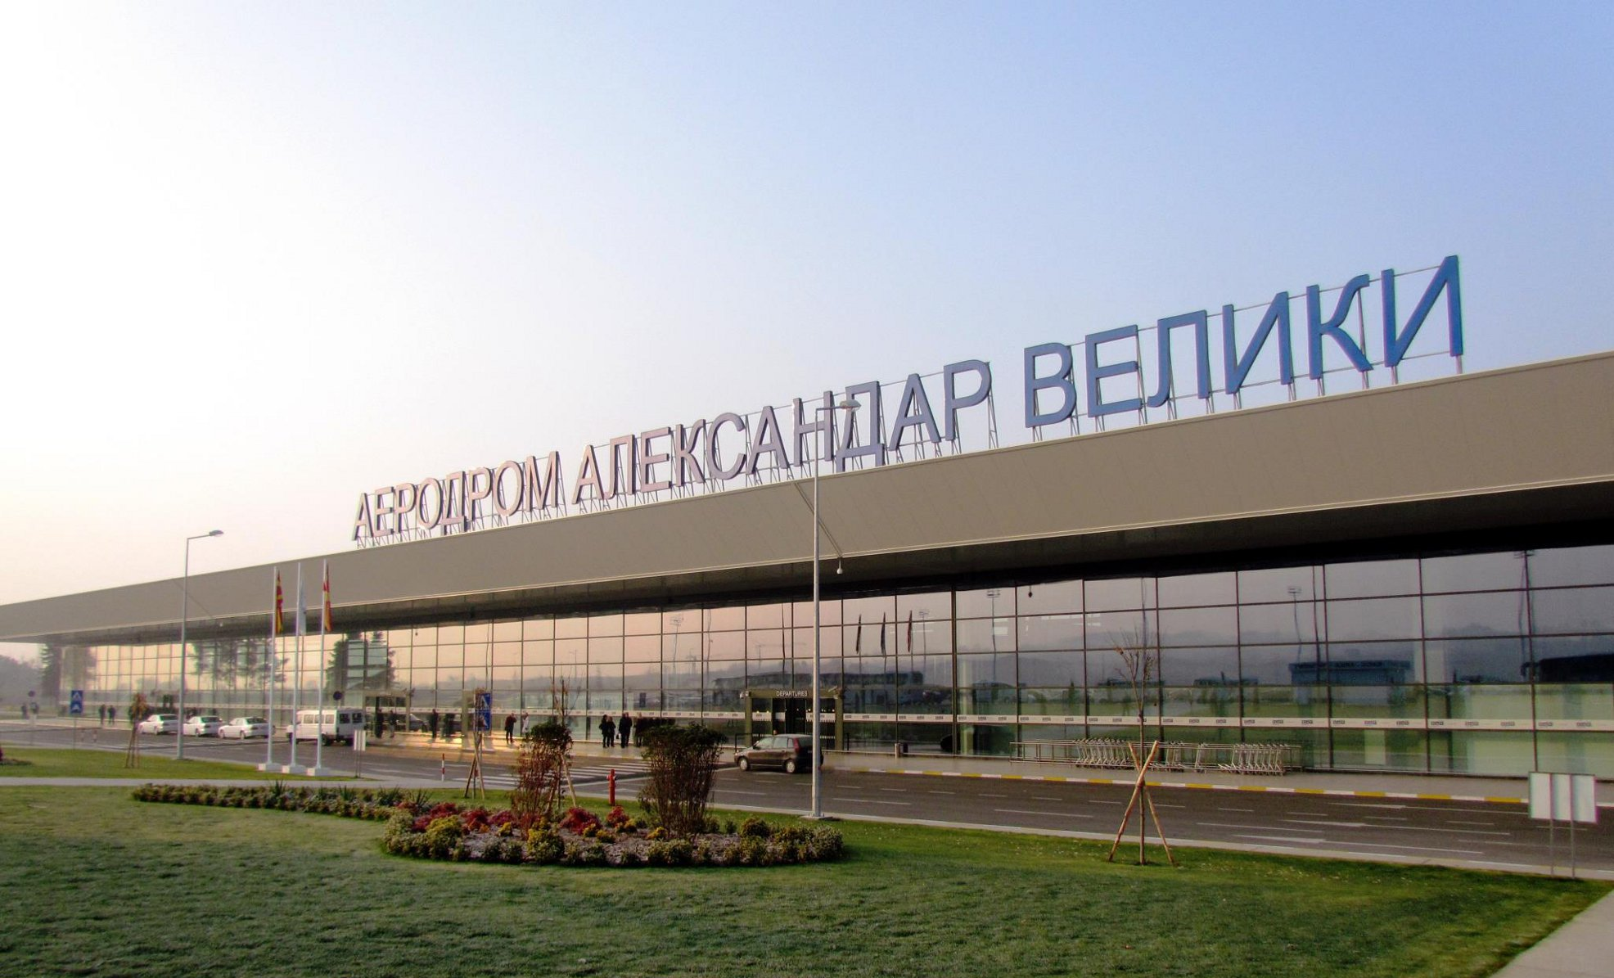
QUIZ FOR MACEDONIA
Let us know how much do you
know for our country

Slide 2
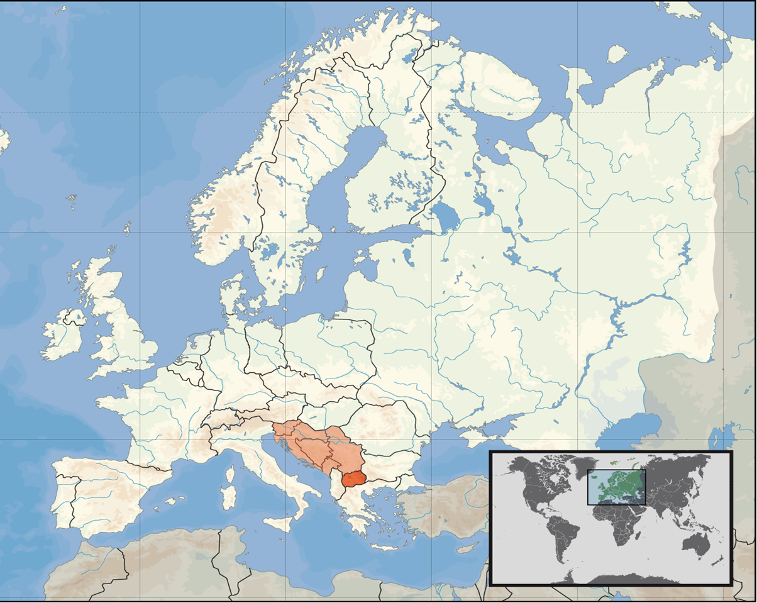
Where is Macedonia located ?
Question 1
A) North Europe
B) South Europe
C) East Europe
D) West Europe

Slide 3
Ups. That's wrong !
You need to start from the beginning...
Back

Slide 4
You have answered this question correctly.
Keep going ...
Next

Slide 5
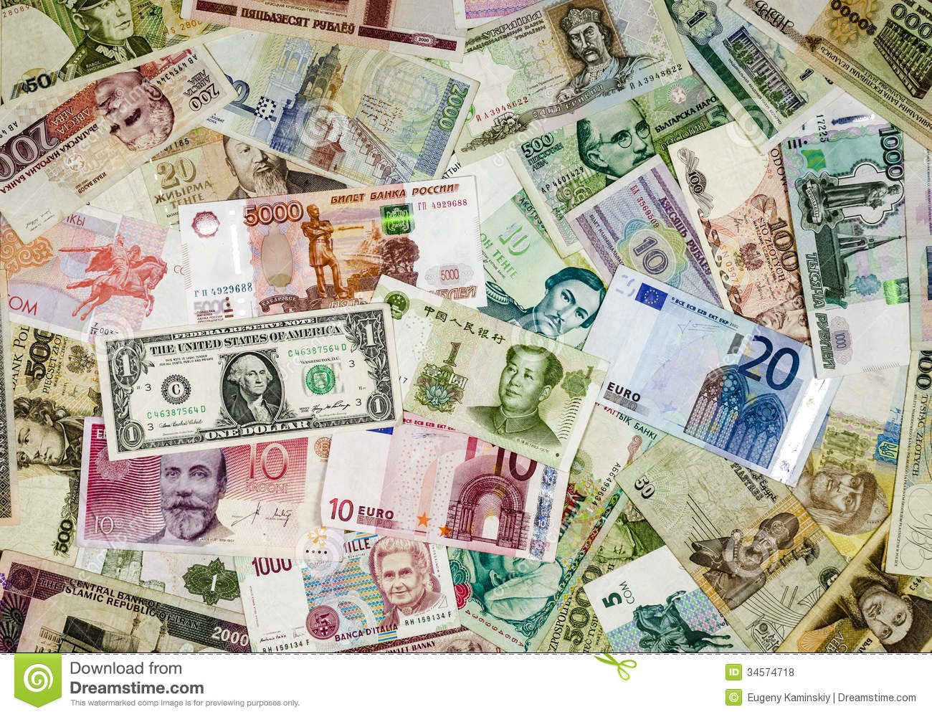
Which is Macedonian currency ?
Question 2
A) Euro
B) Dollar
C) Peso
D) Denar

Slide 6
Ups. That's wrong !
You need to start from the beginning...
Back

Slide 7
You have answered this question correctly.
Keep going ...
Next

Slide 8
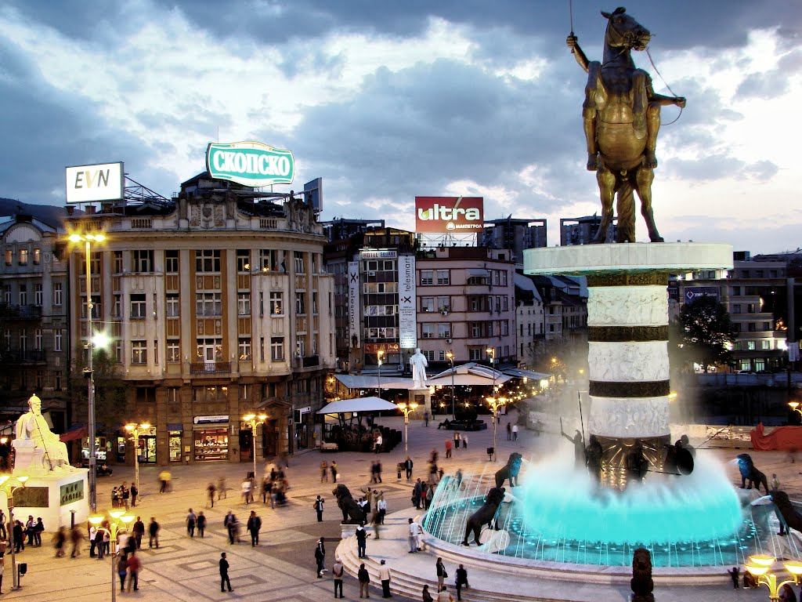
Which is the capital of Macedonia?
Question 3
A) Skopje
B) Zagreb
C) Prague
D) Budapest

Slide 9
Ups. That's wrong !
You need to start from the beginning...
Back

Slide 10
You have answered this question correctly.
Keep going ...
Next

Slide 11
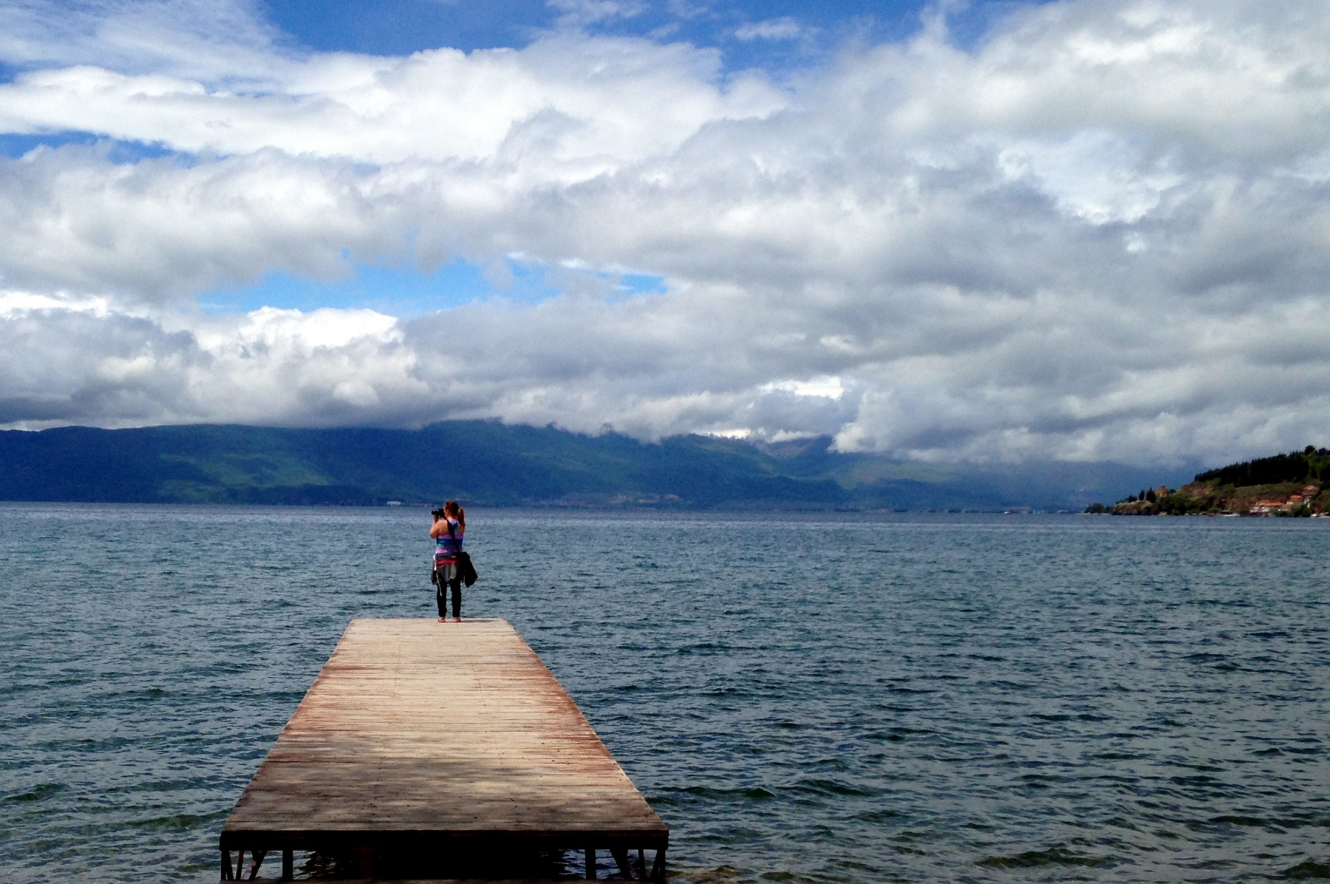
The biggest lake in Macedonia (protected by UNESCO) is :
Question 4
A) Odra Lake
B) Prespa Lake
C) Dojran Lake
D) Ohrid Lake

Slide 12
Ups. That's wrong !
You need to start from the beginning...
Back

Slide 13
You have answered this question correctly.
Keep going ...
Next

Slide 14
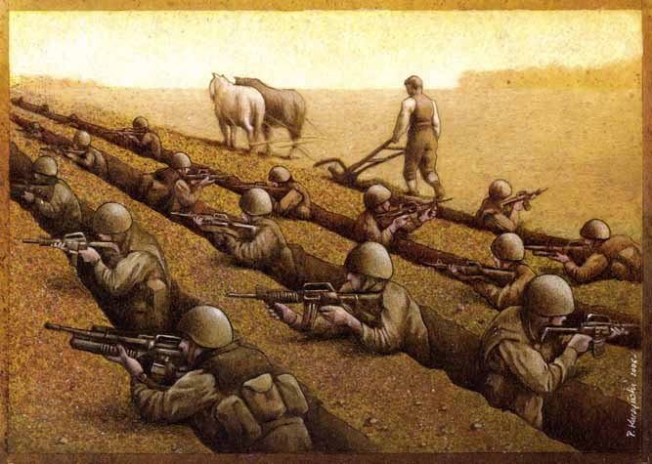
Which country has occupied Macedonia for five centuries?
Question 5
A) Turkey
B) Poland
C) Australia
D) Germany

Slide 15
Ups. That's wrong !
You need to start from the beginning...
Back

Slide 16
You have answered this question correctly.
Keep going ...
Next

Slide 17
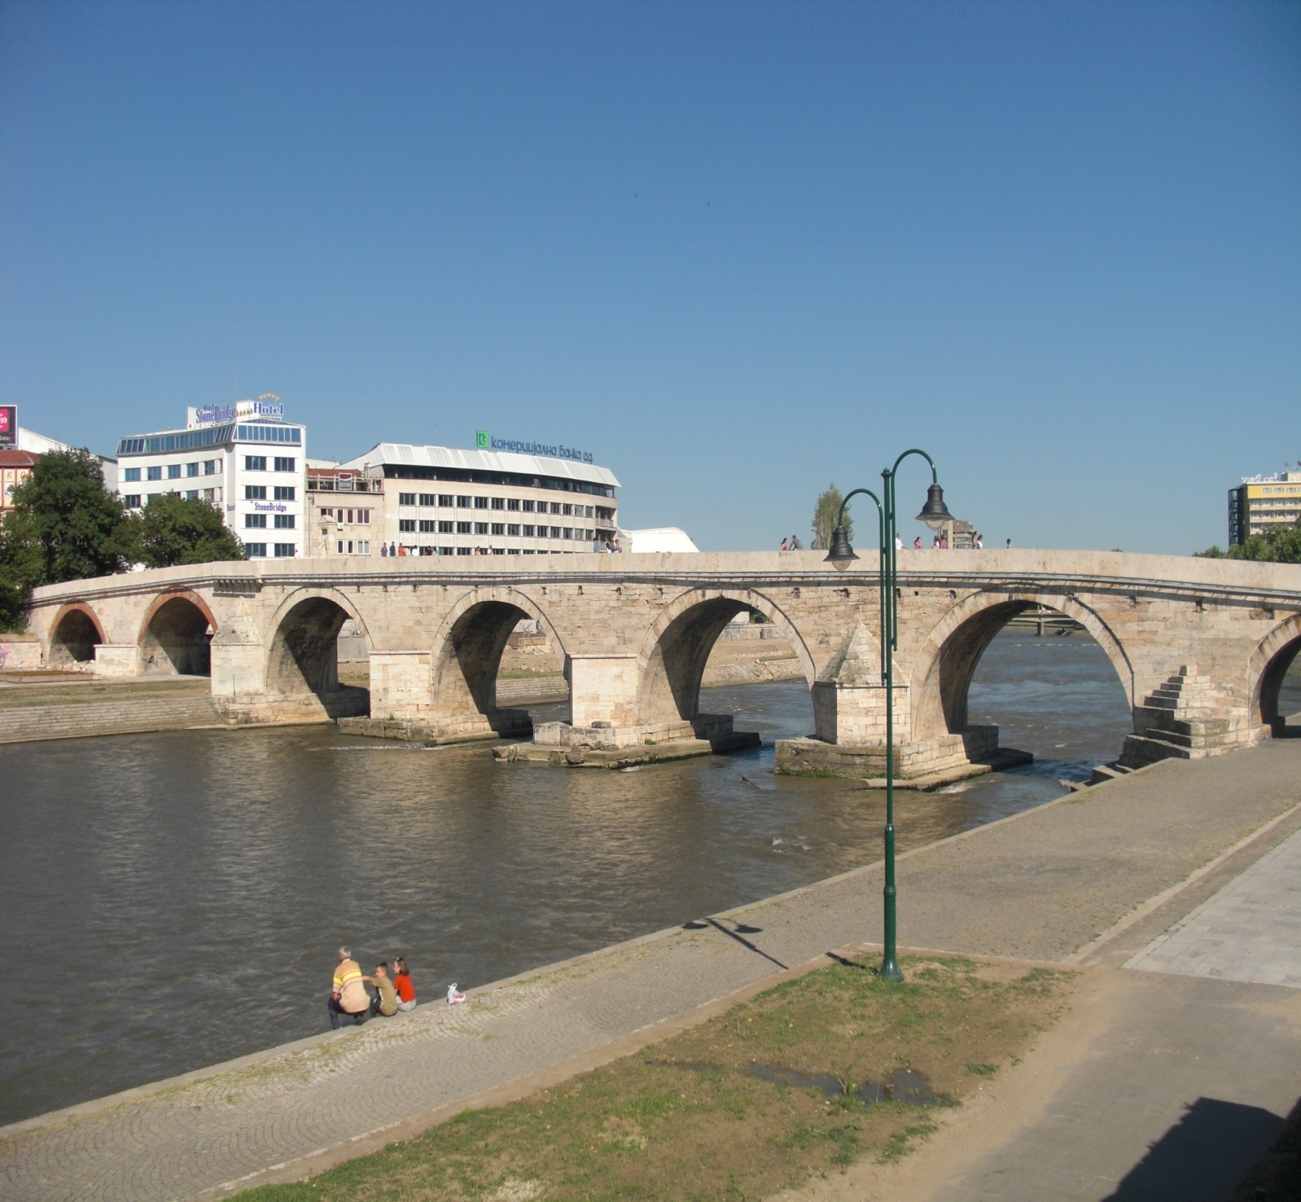
Which is the longest river in Macedonia?
Question 6
A) Nile
B) Radika
C) Vardar
D) Dunav

Slide 18
Ups. That's wrong !
You need to start from the beginning...
Back

Slide 19
You have answered this question correctly.
Keep going ...
Next

Slide 20
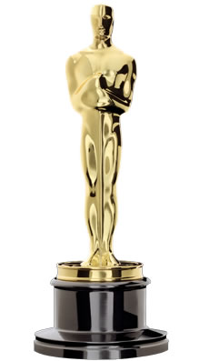
A Macedonian film was nominated for an Oscar in 1994. What was it called?
Question 7
A) Before the rain
B) A place in the Sun
C) Burnt by the Sun
D) To the hill

Slide 21
Ups. That's wrong !
You need to start from the beginning...
Back

Slide 22
You have answered this question correctly.
Keep going ...
Next

Slide 23
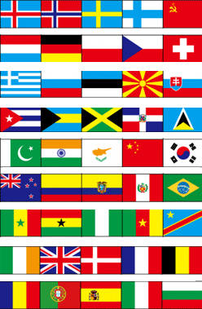
What does Macedonia’s flag look like?
Question 8
A) Red and Blue
B) Blue and Orange
C) Green and white
D) Red and yellow

Slide 24
Ups. That's wrong !
You need to start from the beginning...
Back

Slide 25
You have answered this question correctly.
Keep going ...
Next

Slide 26
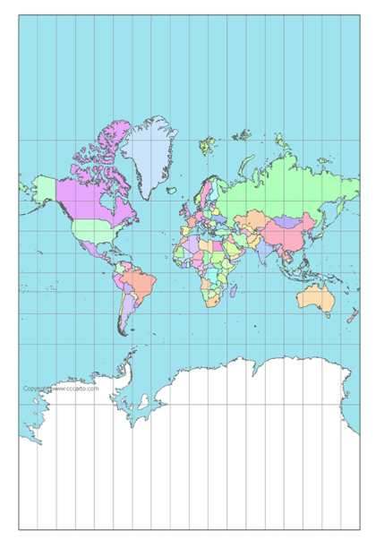
How many countries border Macedonia?
Question 9
A) Five
B) Two
C) Four
D) Three

Slide 27
Ups. That's wrong !
You need to start from the beginning...
Back

Slide 28
You have answered this question correctly.
Keep going ...
Next

Slide 29
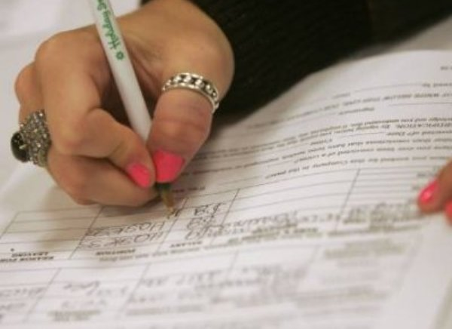
How many people live in Macedonia?
Question 10
A) 2.1 million
B) 1 million
C)5 million
D) 500 thousand

Slide 30
Ups. That's wrong !
You need to start from the beginning...
Back

Slide 31
You have answered this question correctly.
Keep going ...
Next

Slide 32
Good job. Now you know
something for
our country - Macedonia

