Slide 2
Media literacy and Podcasting at the students' fingertips.
Marie-Hélène Fasquel.
eTwinning ambassador,
ESL teacher, IT trainer,
author &
Tedx speaker.

Slide 3
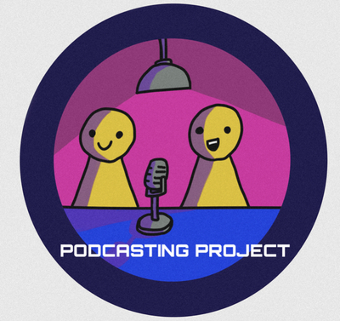
4 schools, 3 countries, 1 project
Project including 2 Italian, 1 German and 1 French schools
With Maria Rosaria Gismondi,
Mariella Sorrentino
Sabine Burkhardt
Times of crisis – need to address the issue of fake news and media literacy during a pandemic
Creatively,
Collaboratively,
While encouraging students to explore the topics of Covid-19 and distance learning (in light of their new knowledge).

Slide 4
Main goals
importance of fact-checking and critical thinking
First topic: “disinformation in the media”, in which our students learned how to debunk fake news.
One of our main concerns: the promotion of a safer and better Internet, used critically and respectfully.
Copyright issues.
Special attention was given to awareness of disinformation, scam, and online safety.

Slide 5
Our other goals
21st century skills
Project-based learning
Creativity (artwork, logos…),
Collaboration,
Critical thinking,
Communication,
Information literacy,
Media literacy,
Technology literacy, and
Flexibility.
Establishing real-world connections,
Anchoring the project within school curricula,
Structuring collaboration for students’ success,
Facilitating learning in a student-driven environment,
Embedding assessment throughout the project,
Publicly presenting the final products.

Slide 6
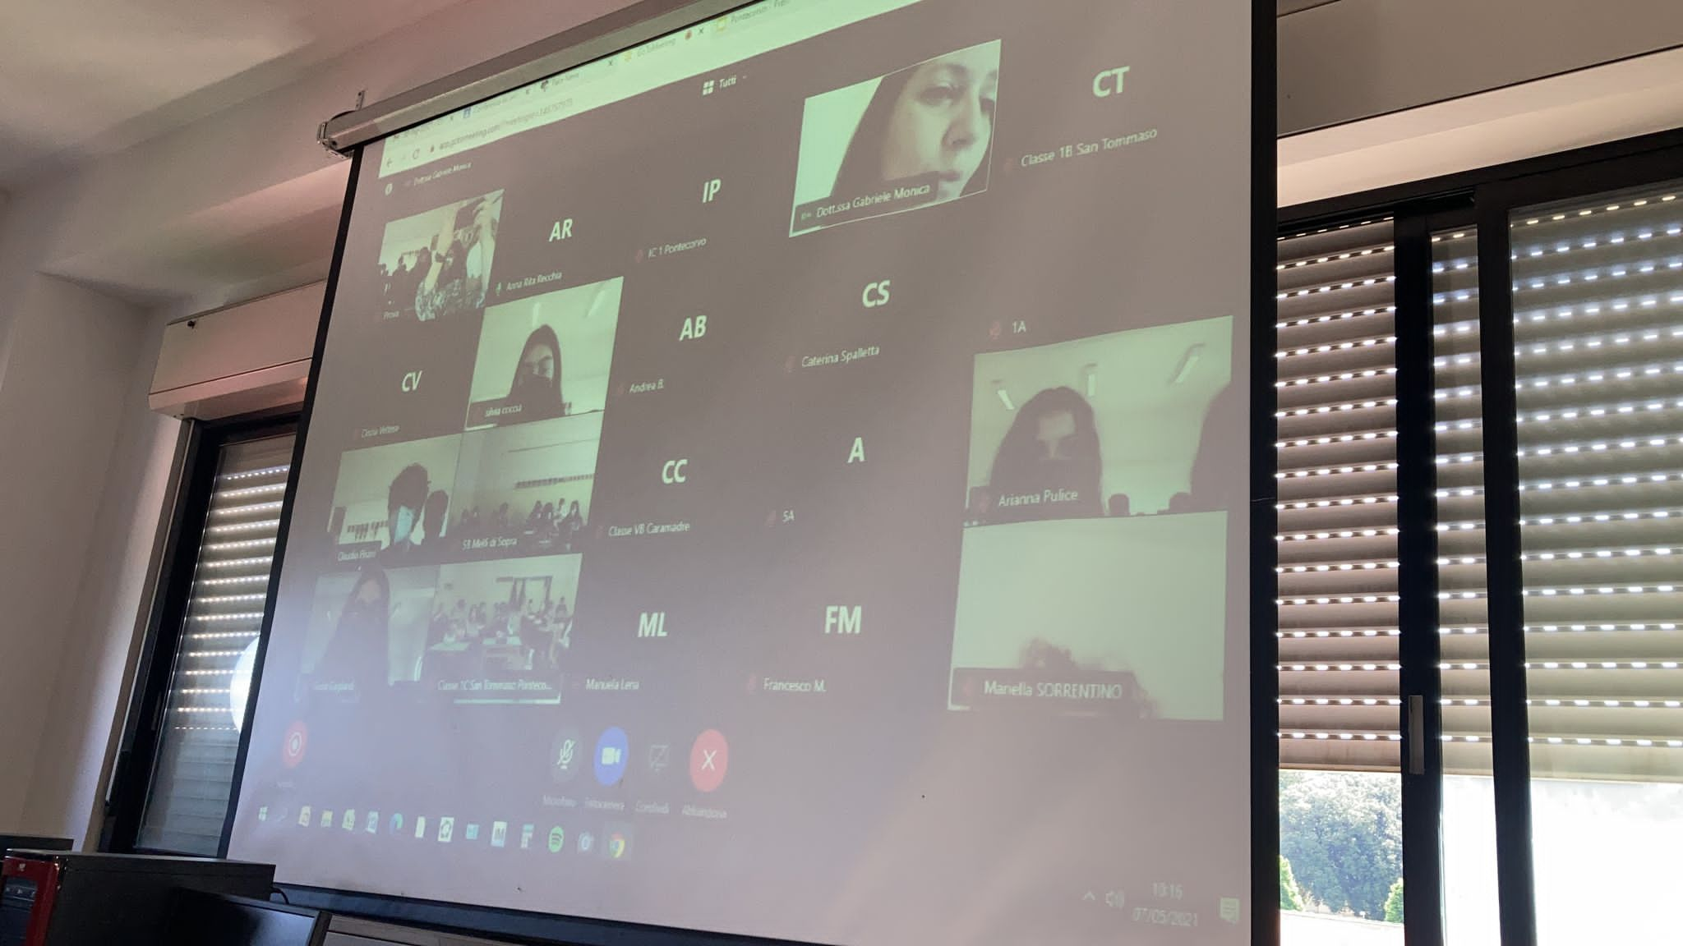
The first step
Media literacy and fake news
… creatively
Learning to debunk fake news,
To choose public domain music and images,
Not to be fooled by fake news…
Creating their own fake news in pairs.
Making it credible.
Sharing it only on our TwinSpace.
Discussing each other’s fake news.

Slide 7
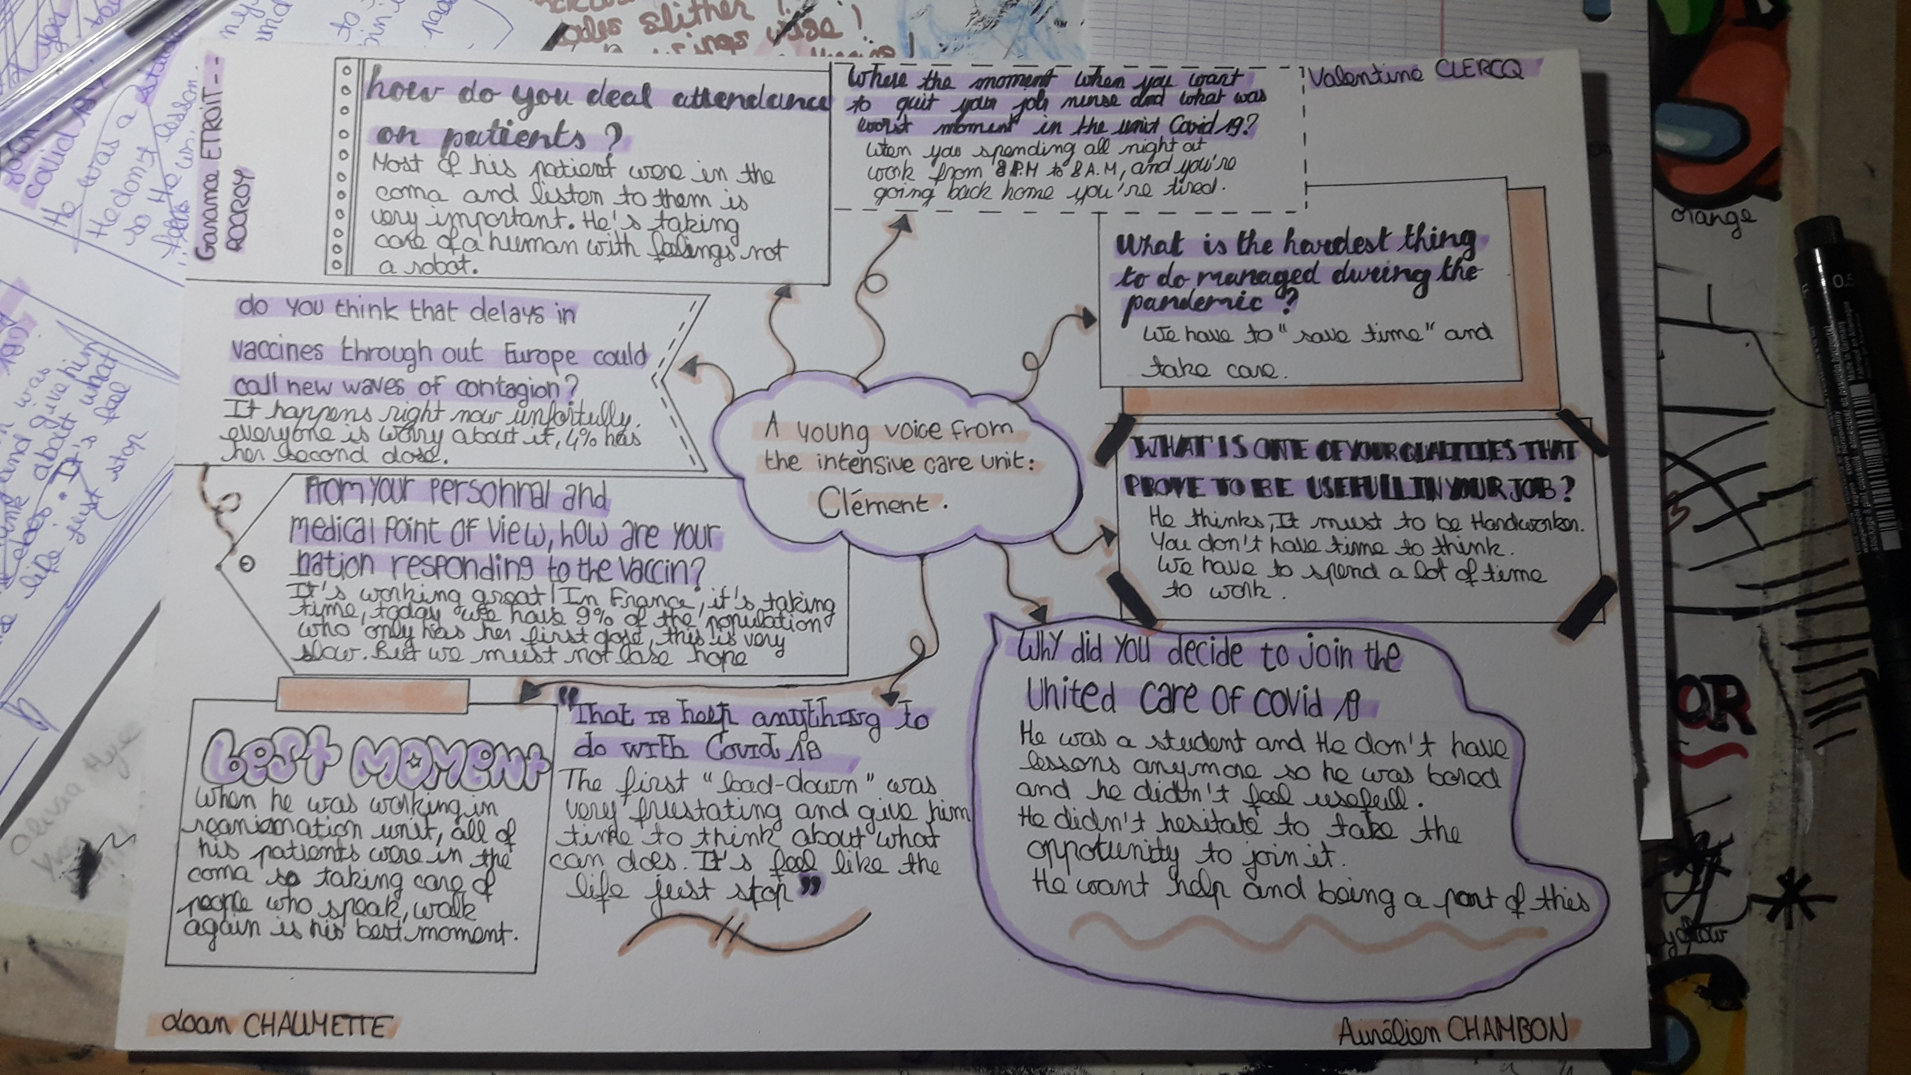
The second step
Making podcasts and sharing REAL news!
Making podcasts out of their interviews in groups of 10 (including students from all 4 schools).
Adding music, logo, editing collaboratively.
Mind mapping and discussing the podcasts,
Exploring 2 current topics:
Covid-19 & distance learning
2 topics which greatly impacted our students
Which allowed us to give them a voice
About which they interviewed 10 experts in order to get real news (with no filter, no media).

Slide 8
Conclusion
Exchanging during the
eTwinning Podcast Café
Learning about media literacy…
… in a hands-on experience, with students from 2 other countries,
Exchanging about their difficulties in times of great strain.
Making sure they would not fall prey to fake news!

Slide 9
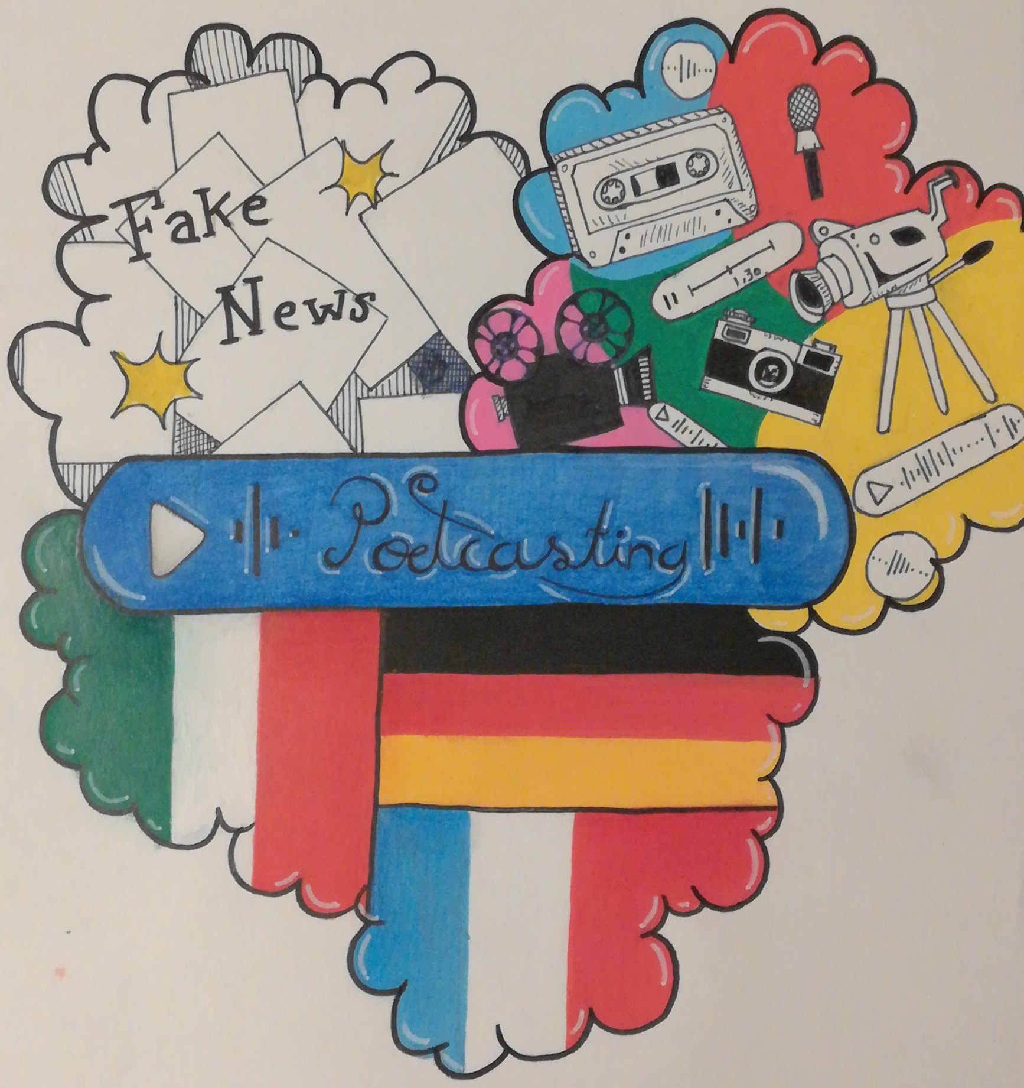
Our main collaborative and podcasting tools
Podcasting
Collaboration
Spreaker
Spreaker tutorial
SoundCloud
SoundCloud tutorial
Answer Garden (brainstorming)
Google doc and Hyperdoc (collaborating)
What’s App groups (exchanging about their different projects and podcasts)
Zoom, Google meet, Jisti meet (video calls, expert interviews, eTwinning Podcasting Café)
Padlet (resources, student work)
Issuu (ebook creation and sharing)

Slide 10
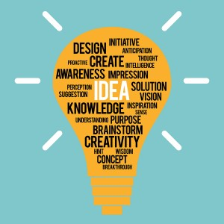
Our main collaborative and podcasting tools
Games – video making
Miscellaneous
Learningapp
Flipgrid
Tutorial
Kahoot
Tutorial
Voki (speaking characters)
Coggle (includes Tutoial) (diagrams, mind mapping tool)
About mind maps.
Wordwall (make custom activities for your classroom)
Canva (designs)
Selection of online tools and websites for students (ESL)
More tools (and tasks)

Slide 11
To dig deeper
What makes a good podcast? And Fake news resources Padlet.
COVID-related topics (vaccination…) and distance learning Padlet.
Our Fake news lesson plan.
Our Covid-19 lesson plan.
Our distance learning lesson plan.
The article about our project.
ebook (our project in 4 languages)
Last but not least:
The students’ podcasts
On SoundCloud
On Spreaker

