Slide 1
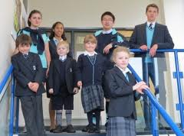
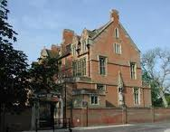
King’s Ely
King’s Ely is a mixed school in the historic town of Ely, about 20km away from Cambridge in the south east of England. It was founded in 970, which makes it one of the oldest schools in the world.

Slide 2
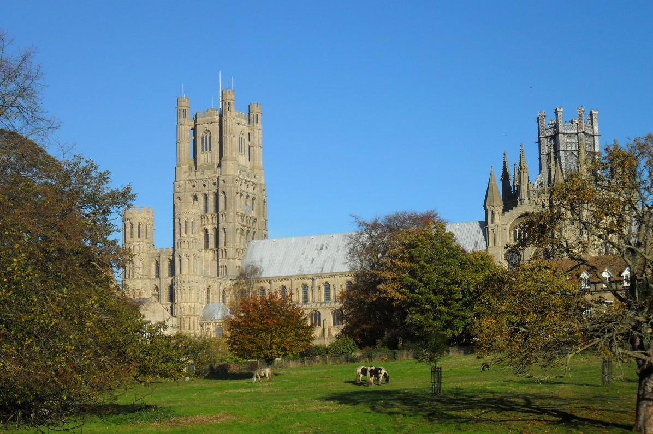
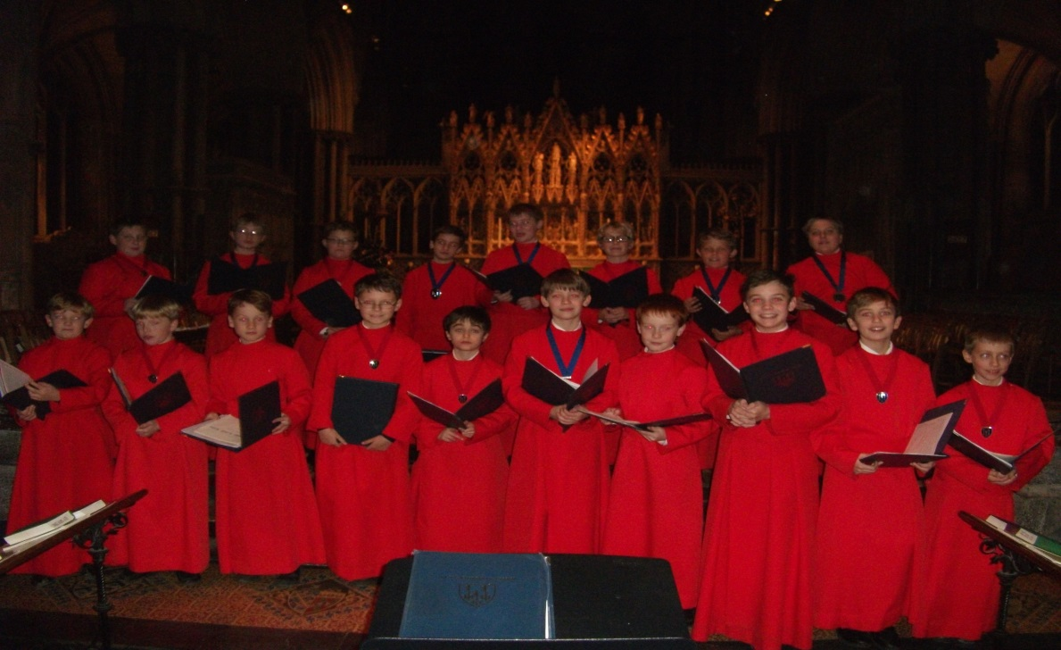
The school enjoys close links with the cathedral and the choristers study at the school. Music plays an important role in the school and many children play a musical instrument and sing in a choir.
La Cathédrale

Slide 3
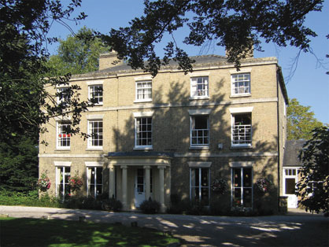
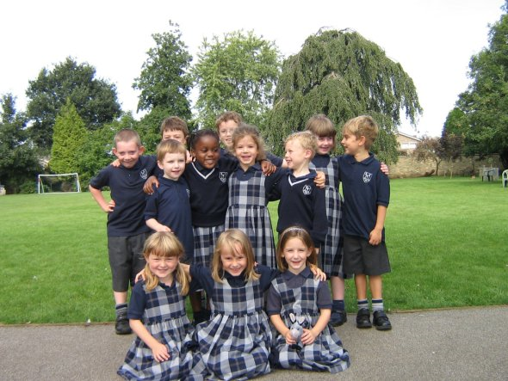
There are a thousand pupils in the school, which is made up of a nursery school.

Slide 4
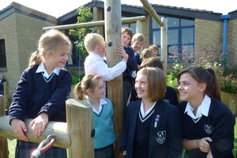
King’s Ely Junior
King’s Ely Junior is for pupils aged between 7 and 13.

Slide 5
King’s Ely Senior
King’s Ely Senior et Sixth Form is for pupils aged 13 to 18 years.

Slide 6
King’s Ely International
King’s Ely International is for pupils of all different nationalities who come to England for one or two years to live and study in England.

