Slide 1

Project mens en getal de bras

Slide 2
Contents
Children from mens en getal (our class)
Our timetable
All of our classes
Our teachers
Photo
End

Slide 3
Children
Ira, Abely, Paris, Liz, Ines, Ilana, Britt, Evie, Lydia, Feline, Katelijn, Hester, Benk, Roemer, Finn, Reinier, Wouter, Thomas, Noortje, Ellemiek, Charlize, Bjorn, Jet, Jasmijn, Julie, Frederique, Mila, Lisan

Slide 4
Our timetable
 | Monday | Tuesday | Wednesday | Thursday | Friday
8.30 – 8.45 | Circle | Circle | Circle | Circle | Cirlce
8.45 – 9.40 | Maths | Maths | Maths | Maths | Maths
9.40 – 11.00 | Language | Language | Language | Language | Language
11.00 – 12.00 | Familygroup | Familygroup | Familygroup until 12.15 | Familygroup | familygroup
12.00 – 13.00 | LUNCH | LUNCH |  | LUNCH | LUNCH
13.05 – 14.00 | Choice | Choice |  | Choice | Choice
14.00 – 14.45 | Choice | Choice |  | Choice | Choice
14.45 – 15.00 | Circle | Circle |  | Circle | Circle
In the choice lessons. The children choose which subject they want to go to. Each subject has a certain topic and assignment that changes every day (sometimes they last a few days).
During familygroup, the children can finish there maths and language assignments or work on assignments that they like. E.g. if they like history they can get a history assignment.
The kids are all in a familygroup. In this group there are children between the ages of 8 and 12. But during math and language they get taught on their level, so then they are with children around their age.

Slide 5
Mens en getal
(People and Numbers)
Mens en getal is a class where we learn math. Add, subtract, divide and multiply.

Slide 6
Mens en taal
(People and Language)
Mens en taal is a class where you can learn to write, speak, listen and read.

Slide 7
Mens en expeditie
(People and Expedition)
Mens en expeditie is a class where you can do really fun stuff like experiments. There are a lot of things to try

Slide 8
Mens en maatschappij
(People and Community)
Mens en maatschappij is a class where you learn about history.

Slide 9
Mens en wereld
(People and World)
Mens en wereld is a class where you learn stuff about the world. This can be geography or society.

Slide 10
Mens en natuur
(People and Nature)
Mens en natuur is a class where we learn a bout nature. From insects, human body to water creatures. Anything you can think of.

Slide 11
Mens en crea
(People and Creativity)
Mens en crea is a class to be creative. We learn to draw, paint and create.

Slide 12
Mens en techniek
(People and Technique)
Mens en techniek is a class where we work with our hands. We saw, make paper, make paint and create other stuff.

Slide 13
Juffen en meesters
(our teachers. A juf is female, meester is male)
juf Nicole, meester Jack, meester Jordi, juf Kirstin, juf Marilyn, juf Tessa, juf Lot, juf Marjan, juf Angèle, juf Lucia, juf Esmeralda

Slide 14
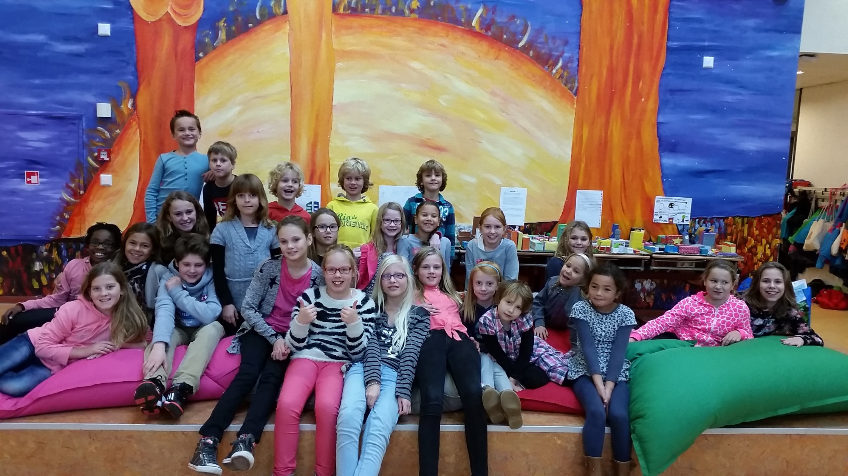
Photo

Slide 15
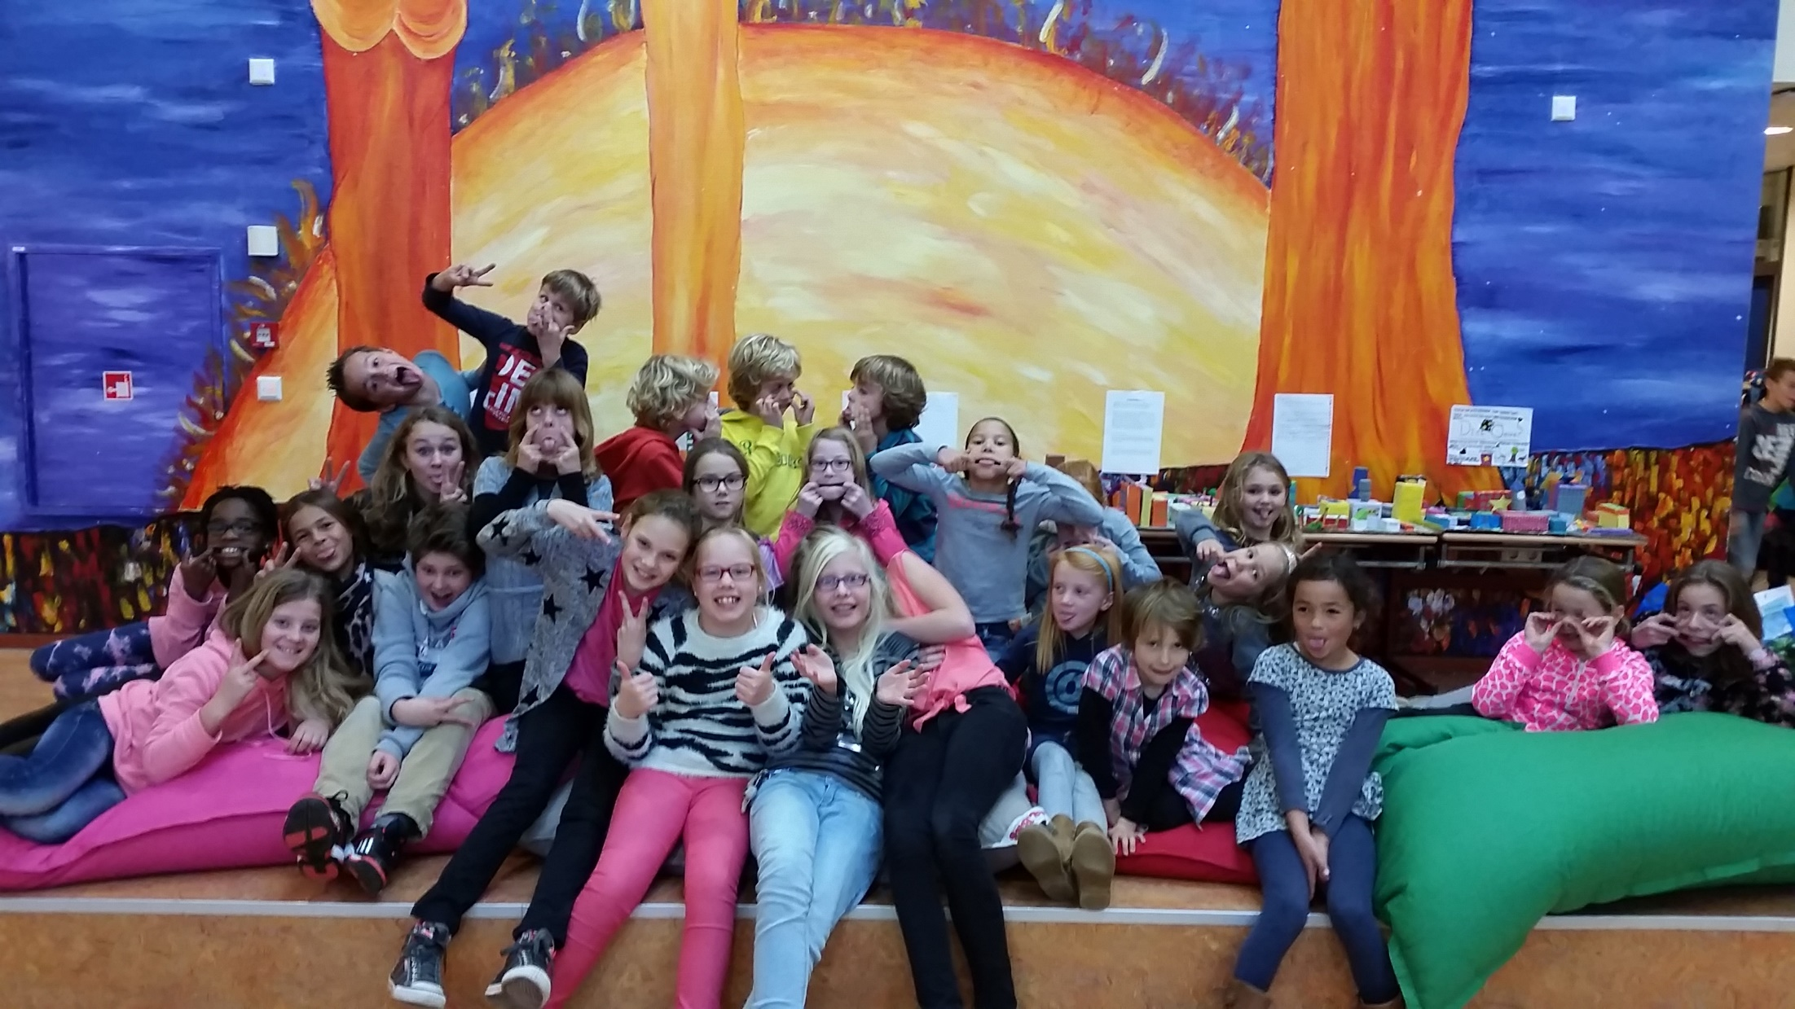

Slide 16


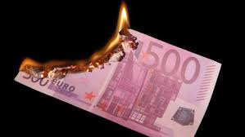
The End

