Slide 1
E-TWINNING PROJECT ˮWe are all humansˮ

Slide 2
We Are All Humans
Project initiated by teacher Branka Lamza and Ioannis Prodromou, a teacher from Greece.
Project coordinators for our school: teachers Iva Naranđa and Branka Lamza.

Slide 3
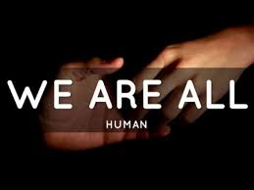
We Are All Humans
The aim of the project – raising the awareness of the importance of the integration of persons with disabilities in everyday life.

Slide 4
We are all humans
Project participants - students from class 4 to 8.
We (class 6b) made short films and presentations about people with hearing and visual impairments.
http://www.os-druga-ck.skole.hr/etwinning?news_hk=5630&news_id=908&mshow=1149#mod_news

Slide 5
Films, presentations, voice animations and comics

Slide 6
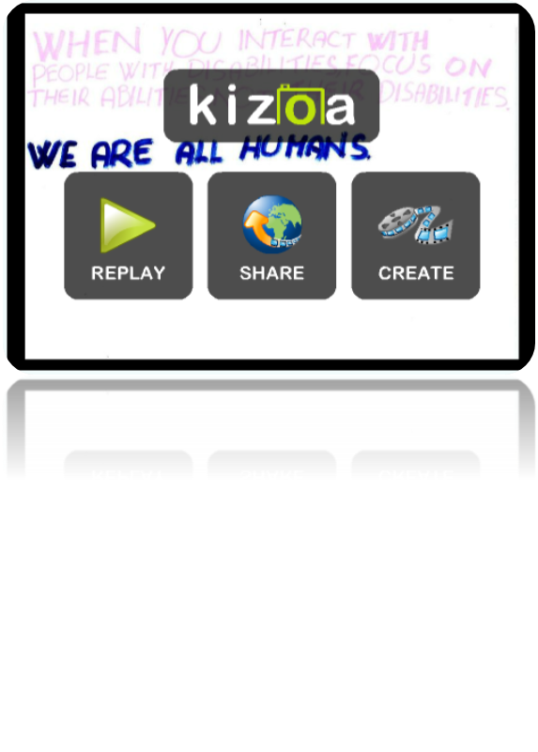
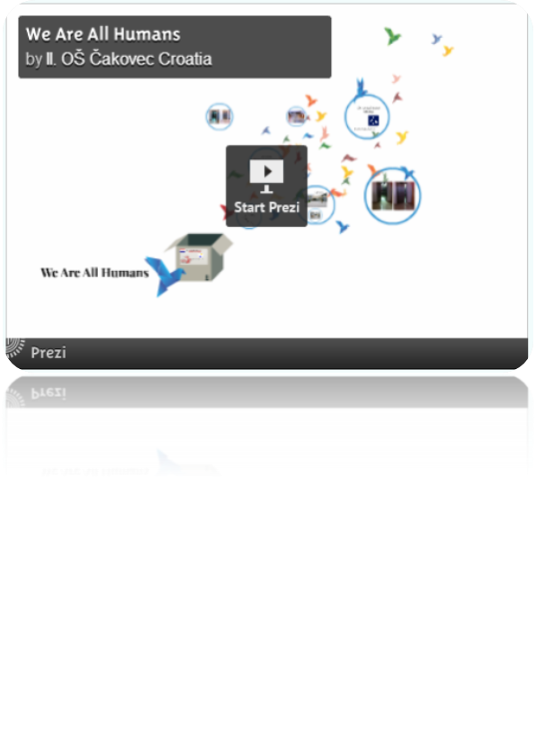

Slide 10
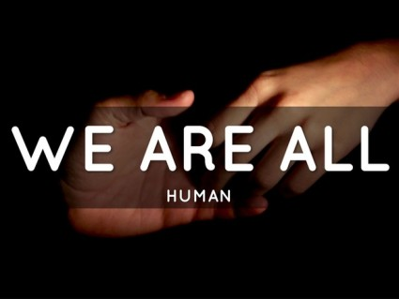
Thanks for watching!
by Elena Rajnović

