Slide 1
ACTIVITIES AT OUR SCHOOL
eTwinning project „We Are All Humans”

Slide 2
What is eTwinning?
eTwinning is the comunity for schools in Europe
the primary workspace for the eTwinning projects is the eTwinning Portal (www.etwinning.net) and it is available in twenty-five languages

Slide 3
eTwinning project „We Are All Humans”
- The project was led by teachers Branka Lamza and Iva Naranđa.
- The project was founded by teachers Branka Lamza and Ioannis Prodromou.
- We made short films, presentations, animations... You can see them on our webpage:
http://www.os-druga-ck.skole.hr/etwinning?news_hk=5630&news_id=908&mshow=1149#mod_newshttp://www.os-druga-ck.skole.hr/etwinning?news_hk=5630&news_id=908&mshow=1149#mod_news

Slide 4
Programes we used…
- We made presentations, drawings, voice animations, short films…
- Programs and tools we used: Powerpoint, Emaze, Voki, Prezi, Windows Live Movie Maker, Blendspace…

Slide 6
The main objective of the project
The main objective of the project was raising the awareness of the importance of the integration of persons with disabilities in everyday life.

Slide 7
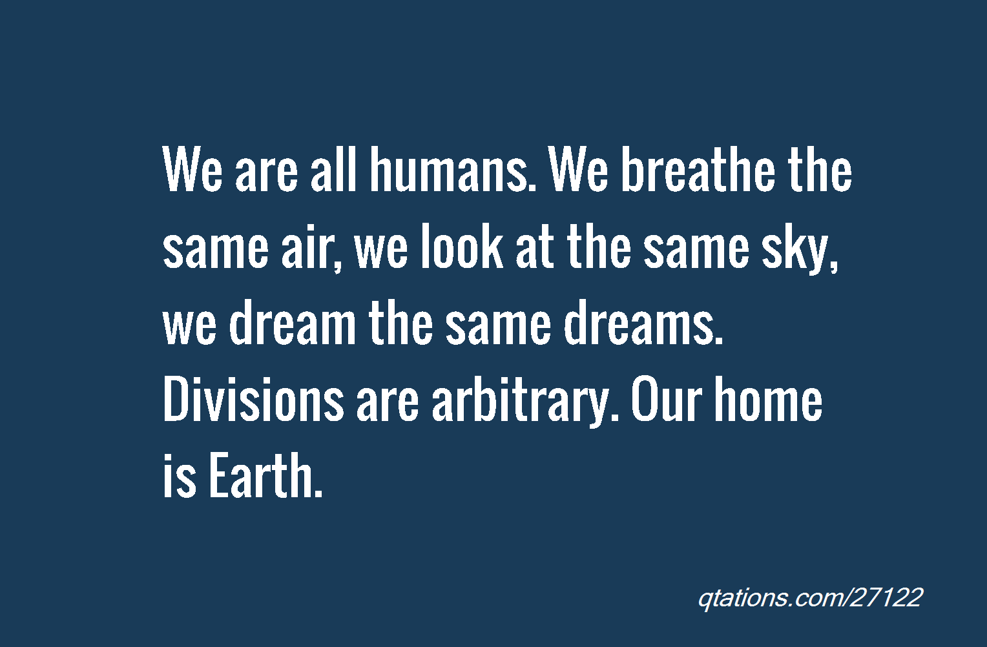
Thanks for your attention!
Made by: Dalia Hamer 6.b
II. osnovna škola Čakovec, Croatia

