Slide 1
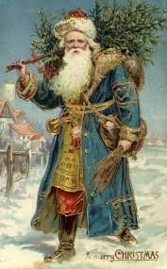
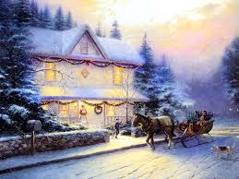
British Christmas Traditions

Slide 2
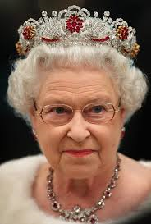
The Queen’s speech is a tradition on Christmas day to watch the Queen address the country on TV at 3pm.

Slide 3
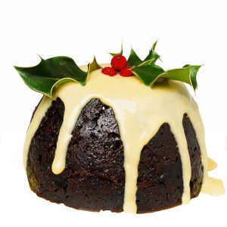
CHRISTMAS PUDDING IS A FRUIT AND ALCOHOL FILLED CAKE. WE EAT IT AFTER OUR CHRISTMAS DINNER.

Slide 4
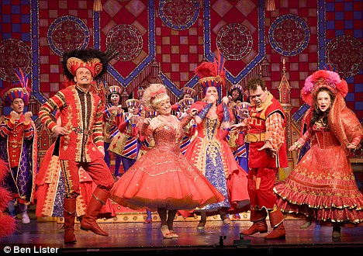
Panto A panto is something to watch at the Theatre. It is funny and it has songs in it. There is a dame played by a man who is dressed as a woman.

Slide 5
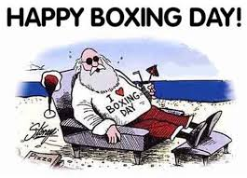
Boxing Day - this is on December 26th and used to be when people gave boxes with presents in .

Slide 6
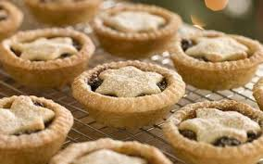
Mince pies are a traditional food eaten over Christmas and is filled with dried mixed fruits, nuts and alcohol. They are normally put out for Santa on Christmas Eve. You can serve them with cream.

Slide 7
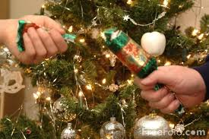
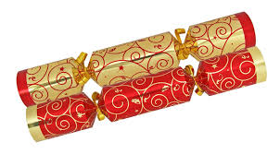
Crackers have hats and jokes in and are a Christmas tradition with a meal. They have gifts in them and go off with a bang when you pull them!

Slide 8
Thank you for waching! eTwinners from Bristol

