Slide 1
Me

Slide 2
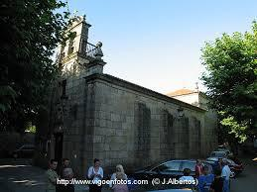
My name is Sergio (I’m a boy if you doubting).
I live in Candean, in Vigo.
This are the church of Candeán and his shield:

Slide 3
My hobbies:
My favourite team is Real Madrid, but I like R.C Celta de Vigo.

