Slide 1
My personal description
I'm Yago Méndez Domínguez.
I’m 13 years old.
I have got a little brother.
He is 10 years old and his name is Diego.

Slide 2
My hair is short and brown, my eyes are brown, too and i'm tall.

Slide 3
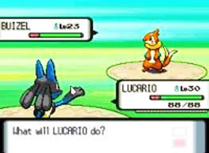
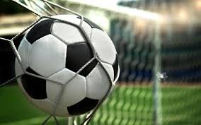
I like the music
video games
and playing with my friends.
football
My favourite subject is music.

