Slide 1
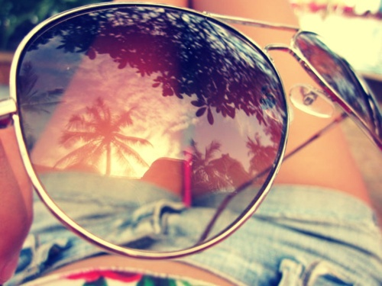
Carlota Pérez Álvarez
Hello, my name is Carlota.
I am 13 years old.
I am high and thin.
My hair is long and brown and I have green eyes. I’m very funny, organized, romantic, studious…

Slide 2
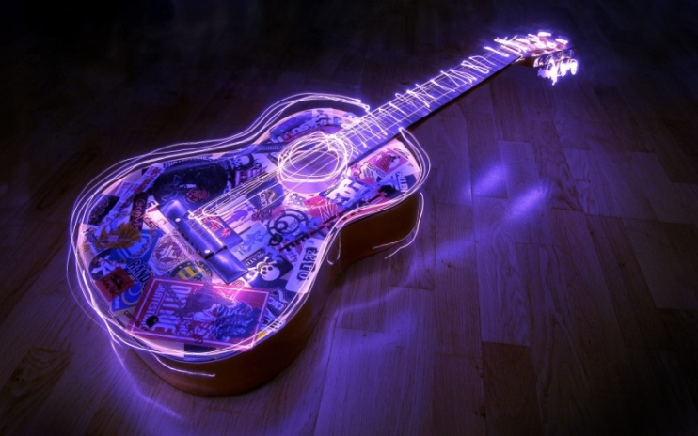
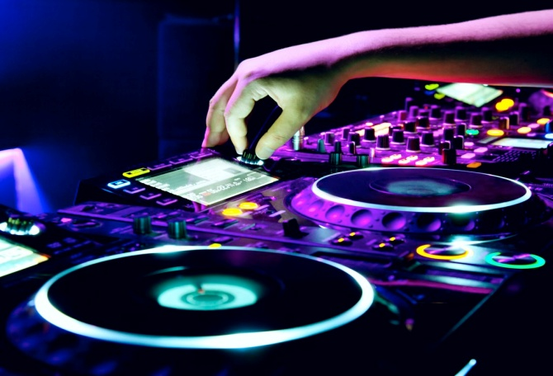
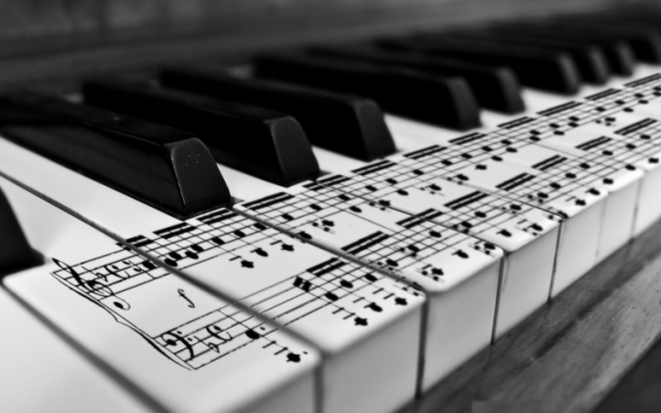
I LOVE MUSIC.
I COULD NOT BE WITHOUT MY MP3.
I DON’T HAVE A FAVORITE SINGER, I LIKE SEVERAL SUCH JASON DERULO, RITA ORA, RIHANNA, BEYONCE, SIA, ZENDAYA, EMINEM…
I LIKE DJ WITH DEHORRO, R3HAB, SIDNEY HOUSE…

Slide 3
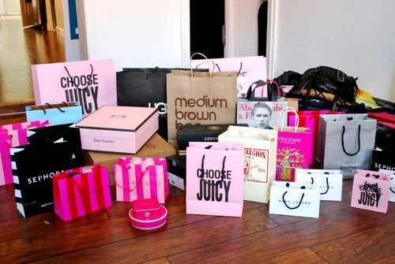
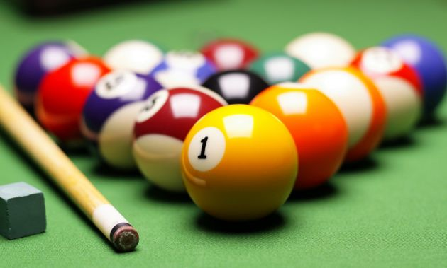
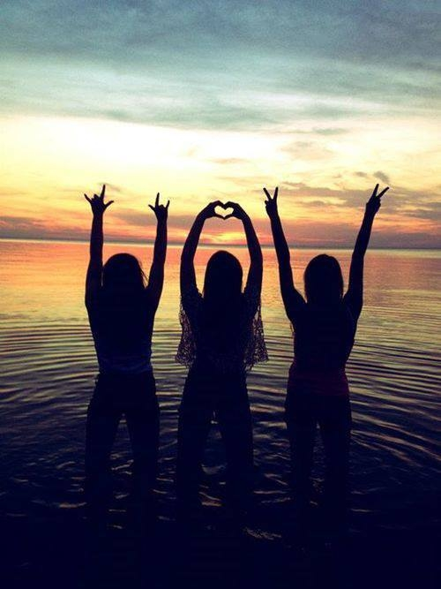
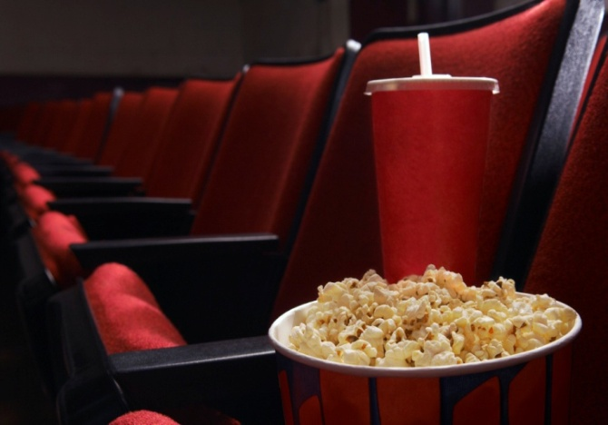
I love fashion, shopping, being with my friends, reading romantic books, going to the cinema, skating…
In my free time I like playing ping pong, tennis, badminton, going to the pool…

Slide 4
I have a family that loves me¡¡¡
I only have one sister.
Her name is Alba.
She is very pretty and caring with my

