Slide 1
PANCAKES

Slide 2
we need
Milk.......... 400 ml
two eggs
bit of salt
flour.......... 200 g

Slide 3
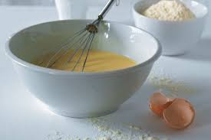
1st step
Mix everything in a bowl

Slide 4
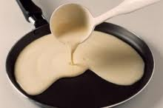
2nd step
fill dough into a pan with oil
fry dough

Slide 5
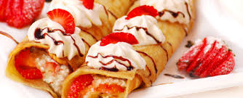
Serve with jam or cinnamon and fruit

