Slide 1
Christmas time in Poland

Slide 2
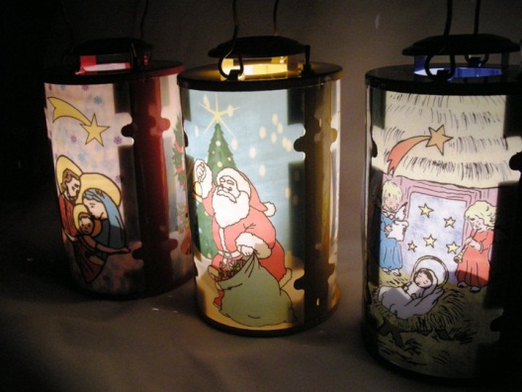
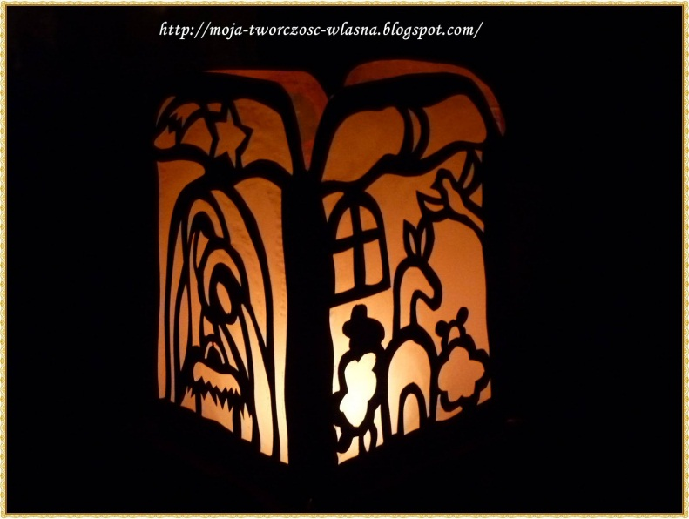
4 weeks before Christmas we start ADWENT – a special time when we go to the church with lanterns

Slide 3
Santa Claus
Christmas and Santa Claus Day are not at the same time in Poland.
Santa Claus (called Mikołaj) Day is celebrated on December 6th, the name day of St. Nicholas.
He visits some children in person or secretly during the night.

Slide 4
CHRISTMAS EVE
December 24 th is called in Polish WIGILIA.

Slide 5
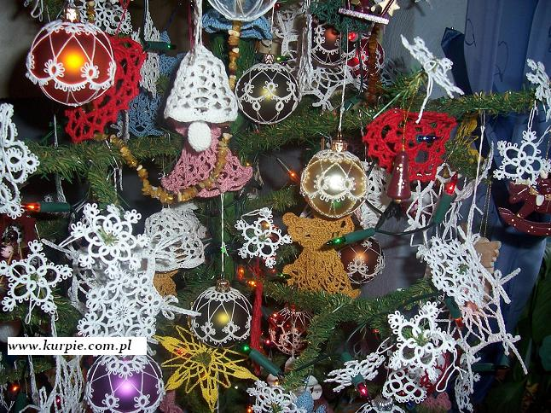
Christmas tree
The Christmas tree is decorated this day with chocolates and sweets or other handmade things.

Slide 6
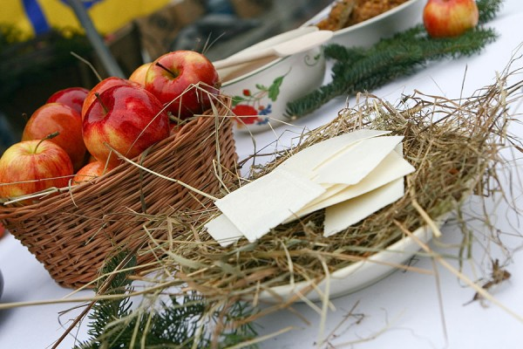
Straw is put under white tablecloth.

Slide 7
Strangers are welcomed
In Poland, an additional seat is kept for somebody unknown at the supper table.
Noone should be left alone at Christmas, so strangers are welcomed to the Christmas supper.

Slide 8
First visiting person
In the morning, if the first visiting person is a man, it means good luck.
If the visitor is a woman, you may expect misfortune.

Slide 9
Stop fighting – breaking Christmas wafer: oplatek
The oplatek is a thin wafer made of flour and water. For table use, it is white.
Sometimes an oplatek is sent in a greeting card to loved ones away from home.
Polish people break the wafer to say I am sorry and wish one another happiness and good health.

Slide 11
The first star
On Christmas Eve, everyone waits impetiently for the first star.
When it appears they can start with the pray and breaking the wafer.

Slide 12
12 meatless dishes
You can taste eg. Red borstch - barszcz
Pierogi – called in English dumplings
Poppy sed cake
Fish with potatoes

Slide 13
The Mass of the Sheperds
After tasty supper everyone sings Christmas carols and at midnight they go to the church for a midnight mess called Pasterka.

