Slide 1
THE
EDUCATION
SYSTEM
IN
T U R K E Y

Slide 2
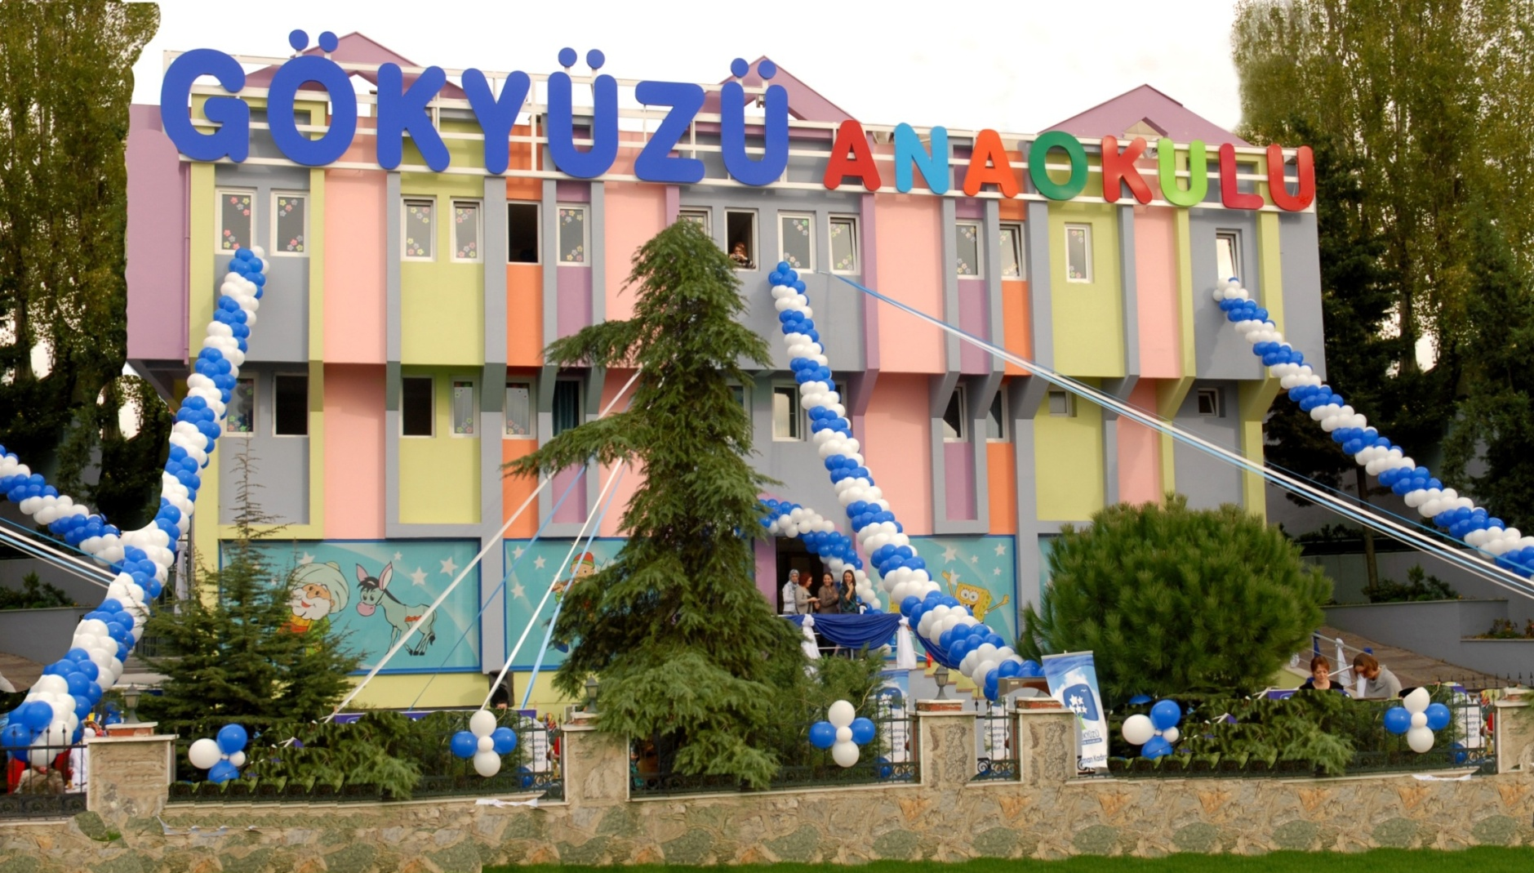
1- KINDERGARTENS

Slide 3
Children between 3 and 6 years go to kindergartens 5 days a week. They usually stay at school from 9.00 to 5.00.
They study Foreign Languages, Maths, Drama, Information Technology, Gymnastics, Swimming, Horse riding, Ballet, Folk Dances, Chess, Music, Drawing, Fine Arts and Reading-Writing (at the age of 6).
The pre-school education is not compulsory but it is becoming more and more popular because not only people have understood how necessary it is but also the number of mothers in business life is increasing every day.

Slide 4
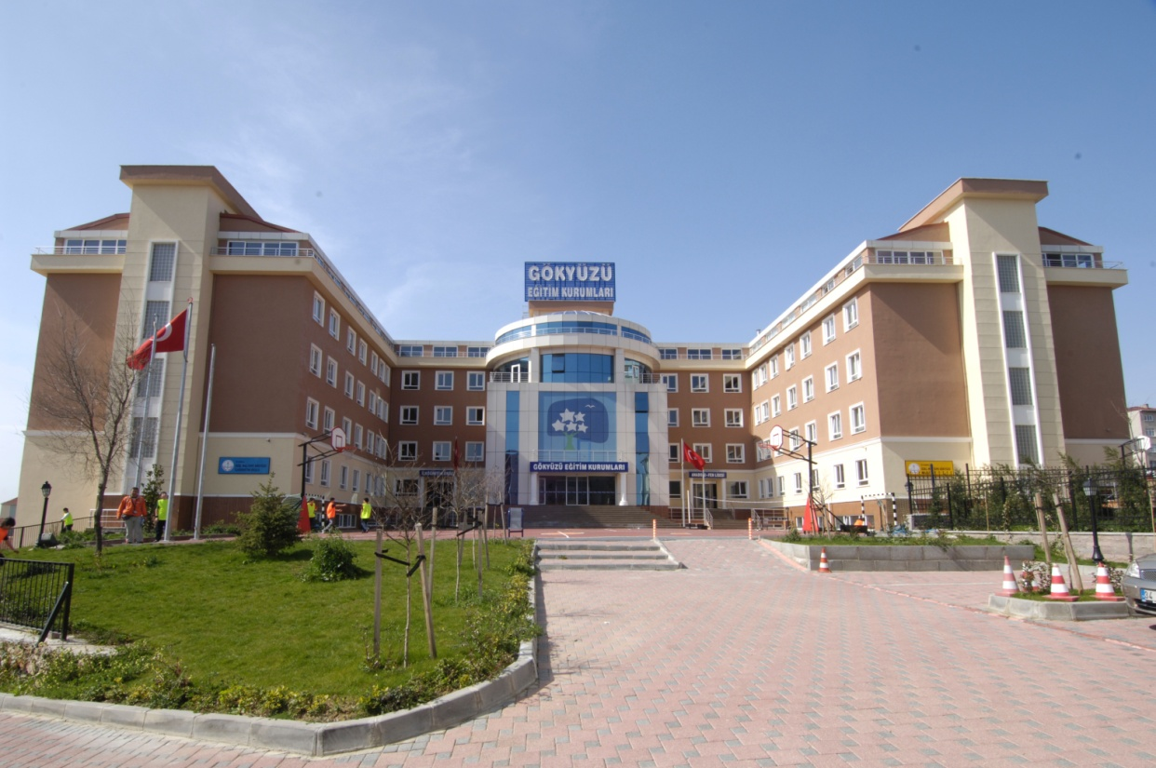

Slide 5
2- PRIMARY AND SECONDARY SCHOOLS
Students between 6 and 14 go to Primary and Secondary Schools 5 days a week. They usually stay at school from 9.00 to 4.00.
They study Turkish, Maths, Science, Social Sciences, History, Geography, Education of Religion and Ethics, Information Technology, Music, Physical Education (they can choose different sports and activities), Art, Drama and Chess.
Apart from these, in private schools they start to study Foreign Languages (English, French, Spanish, Italian, German, Arabic, Chinese) at the 1st grade and learn a second foreign language at the 5th grade. However, in state schools they start to study English at the 2nd grade.
Students have important exams at the 8th grade, and they choose the “suitable” high schools according to their results.

Slide 6
3- HIGH SCHOOLS
Students between 14 and 18 go to High Schools 5 days a week. They usually stay at school from 9.00 to 4.00.
Basically, there are 3 kinds of high schools: Science High Schools, Anatolian High Schools and Vocational High Schools.
They study Turkish, Literature, Foreign Languages, Maths, Physics, Chemistry, Biology, History, Geography, Philosophy, Education of Religion and Ethics, Information Technology, Music, Physical Education (they can choose different sports and activities), Art, Drama, Photography and some vocational courses.
They choose the suitable “department” at the beginning of 10th grade and study the subjects they are good at and they want.
Students have two important (also difficult) exams at the 12th grade, and they choose the “suitable” universities according to their results.

Slide 7
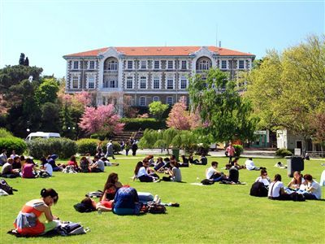
4- UNIVERSITIES

Slide 8
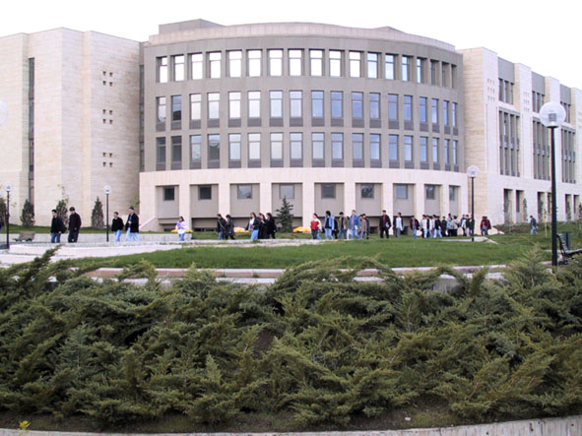

Slide 9
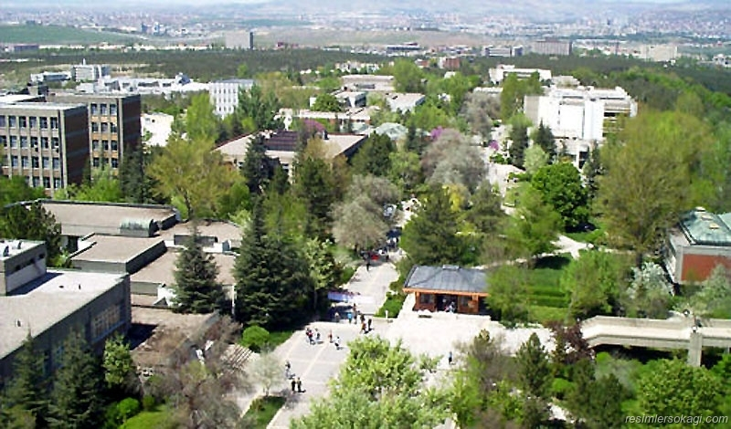

Slide 10
About 1 million students graduate from high schools every year and take “university entrance exams”.
Basically, there are 2 kinds of universities: the ones with 2 years programme, the ones with 4-5-6 years programme. In addition, students at most universities study English for 1 year at the Prep Class because many university subjects are taught in English.
The most popular departments are Medicine, Law, Engineering, Foreign Languages, Architecture, Teaching, Politics, Journalism and Information Technology.
Moreover, studying university in Europe or the USA, and having master’s-doctorate’s degree after university life is becoming very fashionable between students.

Slide 11
THANK YOU
VERY MUCH
FOR LISTENING
☺ ☺ ☺

