Slide 1
Vintage Cameras
eTwinning project
On the Track of Our Recent Past

Slide 3
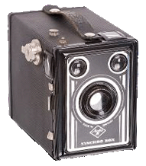
Box Camera Quick
A box camera is a simple type of camera, the most common form being a cardboard or plastic box with a lens in one end and film at the other. They were very popular in the late 19th and early 20th centuries.
The Kodak camera introduced in 1888 was the first "box" camera to become widely adopted by the public and its design became the archetype for box camera designs introduced by many different manufacturers.

Slide 4
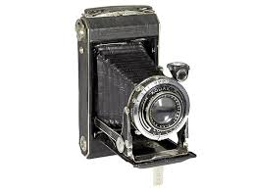
Kodak Vollenda 620
Vollenda 620 is a medium format folding bed camera made by Kodak and produced between 1934-39.
The Vollenda was originally a Nagel design, the name coming with the company when Kodak bought it in 1931.
There are two variants of the camera for 6x6cm and 6x9cm frames.

Slide 5
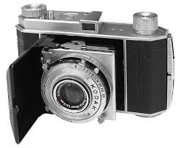
Kodak Retina I
Retina was the brand-name of a long-running series of German-built Kodak 35mm cameras, produced from 1934 until 1969.
The Retina line included a variety of folding and non-folding models.
Retina cameras were noted for their compact size, high quality, and low cost compared to competitors.

Slide 6
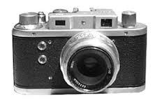
MOM Mometta III
The Mometta is a 35mm rangefinder camera made by MOM in Budapest.
It has a focal plane shutter from 1/25 to 1/500s, and takes pictures in 24×32mm format.

Slide 7
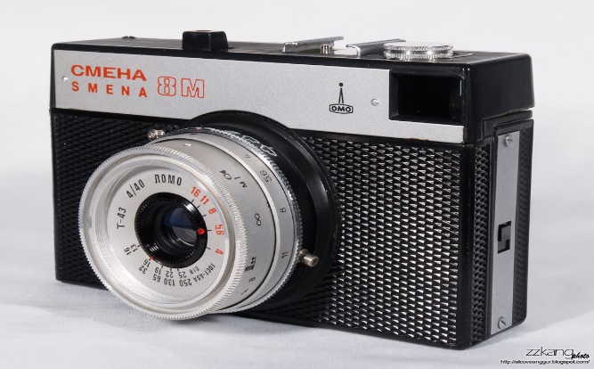
LOMO Smena 8
Smena is a series of low-cost 35mm film cameras manufactured in the Soviet Union by the LOMO factory from 1953 to 1991.
These cameras were designed to be inexpensive and accessible to the public, made of bakelite or black plastic for the later models, and totally manually operated.

Slide 8
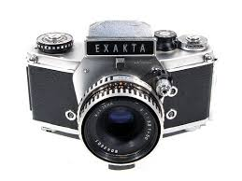
Exacta VX1000
Exakta VX1000 is a 35mm film SLR camera manufactured by Ihagee Kamerawerk Steenbergen & Co, Dresden, former East Germany and produced between 1967-70.

Slide 9
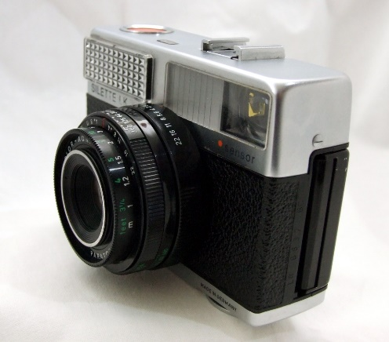
Agfa Silette LK Sensor
Agfa Silette LK Sensor is a 35mm film viewfinder camera made by Agfa, Germany and introduced in 1969.
It belongs to the long lasting Sillete series. Red "Sensor" shutter release button is the distinctive mark of Agfa cameras in the seventies.
In 1973 Silette LK Sensor's top housing was made by plastic.

Slide 10
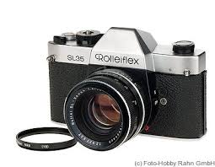
Rolleiflex SL 35
The Rolleiflex SL35 is a range of SLR cameras from the German camera maker, Rollei.This range of camera uses 35mm film.
The camera bodies were initially made in Germany, and later, Singapore.
A whole range of lens were made for the SL35 series, and the lens were interchangeable between the camera bodies in the series.

Slide 11
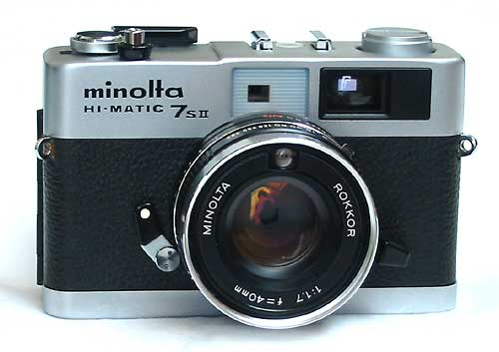
Minolta Hi-Matic
Hi-Matic was the name of a long-running series of 35 mm cameras made by Minolta.
The original Hi-Matic of 1962 was the first Minolta camera to feature automatic exposure and achieved a small degree of fame when a version was taken into space by John Glenn in 1962.

Slide 12
THE END
Made by: Birač Borna
II. osnovna škola Čakovec, Croatia
Teacher: Iva Naranđa
April 2016
Source: http://camerapedia.wikia.com/wiki/Camerapedia

