Slide 1
Kućna osobna računala s početka 1980-ih
Home PCs - the beginning of the 1980s
II. osnovna škola Čakovec, Croatia
eTwinning project „On the Track of Our Recent Past”
Iris Todorović, 7.b
18.01.2016
Teacher: Iva Naranđa

Slide 2
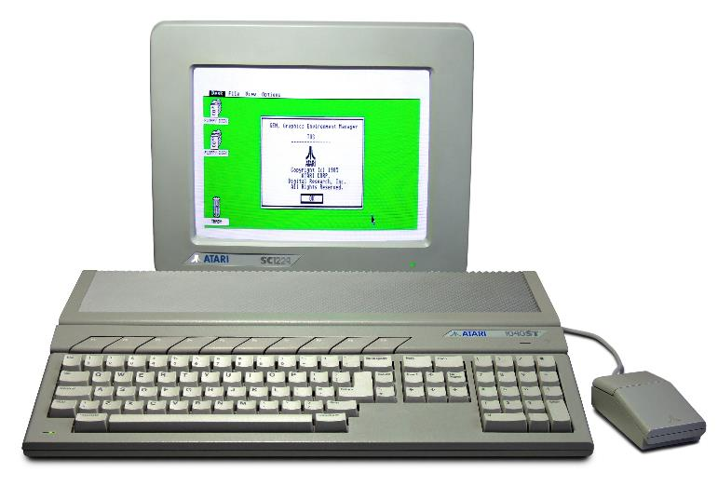
Atari ST
Microprocessor: Motorola MC68000
Tact: 8 MHz
Memory: 524.288 B RAM (520ST) - 4.194.304 B RAM (4160ST)

Slide 3
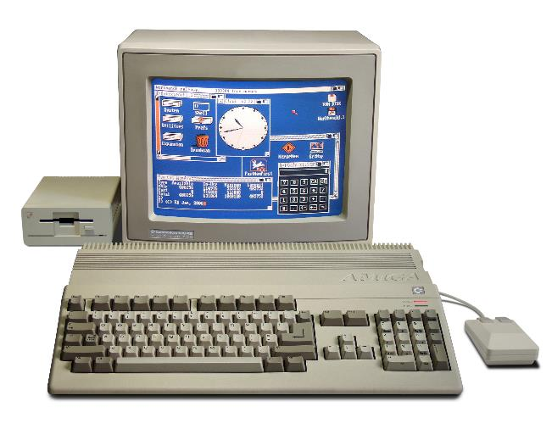
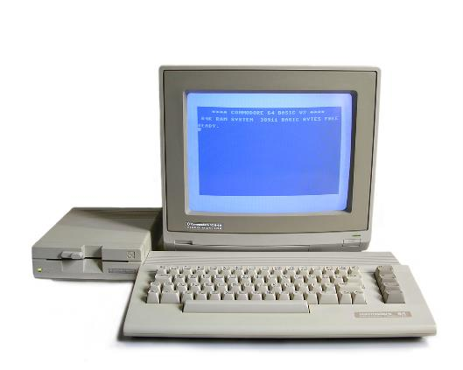
Commodore 64/Amiga
Microprocessor - MOS Technology 6510/8500
Tact: 1,023 MHz (NTSC) or 0,985 MHz (PAL)
RAM – 64 Kb
ROM – 20 Kb
Amiga
Commodore 64

Slide 4
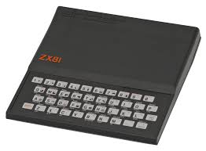
ZX 80/ZX 81
RAM: 1 Kb, 64 Kb max
Microprocessor NEC

Slide 5
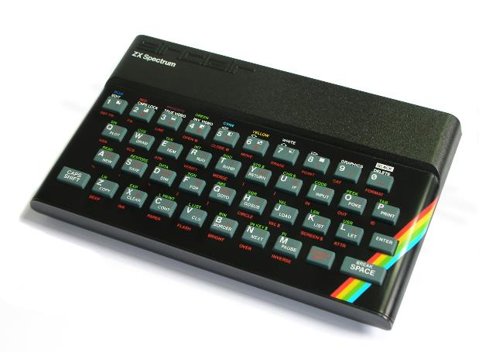
ZX Spectrum
Microprocessor: Zilog Z80
Tact: 3,5 Mhz
ROM: 16 KB
RAM: 48 KB

Slide 6
Sources:
https://hr.wikipedia.org/wiki/Osobno_ra%C4%8Dunalo
http://www.enciklopedija.hr/Natuknica.aspx?ID=45736
https://hr.wikipedia.org/wiki/ZX_Spectrum
https://hr.wikipedia.org/wiki/ZX_81
https://hr.wikipedia.org/wiki/Commodore_64

