Slide 1
eTwinning project
On the Track of Our Recent Past

Slide 2
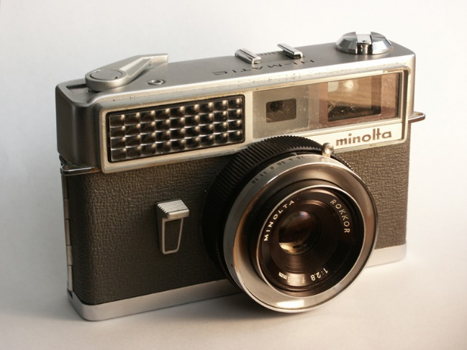
Minolta Hi-Matic
Hi-Matic was the name of a long-running series of 35 mm cameras made by Minolta. The original Hi-Matic of 1962 was the first Minolta camera to feature automatic exposure and achieved a small degree of fame when a version was taken into space by John Glenn in 1962.

Slide 3
The original Hi-Matic of 1962
The first Hi-Matic, introduced in 1962, was offered with a 45 mm f/2 or 45 mm f/2.8 lens and featured a built-in selenium light meter and rangefinder. Both the aperture and shutter speed were set automatically. The Hi-Matic was also rebadged as the Ansco Autoset.

Slide 4
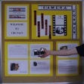
In 1969 Minolta came out with a new, smaller model, the Hi-Matic C. In the interest of compactness, it had a smaller 40 mm f/2.7 lens (which was collapsible), reduced aperture and shutter speed ranges, and no longer featured a rangefinder.

Slide 5
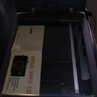
The C had shutter-priority automatic exposure with a CdS meter. The Hi-Matic 5, also released in 1969, was basically a less expensive C without the collapsing lens.

Slide 6
Instructions

Slide 7
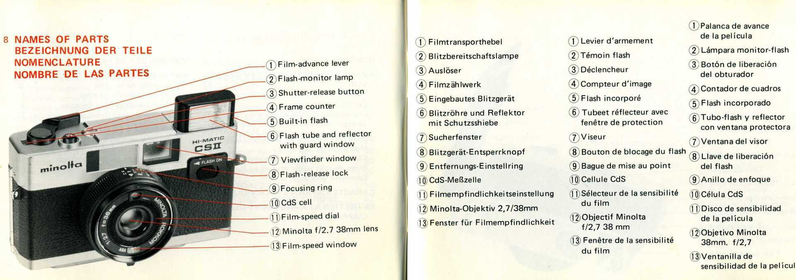

Slide 8
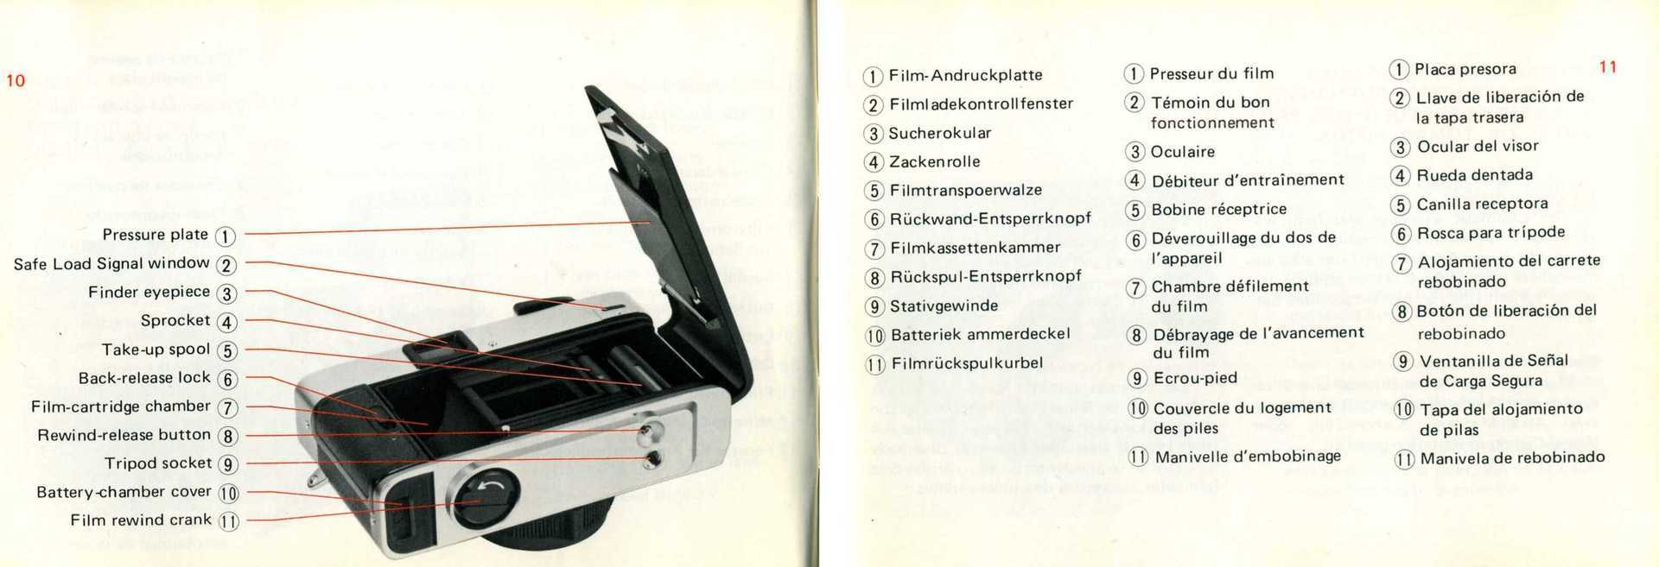

Slide 9
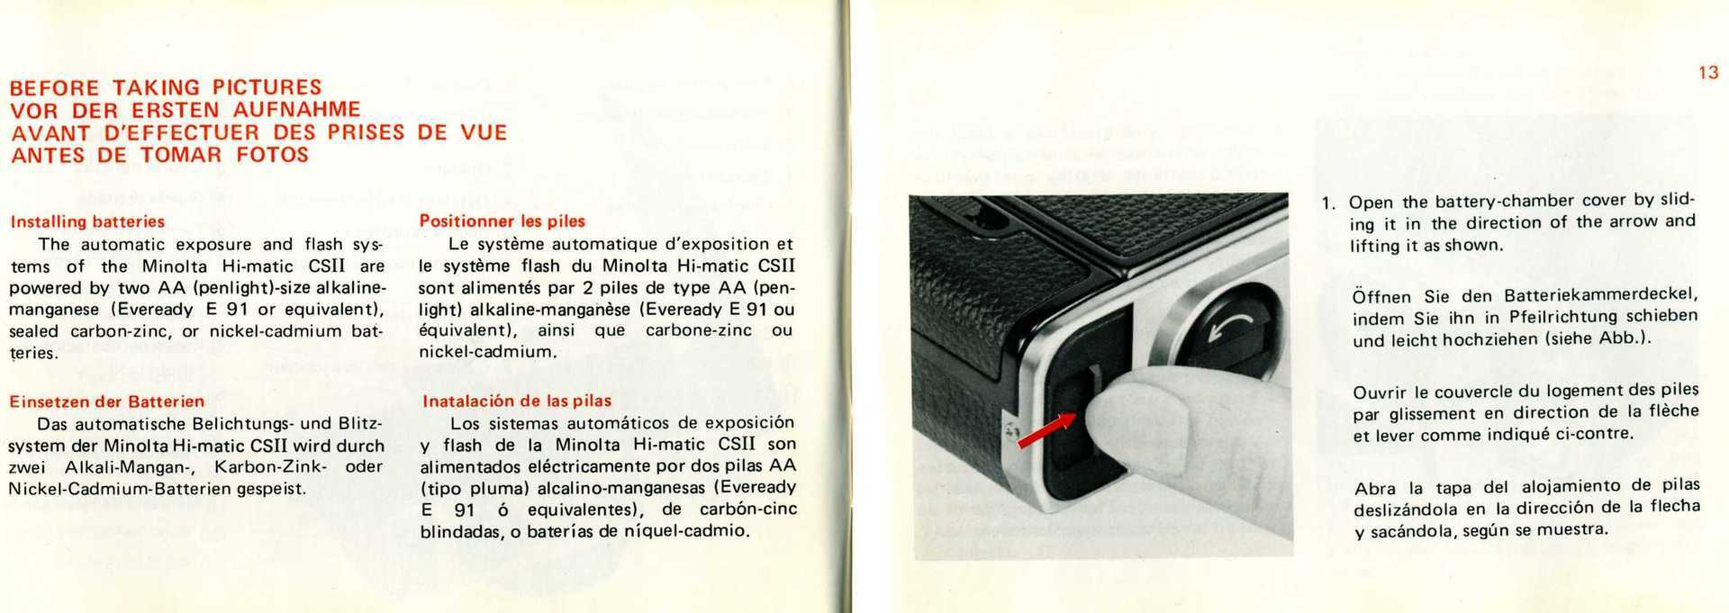

Slide 10
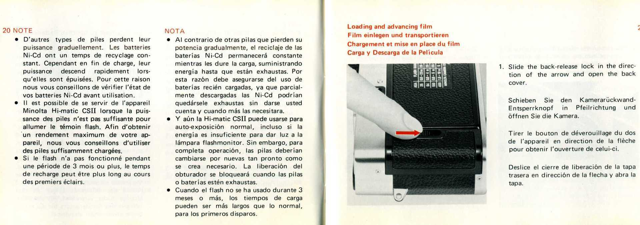

Slide 11
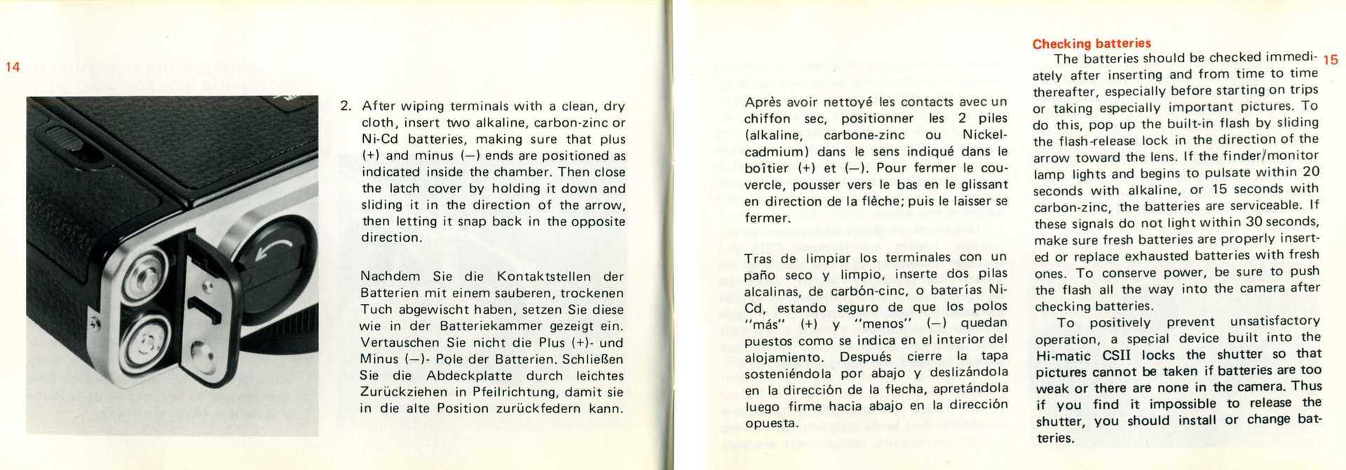

Slide 12
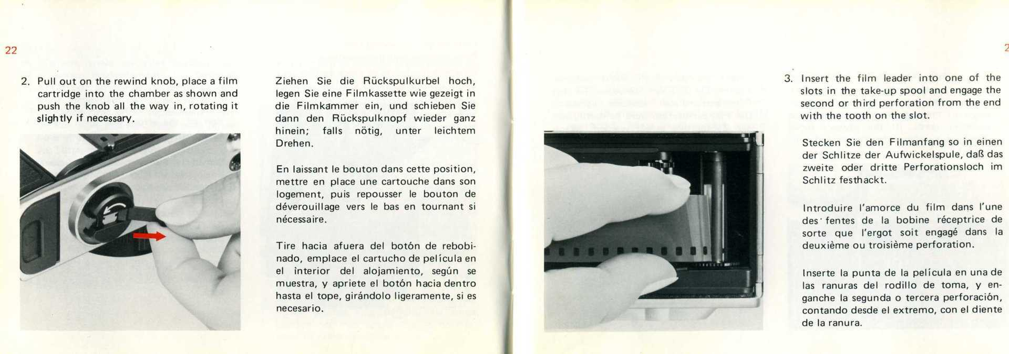

Slide 13
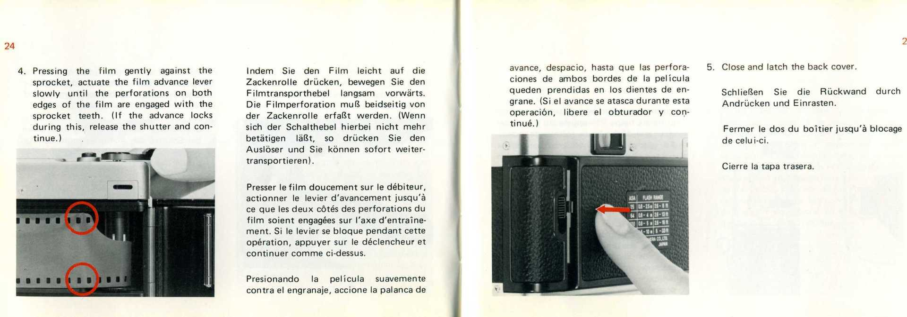

Slide 14
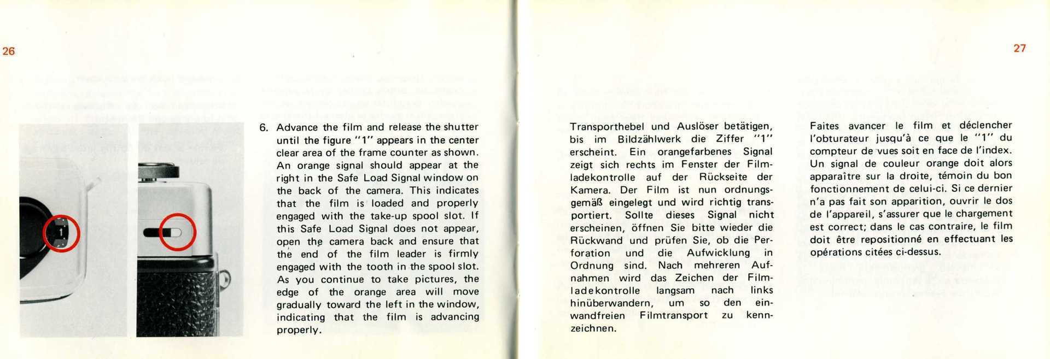

Slide 15
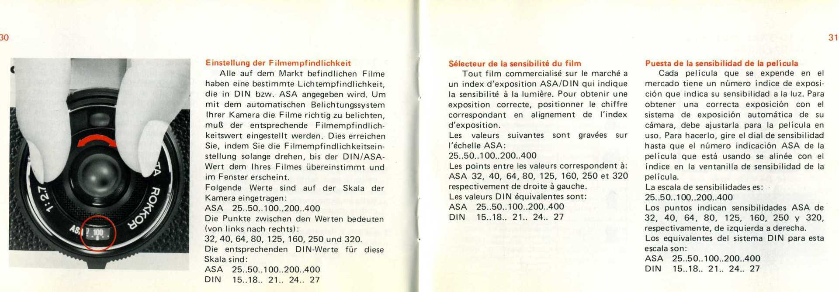

Slide 17
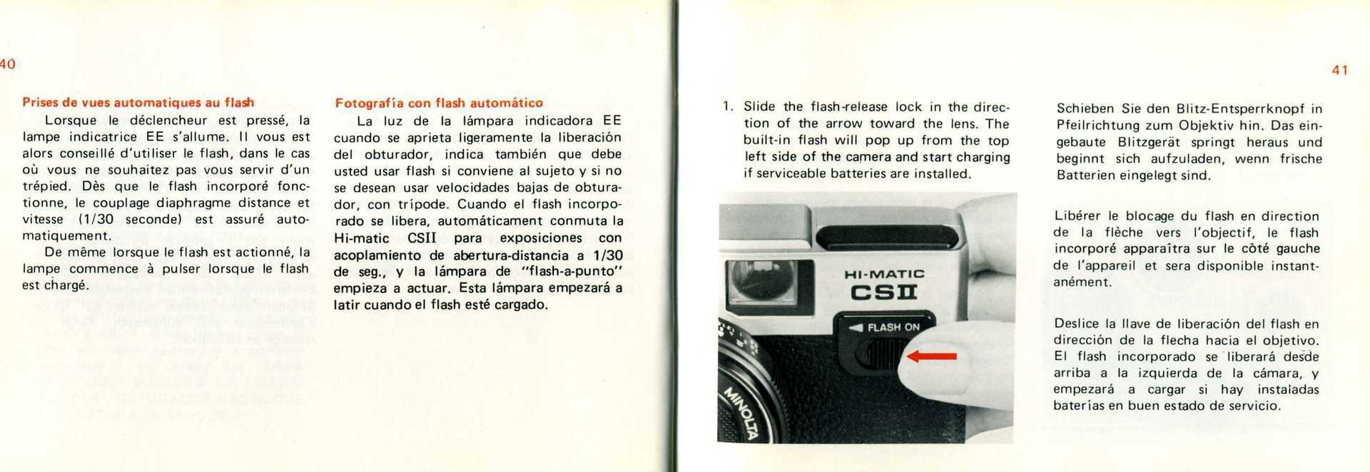

Slide 18
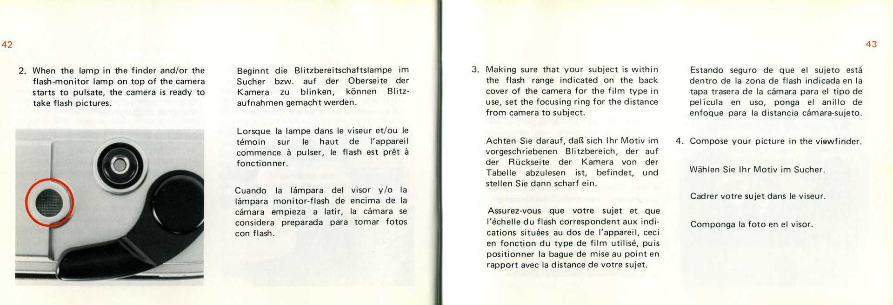

Slide 19
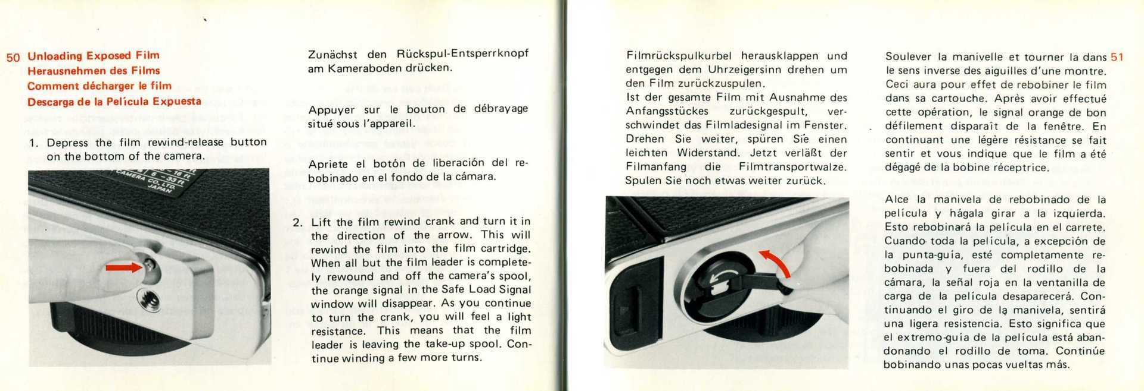

Slide 20
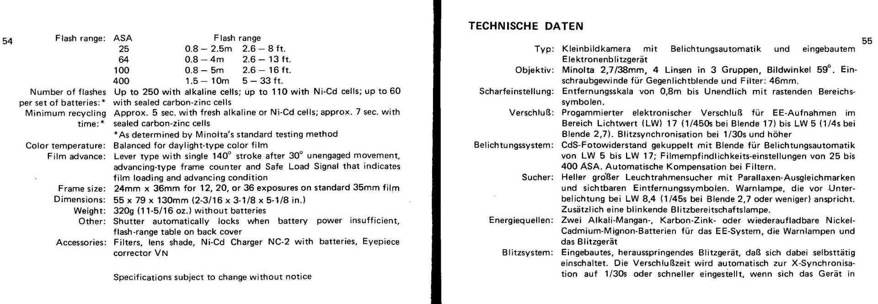

Slide 21
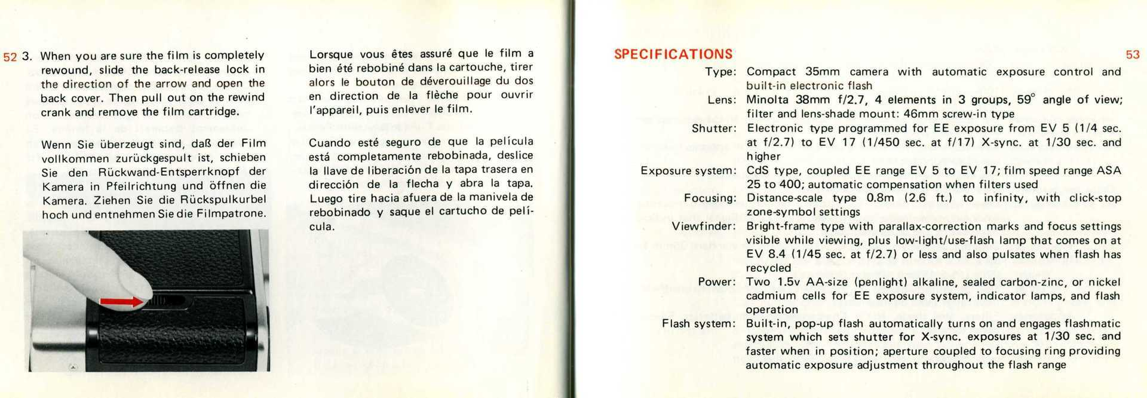

Slide 22
Sources:
https://en.wikipedia.org/wiki/Minolta_Hi-Matic
http://www.rokkorfiles.com/7SII.htm

Slide 23
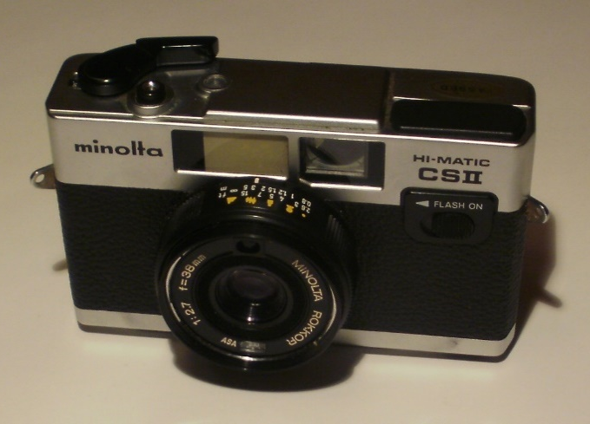
The End
School: II. osnovna škola Čakovec, Croatia
Teacher: Iva Naranđa
Made by: Lovro Žbulj 7.b
April 2016

