Slide 1
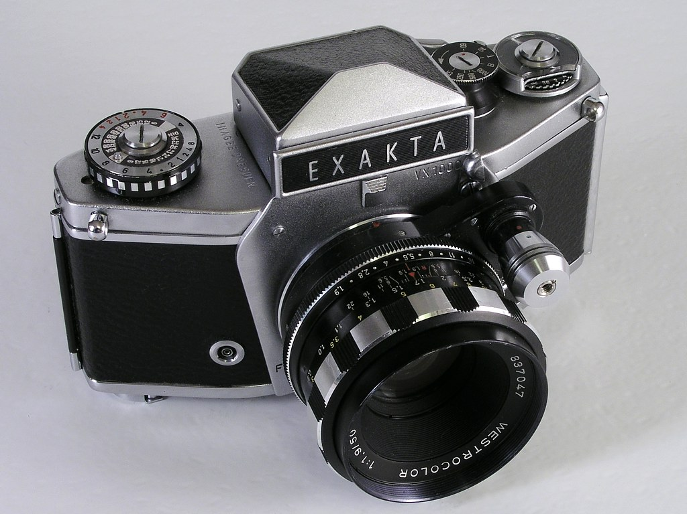
Exacta VX 1000
eTwinning project : On the Track of Our Recent Past
II. osnovna škola Čakovec , Croatia
Teacher : Iva Naranđa
Camera Week, April, 2016
Made by : Edi Plaftak , 7.B

Slide 2
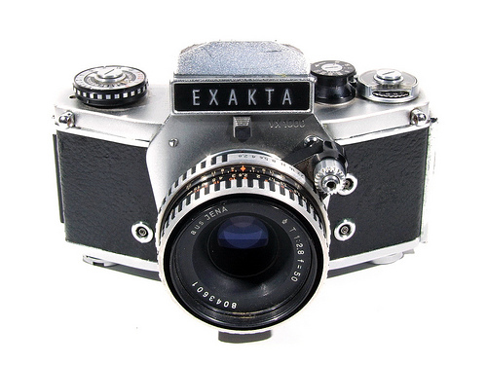
Exacta VX 1000
Exacta VX 1000 is a 35 mm film SLR camera
Manufactured by Ihagee Kamerawerk Steenbergen & Co, Dresden
Produced between 1967-70

Slide 3
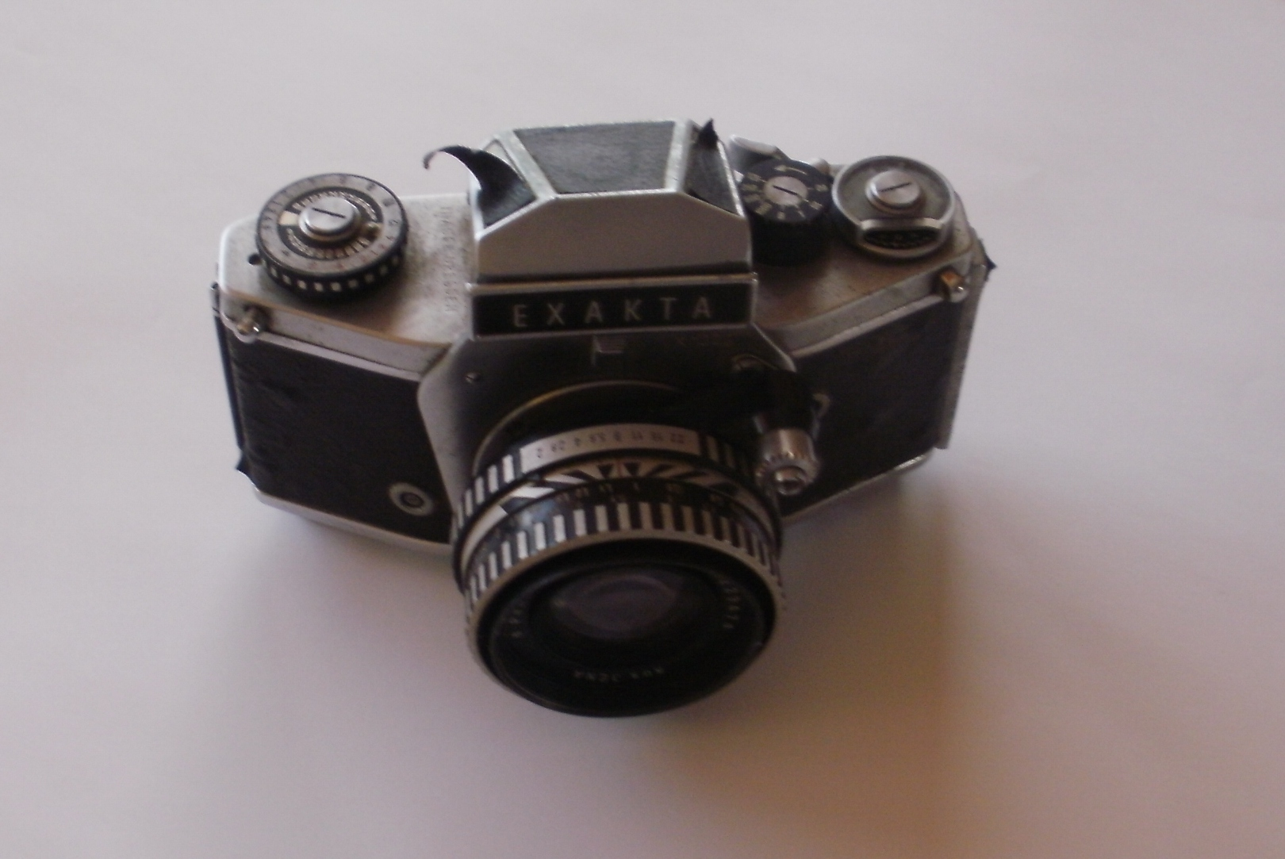
Exacta VX 1000
Version 7
New body construction

Slide 4
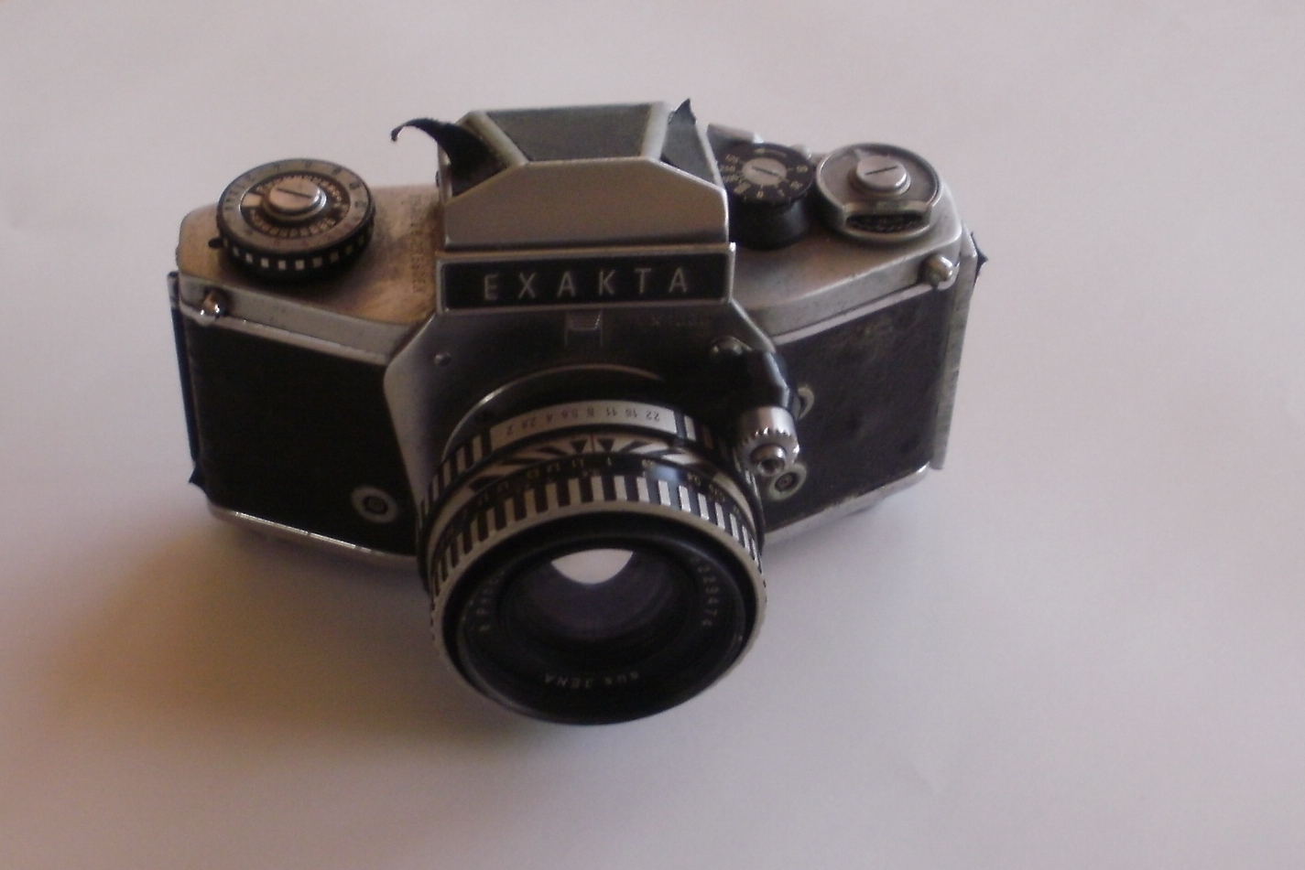
Exacta VX 1000
Cocking lever short-stroke
Mirror instant return type
Backcover hinged, non-detachable

Slide 5
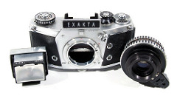
Exacta VX 1000

Slide 6
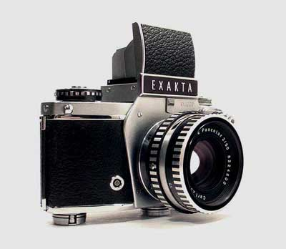
Exacta VX 1000

Slide 8
Sources
http://camerapedia.wikia.com/wiki/Exakta_VX1000
http://www.butkus.org/chinon/exakta/exakta_vx1000/exakta_vx1000.htm

