Slide 1
Camera week Rolleiflex sl 35
Tibor Pomor 7.b

Slide 2
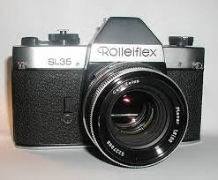
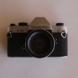
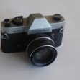
Rolleiflex sl 35

Slide 3
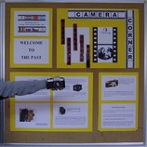
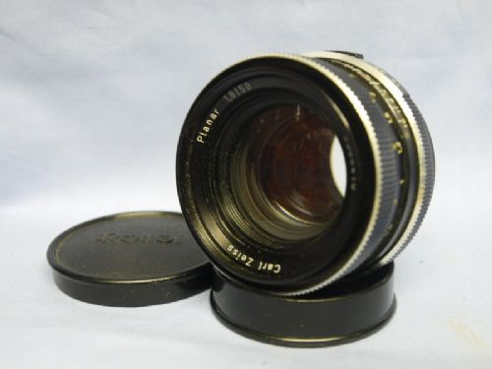
History
First 35 mm camera produced by rollei in 1970.
Produced until 1990.
Second Rollei sl camera to be equipped by Carl zeiss lenses

Slide 4
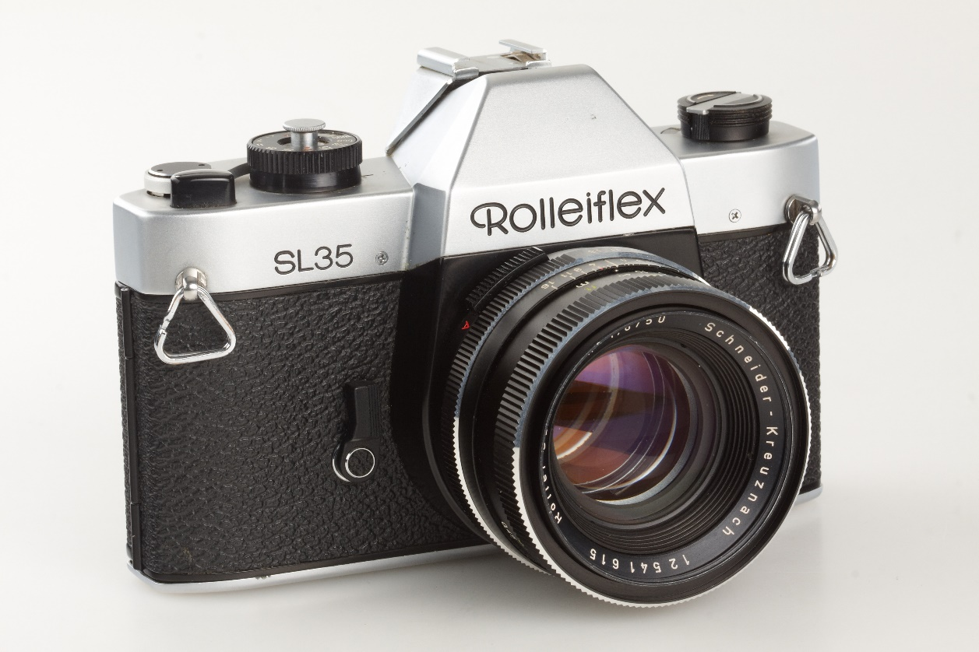
Sl 35
Production dates: 1970. - 1976.
Shutter type: Focal plane rubber cloth curtain
Shutter speeds: 1-1/1000s, b
Variants:
Chrome
black

Slide 5
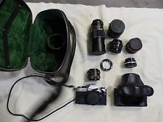
accessories
For the bodY:
eyecup
pivoting angle finder
eveready bag
eveready case
strap
body cap

Slide 6
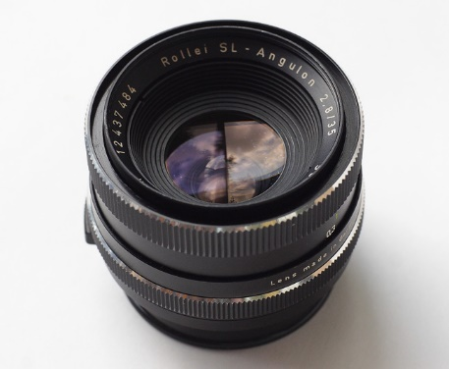
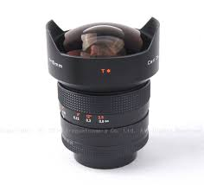
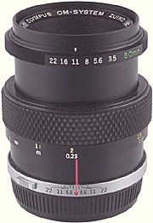
lenses
Some schneider lens:
35/2.8 angulon
50/1.8 xenon
Some Carl zeiss lens:
15/3.5 distagon
28/2 distagon
Some rolleinar lens:
50/3.5 macro
50/2

Slide 7
links
https://en.wikipedia.org/wiki/Rolleiflex_SL35
http://camerapedia.wikia.com/wiki/Rolleiflex_SL35

Slide 8
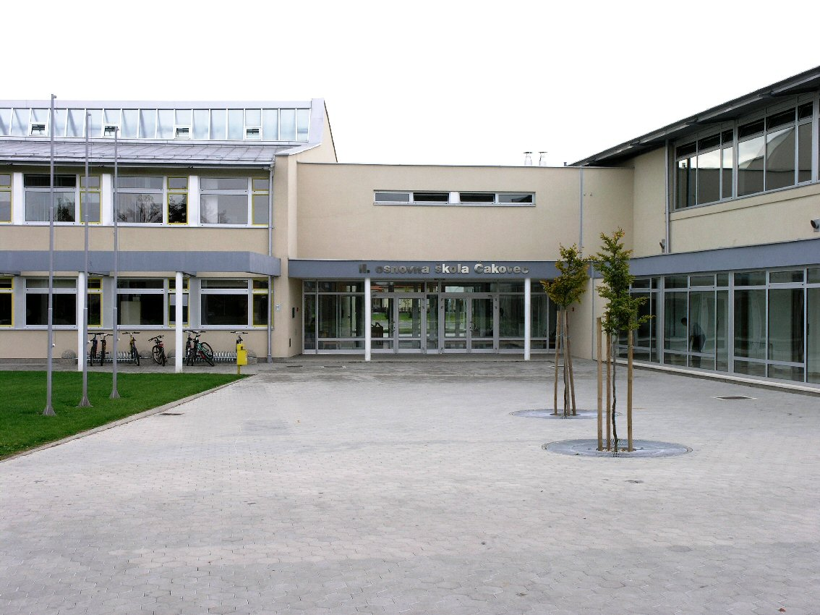
Student: tibor pomor
Teacher: iva naranđa
Etwinning Project:
on the track of our recent past
Ii. Osnovna škola čakovec, croatia
April 2016

Slide 9
The end
Thanks for your attention!

