Slide 1
Seagull
eTwinning project: On the Track of Our Recent Past
II. osnovna škola Čakovec , Croatia
Teacher: Iva Naranđa
April, 2016
Made by: Vedran Knežević 7.b

Slide 2
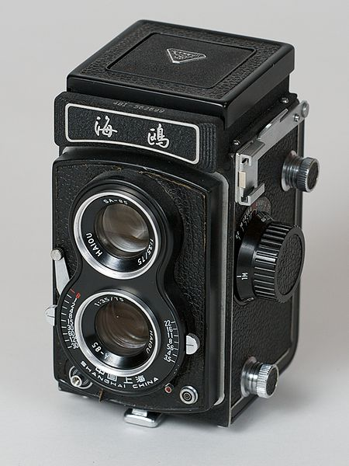
Seagull 4B1
Seagull 4B and 4B-1 are simplified models of 4A. The 4B-1 may take 645 formats. The focus screen of 4B-1 is Fresnel lens achieving bright viewing. Unlike 4A, the original lenses for 4B and 4B-1 are three-element cooke triplet.

Slide 3
Shanghai Seagull Camera Ltd
Shanghai Seagull Camera Ltd is the oldest camera maker located in Shanghai, China.
Seagull's cameras usually use basic, time-tested mechanical designs that require no batteries. Seagull has made 21 million cameras since it was founded in 1958.

Slide 4
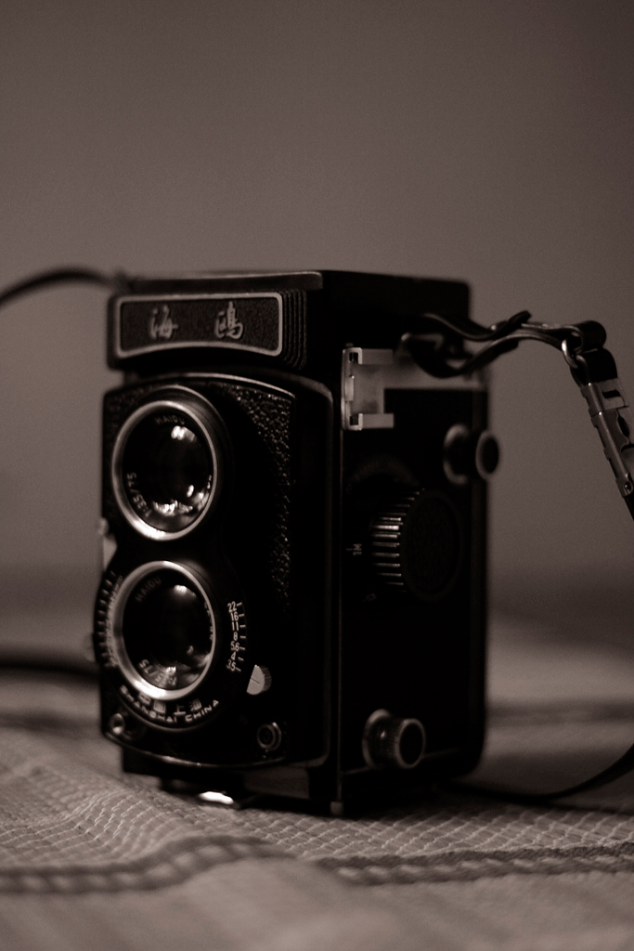
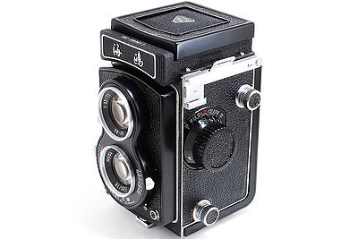
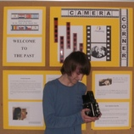

Slide 5
Sources :
http://www.wikiwand.com/en/Seagull_Camera
https://en.wikipedia.org/wiki/Seagull_Camera

