Slide 1
Water Sports
Simona Micheľová 7.B

Slide 2
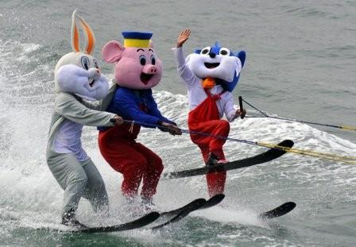
WATERSKIING
Person is pulled behind a boat or a cable ski installation
You can use two skis or one „slalom“ ski
I like this sport very much

Slide 3
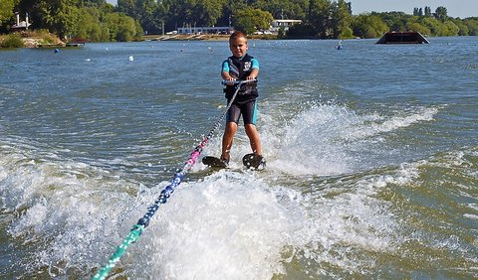
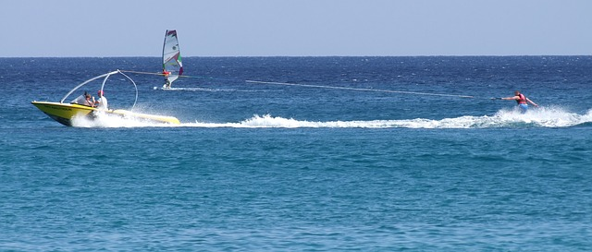

Slide 4
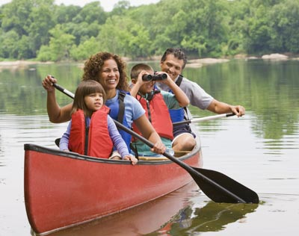
CanoEing
It is a paddle sport
You kneel or sit facing forward in an open or closed-decked canoe
You propel yourself with a „singel“ padle, under your own power

Slide 5
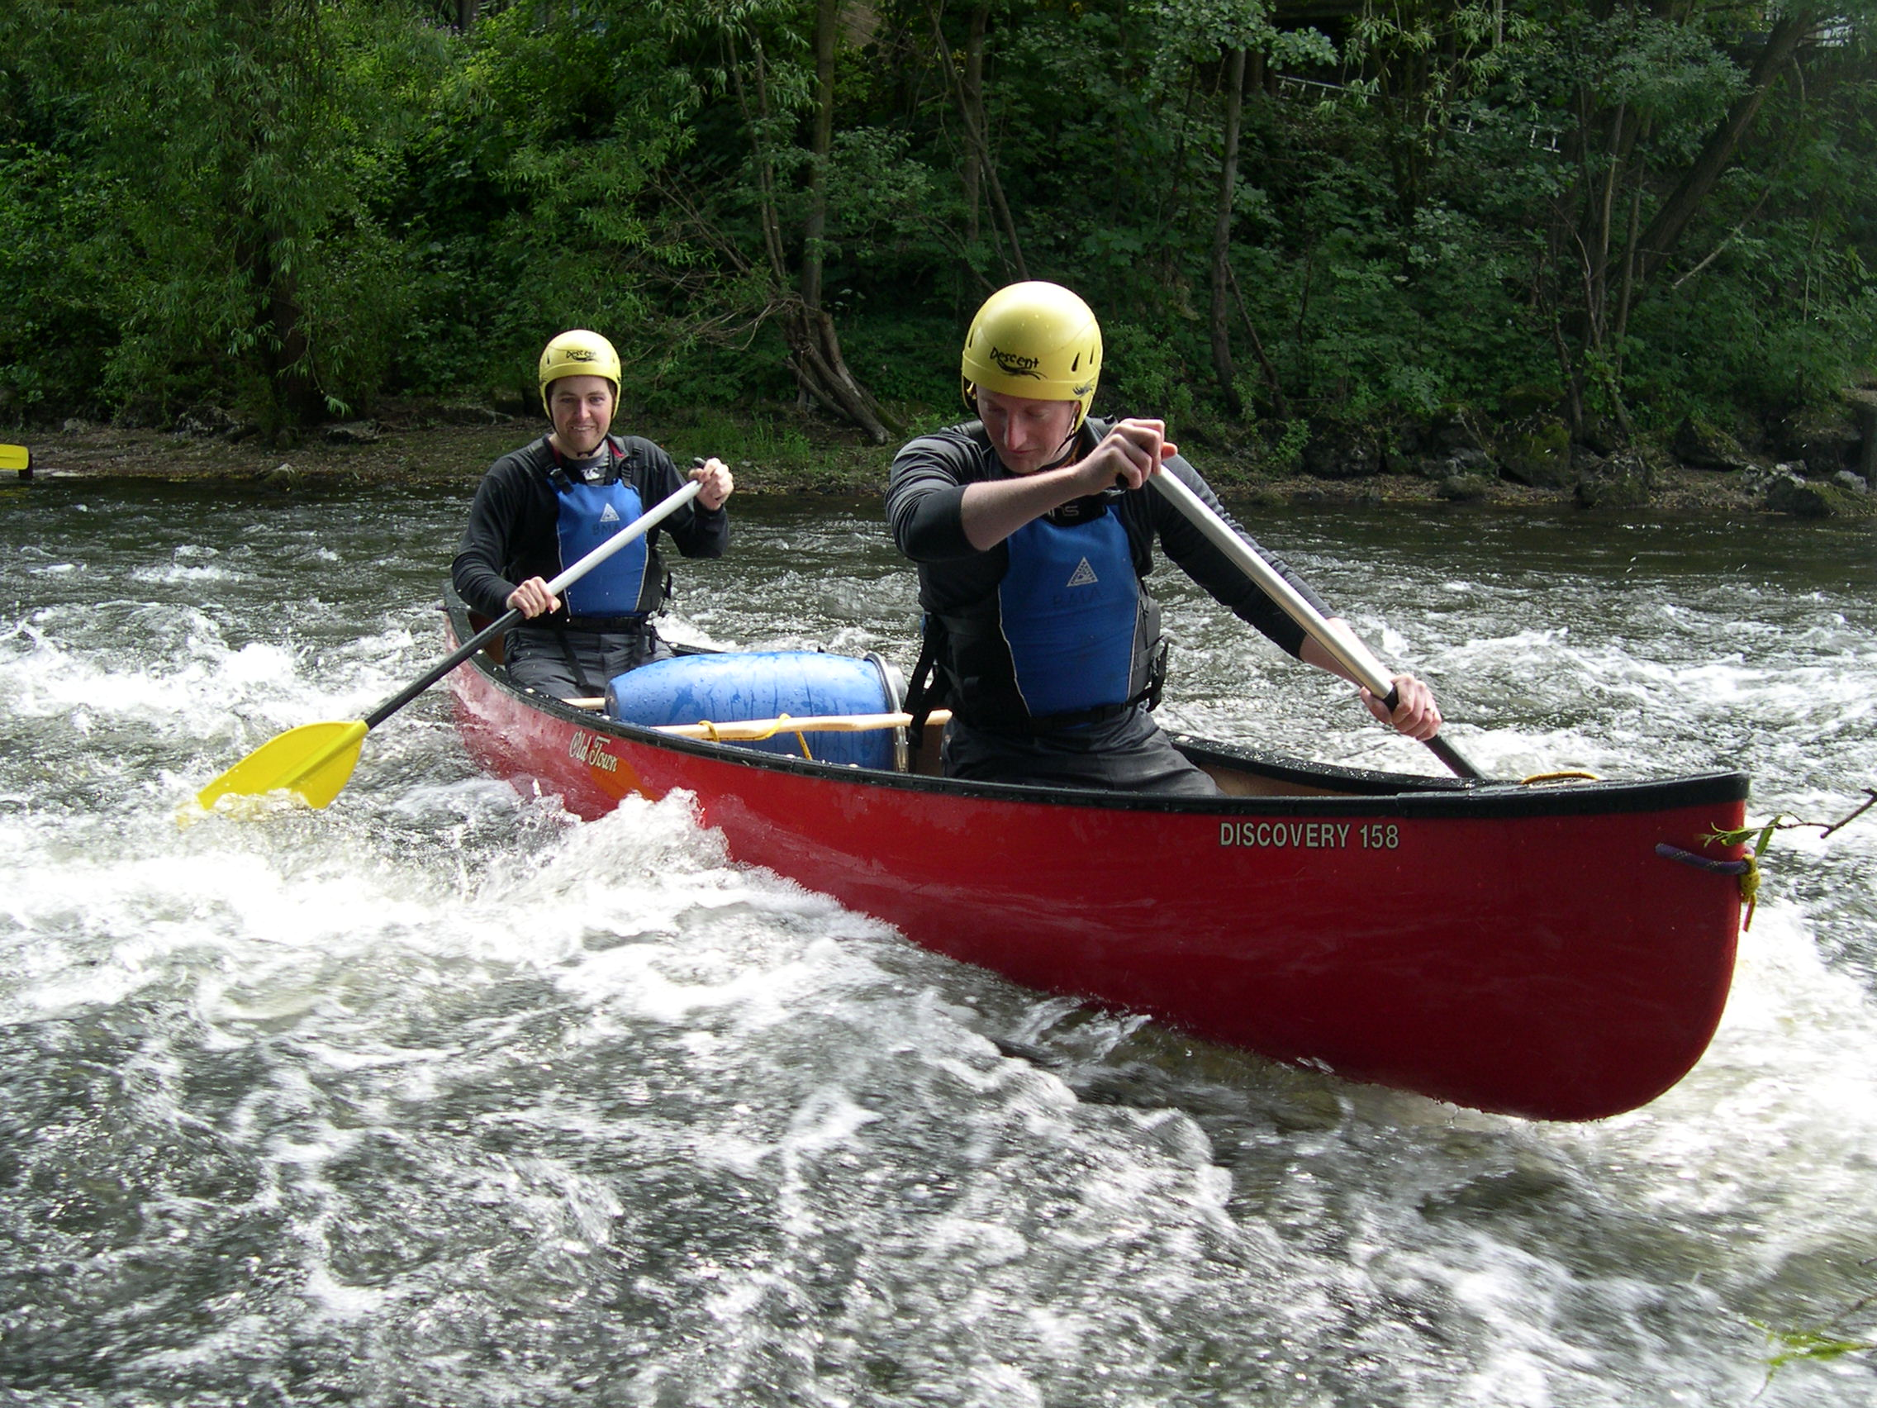

Slide 6
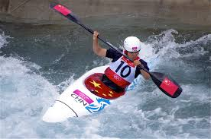
KAYAKING
It is a paddle sport too
You use a kayak for moving across water
You propel yourself with a „double“ padle, under your own power
You sit in the kayak with legs in front

Slide 7
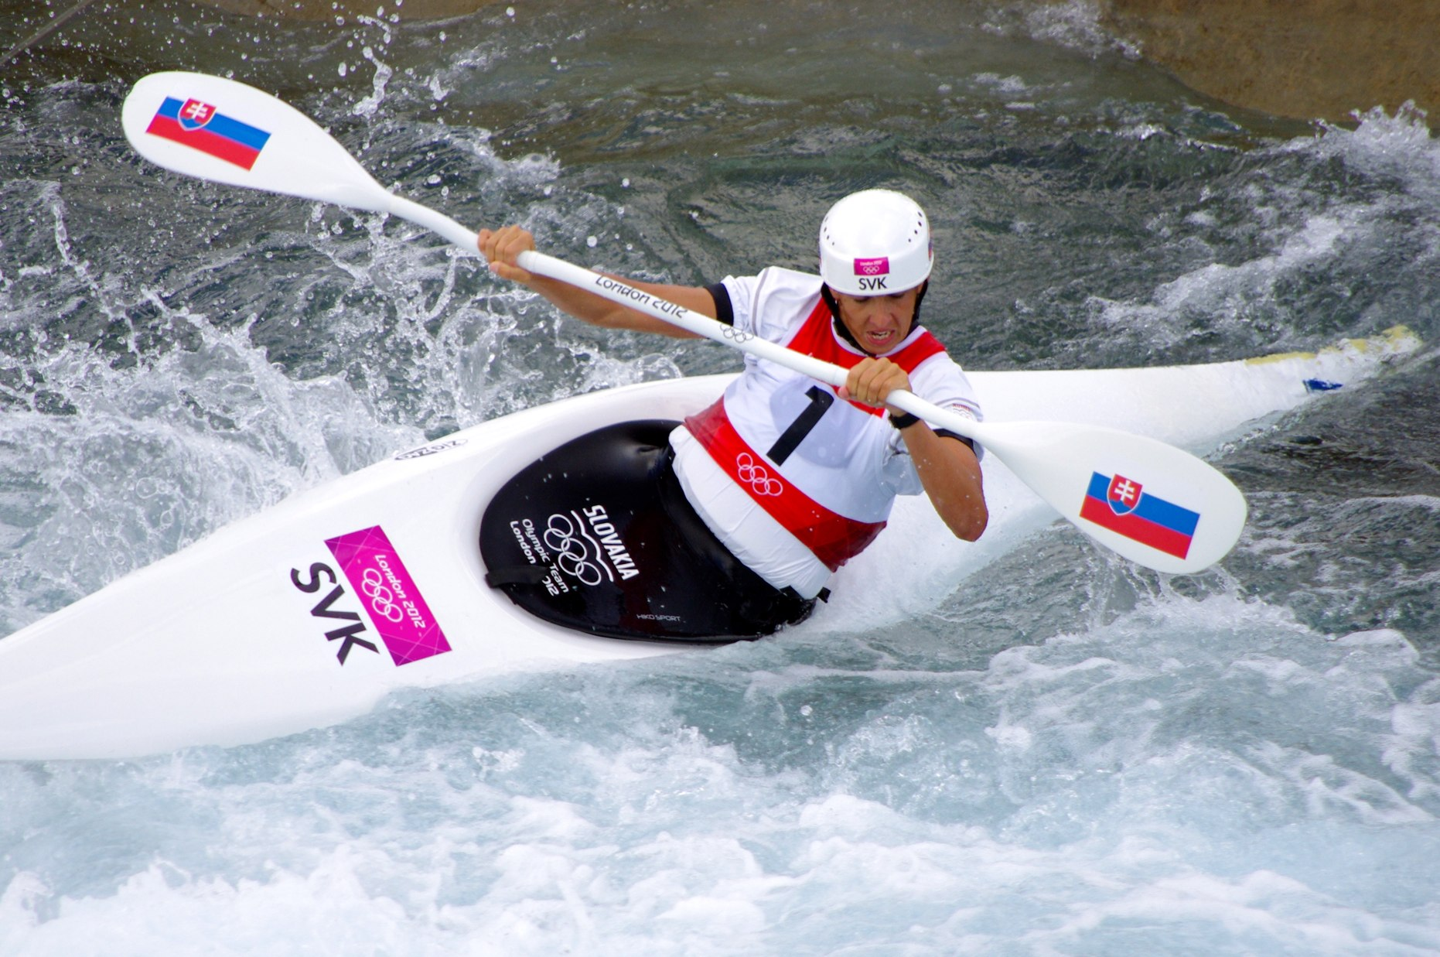

Slide 8
RAFTING
It is extreme water sport in rough water
2 – 6 people sit in the rubber inflatable boat
Everybody use the paddle
I tried it and it was perfect

Slide 9
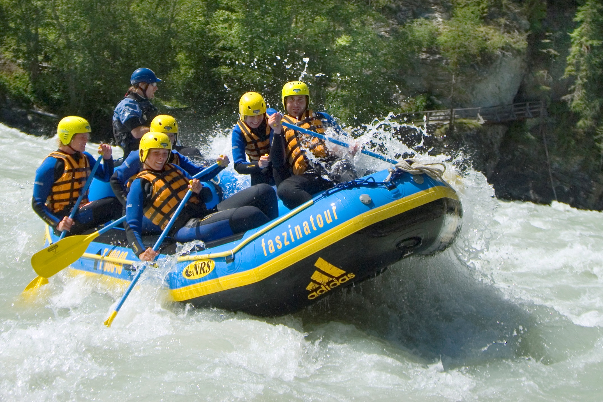

Slide 10
Our best sportsmen
We have good sportsmen :
Michal Martikán (kayaking)
Brothers Hochshornerovci
(Canoeing)

Slide 11
