Slide 1
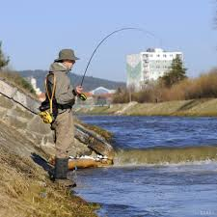
River in Poprad city
Šimon Kováč 7.A

Slide 2
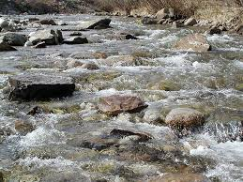
Poprad river begins as Hincov potok in the High Tatras.

Slide 3
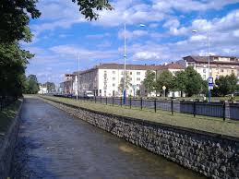
It flows trough the Poprad city to Poland.
It is called Poprad

Slide 4
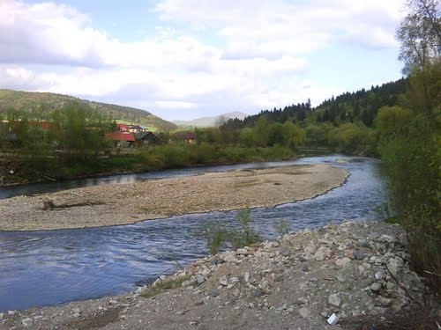
A length is 174 kilometers. Ten rivers flow into it.
Island in Poprad river

Slide 5
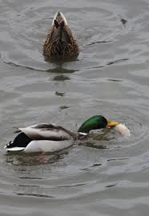
On the river we often see ducks.

Slide 6
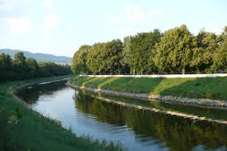
Thanks for your atention

