Slide 1
Water
Vanesa Kováčová
7.A

Slide 2
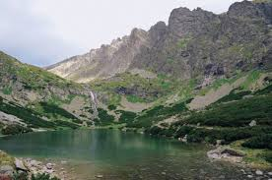
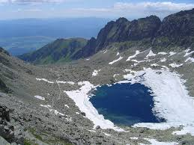
Natural lakes and tarns
Except that there are 110 natural lakes in Slovakia. In High Tatras there are about 175 tarns.
Besides natural water reservoirs, there are some artificial ones as well - about 360 ponds and dams.
Many of them are suitable for leisure and water sports.

Slide 3
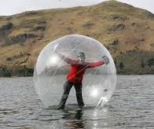
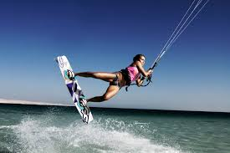
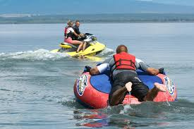
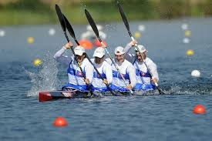
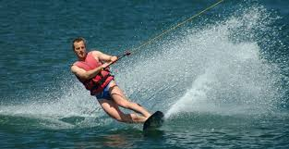
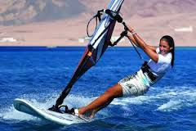
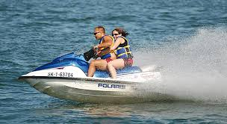

Slide 4
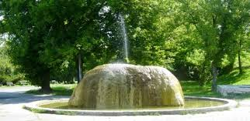
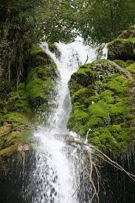
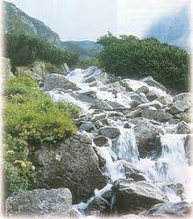
Mineral and thermal water
Slovakia has the most significant water resources in Europe, they consist of almost 1,500 springs of mineral and thermal water.

Slide 5
Ďakujem za pozornosť

