Slide 1
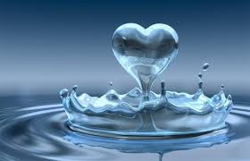
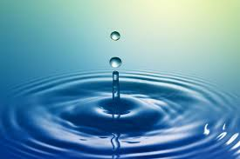
Water
Veronika Mlynárová 7.B

Slide 2
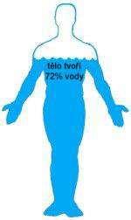
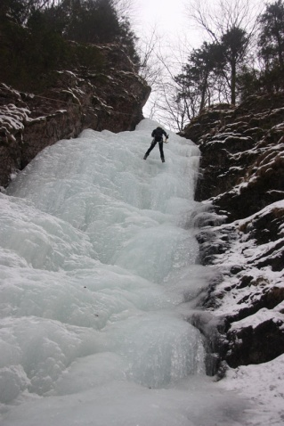
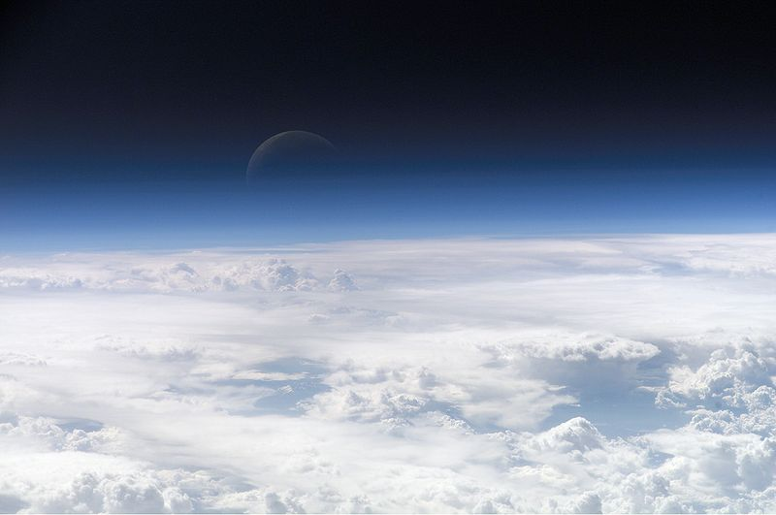
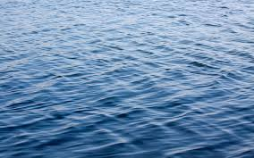
Water, water, water ...
Water is a chemical substance which is everywhere around us. Covers up to 70% of the Earth's surface, which represents 369 000 square kilometres. It is one of the ingredients necessary for life. It is in liquid, solid and gaseous form.

Slide 3
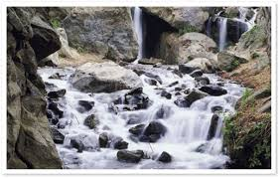
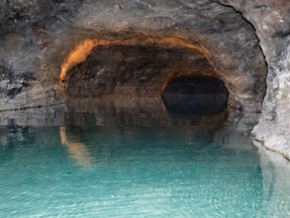
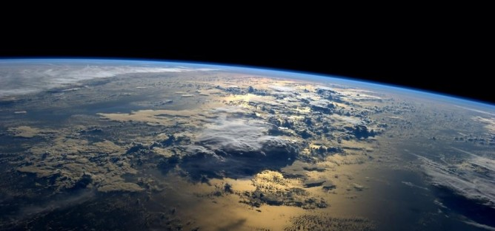
Water ...
Surface water: it's the water torrents, streams, rivers, ponds, lakes, dykes close to tanks.
Underground water:
Atmospheric water:

Slide 4
Thank you for your attention

