Slide 1
Hydro-powerstations
Jakub Chlebec

Slide 2
Hydro-powerstations
Hydro-power station is used to produce electricity. Usual hydro-power station consists of the dam
Hydro-power stations are divided into: - small hydro-power station - hydro-storage / reservoirs/ - tidal powerstation

Slide 3
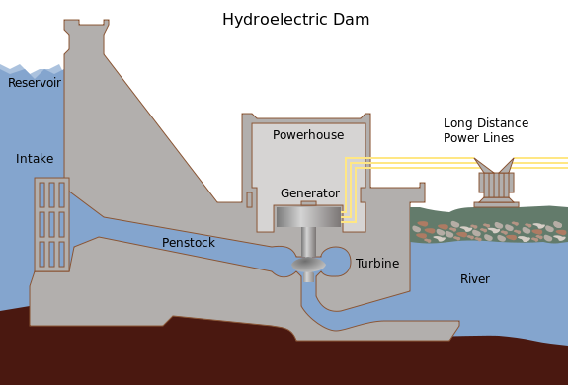
Cross section of a conventional hydroelectric dam

Slide 4
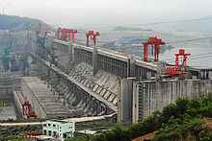
The world´s largest dam – Three Gorges Dam (in China)

Slide 5
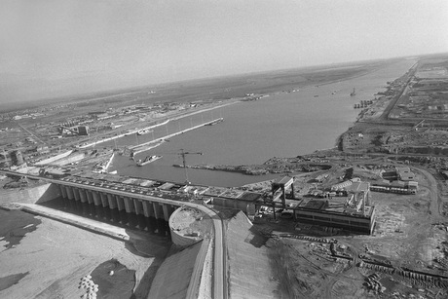
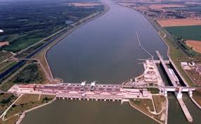
The largest hydro-powerstation in Slovakia is VE Gabčíkovo This hydro-powerstation was opened on 10th of March 2006

Slide 6
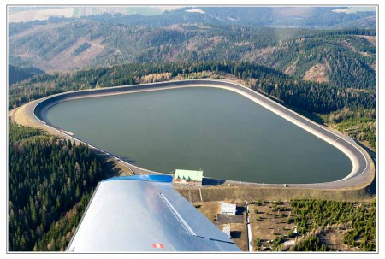
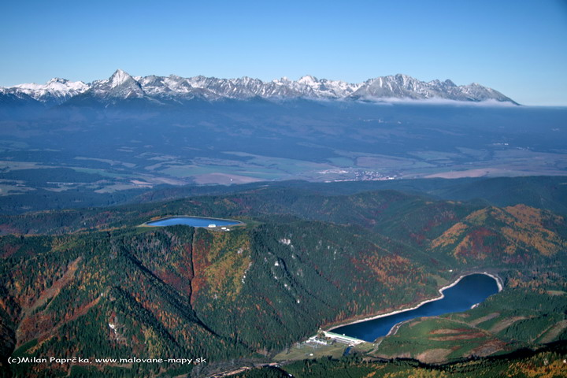
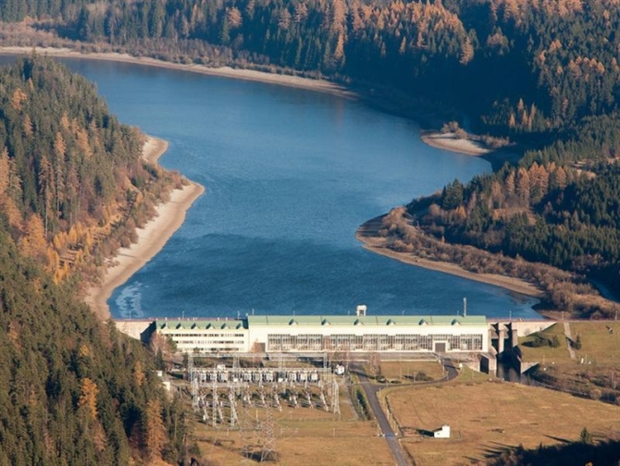
The nearest hydro-powerstation to Poprad is Čierny Váh. Upper and lower part

